Slide 1
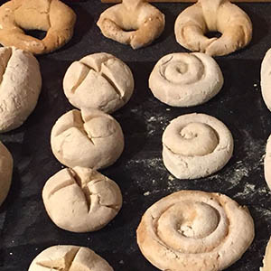
Salt Dough Breads (These are not for eating)
Research some different kinds of breads.
Set up a baking station.
Let children form breads, buns, croissants, or cinnamon rolls
(Let children roll the dough into a long snake shape and roll into a spiral. Provide cookie cutters to cut out cookie shapes. Use dried bakery items in your pretend bakery store for sale).
What you need:
Bowl
1 cup flour
1/2 cup Salt
2 tbs vegetable oil
To make the dough place a bowl of flour, a bowl of salt, and a bowl with water on a table.
Provide measuring spoons, small plastic bowls, and plastic forks. Demonstrate to children how to make a salt dough.
In a small bowl let them use the measuring spoon to add 2 scoops of flour and 1 scoop of salt into a bowl. Let them stir the salt and the flour with the fork. Then, add 2 spoons full of water to the mixture. Let children use their hands to mix the dough. (Option add a small amount of oil to the dough. This will make the dough smoother.) Let children form the dough into different breads. Place them on a cookie sheet to dry. To speed up the drying time place the salt dough breads in the oven on low heat. Usually, it takes about 3 hours at a low heat so they don’t burn.
Let children paint the breads and sell them in their pretend bakery.

Slide 2
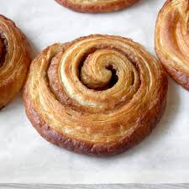
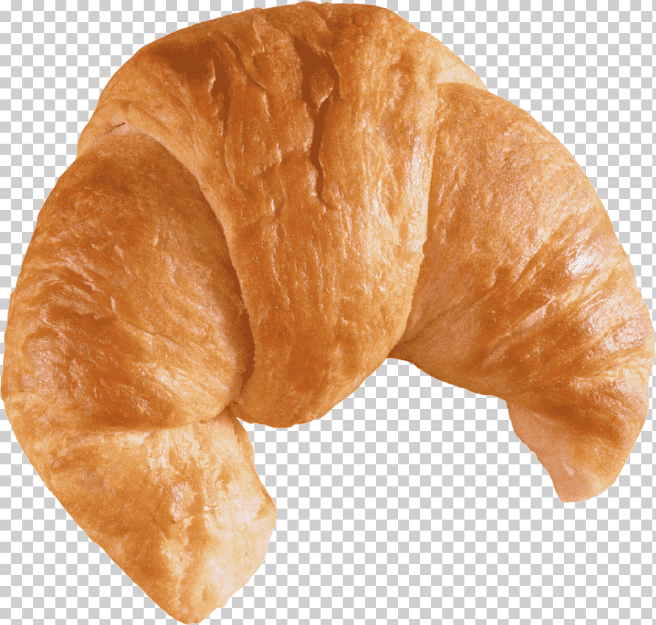
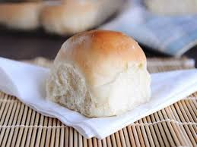
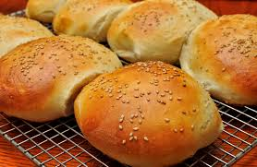
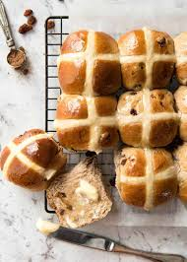
Cinnamon rolls
Croissants
Buns

