Slide 1
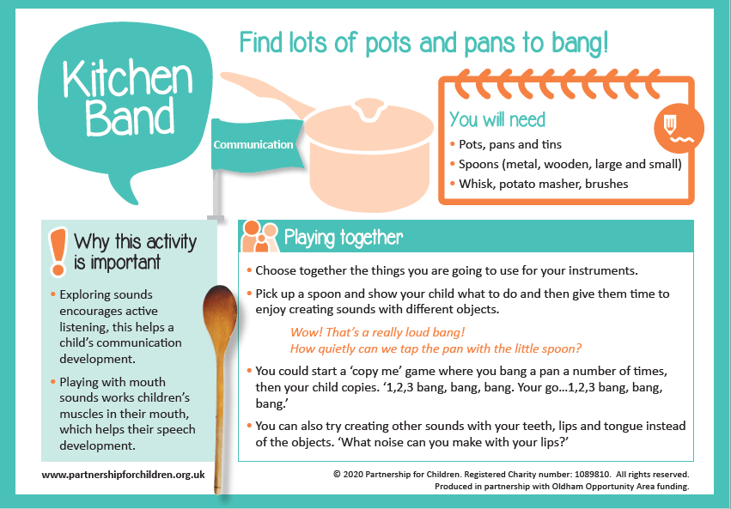

Slide 2
Teddy Tummy Ride – Breathing activity
Choose a teddy or small pillow.
Lie down and place your teddy or pillow on your tummy.
Let your arms rest loosely by your sides.
Breathe normally and watch your teddy or pillow ride up and down on your tummy.
Pretend it is riding an ocean wave.
Count as you breathe: “Breathe in – two – three, breathe out – two – three.”
Complete several breaths repeating these phrases.

