Slide 1
Chandeleur
La fete de Chandeleur on 2 février marks the celebration of the Presentation of the baby Jesus at the Temple and is 40 days after Christmas. It is the end of the Christmas season. It is also the day when French people eat pancakes – les crêpes.
le 2 février

Slide 2
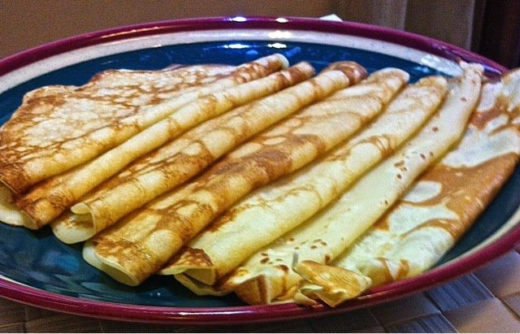
Why do les français eat les crêpes at Chandeleur?
There are several reasons. Firstly, in the old days, it was a good way to eat up extra wheat ahead of the new harvest. Another is that the crêpes resemble a sun so it is a reason to rejoice as the days start to get longer and sunnier. As the crêpe is tossed, it is like the sun rising in the sky to make the day lighter.

Slide 3
There are some superstitions to go along with this tradition too…
Toss the crêpe in the pan with your right hand while holding a coin in your left – for prosperity for the year (as long as you don’t drop it!)
Put the first crêpe in a drawer or on top of a wardrobe for good luck in the coming year!

Slide 4


J’adore les crêpes
J’aime les crêpes
Je n’aime pas les crêpes
Je déteste les crêpes

Slide 5
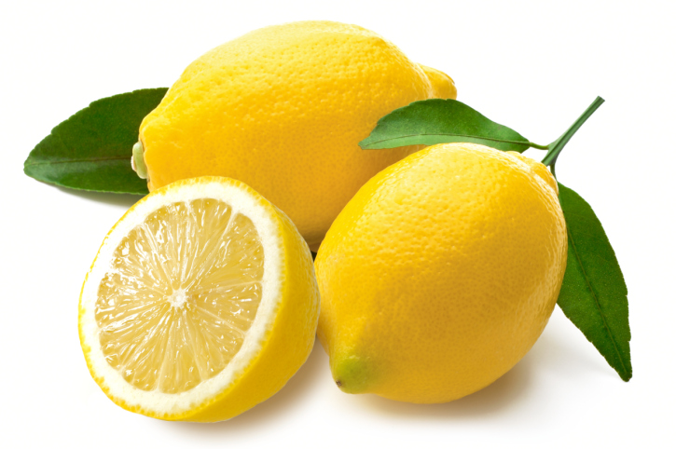
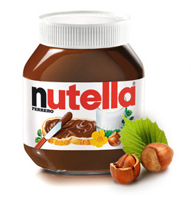
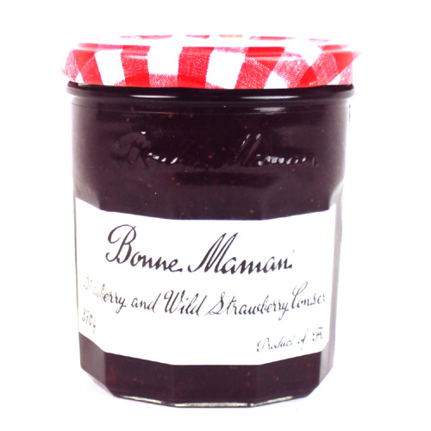
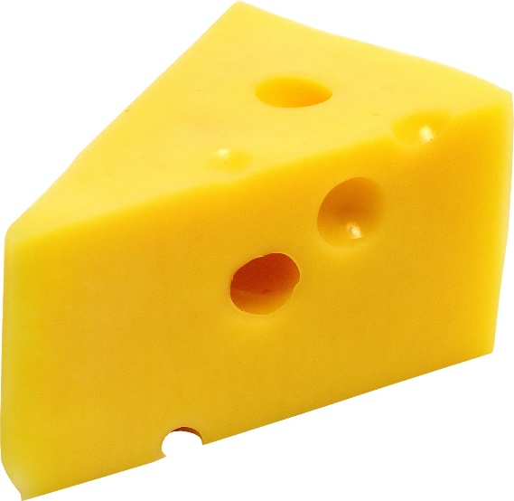
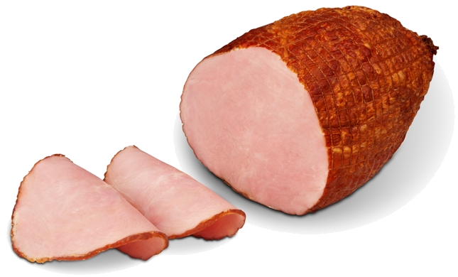
au citron
au chocolat
à la confiture
1
2
3
4
5
au fromage
au jambon

Slide 6
In your book, write the date in French and the learning objective:
Can I write my opinions of pancakes?
Please write one sentence for each opinion – J’adore...J’aime …. Je n’aime pas…. and Je déteste .
Here’s a model to help you:
J’adore les crêpes au citron. I love pancakes with lemon.
Je n’aime pas les crêpes au jambon. I don’t like pancakes with ham.
I’d love to hear what kind of pancakes you like and don’t like on Seesaw! Can you make a little video and upload it?
There is a recipe for making pancakes on the next slide. Maybe you could make some for a treat!

Slide 7
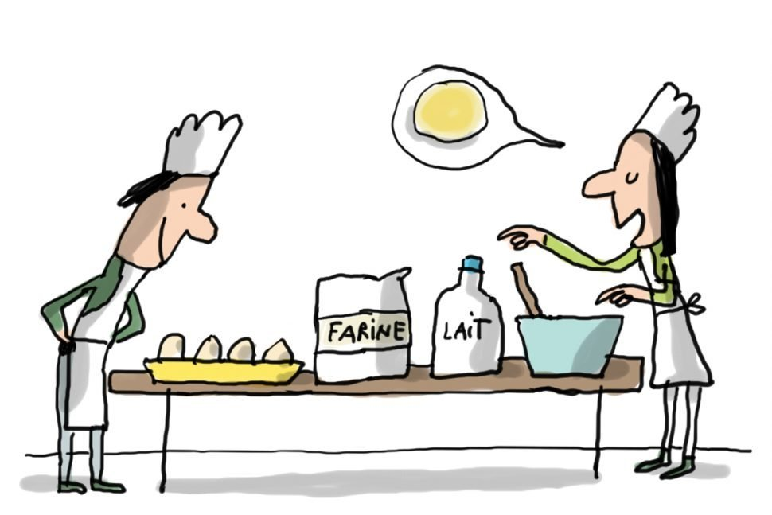
Voici une recette pour faire les crêpes.
https://www.bbcgoodfood.com/recipes/easy-pancakes
Don’t forget to hold a coin in your hand while you toss them for good luck!
Bon appétit!

