Slide 1
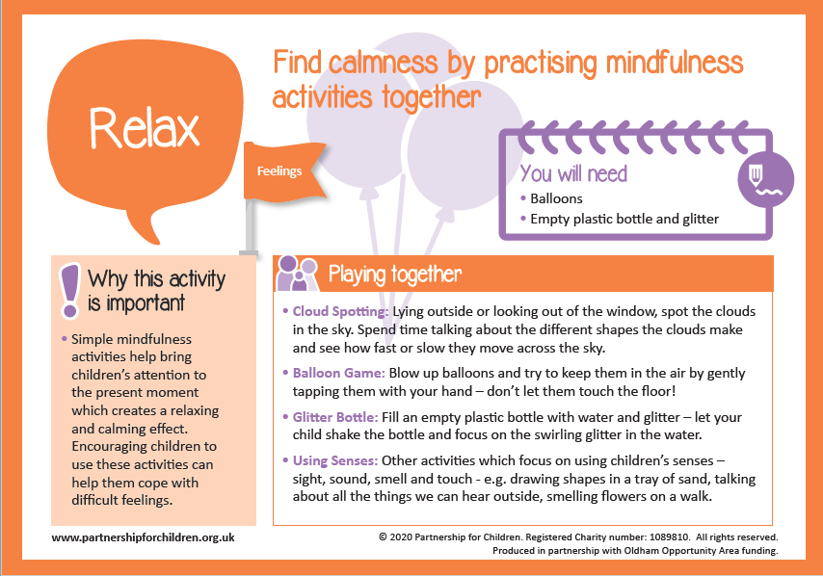

Slide 2
Five Finger Breathing
Follow the link and learn a breathing exercise where you use your hand.
https://www.youtube.com/watch?v=HQVZgpyVQ78&safe=active

