Slide 1
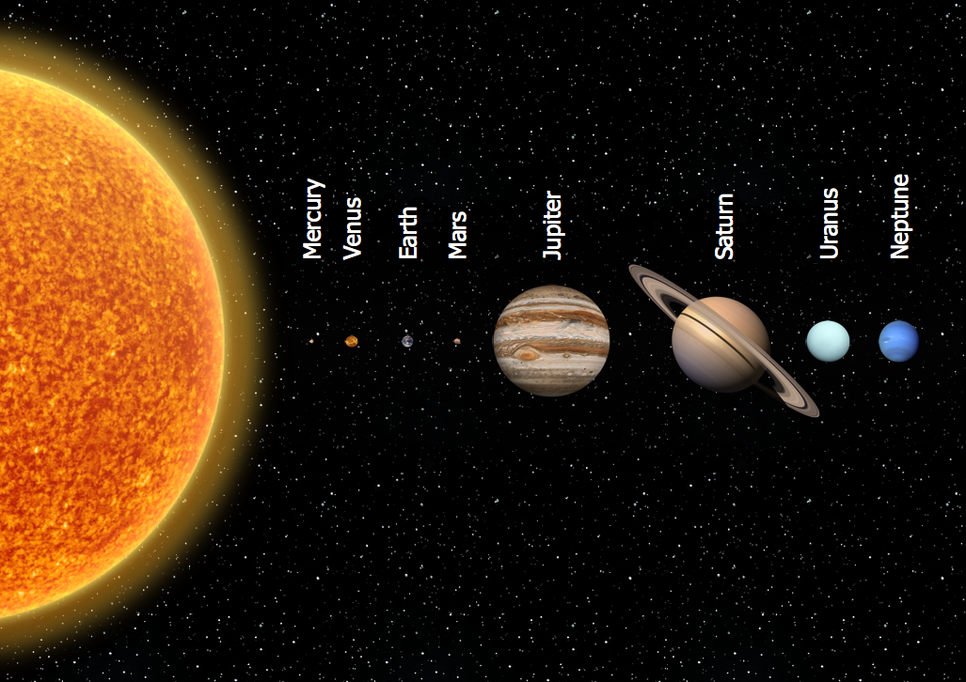

Bonjour Année 5! Ca va? Moi, ça va super!
Today we are going to write our own sentences about the planets. Don’t worry. There is lots of help!
There is a flow chart on the next slide and the sentences that we translated last week are on the slide after. You might like to look up some facts of your own such as what colour the planets appear and how many moons they have so you can add these to your sentences. Try to write at least one sentence for each planet. It’s up to you whether you include Pluto or not.
Write today’s date and the learning objective in your book:
Can I write sentences about the planets?
Listen to the audio buttons on the next slide before you start to help you.
There’s a treat idea on the last slide!

Slide 3
Here are the sentences we transated into English last week.. Don’t copy them – just use them for some more ideas or vocabulary.
Mercure est une planète lente. Un jour dure cinquante-neuf jours terrestres.
Vénus est une planète très chaude car elle est près du soleil.
La Terre est parfaite pour les êtres humains - pas trop chaude ni trop froide. Elle est bleue et verte.
Mars est une petite planète rouge.
Jupiter est une grande planète gazeuse, très loin du soleil.
Saturne est une planète rapide. Un jour dure neuf heures quarante minutes.
Uranus est la septième planète du système solaire. Elle a vingt-sept lunes.​
Neptune est une planète glaciale car elle est très loin du soleil.

Slide 4
I hope you have managed at least one sentence for each planet. Copy the word order and spellings carefully from the flow chart, please. If you upload a picture of your work to Seesaw, I will check it for you before we copy it out onto special paper next week.
French Pancake Day – 2 février – 2nd February
This week in France, people celebrate La Chandeleur or Candlemas. It is the feast of the Presentation, when Jesus was taken to the Temple for the first time, 40 days after Christmas. It marks the official end of the Christmas season. French people use this feast as a good reason to eat pancakes – it is their pancake day! Why pancakes? Well, historically, it was a way of using up last year’s wheat before this year’s harvest. People also say that a pancake looks a bit like the sun and reminds us that the dark days of Winter are beginning to pass and the lighter days of Spring will soon be here. When they toss a pancake, it is like the sun rising in the sky. That’s a good enough reason for me to eat pancakes!
If you’d like to join in, here’s a link to a pancake recipe.
https://www.bbcgoodfood.com/recipes/easy-pancakes
Obviously, you should ask an adult to help you. Enjoy! Bon appétit! Moi, j’adore les crêpes au beurre, sucre et citron. Et toi?

