Slide 1
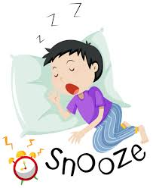
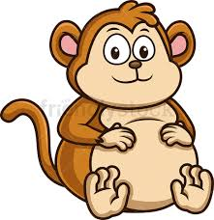
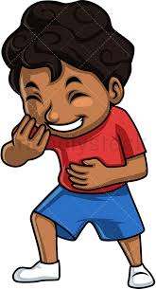
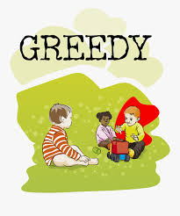
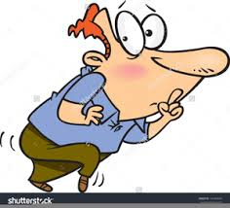
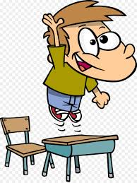
Can I discuss with my grown up what these words mean? 02.02.21
Can I listen to the story again and put my thumbs up when I hear the words?
Can I make up actions for these words?
Can I think of my own sentences for the words?
(We would love to see your recordings of either acting out the words or saying your own sentences)
snoozing plump
gleeful greedy
sneaky eager

