Slide 1

Monday 1st February 2021
Can I use different sentence structures?
Questions.
Short sentences.
Longer, descriptive sentences using commas.
Capital letters and full stops
Beautiful handwriting
Perfect spelling

Slide 2
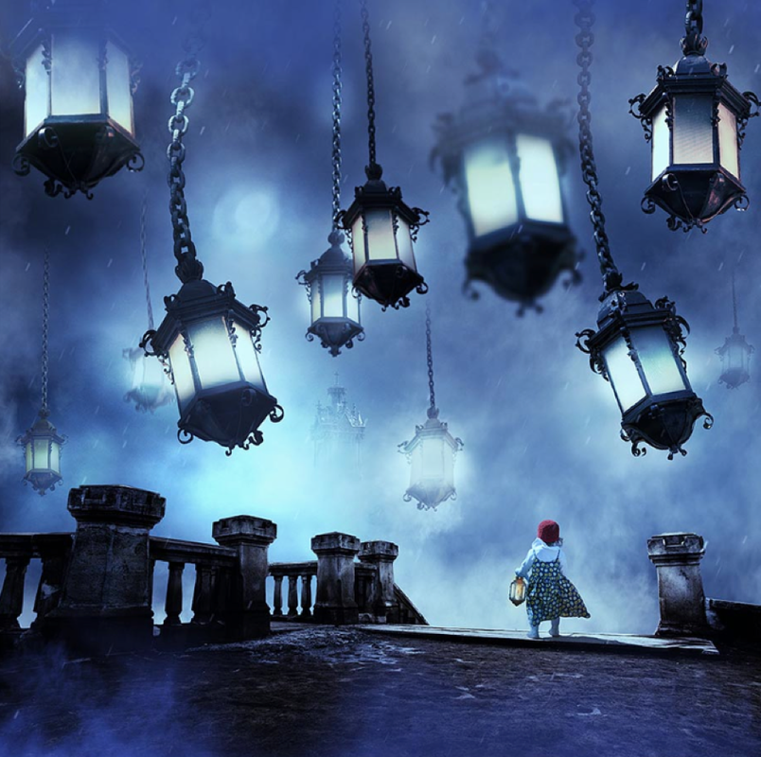
Am I asleep, or am I dreaming?
This was the question that rang out in her head.
She looked down at her hands. Then her feet. Then her clothes. Why was she so small?
Amy had gone to bed that night as an 8-year-old girl, yet in her dream she was tiny again. She had not worn these clothes since she was 2 years old! What was going on?
She had been to this place before, she was certain. It all seemed familiar. Carrying the metal lantern in her fingertips, she waddled slowly through the night, not being able to see further than a few feet in front of her due to the thick wisps of fog that blanketed her vision.
Feeling the warm breeze caress her face, Amy inhaled. The air smelled damp, like it had just finished raining, but she couldn’t remember it having done so. Lanterns, as big as post boxes, swayed in the wind, shedding a feeble, hazy glow across the never-ending blackness.
She shivered. Something was wrong. Surely dreams couldn’t feel this real?

Slide 3
Am I asleep, or am I dreaming?
This was the question that rang out in her head.

Slide 4
She looked down at her hands. Then her feet. Then her clothes. Why was she so small?

Slide 5
Amy had gone to bed that night as an 8-year-old girl, yet in her dream she was tiny again. She had not worn these clothes since she was 2 years old! What was going on?

Slide 6

She had been to this place before, she was certain. It all seemed familiar. Carrying the metal lantern in her fingertips, she waddled slowly through the night, not being able to see further than a few feet in front of her due to the thick wisps of fog that blanketed her vision.
Feeling the warm breeze caress her face, Amy inhaled. The air smelled damp, like it had just finished raining, but she couldn’t remember it having done so. Lanterns, as big as post boxes, swayed in the wind, shedding a feeble, hazy glow across the never-ending blackness.

Slide 7
She shivered. Something was wrong. Surely dreams couldn’t feel this real?

