Slide 1
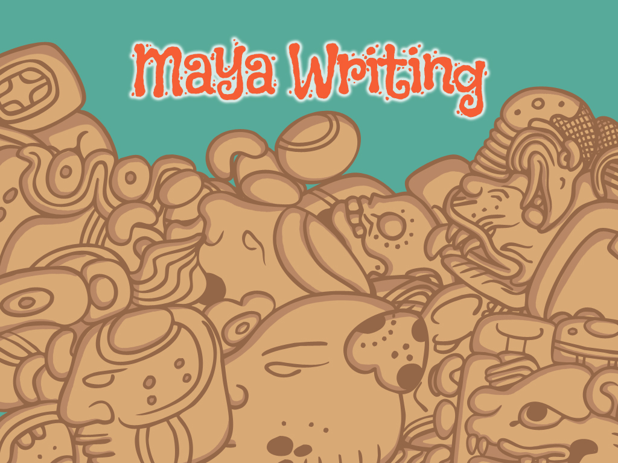


Slide 2
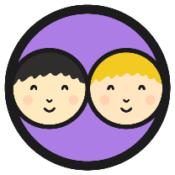
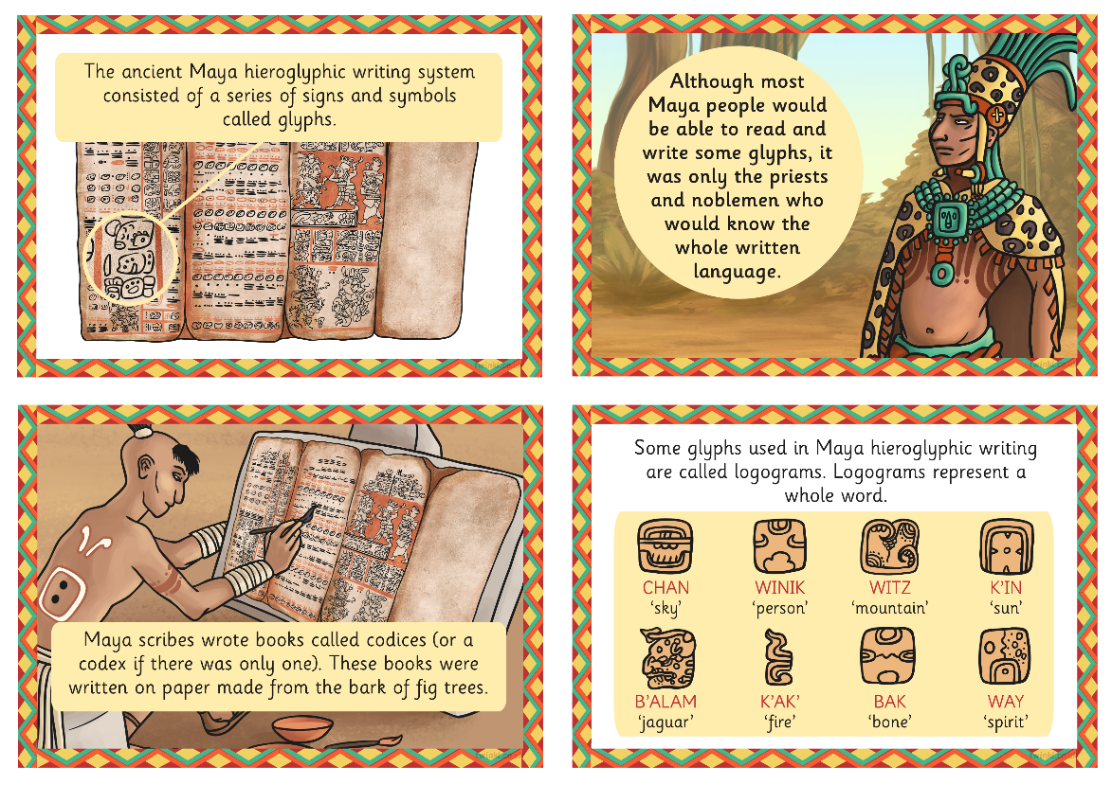
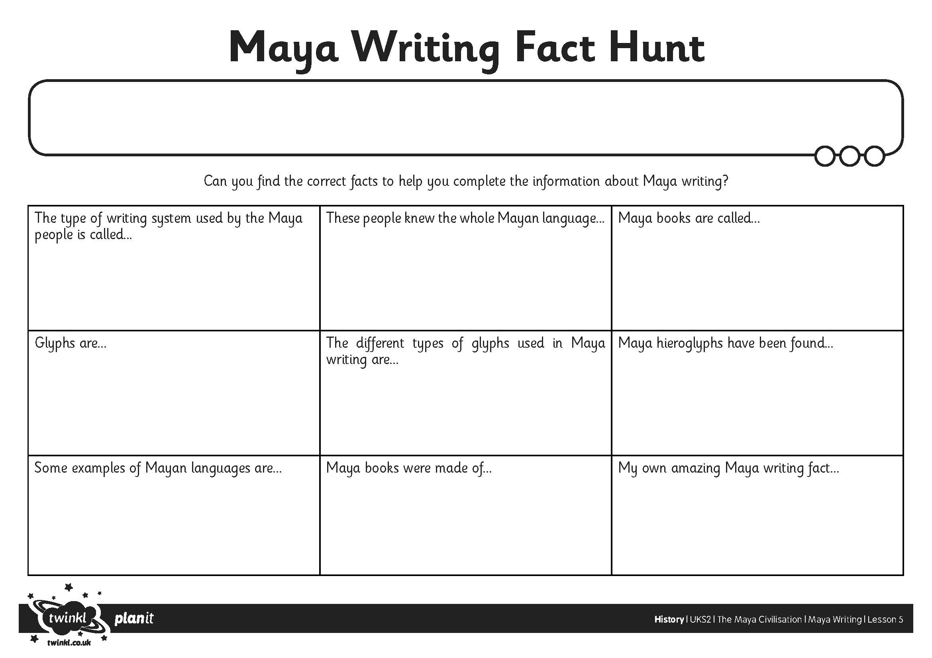
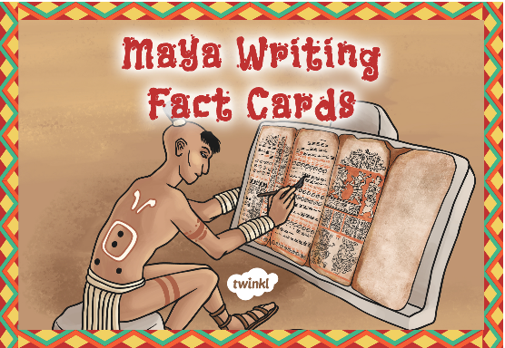
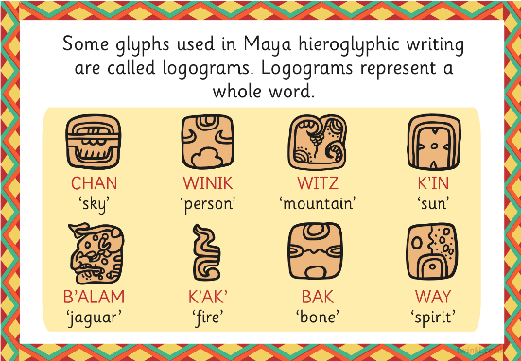
Maya Writing Fact Hunt
Can you work with a partner to find and read all the Maya Writing Fact Cards?
Use the information on the fact cards to help you complete the Maya Writing Fact Hunt Activity Sheet.

Slide 3
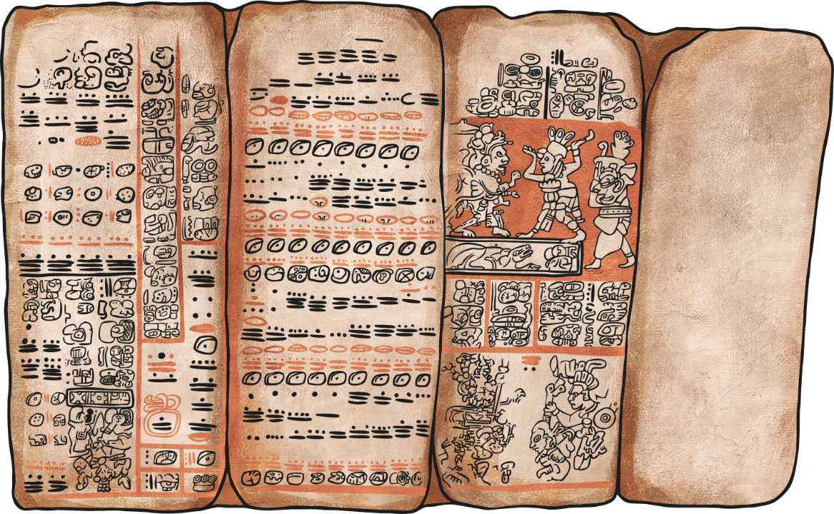
Codices
The Maya people also wrote books made of the bark from fig trees. One book is called a codex and the plural is codices.
The codices were written by professional scribes and contained information about astronomy, gods, war and history.
Rather than having separate pages, the codices unfolded like a concertina.

Slide 4
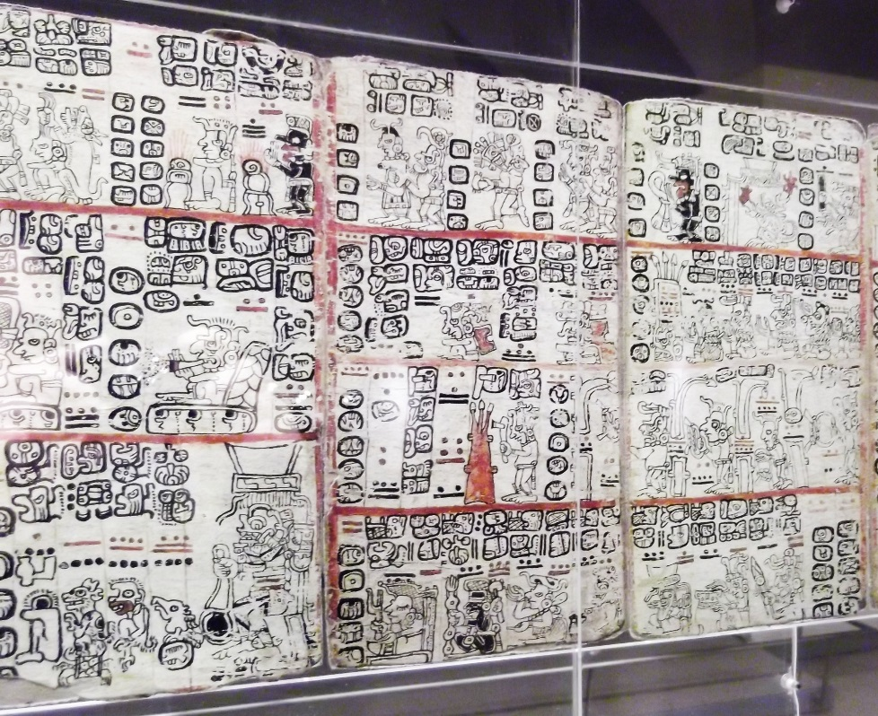
The Last Codices
Unfortunately, when the Spanish arrived and set to conquer the Maya, their priests burned as many Maya codices as they could find as they considered them to be the work of the devil. Three genuine Maya codices remain, and they were discovered ‘hiding out’ in Europe. These codices are named after the places they are kept.
The Dresden Codex: part of the Royal Library collection in Dresden, Germany.
The Madrid Codex: Housed in the Madrid Archaeological Museum, Spain.
The Paris Codex: Housed in the National Library of Paris, France.
A fourth codex was discovered in the 1960s, but historians cannot decide if it is real. It is called the Grolier codex.
Photo courtesy of David Holt London (@flickr.com) - granted under creative commons licence - attribution

Slide 5

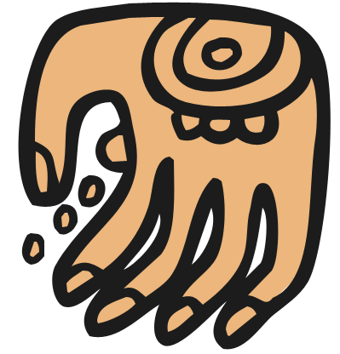

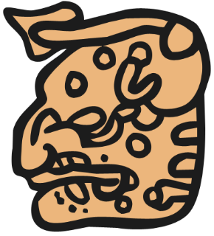

Maya Hieroglyphs
Maya hieroglyphic writing can be made up of syllabograms (representing sounds) or logograms (representing whole words).
Logograms often resemble the thing that they represent, so it is easy for us to see what they mean, but others are more tricky.
Look closely at these logograms. Can you match them to their meanings?
to grab
fire
to scatter
jaguar

Slide 6
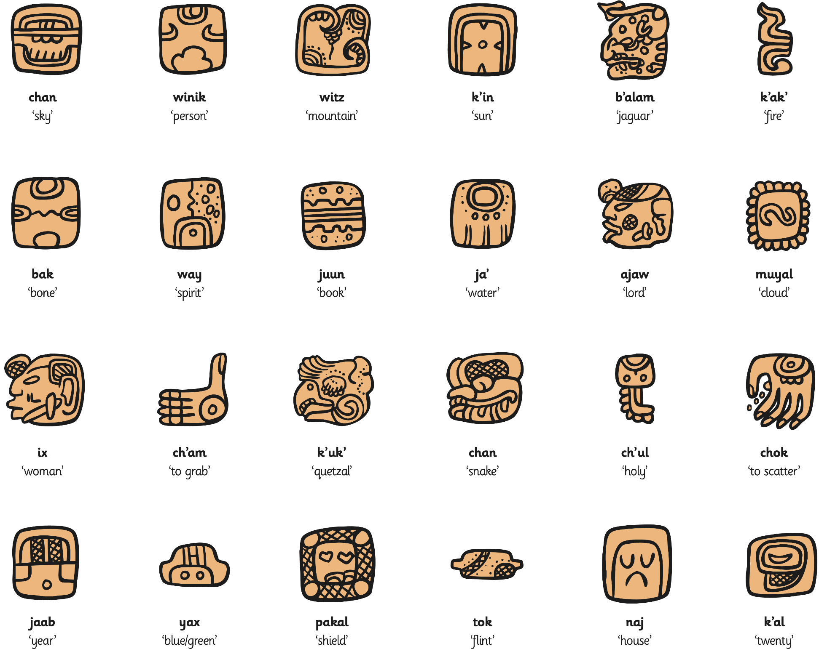


Maya Hieroglyphs
Choose a few of your favourite logograms to draw carefully. Write down its meaning too.
Why not have a go at creating your own logograms in the Maya style?
Click the image to view a larger version.

Slide 7
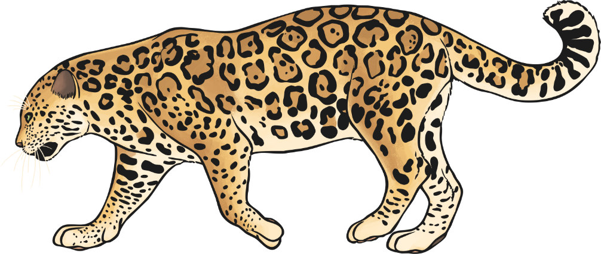
Syllabograms
About 150 syllabograms were used in the Maya script and syllables were often represented by more than one glyph. This meant that different people could spell the same words differently depending on which syllabograms they chose to use.
For example, the Maya word for jaguar is b’alam which can be split into three syllables b’a – la – am, with the final ‘a’ silent.
Have a look at the syllabograms for the syllables in b’alam. How many different ways of spelling the word can you find?
Remember there is a logogram for the word jaguar too!

Slide 8
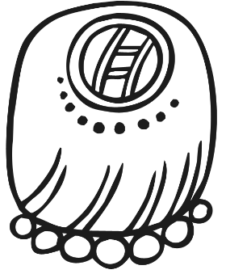

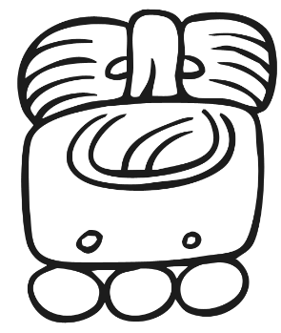
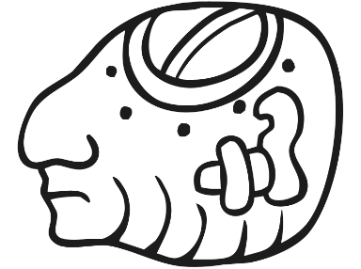
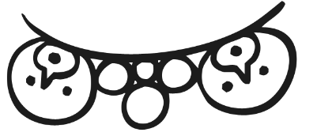
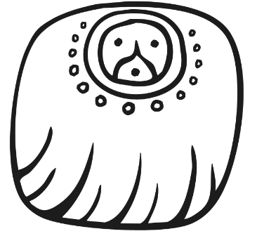
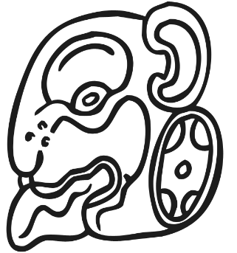


Jaguar – b’alam
ba
la
am
+
+
=

Slide 9
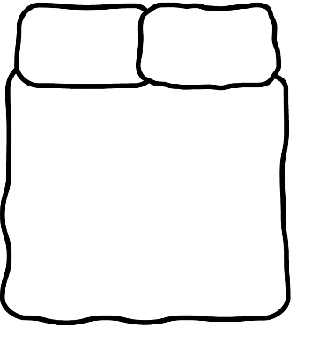


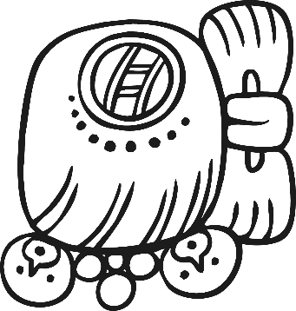
Creating a Glyph Block
Now you have three syllabograms to write b’alam, you need to combine them into one glyph block.
Maya glyphs were roughly read top to bottom and left to right.
For example:
1
2
1
2
1
1
2
3
3
2
3
3
So the word b’alam could look like this:

