Slide 1

Thursday 28th January
Please read the text (attached in uploads on the blog) for today’s lesson. If you have the book it is Chapter 6.
On the next slide you can follow whilst I read the chapter.

Slide 2
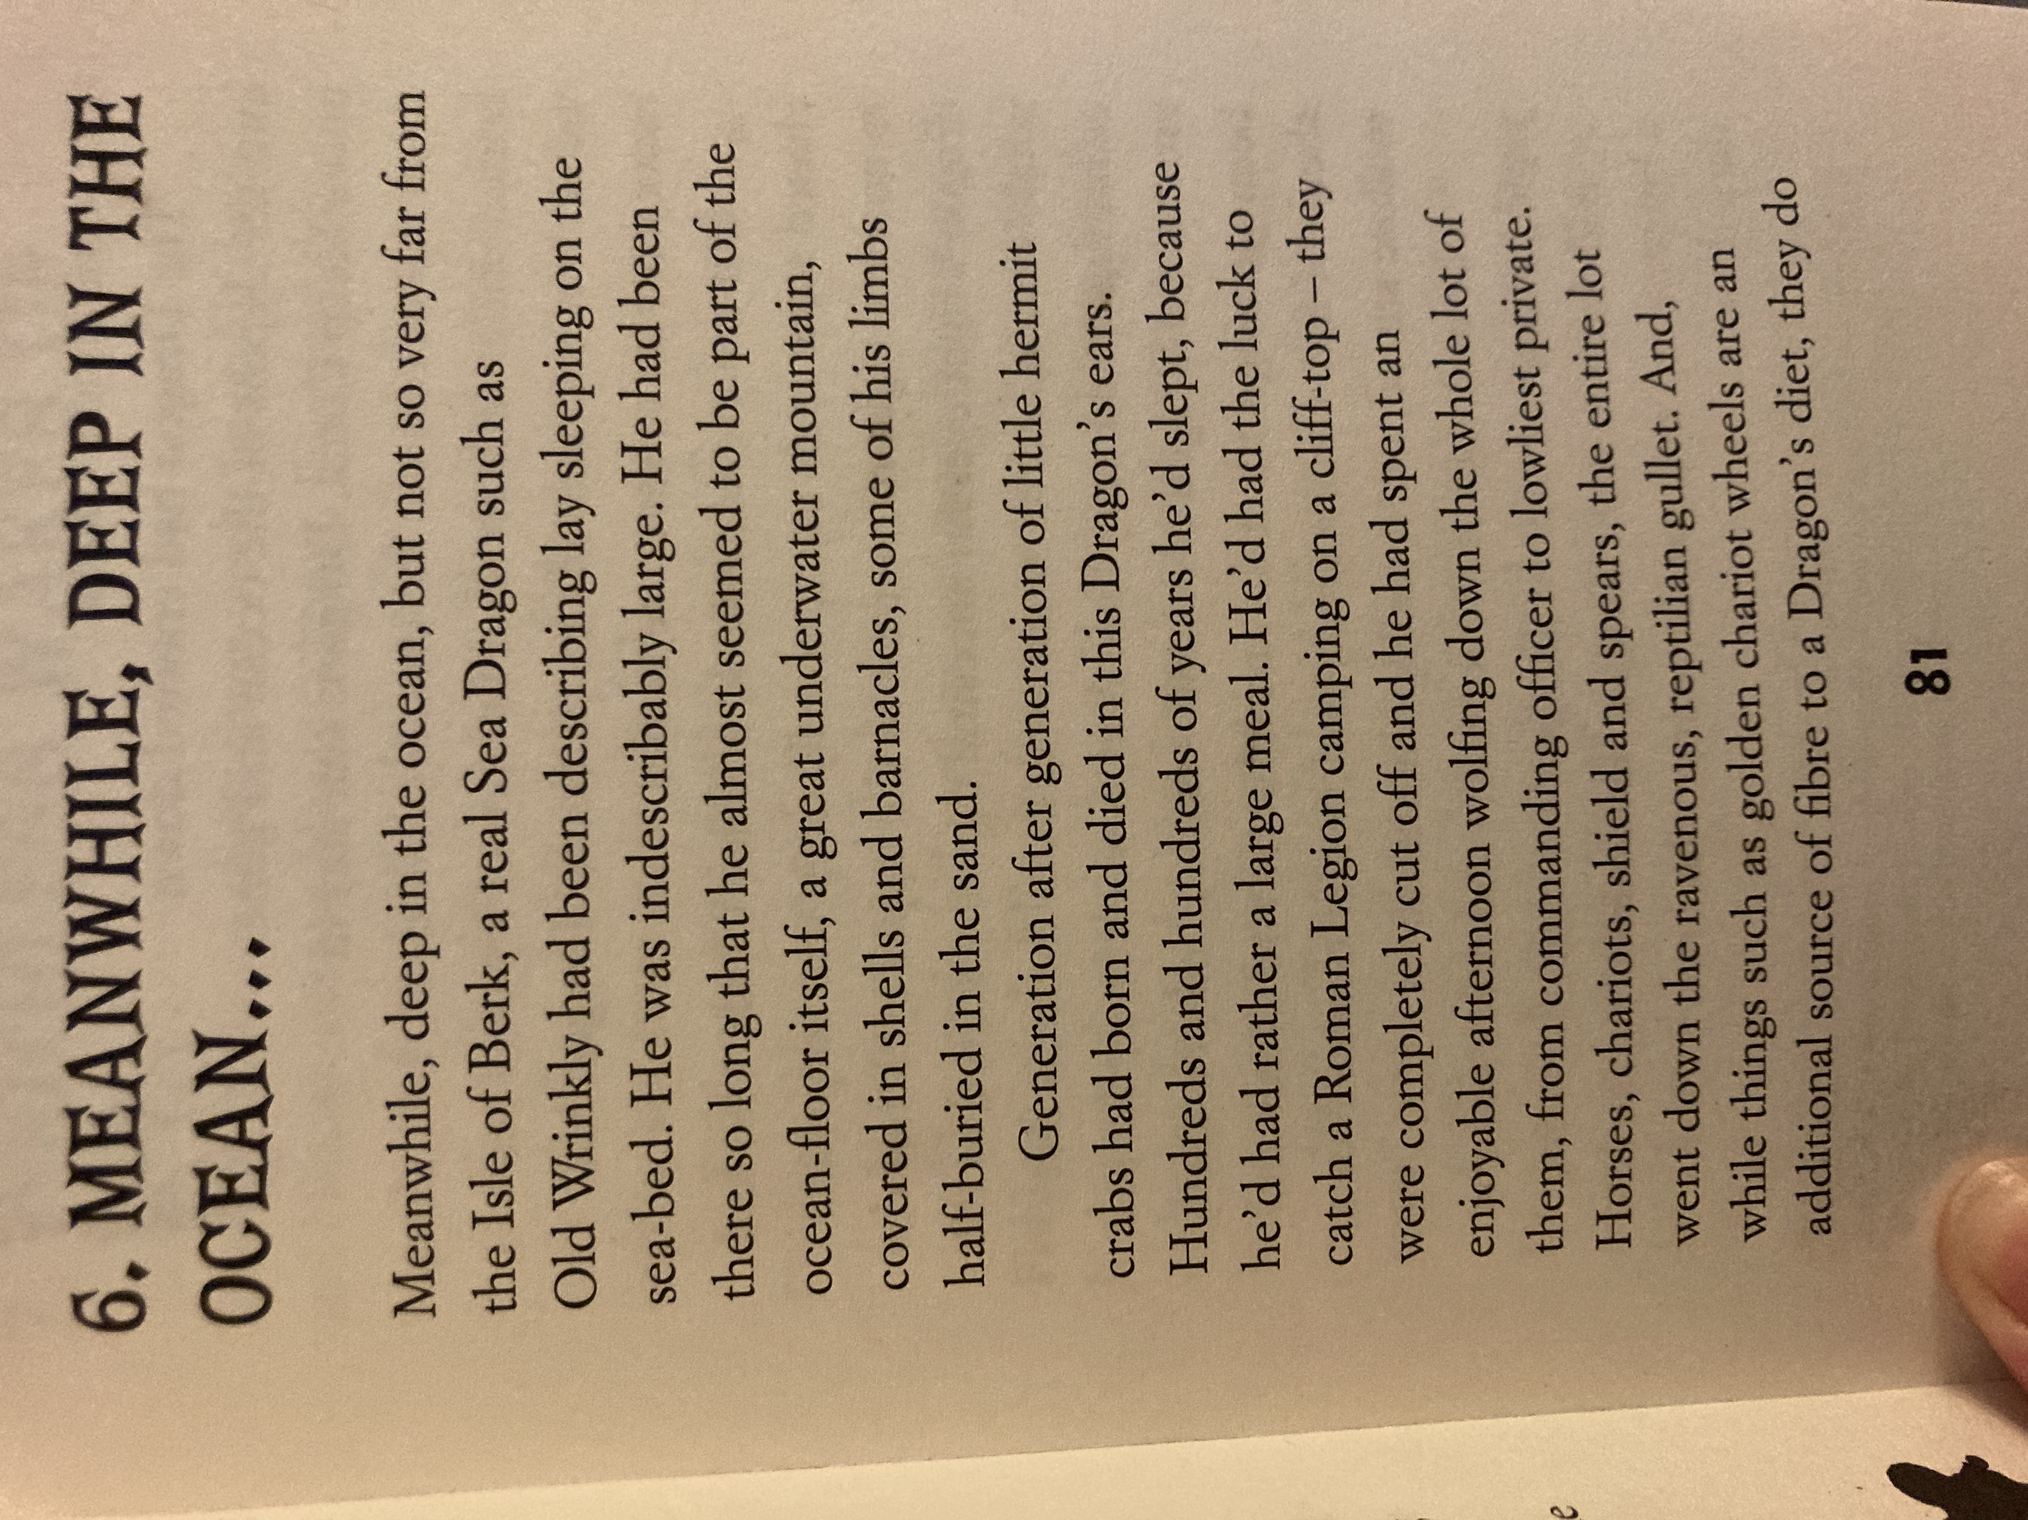
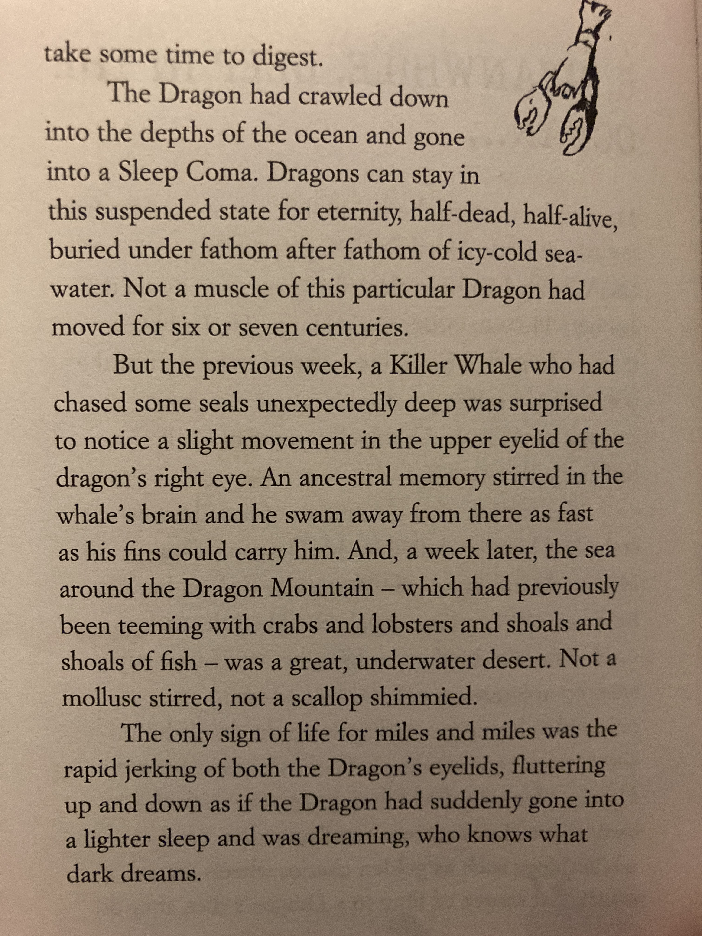

Slide 3
Main Lesson
Today we are going to create a poster with the title – Have you seen this dragon?
Starter
Collect some information that we have just read about the sea dragon.
Here are a few facts I heard:
indescribably large (it’s so big, you can’t even describe it with words)
a great underwater mountain,
part of the ocean floor.
Notes:
Try and write 10 little bits of information. Look back through the text and pull out all the information which describes the sea dragon.

Slide 4
These questions might help you find out some more information from the text.
What has the sea dragon eaten?
Where does it live?
Why has the dragon not moved?
What does the dragon look like?
How long has the sea dragon been in the ocean?
Notes:
dicuss with an adult

Slide 5
Task
Can I create a poster all about the Sea Dragon? Use this as your title:
Have you seen this Sea Dragon?
The poster will be put all around the Isle of Berk.
You may use colours to make your poster stand out – we want every Hooligan on the Isle of Berk to look and read your poster.

Slide 6
Using the information you have collected about the Sea dragon can you:
- Write your facts on your poster.
- You might want to write sub-titles around your poster to include different information.
These could include:
What does it look like? When was it last seen? Where does it live? If you go on your boat here are the things to look out for.
What does it like to eat?
Make sure you get all your information on and draw a picture too of what the Sea dragon looks like.
Notes:
use your imagination

Slide 7
Success Criteria
Use colour and sub-headings to make your poster stand out.
Use information from the story.
Draw pictures of the sea dragon.
Use lead-ins on all your letters.
Please upload a picture of your work onto SeeSaw.
We will look forward to seeing all your brilliant work.

