Slide 1

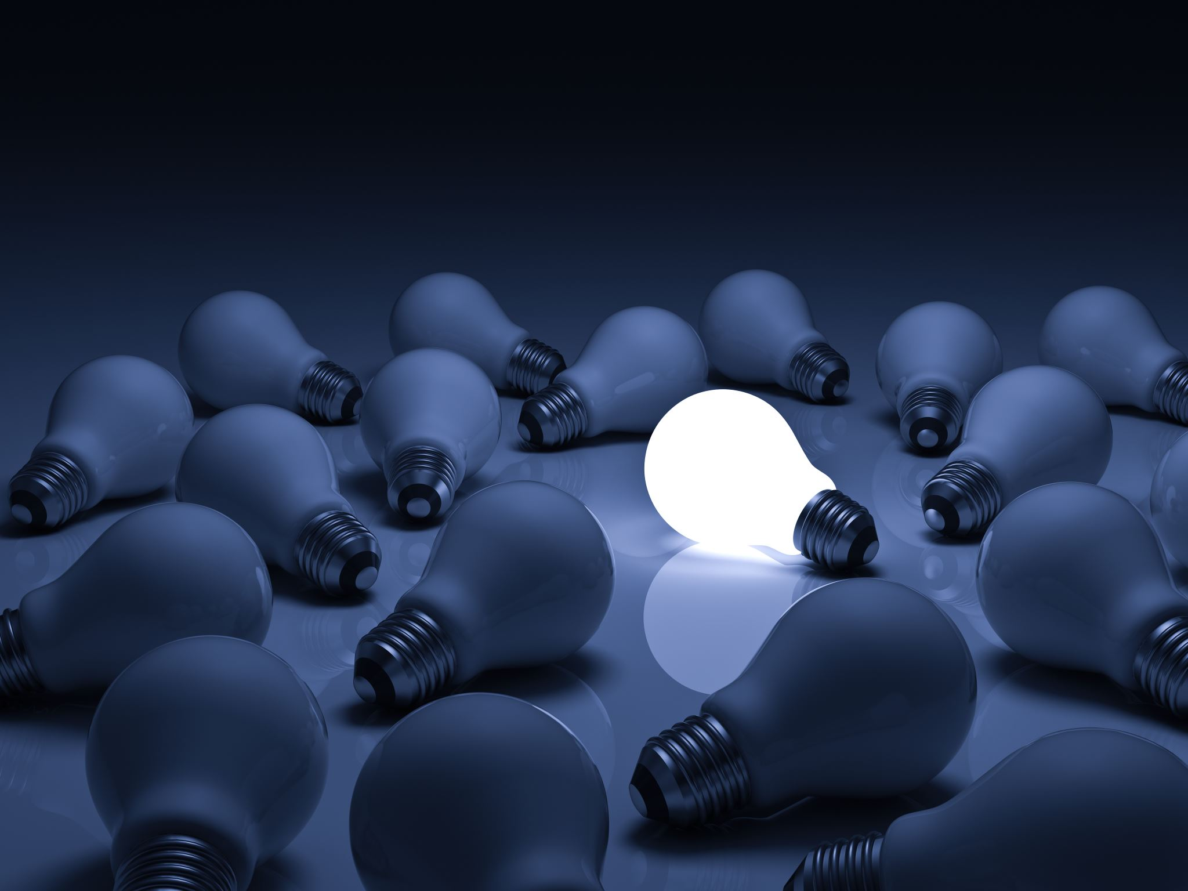

Light
For parents and carers
Thank you for supporting your child’s learning in science.
Before the session:
Please read slide 2 so you know what your child learning and what you need to get ready.
As an alternative to lined paper, slide 5 may be printed for your child to record on.
During the session:
Share the learning intentions on slide 2.
Support your child with the main activities on slides 3 & 4, as needed.
Slide 6 is a further, optional activity.
Slide 7 has a glossary of key terms.
Reviewing with your child:
Slide 8 gives an idea of what your child may produce.
Exploring sources of light
Year 3 / Key Stage 2
Age 7-8

Slide 2
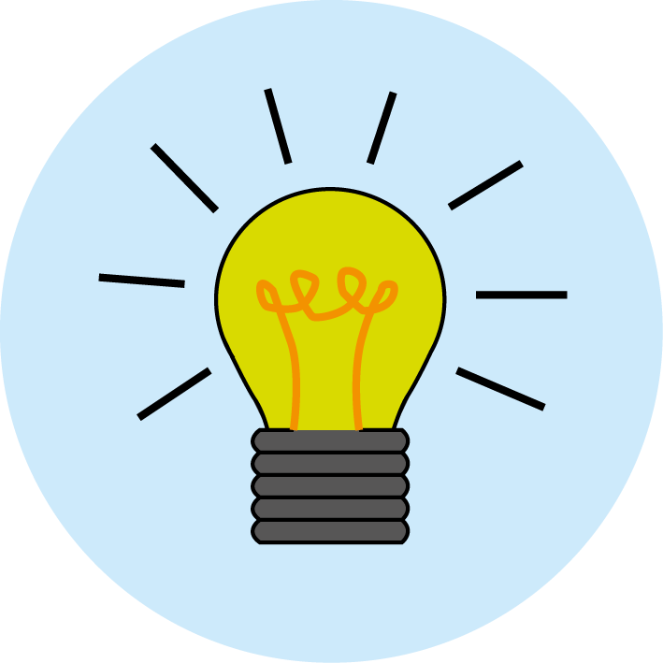

Light
Logo for section to sit inside roundel
Sources of light
Key Learning e.g.
Some objects, for example, the sun, a lit light bulb and a burning candle are sources of light.
Objects are easier to see if there is more light.
Activities (pages 3-5): approx.30-40 mins
Use lined paper, ruler and pencil.
Alternatively, print page 5 as a worksheet.
Find out more… (page 6): approx. 10 mins
Which light source is the odd one out?
I can…
identify which objects are sources of light and which reflect light.
2

Slide 3
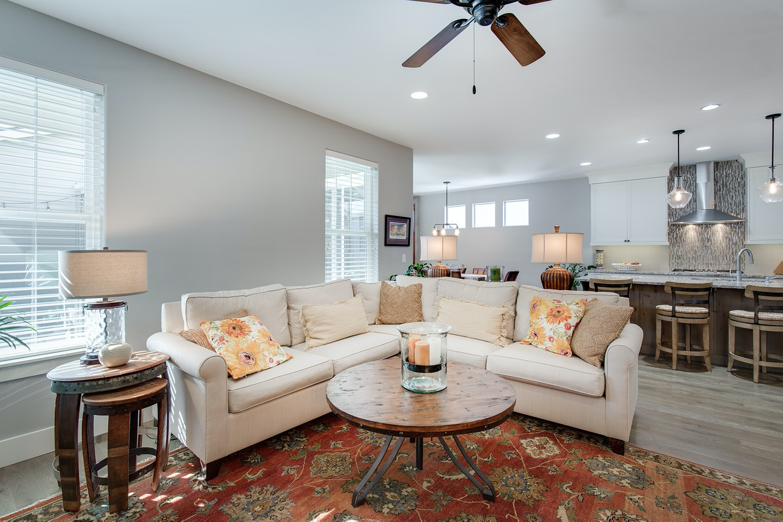
Explore, review, think, talk….
Logo for section to sit inside roundel
How ‘light’ is your home?
(10 minutes)
Walk around your home and jot down any light sources you can see.
Questions to think about:
  What is it used for (its function)?
  What type of bulb is it?
  What colour is the light?
  How is it powered?
3

Slide 4
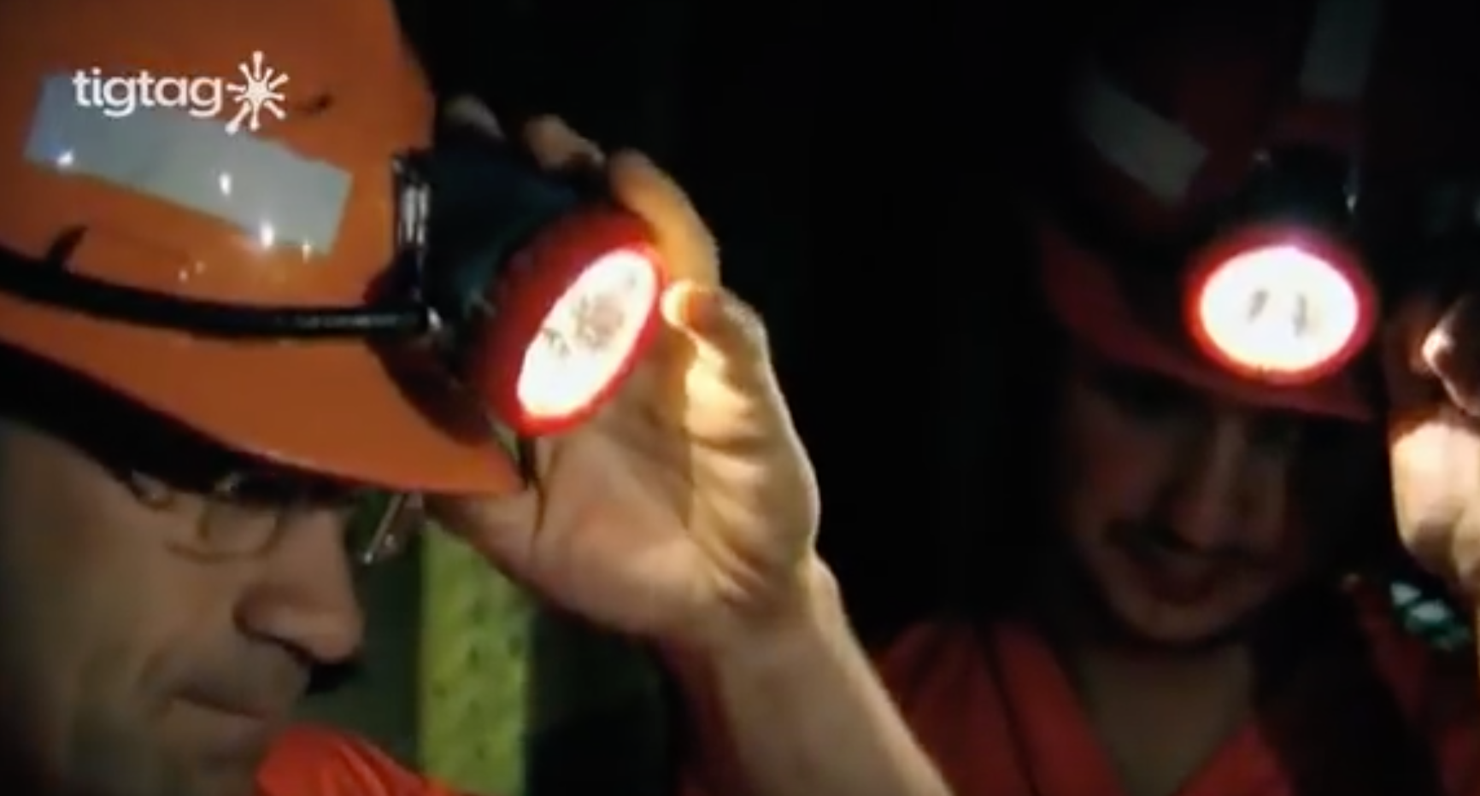
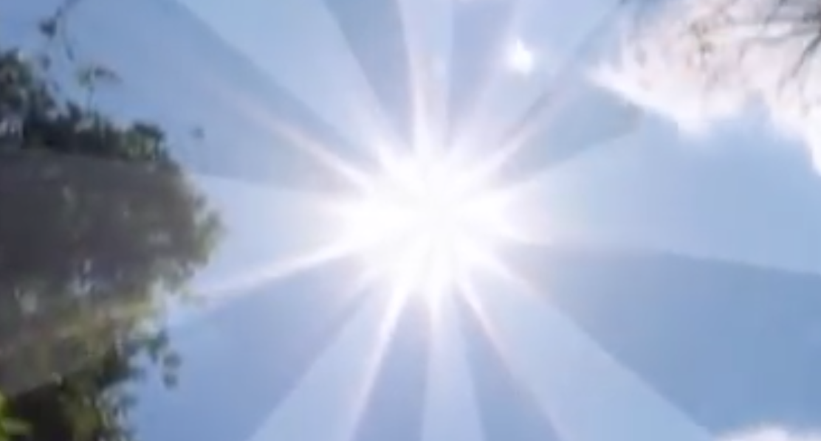
Watch, read, listen…
Logo for section to sit inside roundel
What is light?
(5 minutes)
Watch this clip about light sources:
https://www.youtube.com/watch?v=1PsHHKwtXQU
What sources of light did you see in the video?
A light source emits beams of light.
Light sources allow us to see objects.
Light leaves a light source in straight lines.
We can see the world around us because of reflected light.
The Sun is our largest light source and emits light in all directions .
4

Slide 5
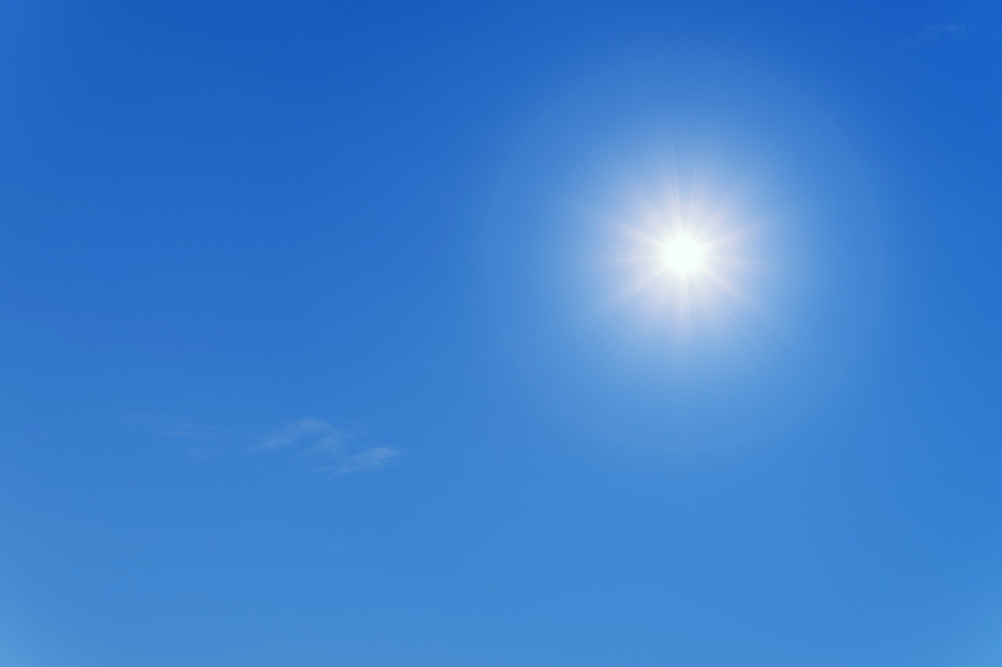
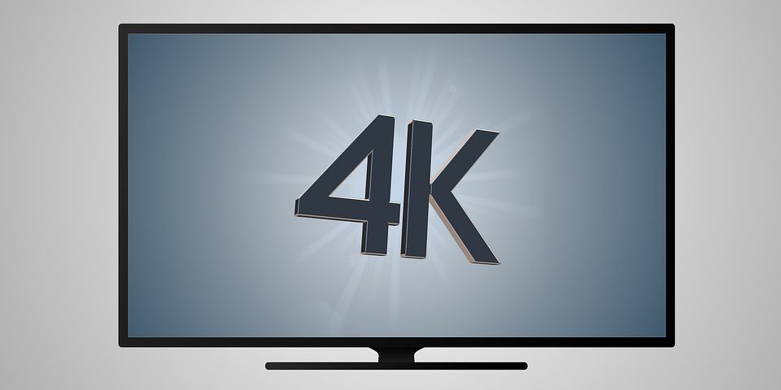
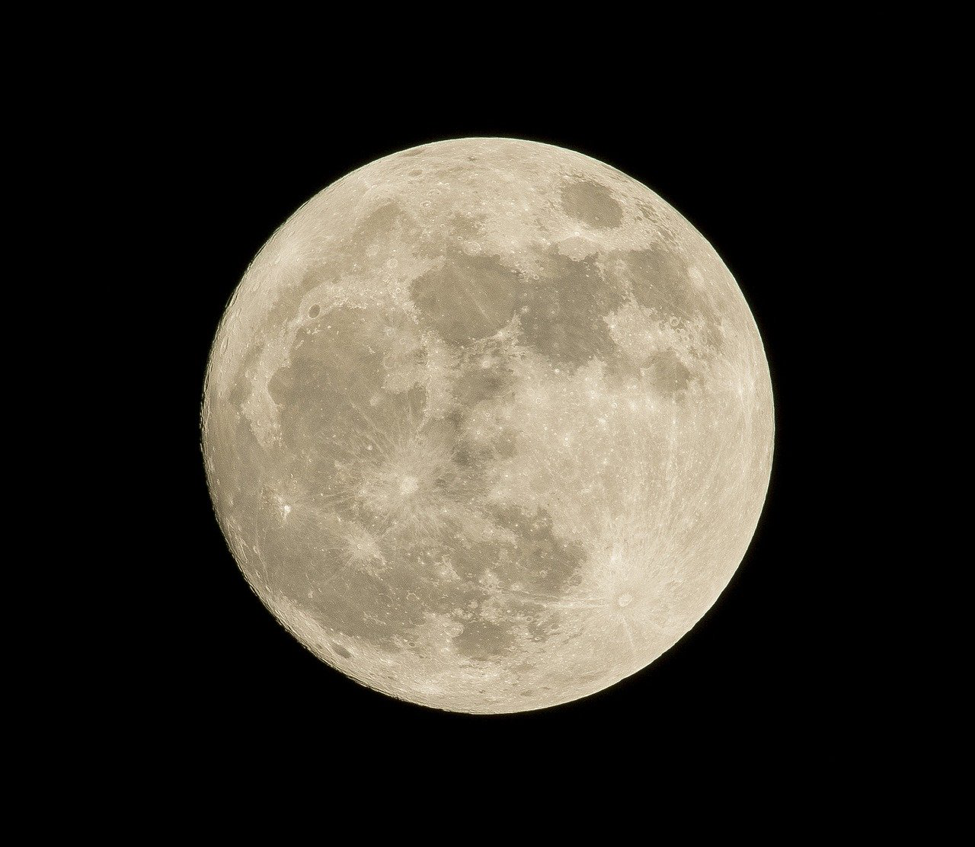
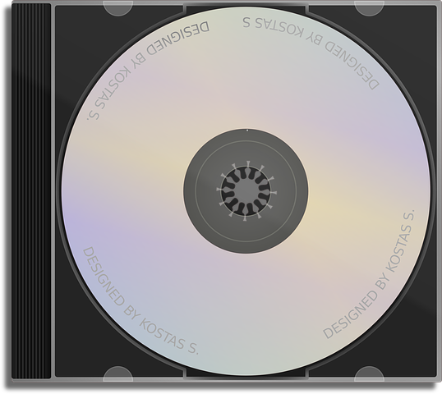
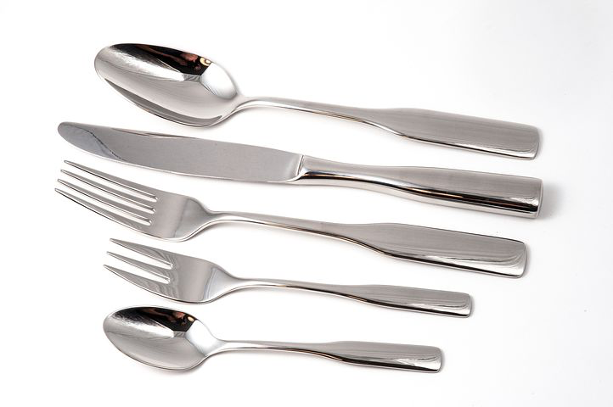
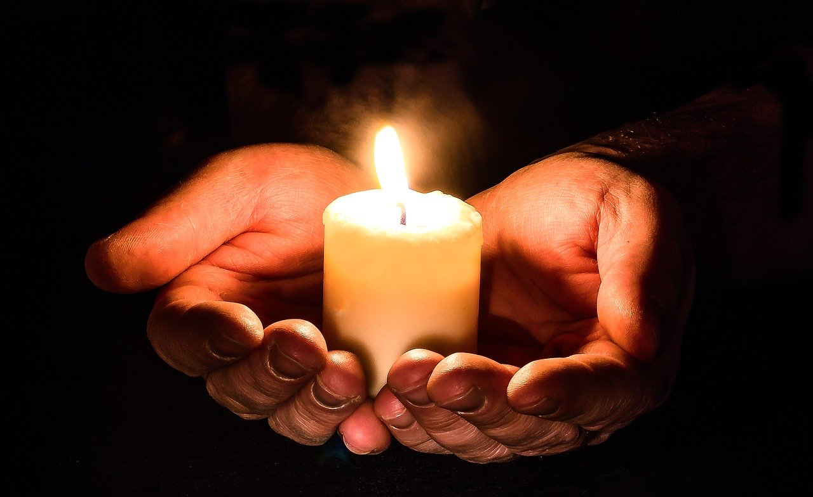
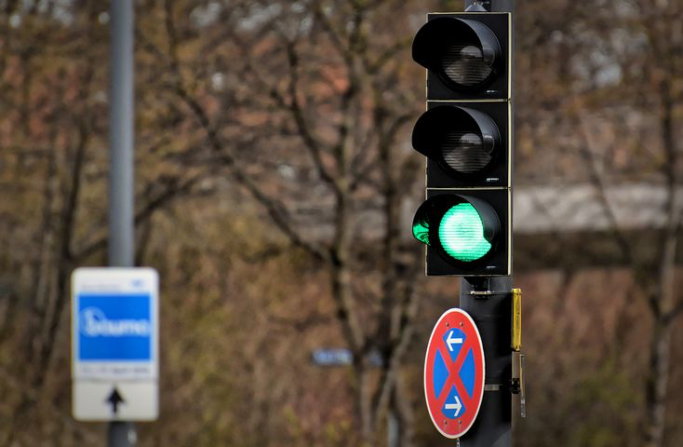
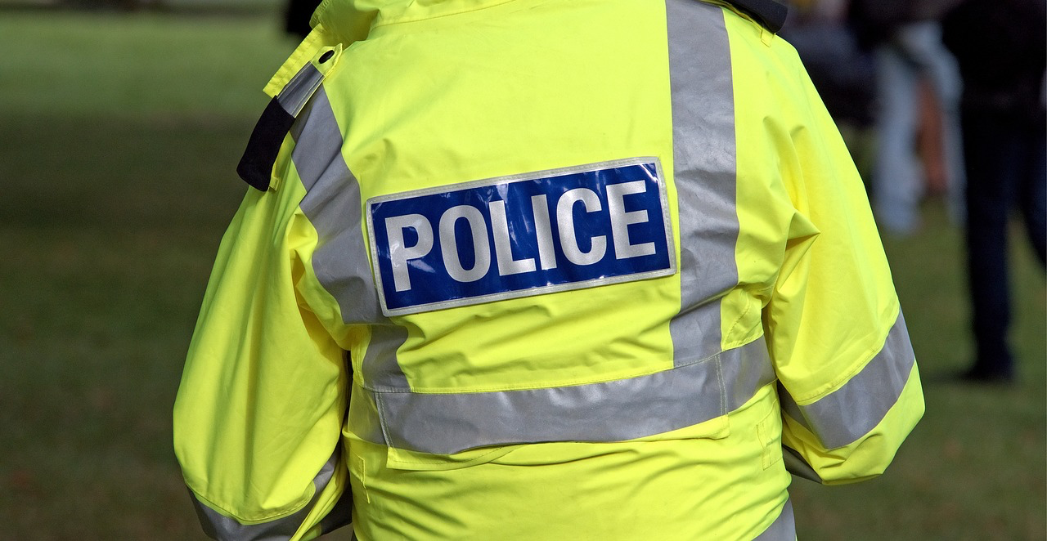
Instructions for Activity
Sort the images into two groups:
  light source
  reflects light
Can you think of any other sources of light to add to the group?
Do any of these surprise you? Why?
Learning outcome: I can identify which objects are sources of light and which reflect light
Sun
television
Moon
cutlery
C D
candle
traffic lights
high-visability jacket
5

Slide 6
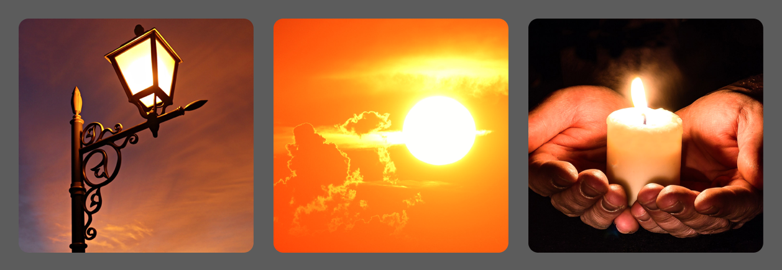
Find out more about light sources
Logo for section to sit inside roundel
Which is the odd one out?
(15 minutes)
Explorify ‘Odd One Out’ on Light sources:
https://explorify.wellcome.ac.uk/en/activities/odd-one-out/sources-of-light
Put your child’s observation skills to the test with these three sources of light.
Show the three images and ask them to come up with as many similarities and differences as they can. If they get stuck, prompt them to think about:
  appearance
  what they do
  where they might be found
Then, everyone needs to decide which one is the odd one out and why.
Encourage a reason for every answer; there is no wrong answer!
6

Slide 7
Glossary of terms
bright: If an object is bright it gives out or reflects much light.
dark (scientific): Dark is the absence of light.
dark (everyday): very little amount of light.
dull: If an object is dull it is not shiny or bright.
light: Light is the form of energy that makes it possible for eyes to see.
material: Anything used for building or making something else.
shiny: Reflecting or glowing with light.
surface: The outside limit or top layer of something.
7

Slide 8
Possible learning outcome for reviewing your work: I can identify which objects are sources of light and which reflect light.
All of these are sources of light. Children may not think that the TV emits light, but most modern televisions use LEDs or LCD to produce light.
Some children will think the Moon is a light source, but it actually reflects the light from the sun.
traffic lights
Moon
cutlery
The Sun and the candle are the two natural sources of light. The television and the traffic light are man-made sources of light.
television
C D
All of these objects reflect light. High-visibility jackets are designed to reflect as much light as possible.
high-visability jacket
Sun
candle
8

