Slide 1
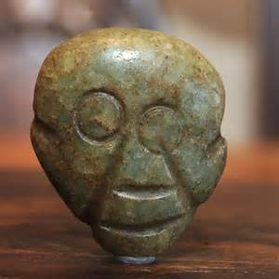
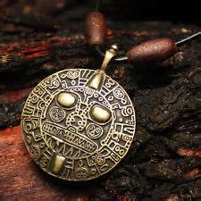
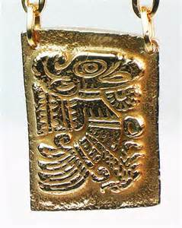

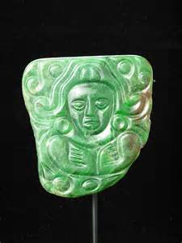
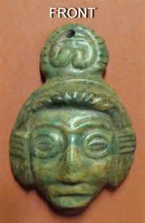
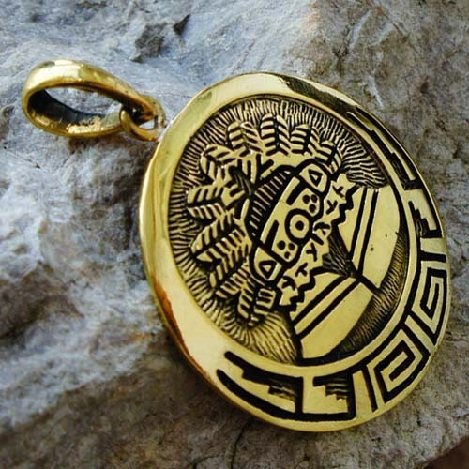

Slide 2
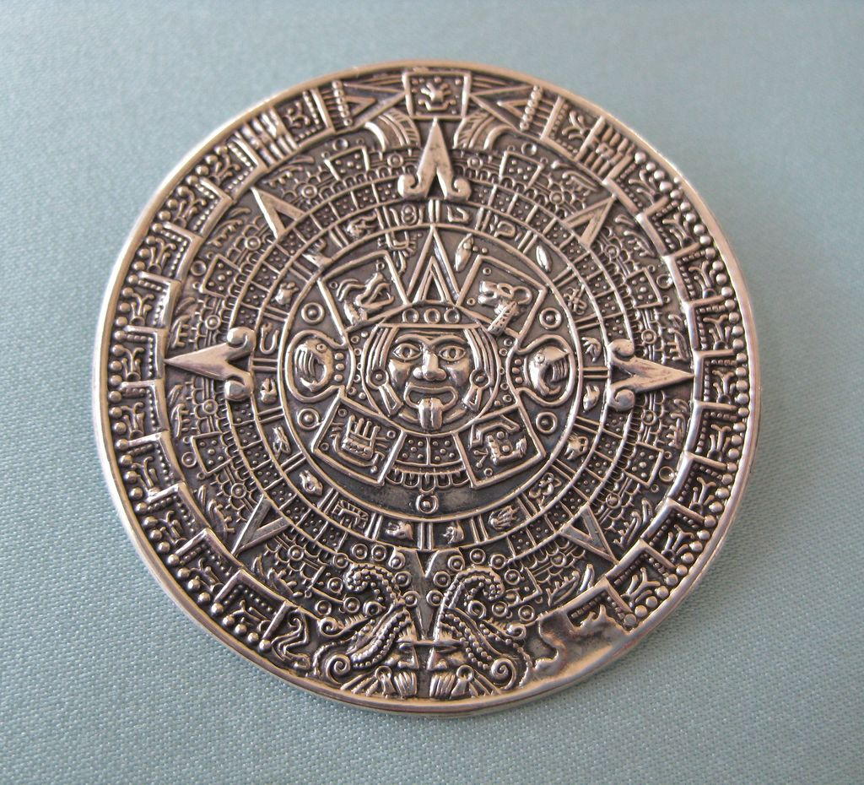

Slide 4
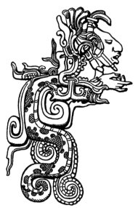
Kukulkan

Slide 5
Stories are still told about Kukulkan among the modern Yucatec Maya.^{[15]} In one tale, Kukulkan is a boy who was born as a snake. As he grew older it became obvious that he was the plumed serpent and his sister cared for him in a cave. He grew to such a size that his sister was unable to continue feeding him, so he flew out of his cave and into the sea, causing an earthquake. To let his sister know that he is still alive, Kukulkan causes earth tremors every year in July.

Slide 6
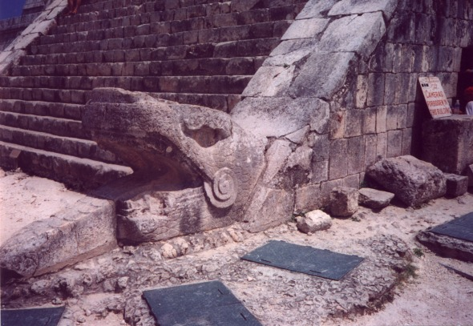

Slide 7
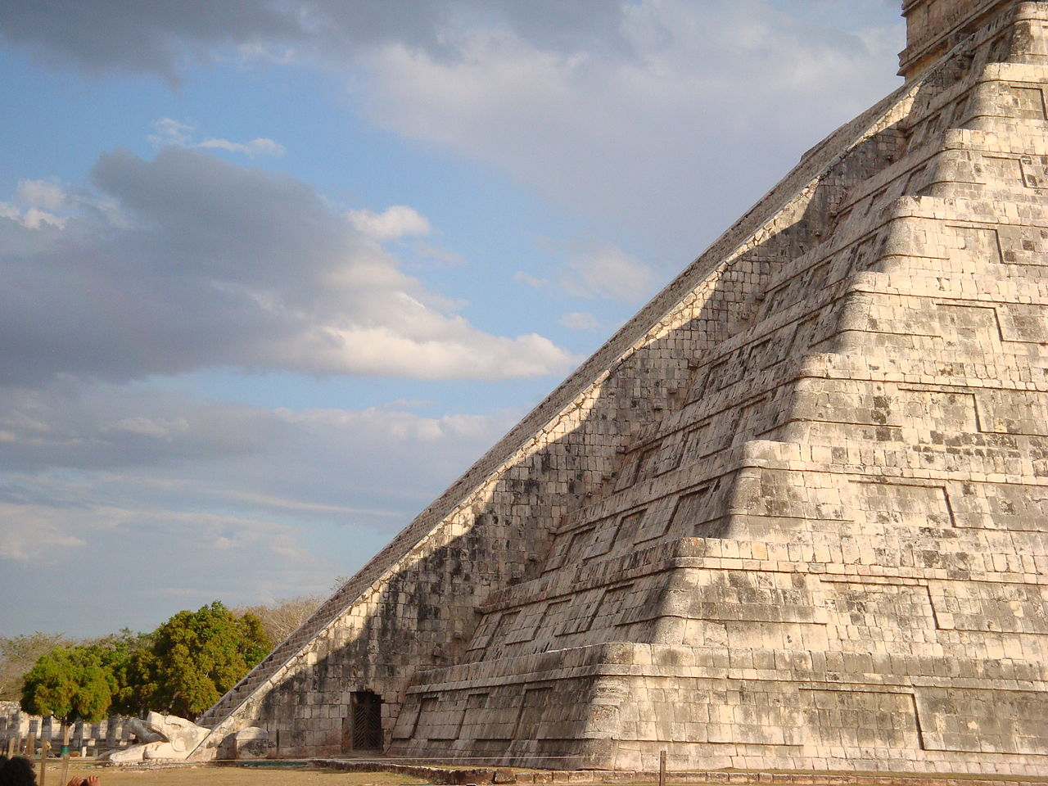

Slide 8
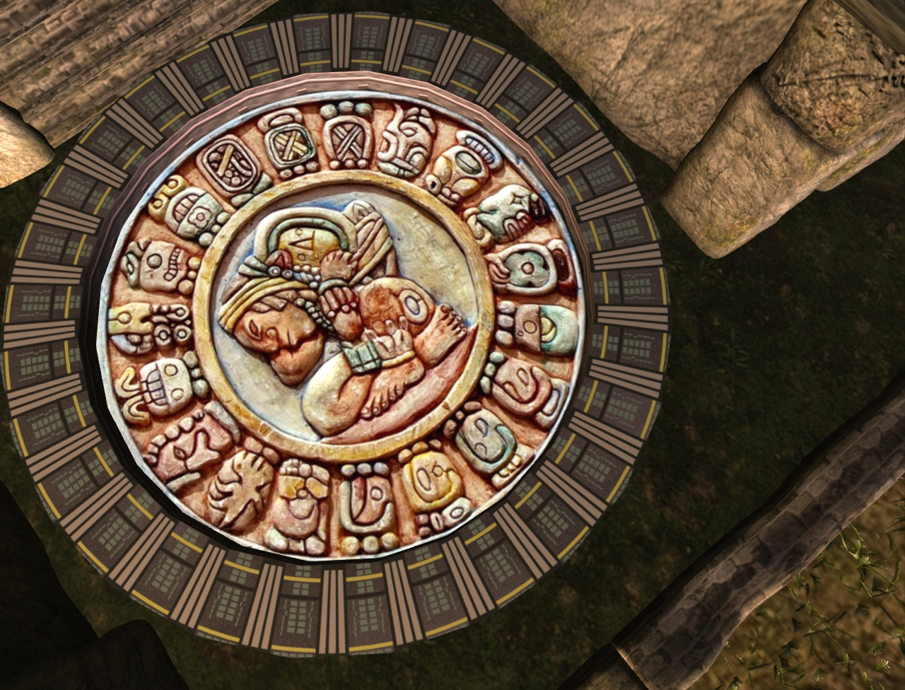

Slide 9
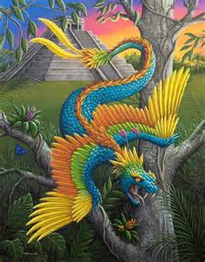

Slide 10
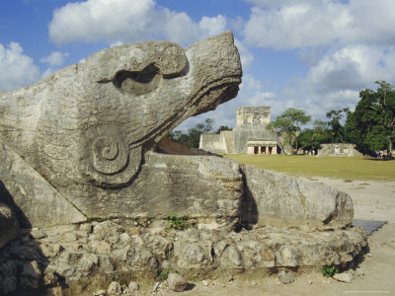

Slide 11
