Slide 1
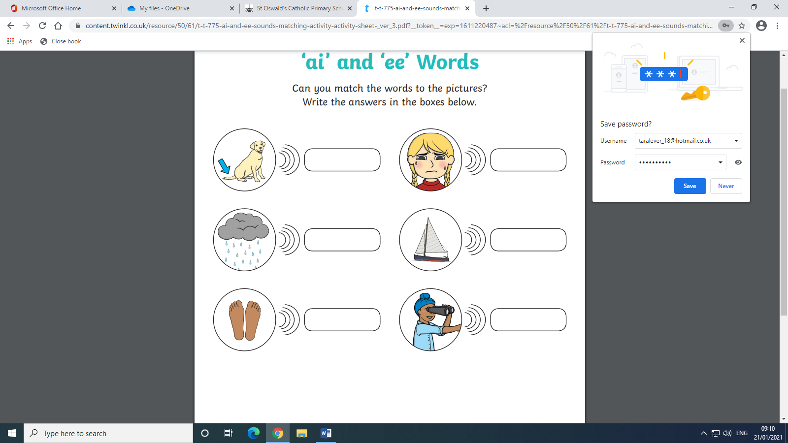
‘ai’ and ‘ee’ words 22.01.21
Can I use my sounds to write these words?
Feet sail see weep tail rain

