Slide 1
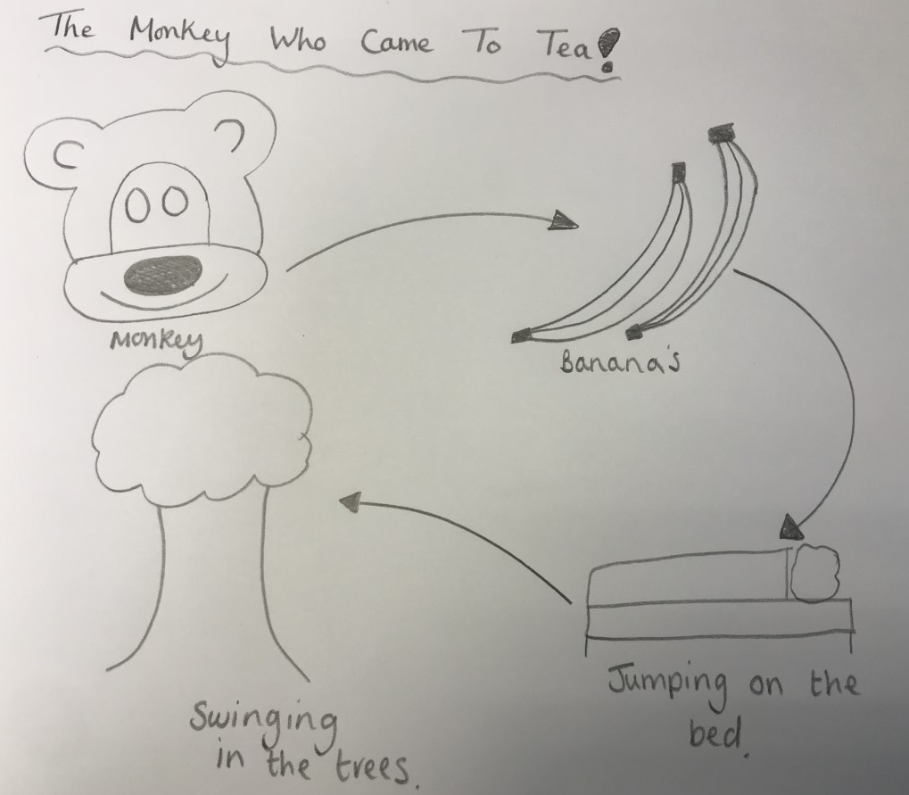
Can I draw and label my own version of the story? 19.01.21

