Slide 1

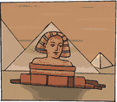







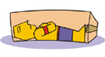



Order Ancient Egyptian Events on a Timeline
3500 BC
First use of hieroglyphics
1500 BC
Valley of the Kings tombs built
2400 BC
First obelisks built (tombs for nobles)
30 BC
Death of Cleopatra
3000 BC
First buildings of mud brick
525 – 404 BC
Persians invade and rule Egypt
5000 BC
Farm cattle, wheat and barley
30 BC onwards
Romans control Egypt
6000BC
People settle near River Nile
1325 BC
King Tutankhamun buried
2500 BC
Great Sphinx and Great Pyramid
332 BC
Alexander the Great takes over
4500 BC
Egyptians use sails for first time

