Slide 1
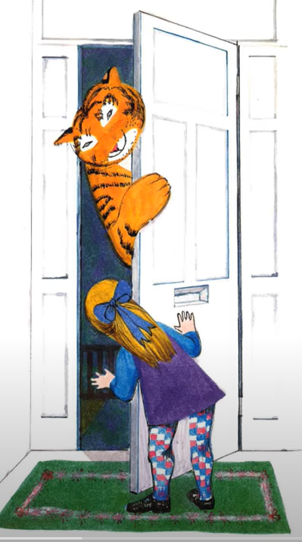
Can I write a speech bubble for the tiger?
19.01.21

Slide 2
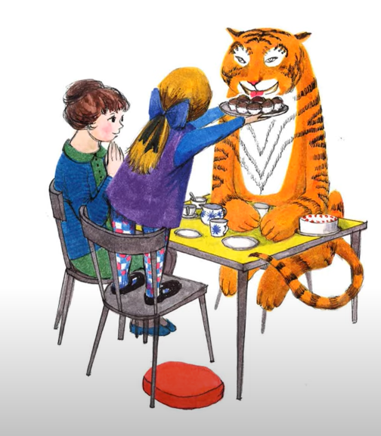
Can I write a thought bubble for mum?
19.01.21

Slide 3
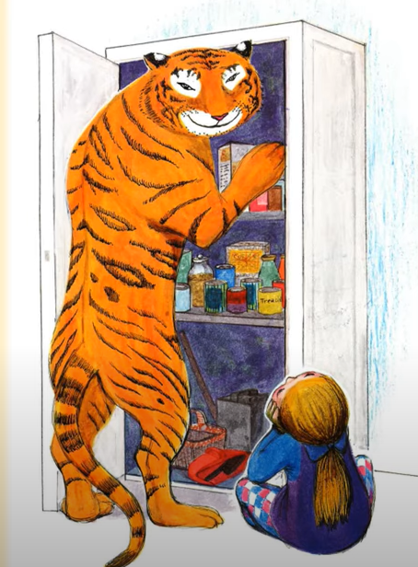
Can I write a speech bubble for Sophie?
19.01.21

