Slide 1
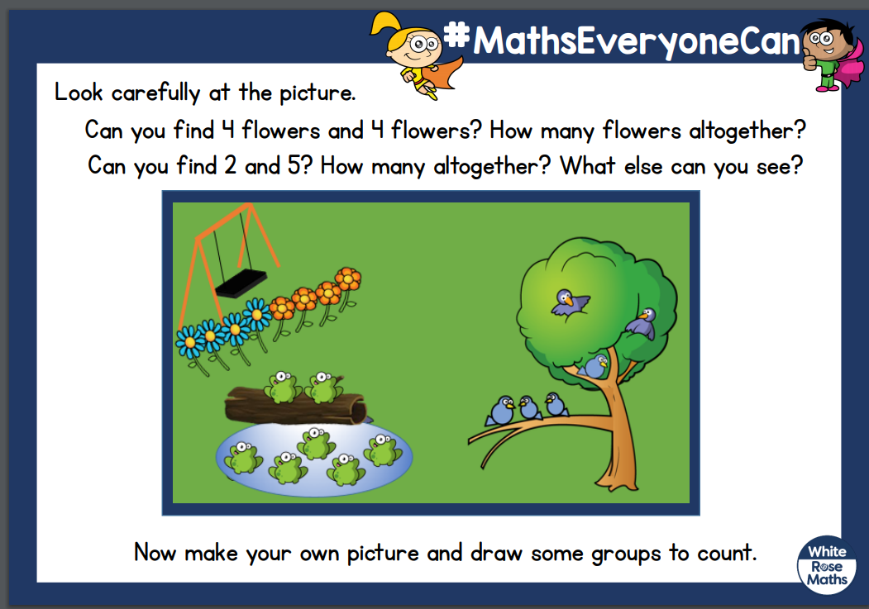

Slide 2
Here are some ten frames to help you draw out the question. 19.01.21

