Slide 1

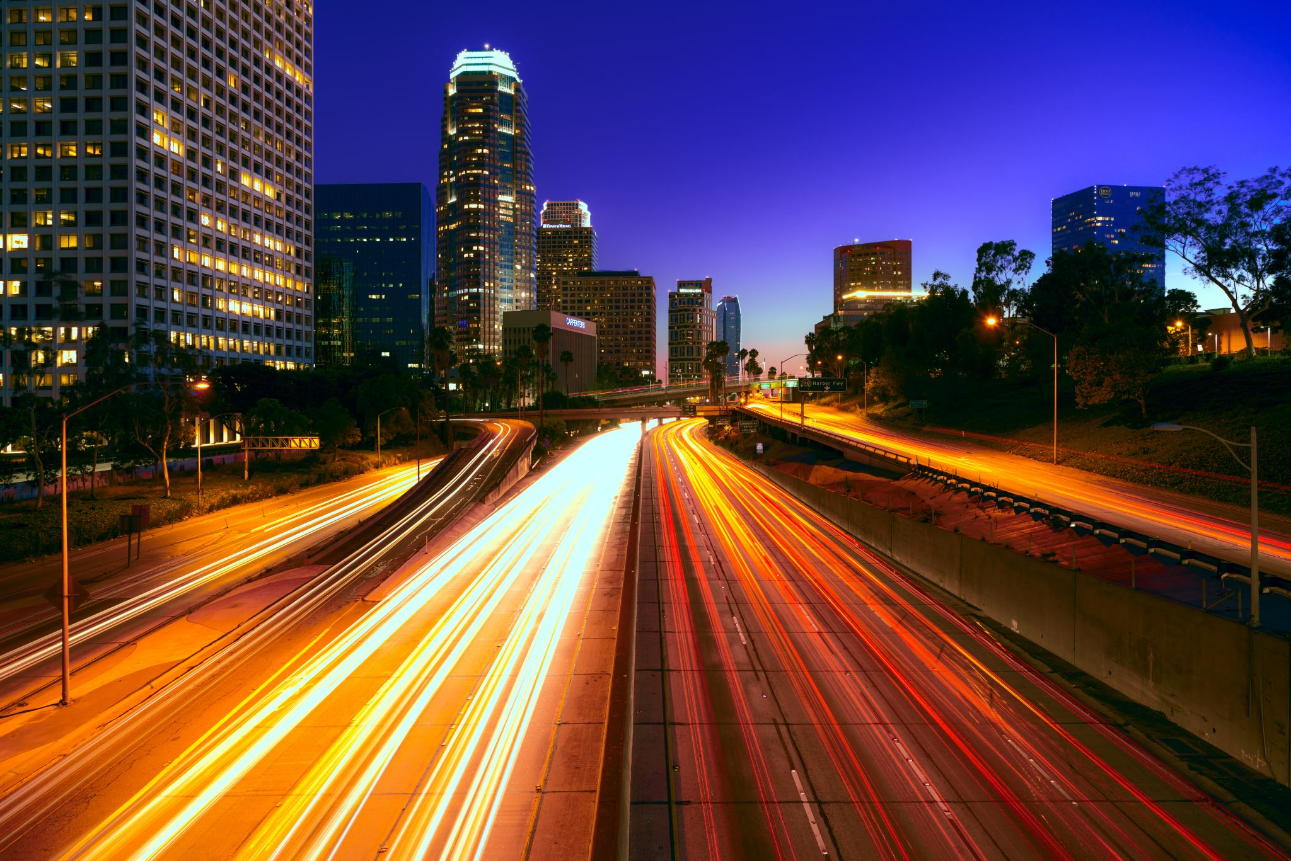


Light
For parents and carers
Thank you for supporting your child’s learning in science.
Before the session:
Please read slide 2 so you know what your child learning and what you need to get ready.
As an alternative to lined paper, slide 5 may be printed for your child to record on.
During the session:
Share the learning intentions on slide 2.
Support your child with the main activities on slides 3 & 4, as needed.
Slide 6 is a further, optional activity.
Slide 7 has a glossary of key terms.
Reviewing with your child:
Slide 8 gives an idea of what your child may produce.
Exploring that we need light to see things
Year 3 / Key Stage 2
Age 7-8

Slide 2


Light
Logo for section to sit inside roundel
Exploring that we need light to see things
Key Learning:
We see objects because our eyes can sense light.
Dark is the absence of light.
We cannot see anything in complete darkness.
Some surfaces reflect light.
Activities (pages 4-6): approx. 30 – 40 mins
Use lined paper, ruler and pencil.
Alternatively, print page 6 as a worksheet.
Find out more… (page 7): approx. 10 mins
Explore how people use lights in the dark to help others
I can…
recognise that you need light to see things.
2

Slide 3
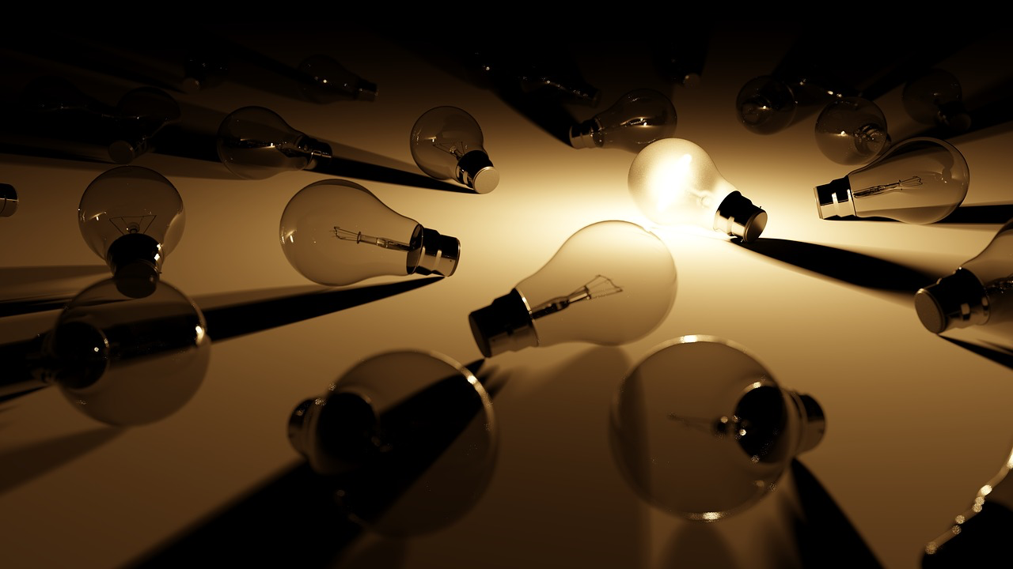

Explore, review, think, talk….
Logo for section to sit inside roundel
What do you already know about light?
(5 minutes)
Talk or think about what happens when you turn the lights off at home when it is dark.
What can you see?
What can’t you see?
Why do you think this is?
Watch this clip about light.
https://www.bbc.co.uk/bitesize/topics/zbssgk7/articles/z2s4xfr
Why do you think we can’t see light ‘move’?
What does it mean if something is a ‘source of light’?
3

Slide 4
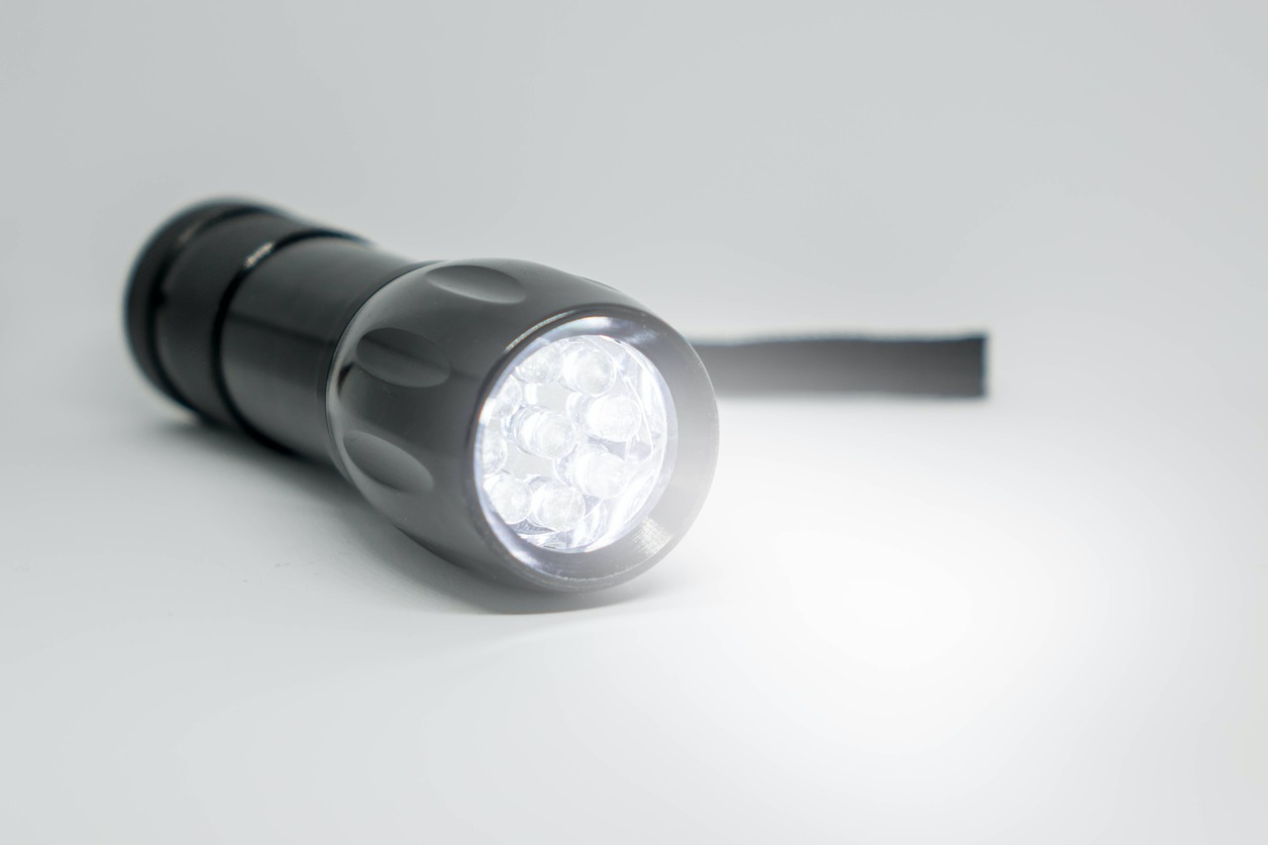
Watch, read, listen…
Logo for section to sit inside roundel
Seeing in the dark
(10 minutes)
Watch this clip about a torch as a light source:
https://www.bbc.co.uk/bitesize/clips/zb3s34j
What did you manage to see in the dark?
A light source is required to see objects in the dark.
If you shine a torch around a dark room, when you turn the torch off, you cannot see anything.
Some surfaces, such as the cat’s eyes reflect light from the torch.
4

Slide 5
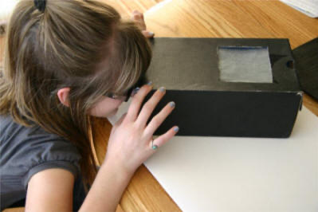
Instructions for Activity:
Use a shoe box, or any other cardboard box with a lid/opening. e.g. cereal box.
With an adult’s help, make one small eye hole at the end of the box and another at the other (to let in light).
Ask an adult, or someone else to put an object in the box and close the lid, so that it is as dark as possible.
Use your hand to cover the light hole and look through the small eye hole.
Can you identify the object?
What happens when you let different amounts of light in?
Children could control the amount of light that is entering, using their hand, paper or leaving it open.
Complete the table opposite to record your observations
Learning outcome: I can explore the need for light to see things
image courtesy of: https://www.dltk-teach.com/alphabuddies/mhabitat.html
Can the object be seen with very little light? | Can the object be seen with more light? | What might the object be? | Were you correct? Why? Why not?
Explain why some objects were easier to see than others. Try to use these scientific words in your explanation: material, shiny, dull, bright, surface, light, dark
5

Slide 6
Find out more about using lights in the dark
Logo for section to sit inside roundel
How do people use lights to help others in the dark?
(10 minutes)
BBC bitesize clip about a cliffside rescue:
https://www.bbc.co.uk/bitesize/clips/zygvr82
The use of lights and a rescue dog to assist in a cliffside rescue at night.
The report shows the preparation before the rescue and the wide variety of torches and lamps used.
Why do the rescue workers wear brightly coloured jackets?
What colours can we see the best in low-light conditions?
Put some similarly coloured counters in a box.
Cover the box with a blanket.
Go under the blanket and remember the colours you see.
Afterwards, tip the counters out into the light.
Is it harder to distinguish colours in low light conditions?
6

Slide 7
Glossary of terms
bright: If an object is bright it gives out or reflects much light.
dark (scientific): Dark is the absence of light.
dark (everyday): Very little amount of light.
dull: If an object is dull it is not shiny or bright.
light: Light is the form of energy that makes it possible for eyes to see.
material: Anything used for building or making something else.
shiny: Reflecting or glowing with light.
surface: The outside limit or top layer of something.
7

Slide 8
Possible learning outcome for reviewing your work: I can explore the need for light to see things
Unless they’re reflective, most objects can’t be seen in darkness
Can the object be seen with very little light? | Can the object be seen with more light? | What might the object be? Can you describe it? | Were you correct?
Yes – I can see something | Yes – it looks shiny | Necklace | I was correct
No – I can’t see anything | Yes – I can see something soft | Soft toy. It looks green and yellow | I was correct
No – I can’t see anything | Yes – it looks really black | Black Lego | I was correct
No – I can’t see anything | Yes – I can see some shiny writing | A black camera with the writing Sony on it. | I was correct
No – I can’t see anything | No - I still can’t see | Marbles. | I was incorrect – it was tinfoil
Explain why some objects were easier to see than others. Try to use these scientific words in your explanation: material, shiny, dull, bright, surface, light, dark Some objects are easier to see because the object is shiny or a bright colour. I. think dull objects are harder to see because there’s less light reflected from the surface of the object.
Some colours are easier to see in low-light conditions because of how our eyes receive the light reflected from the object.
Depending on the surface of the object, some light may be reflected which will allow us to see them in low-light conditions
8

