Slide 1
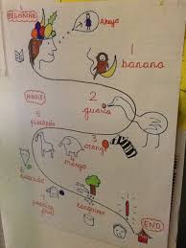
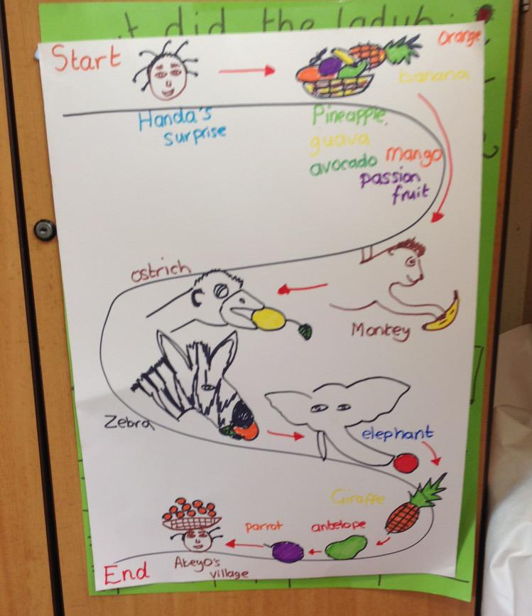
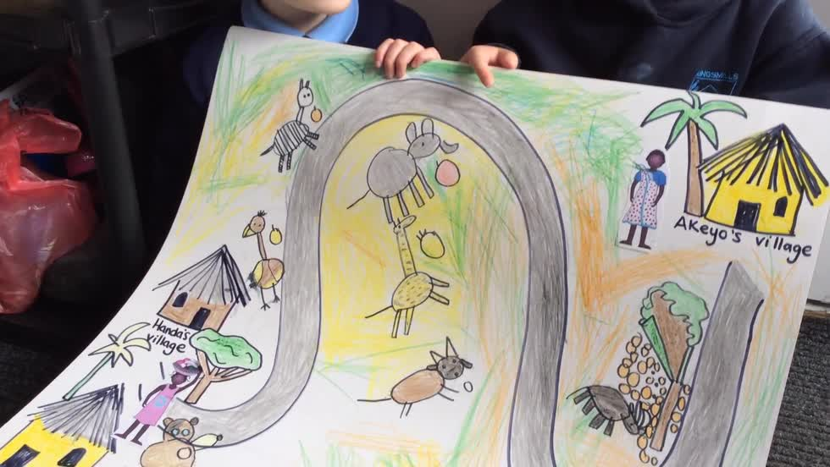
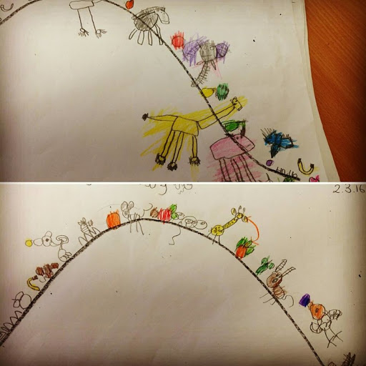
Can I draw a story map?
A story map is the story in picture form.
What happens at the beginning?
What happens along the way?
What happens at the end of the story?
Here are some examples of story maps for Handas Surprise.
(You do not have to include everything that happens, just what your child remembers)

