Slide 1

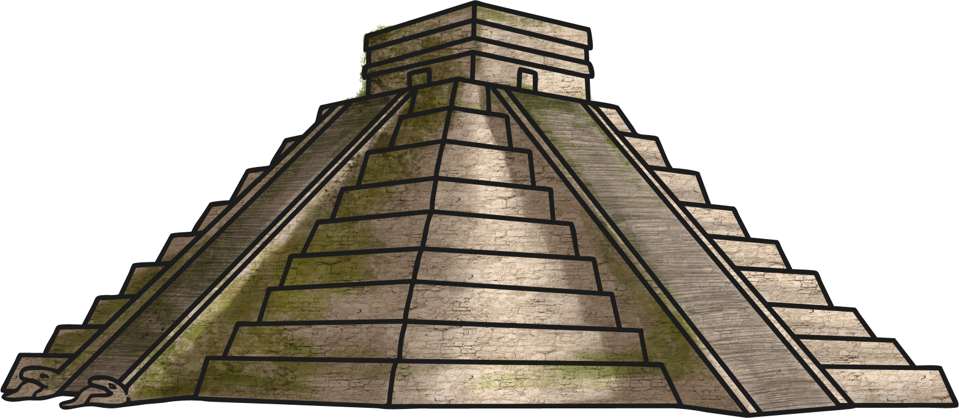


Slide 2

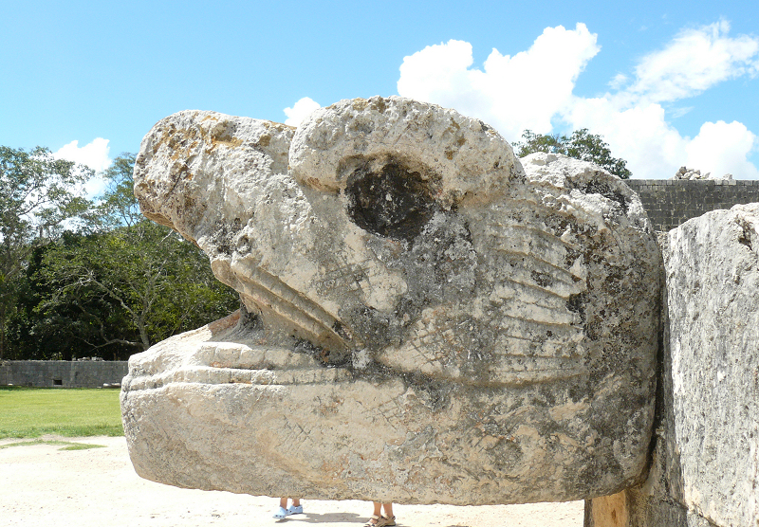
Photo courtesy of mike_fleming(@flickr.com) - granted under creative commons licence - attribution

Slide 3

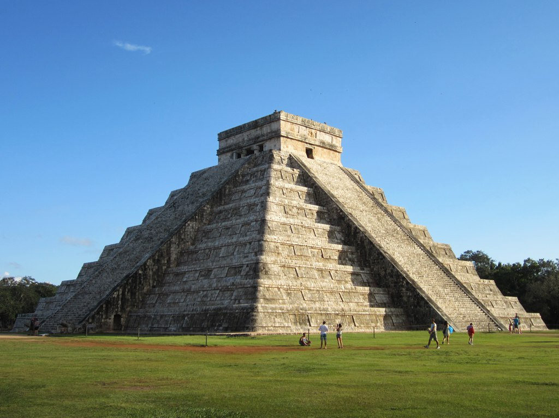
Photo courtesy of D-Stanley(@flickr.com) - granted under creative commons licence - attribution

Slide 4
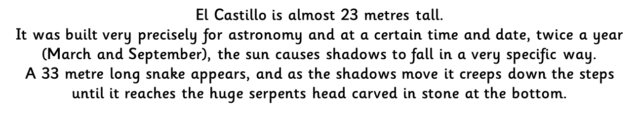
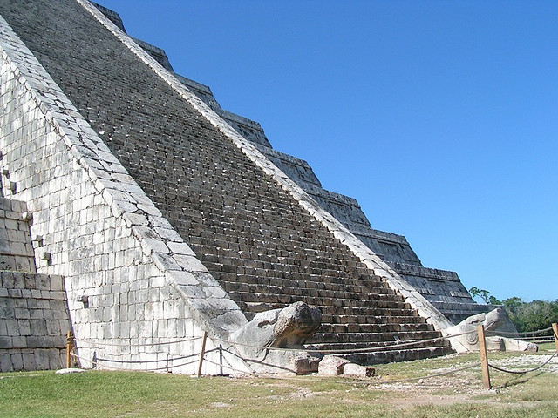
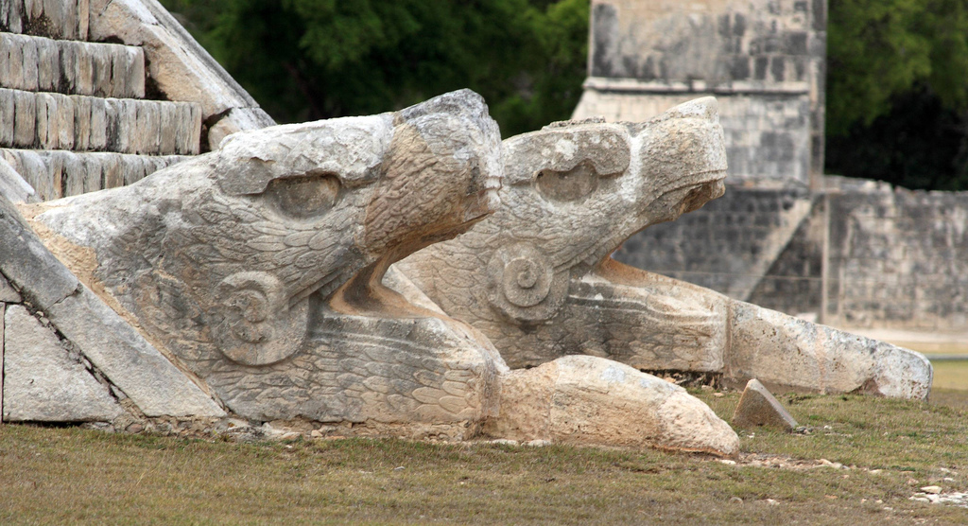
Photo courtesy of tristanf and Alaskan Dude(@flickr.com) - granted under creative commons licence - attribution

Slide 5
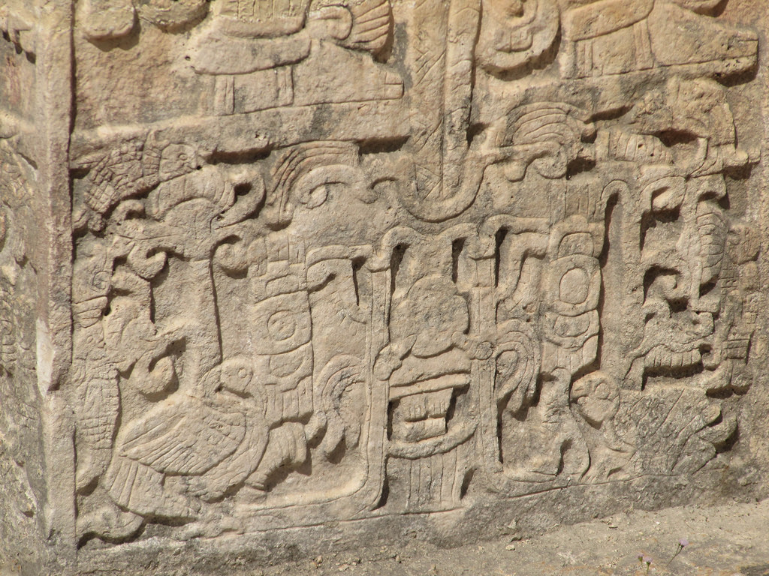
Photo courtesy of kelly.sikkema(@flickr.com) - granted under creative commons licence - attribution

Slide 6
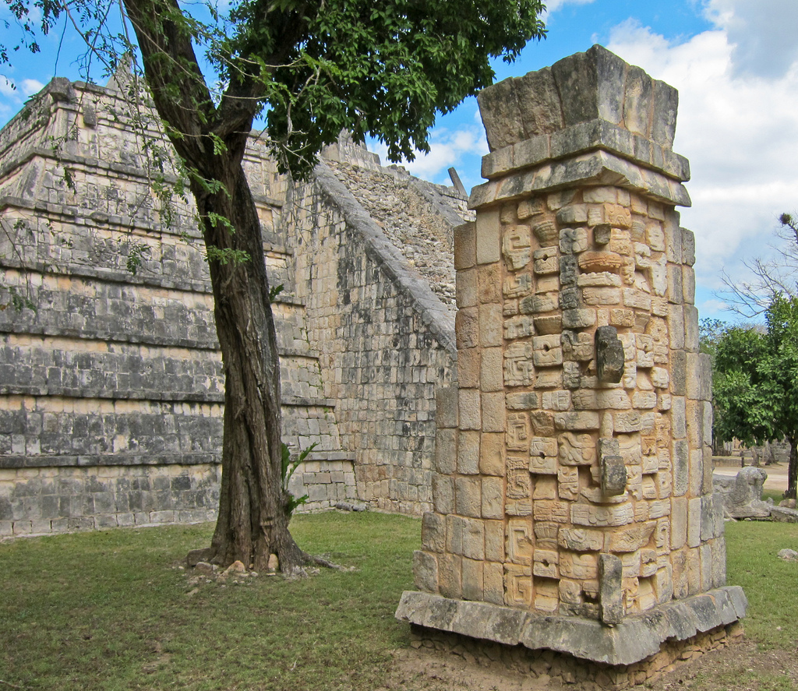
Photo courtesy of ex_magician(@flickr.com) - granted under creative commons licence - attribution

Slide 7
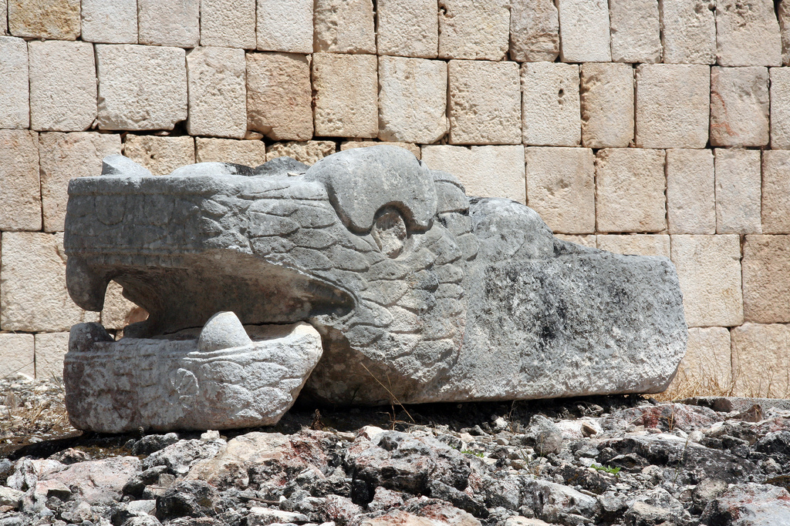
Photo courtesy of pas cal(@flickr.com) - granted under creative commons licence - attribution

Slide 8
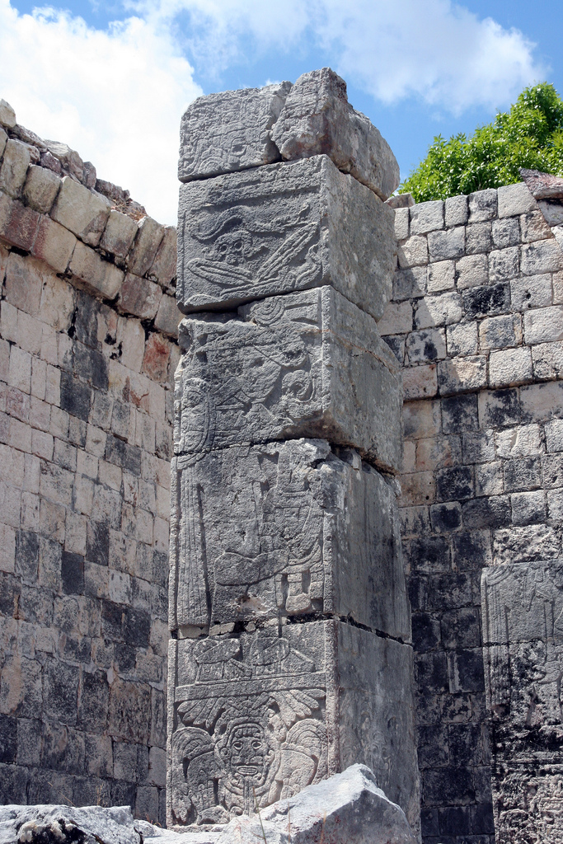
Photo courtesy of redeo(@flickr.com) - granted under creative commons licence - attribution

Slide 9
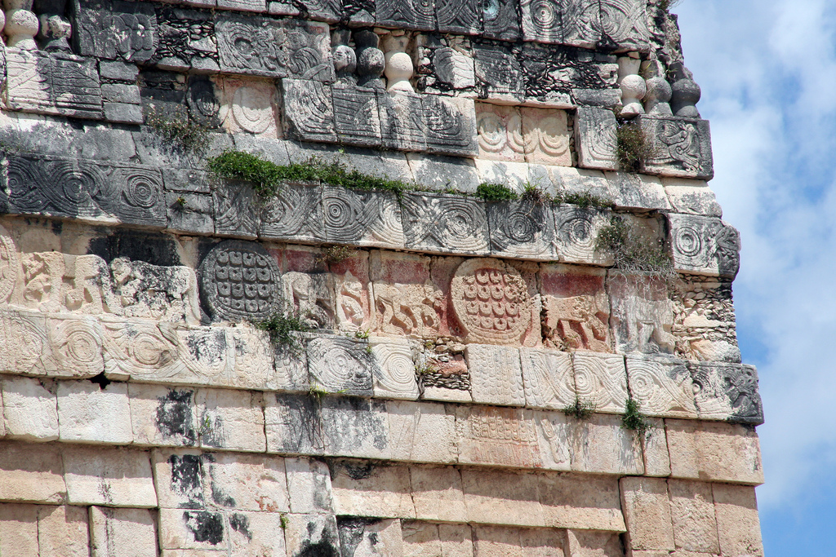
Photo courtesy of Pascal(@flickr.com) - granted under creative commons licence - attribution

Slide 10

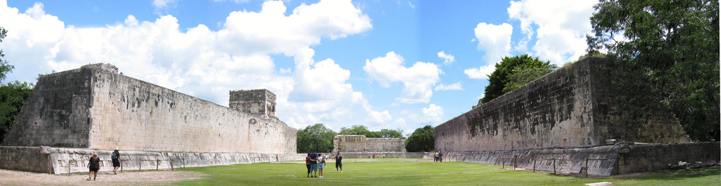
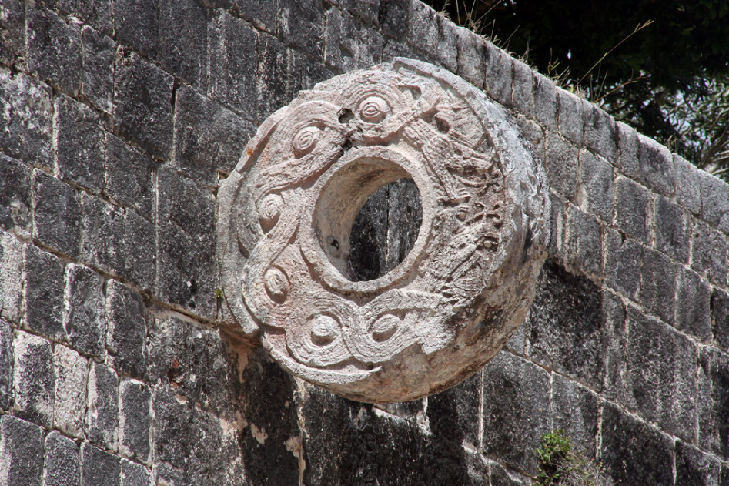
Photo courtesy of paul mannix(@flickr.com) - granted under creative commons licence - attribution
Photo courtesy of redeo(@flickr.com) - granted under creative commons licence - attribution

Slide 11
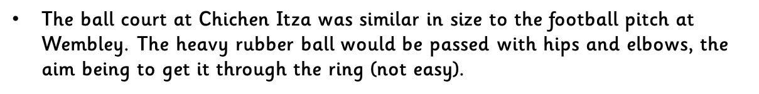
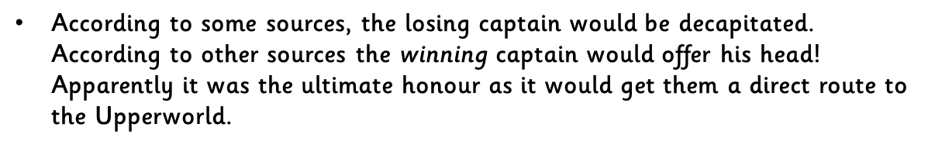
Photo courtesy of paul mannix(@flickr.com) - granted under creative commons licence - attribution

Slide 12

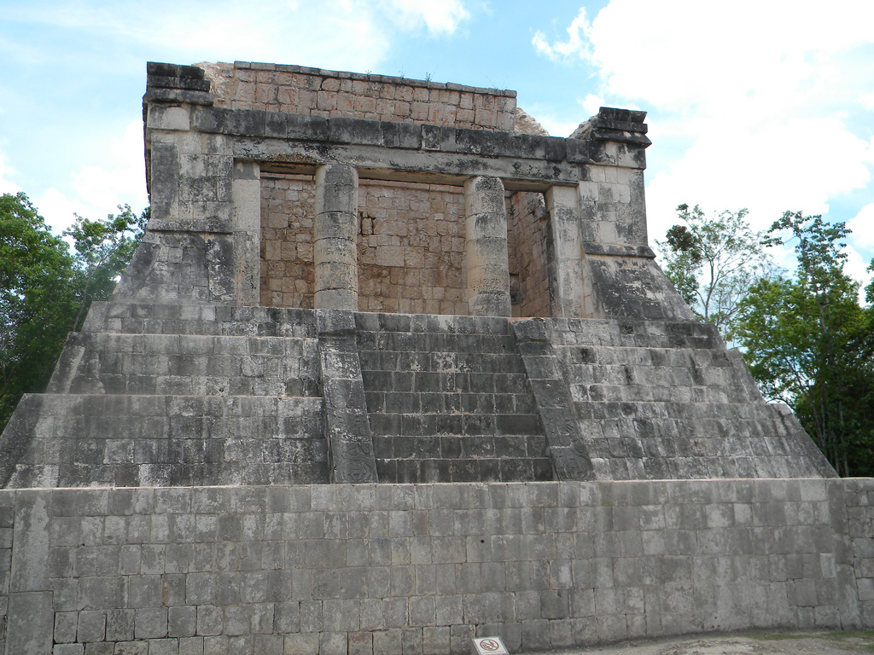
Photo courtesy of tonya2hadassah(@flickr.com) - granted under creative commons licence - attribution

Slide 13
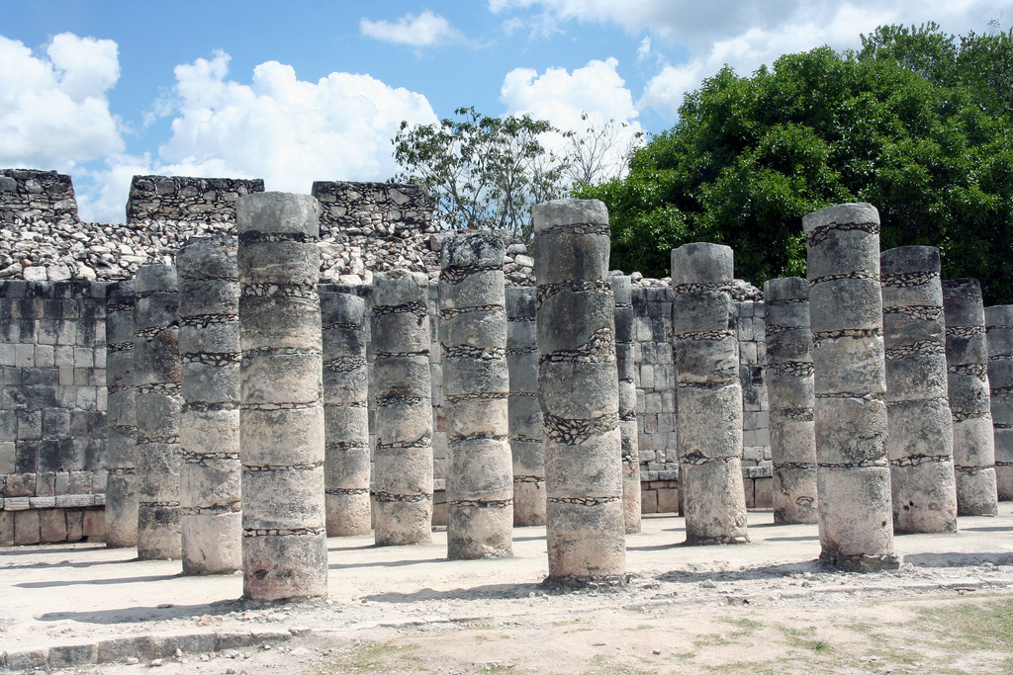
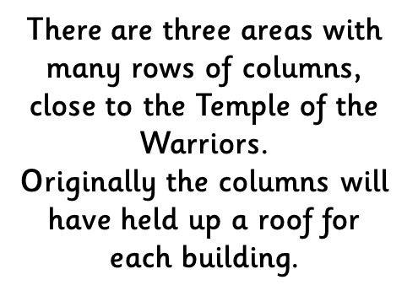
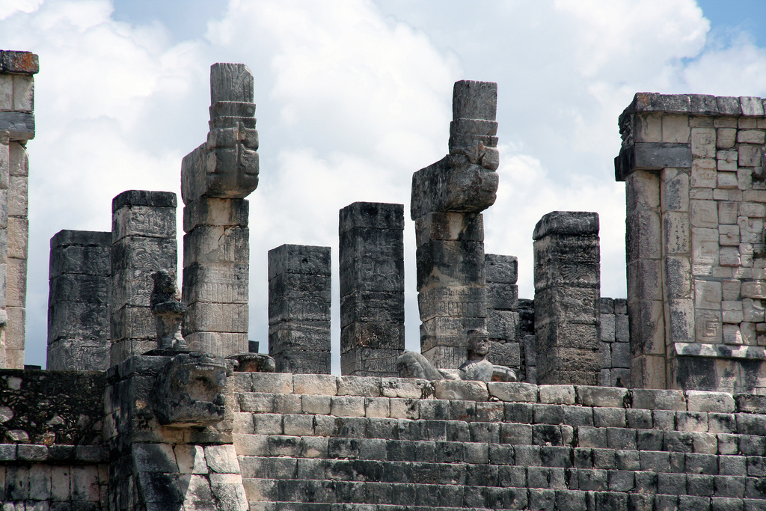

Photos courtesy of redeo(@flickr.com) - granted under creative commons licence - attribution

Slide 14


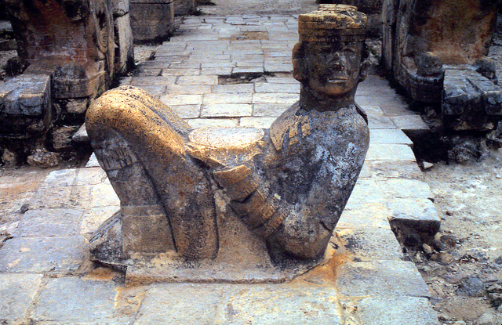
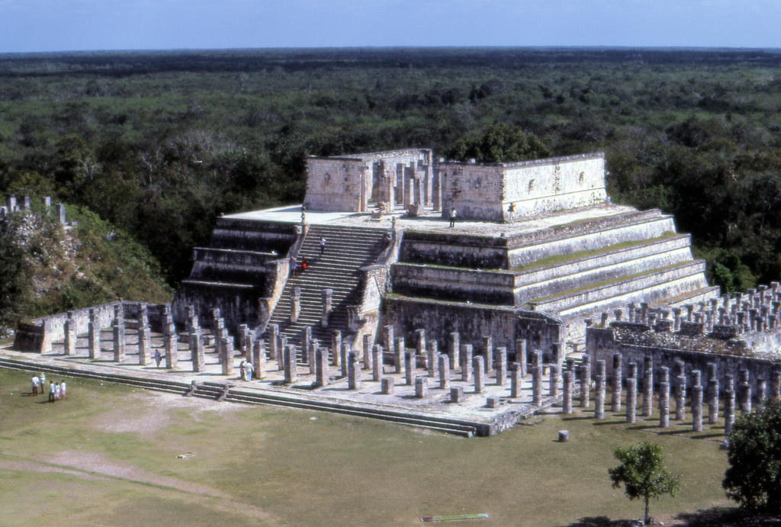

Photos courtesy of jimg944 and olibac(@flickr.com) - granted under creative commons licence - attribution

Slide 15

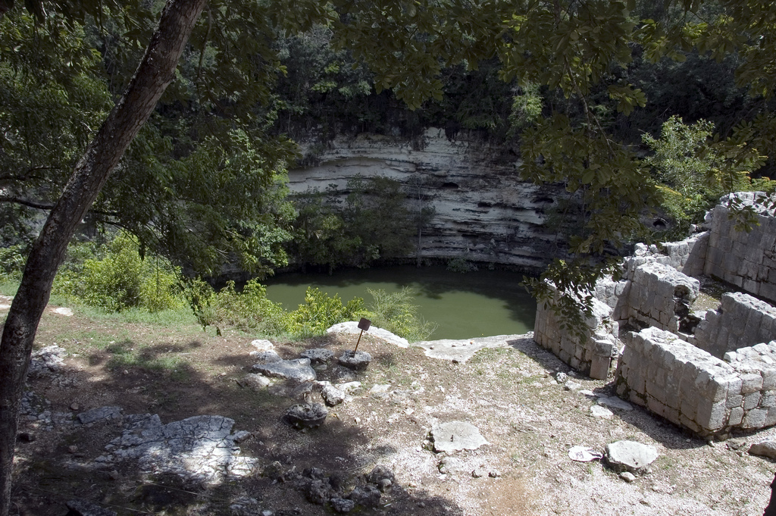
Photos courtesy of jimg944 and BruceHH (@flickr.com) - granted under creative commons licence - attribution

Slide 16
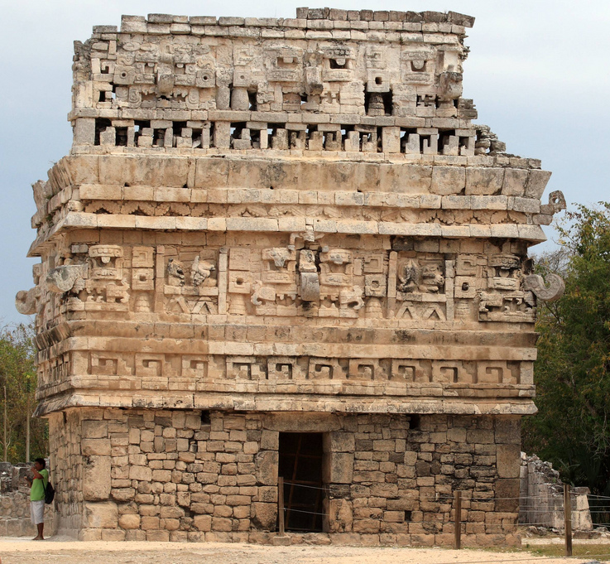

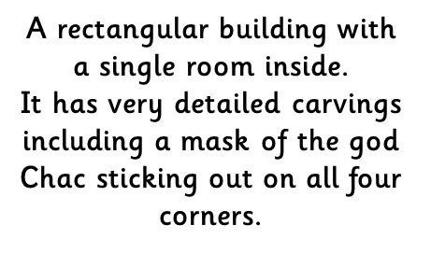
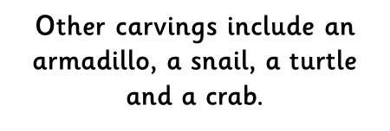

Photo courtesy of Alaskan Dude(@flickr.com) - granted under creative commons licence - attribution

Slide 17

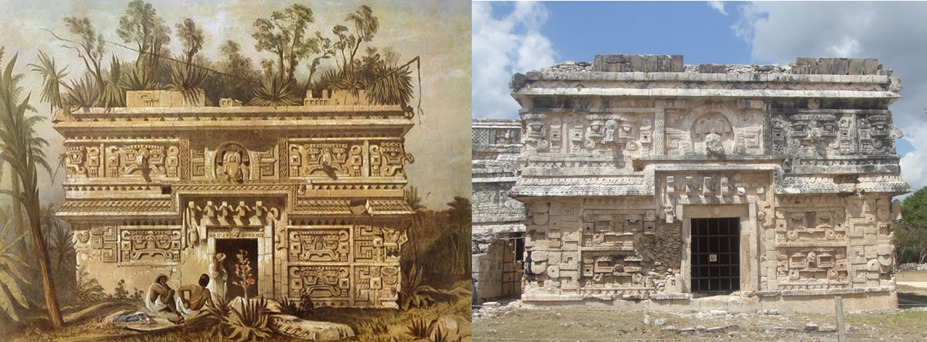
Photo courtesy of grahamc99(@flickr.com) - granted under creative commons licence - attribution

Slide 18

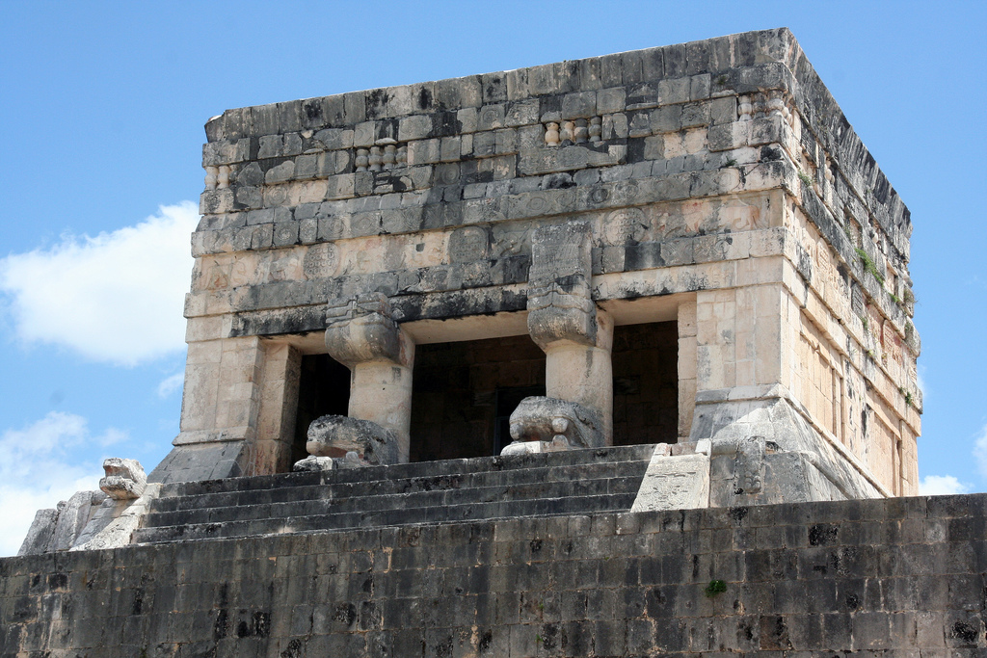

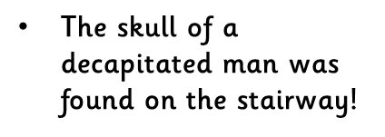

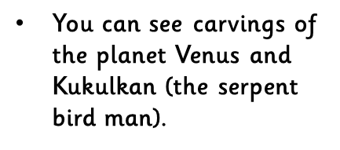
There are various stone platforms at Chichen Itza, probably used as podiums for rituals, ceremonies or dances.
Photo courtesy of redeo(@flickr.com) - granted under creative commons licence - attribution

Slide 19

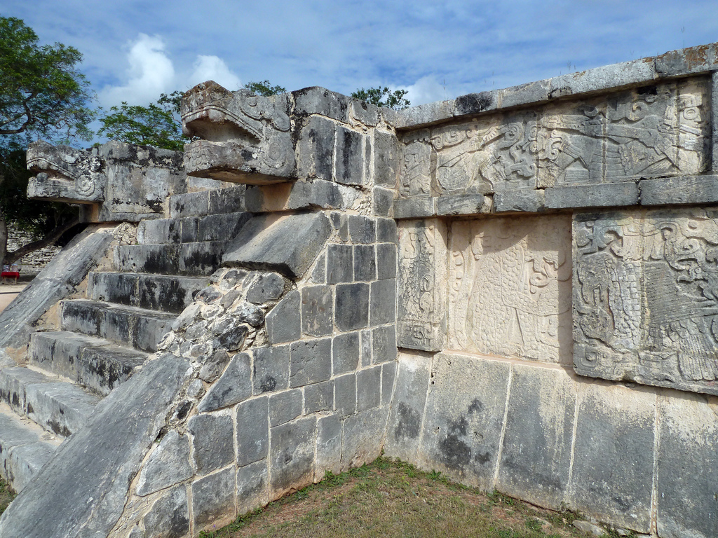
Photo courtesy of Rob Young @ flickr.com -granted under creative commons licence - attribution

Slide 20

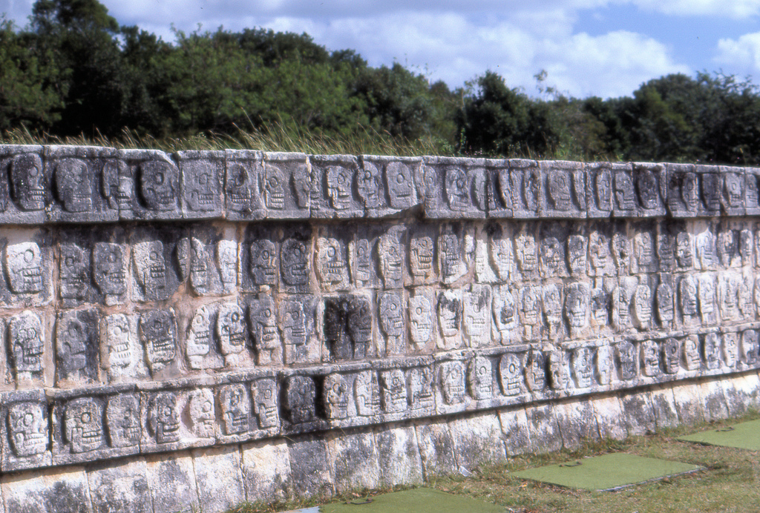
Photo courtesy of jimg944 @ flickr.com -granted under creative commons licence - attribution

Slide 21


