Slide 1
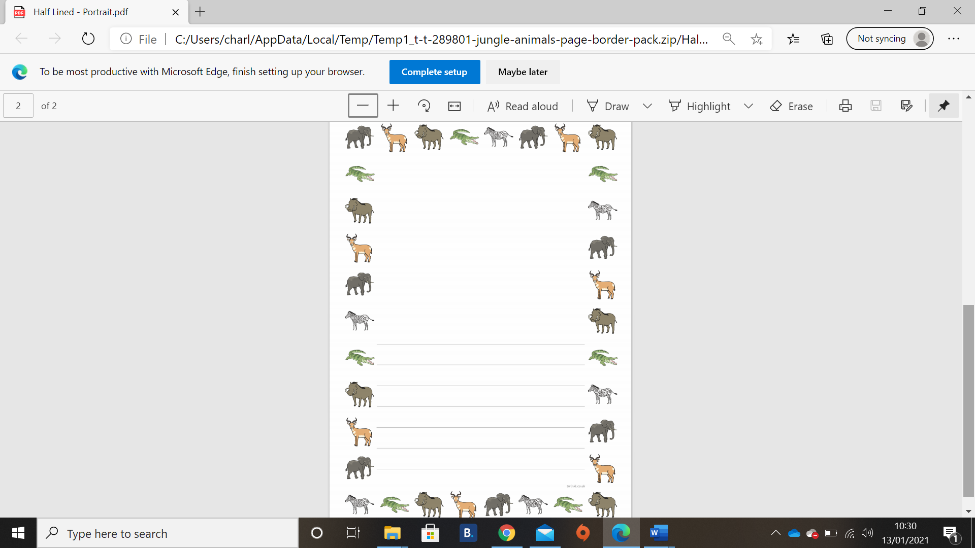
Can I draw a picture and write about my chosen animal? 14.01.21

