Slide 1
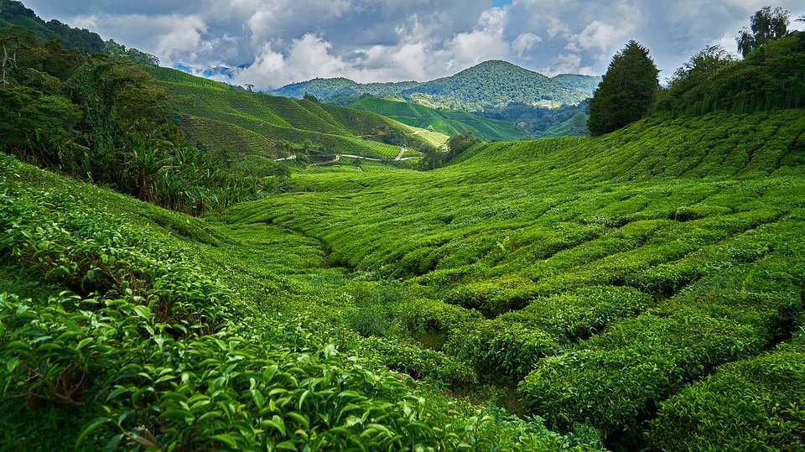
Expanded noun phrases can convey complicated information concisely
Faraway Fiction

Slide 2
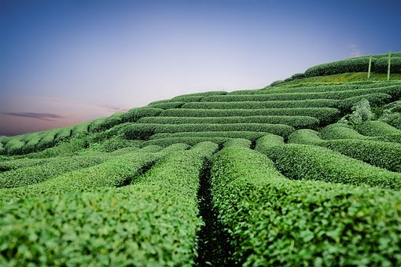
Nouns and Noun Phrases
Tashi shivered in the cold, blue morning.
Rows of glossy green tea bushes curved into the distance like waves.
What is the head noun in each noun phrase?

Slide 3
Nouns and Noun Phrases
Tashi shivered in the cold, blue morning.
Rows of glossy green tea bushes curved into the distance like waves.
What is the head noun in each noun phrase?
Which words make up the noun phrase?

Slide 4
Nouns and Noun Phrases
The words in the noun phrase depend on the head noun and build on its meaning.
it
Tashi shivered in the cold, blue morning.
Rows of glossy green tea bushes curved into the distance like waves.
We can replace a noun phrase with a pronoun.
they
What is the head noun in each noun phrase?
Which words make up the noun phrase?

Slide 5
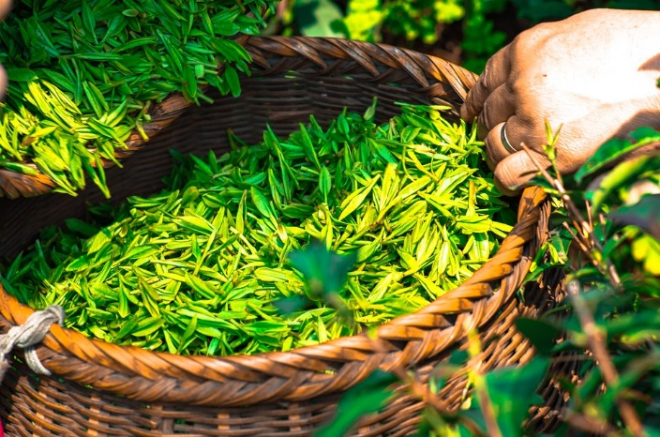
How to build Expanded Noun Phrases
Add words before the head noun:
The leaves astonished Tashi.
The fresh, green leaves astonished Tashi.
leaves
Add words after the noun:
The leaves in the basket astonished Tashi.
The leaves, spangled with tiny droplets of water, astonished Tashi.
Or you can do both at once:
The fresh, green leaves in the basket astonished Tashi.

Slide 6
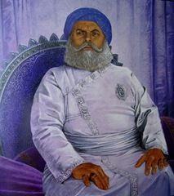
How to build Expanded Noun Phrases
Different types of words, phrases and clauses can all be used in an expanded noun phrase.
adverb
adjectives
determiner
the rather stern royal tea-taster
Tea-taster
the tea-taster with a moustache like a spread of snowy wings
Prepositional phrase
The tea-taster, who travelled the world to taste tea, examined the leaves.
Relative clause

Slide 7
Spotting Expanded Noun Phrases
With long and delicate fingers they groomed her thick dark hair.
On the cart was a grand chair with cushions and a tall back, like a throne.
The little man, who was the Deputy Chief Tea-Boiler, woke up.
Identify the head nouns.
Which other words make up the noun phrase?
Hint: Can you replace them with a pronoun?
ANSWERS

Slide 8
Spotting Expanded Noun Phrases
With long and delicate fingers they groomed her thick dark hair.
On the cart was a grand chair with cushions and a tall back, like a throne.
The little man, who was the Deputy Chief Tea-Boiler, woke up.
Identify the head nouns.
Which other words make up the noun phrase?
Hint: Can you replace them with a pronoun?
ANSWERS

Slide 9
Making Complicated Information Concise
On those wild mountain-tops above the clouds were things Tashi was afraid of.
There is quite a lot of information conveyed in this expanded noun phrase.
There are tops.
They are the tops of mountains.
They are the mountains mentioned before.
The mountains are wild.
You can give your reader lots of detail to create a vivid picture using a few well-chosen words.
There are clouds.
The mountains are so high they are above the clouds.

Slide 10
Making Complicated Information Concise
He was a bad-tempered man with a beaky nose and eyes like sharp little stones.
How many ideas can you find in this expanded noun phrase?

Slide 11
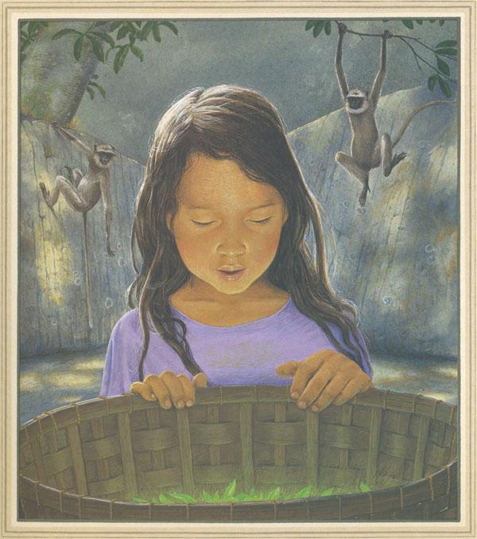
Making Complicated Information Concise
Tashi stared in wonder at the glowing emerald leaves which had appeared magically in her basket.
The kindly monkeys in the trees had given a precious gift to Tashi.
Now try to collect as many ideas about this image as you can.
Write these down as words, phrases or sentences.
Amazed Tashi, who had felt so sad when the monkeys took her mother’s basket, now understood.
Next, pick the most impactful ideas and condense into a vivid expanded noun phrase.
IDEAS

