Slide 1
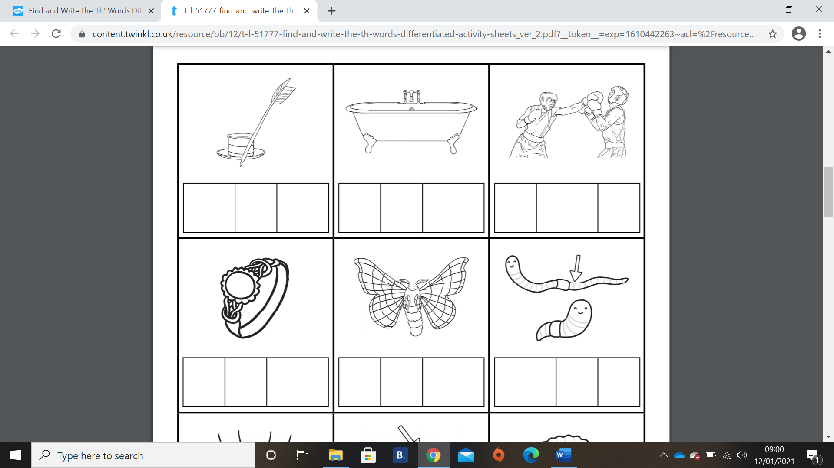
Can I write these ‘th’ words?
When writing in a phoneme frame you put only one sound in a box, so the th sound would be together in one box like the first example.
th
i
n

Slide 2
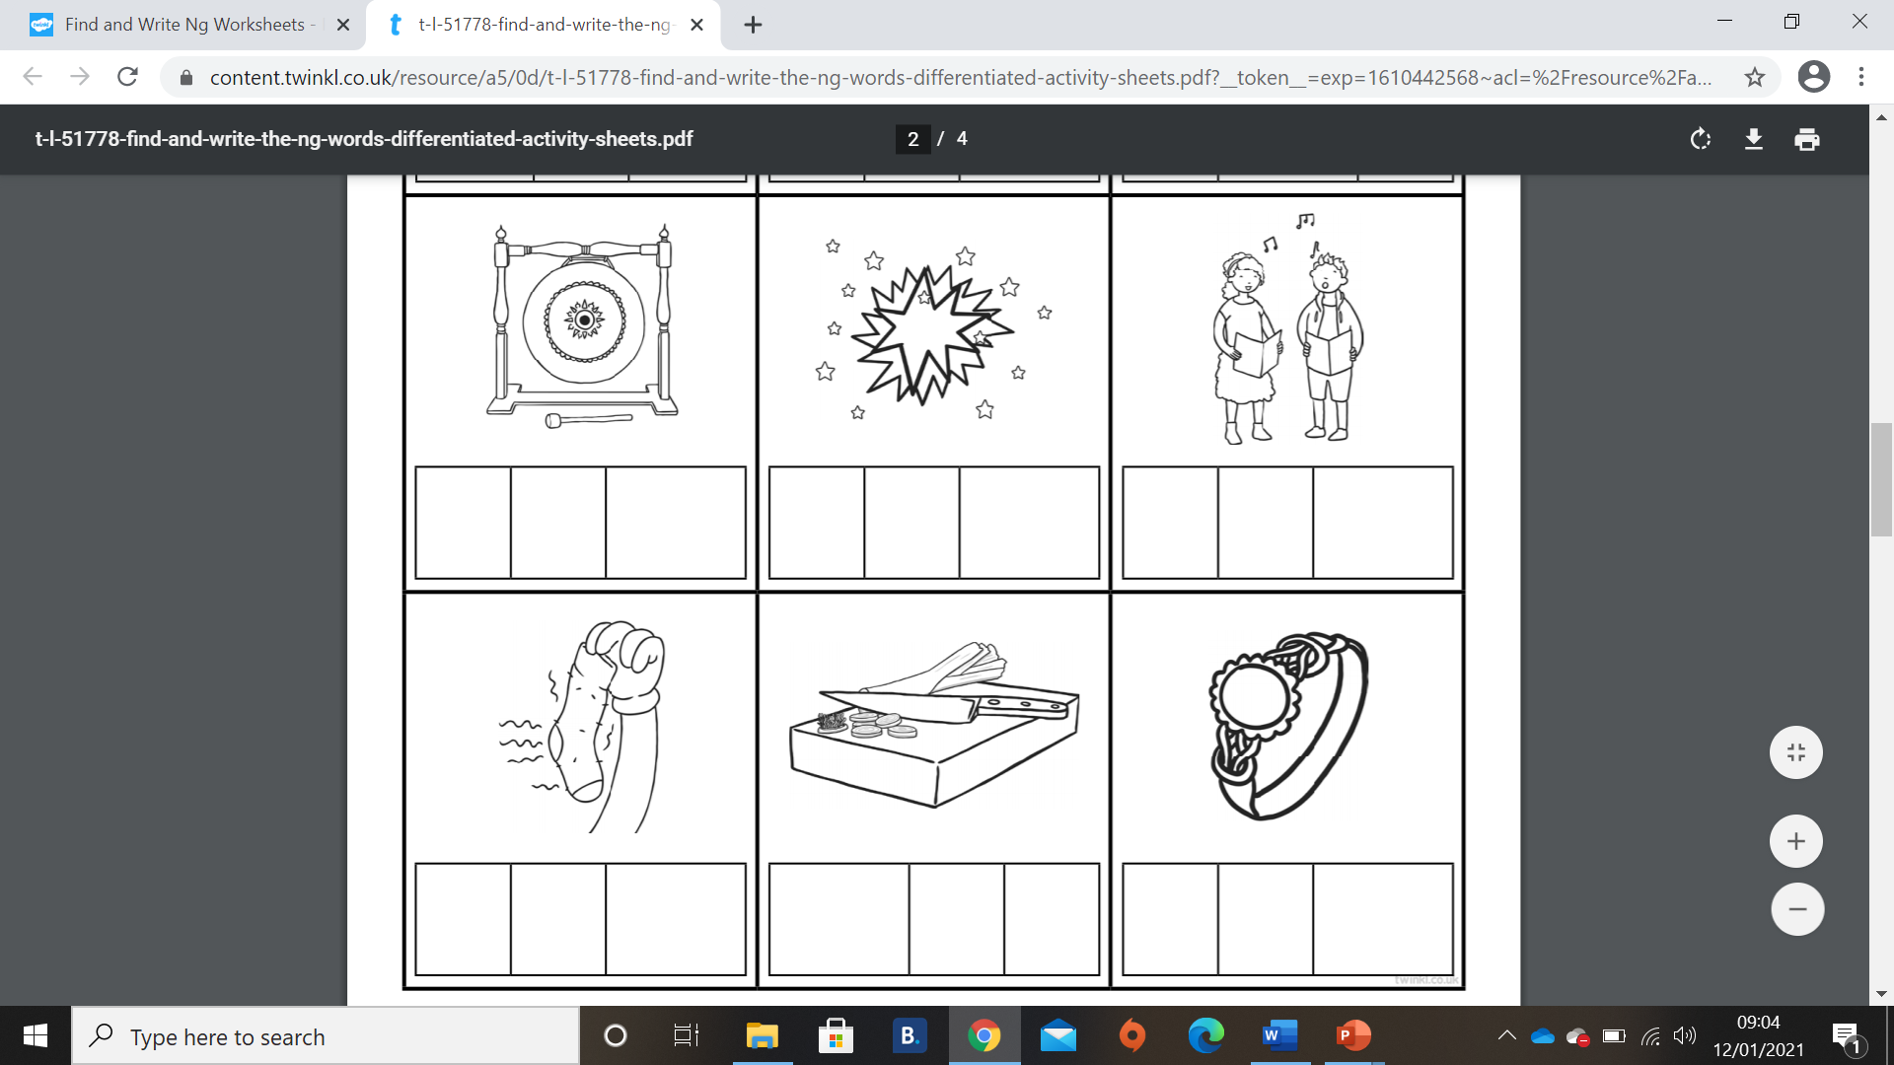
Can I write these ‘ng’ words?

