Slide 1
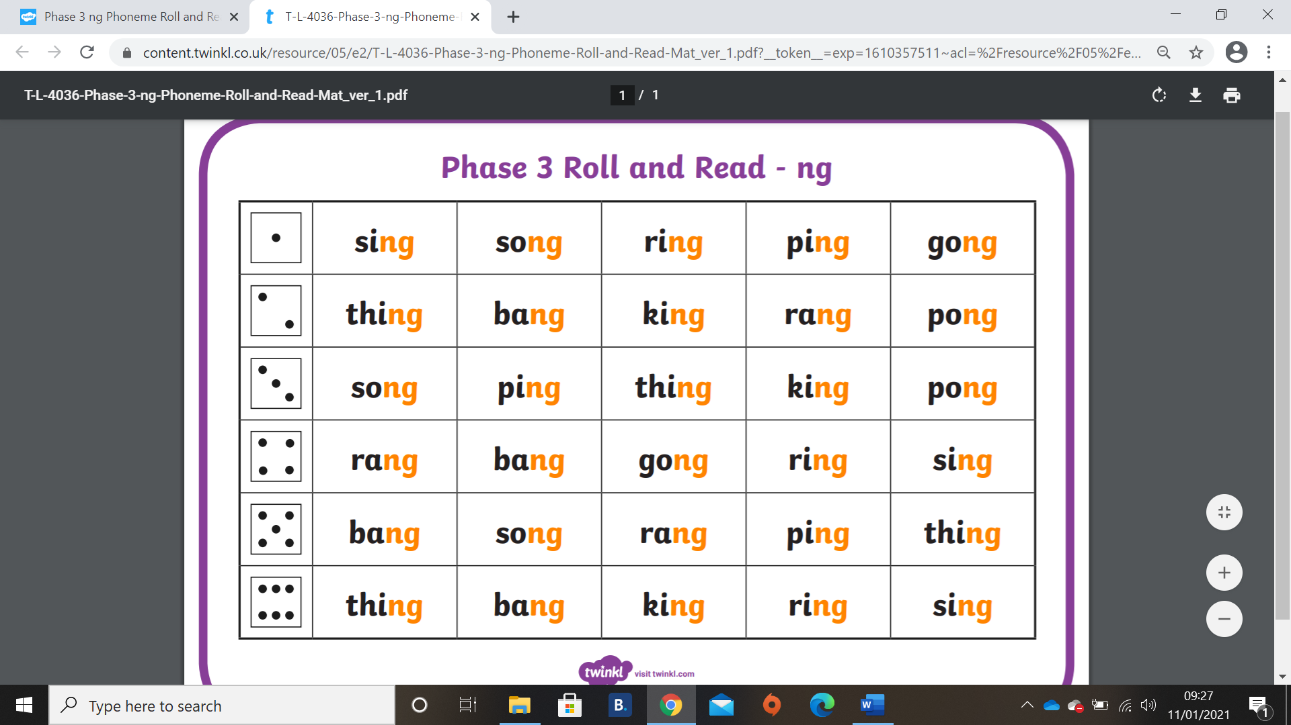
You will need a dice and a counter each.
Roll the dice to see which number you will start on, then every time you roll again, move across the board to the word that is in the next column but matching the number you rolled (read it out loud). The winner is the first to get to the end of the board.

