Slide 1
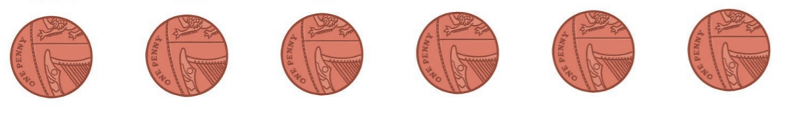
If you do not have any 1ps to use, you can print these one off ☺

Slide 2
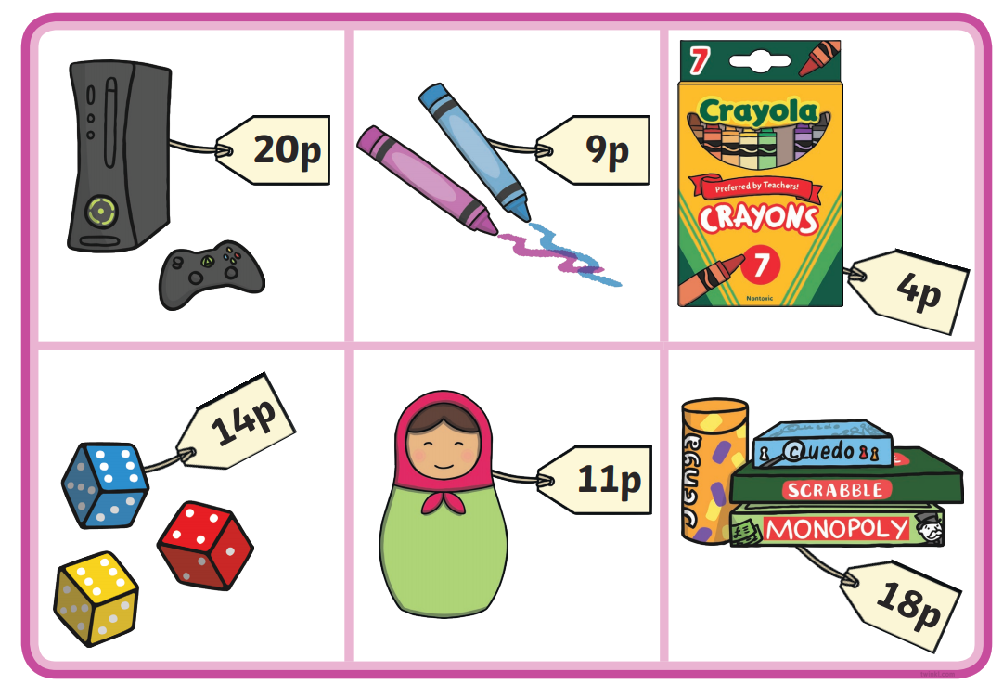

Slide 3
