Slide 1
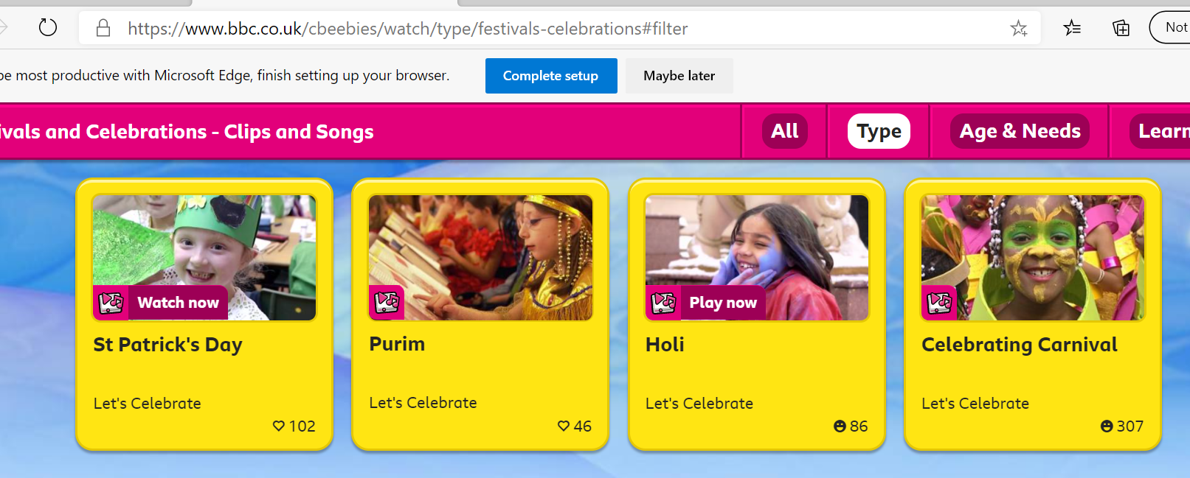
Read together, share and talk about:
1. https://www.bbc.co.uk/cbeebies/watch/type/festivalscelebrations#filter
CBeebies clips of celebrations around the world.
2. Look at photographs or remember and to talk about celebrations they have been part of, other than birthday parties. What are their memories?
3. Can I draw a picture of how you celebrated Christmas or New Year?

