Slide 1
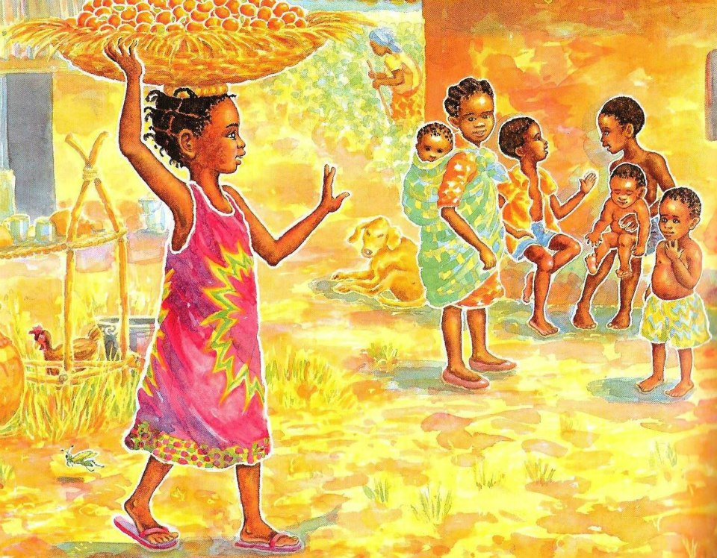
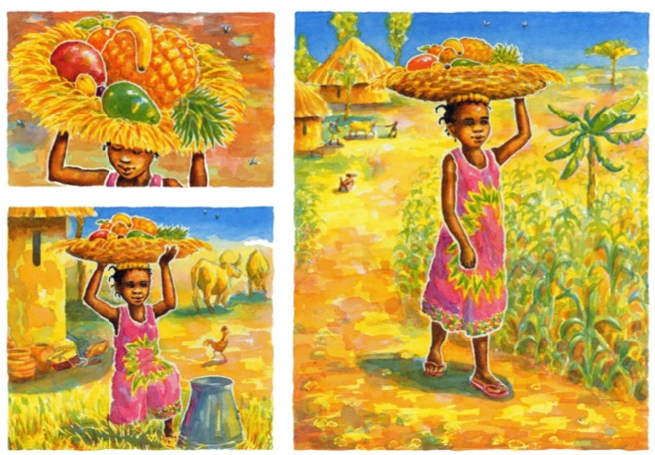
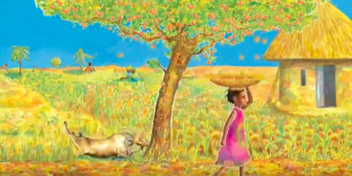
Can I discuss the questions with my grown up? 11.01.21
Handa lives in a different country to us. (Africa)
Where do you think it is? Do you think it is a hot or cold country? Why?
What do you notice about the houses?
What do you notice about the clothing?
Can you find Handas country on a map?
Can you think of any similarities or differences between where Handa lives and where you live?

Slide 2
Can I write a sentence about Handa’s country? 11.01.21
Remember when writing with your child, keep it simple, for example your sentence could be, It is hot or The grass is yellow.
Say the sentence a couple of times together first, let them say the sentence, count how many words are in the sentence – when writing have a go a word at a time and let your child use their sound mat to find the sounds they can hear. (do not worry about spelling things correctly – let them have a go) ☺

