Slide 1
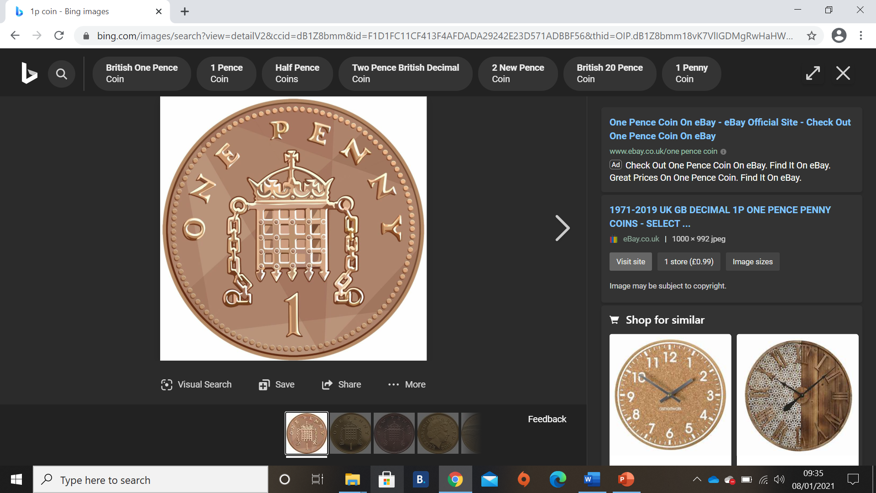
Here is a 1p coin.
We can use lots of 1p’s to help us make different amounts. Have a look in the boxes below, using your careful counting, can you check how much is inside the box?
2p
3p
4p

Slide 2
Can I work out how much money are in these boxes? 11.01.21 (write your answers in the space below each box)

