Slide 2
Aim
To understand who William Morris was.
To recognise examples of William Morris patterns.

Slide 3
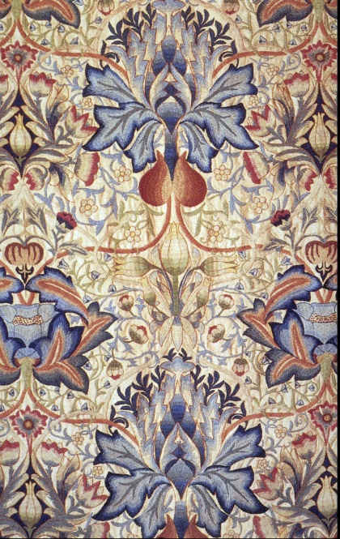
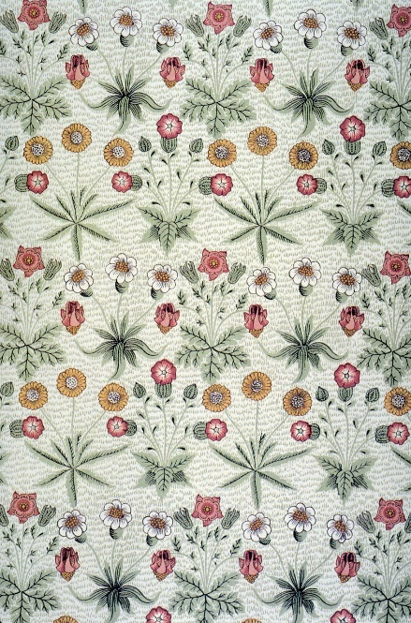
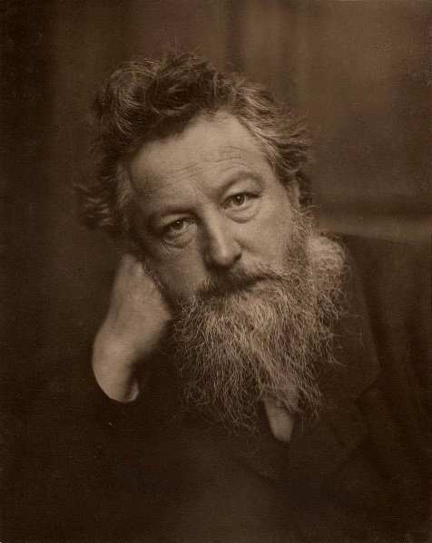
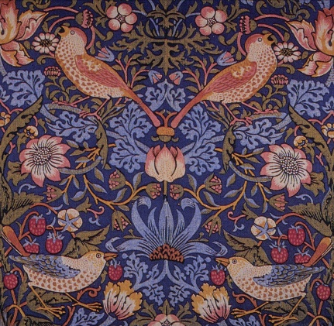
William Morris
‘Have nothing in your house that you do not know to be useful, or believe to be beautiful.’
- William Morris

Slide 4


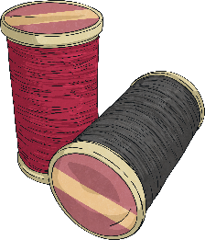


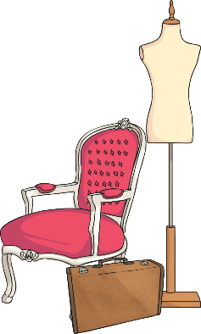
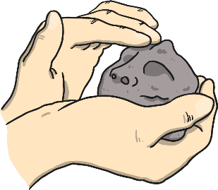
Who Was William Morris
William Morris was born on 24th March, 1834.
He was the son of a wealthy business man.
He originally was going to become a priest but decided to devote his life to art instead.
He became a poet, artist and manufacturer.
He had lots of friends who were writers, poets and artists.
His career in designing started when he decorated his own house in London.

Slide 5
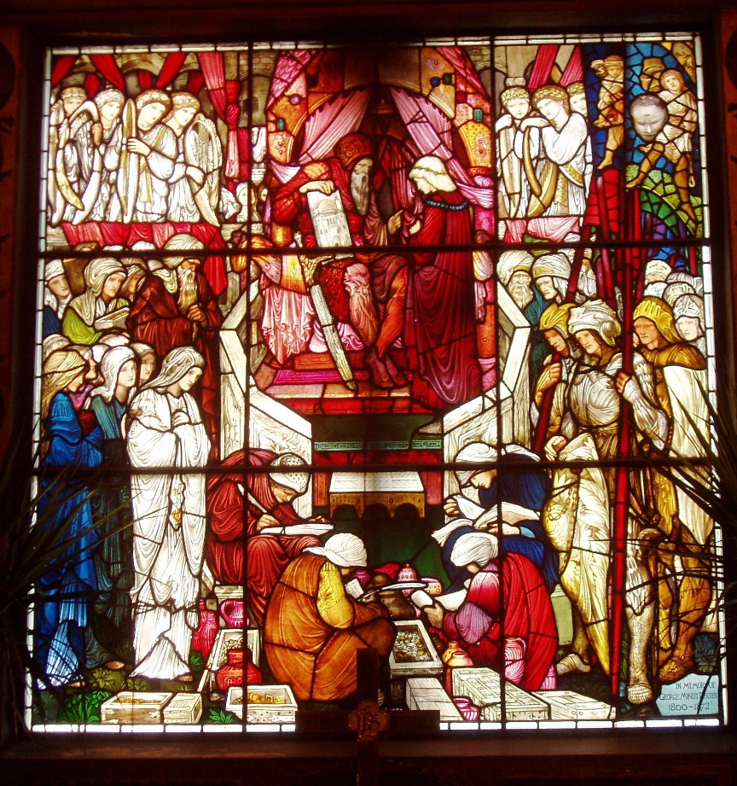
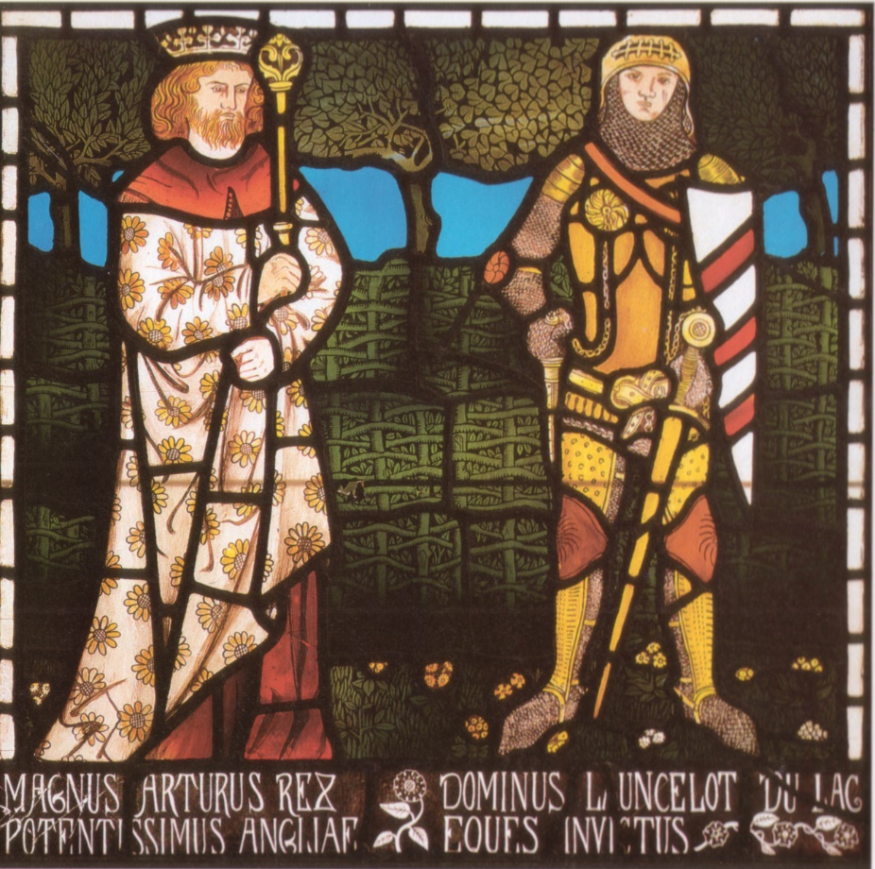
Who Was William Morris
He made stained glass windows…

Slide 6
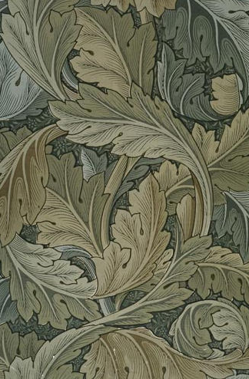
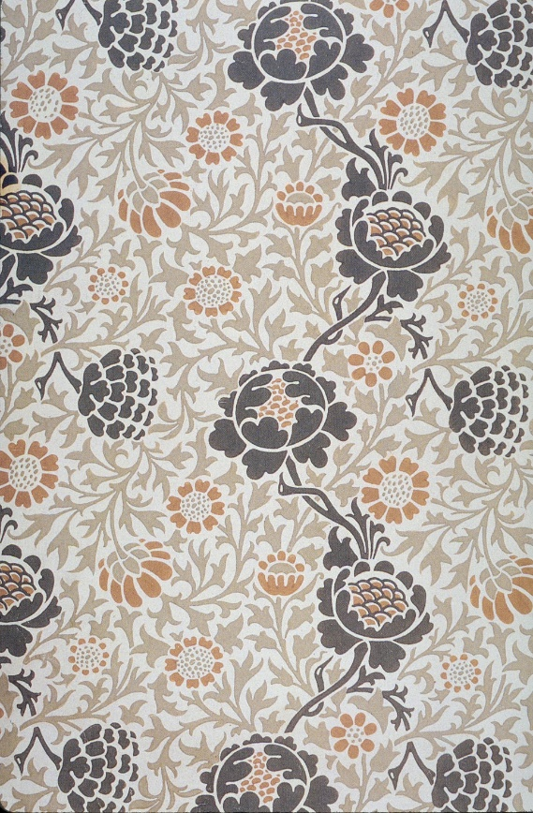
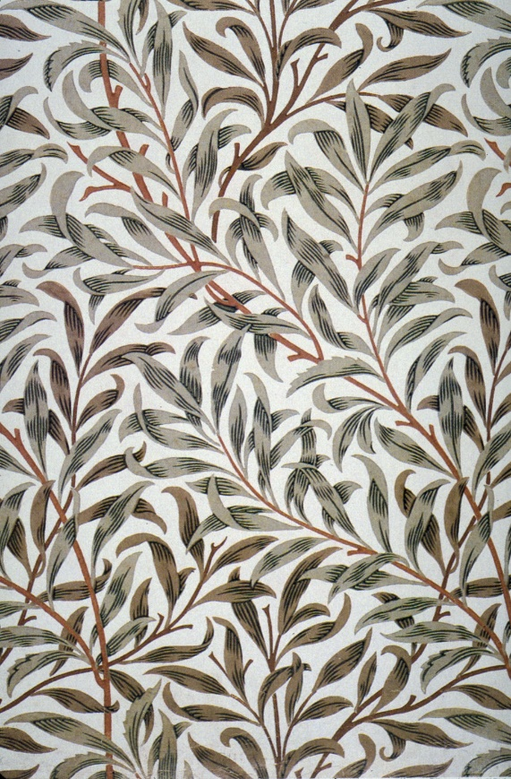
Who Was William Morris
He made patterned wallpaper…

Slide 7
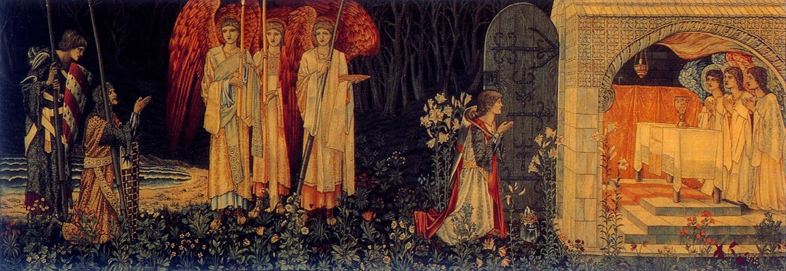
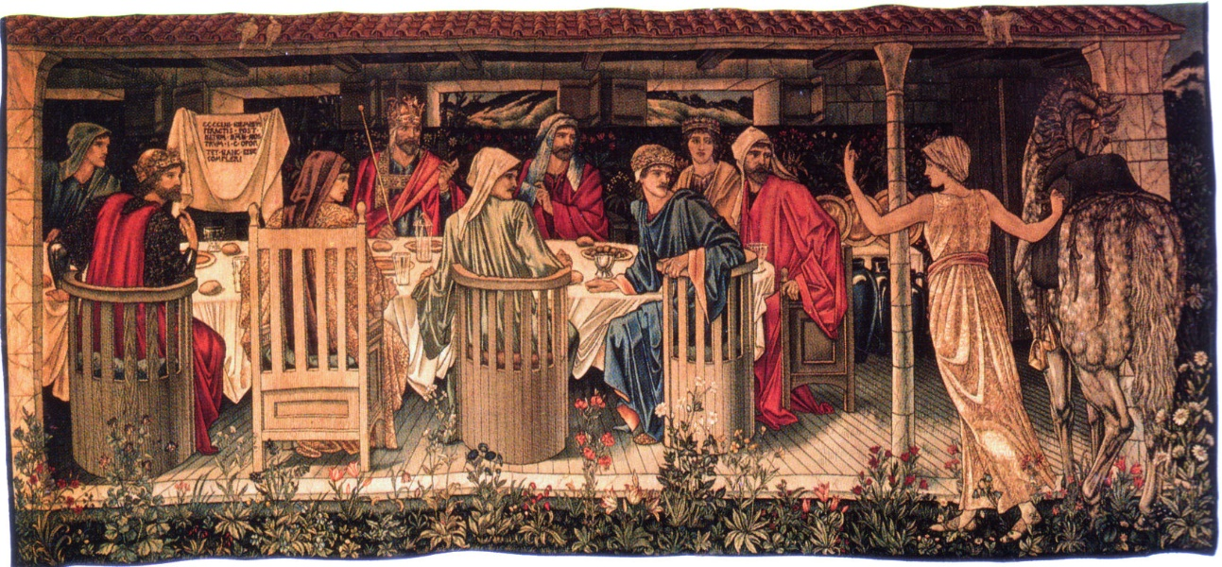
Who Was William Morris
He made tapestries…

Slide 8

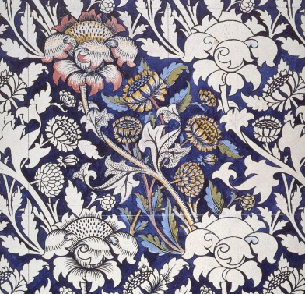
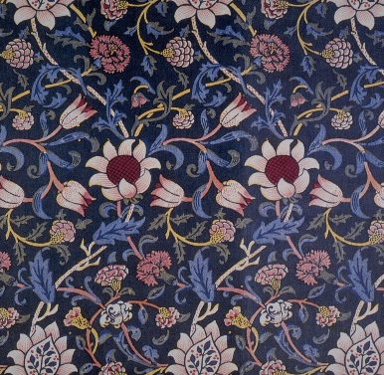
William Morris – The Style
William Morris is very famous for his wallpaper designs. He created some beautiful designs, the likes of which had never been used before. In fact, wallpaper before his day was quite plain.
The Victorian era was the era of industrialisation; factories were being built in the cities in Britain, especially London. People flocked to the cities to work in these factories or run them, and the cities grew bigger and bigger. As a result, people led more urban lifestyles and grew to miss the countryside. Wealthier people did have gardens, but still, it was desirable to feel closer to nature.
William Morris, who was also an environmental campaigner, created designs of floral patterns (patterns inspired by flowers and plants) which were repeated many times by block printing.

Slide 9
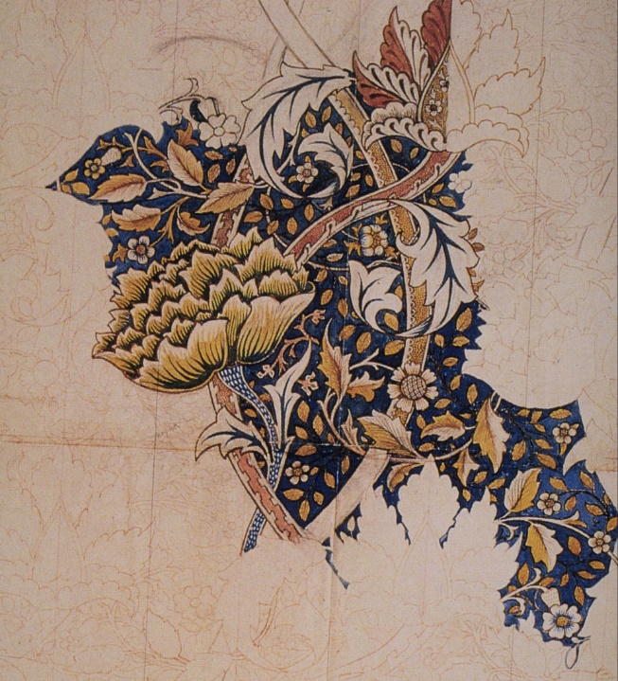
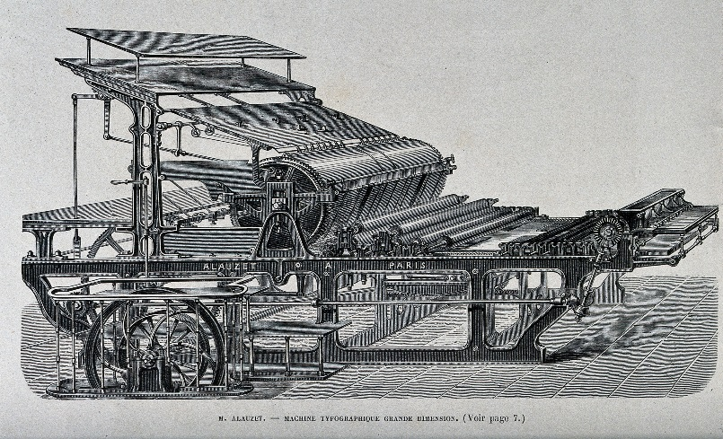
William Morris – The Technique
What William Morris did was to make designs of floral patterns (patterns inspired by flowers and plants) that could be repeated many times by block printing techniques on large pieces of paper to make patterned wallpaper.
“Machine Typographique Ghande Dimension” courtesy of Wellcome Library, London via Creative Commons Wikimedia is licensed under CC BY 2.0
This process was later improved through advances in technology, using printing machines and synthetic coloured inks.

Slide 10

An Influential Artist
“Windrush” 1881-1883

Slide 11
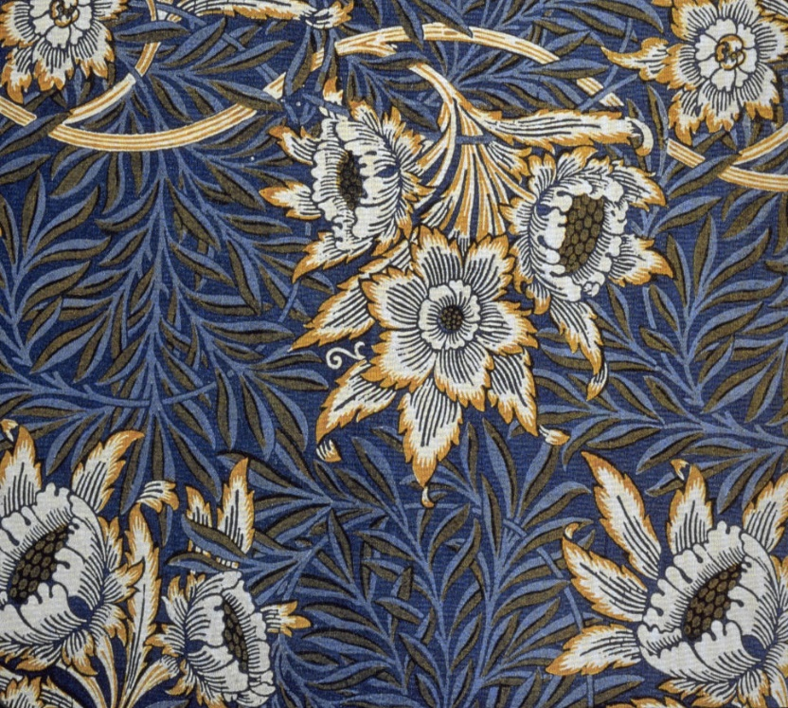
An Influential Artist
“Tulip and Willow” 1873

Slide 12
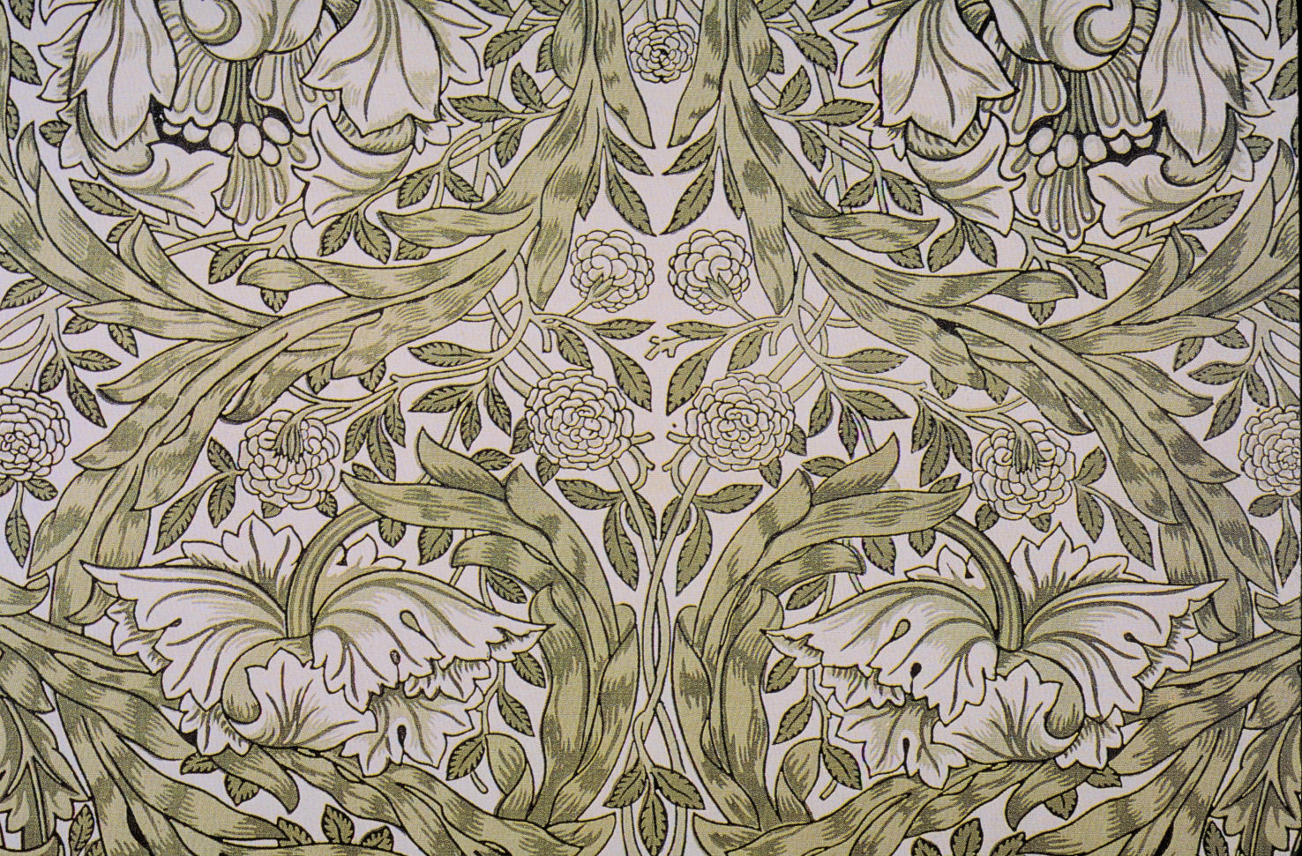
An Influential Artist
“African Marigold” 1876

Slide 13
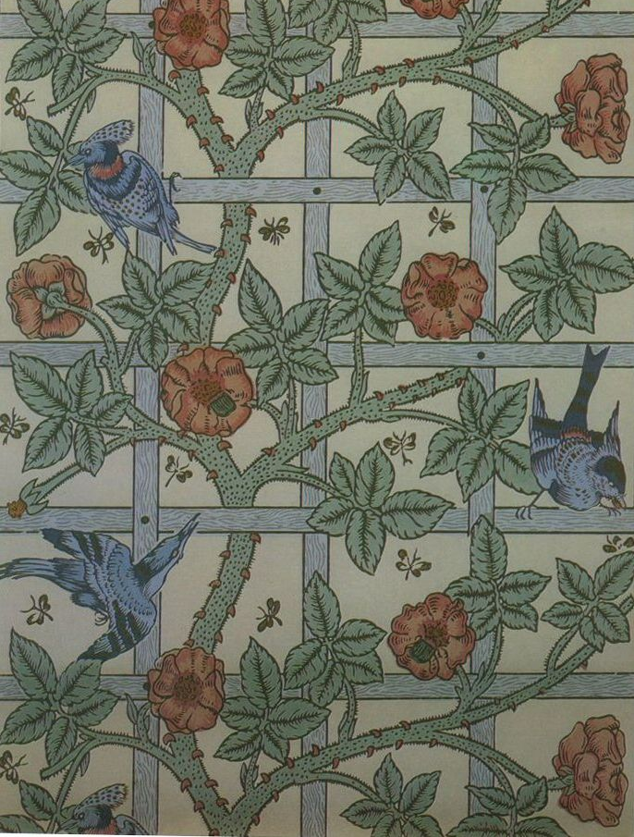
An Influential Artist
“Trellis” 1876

Slide 14
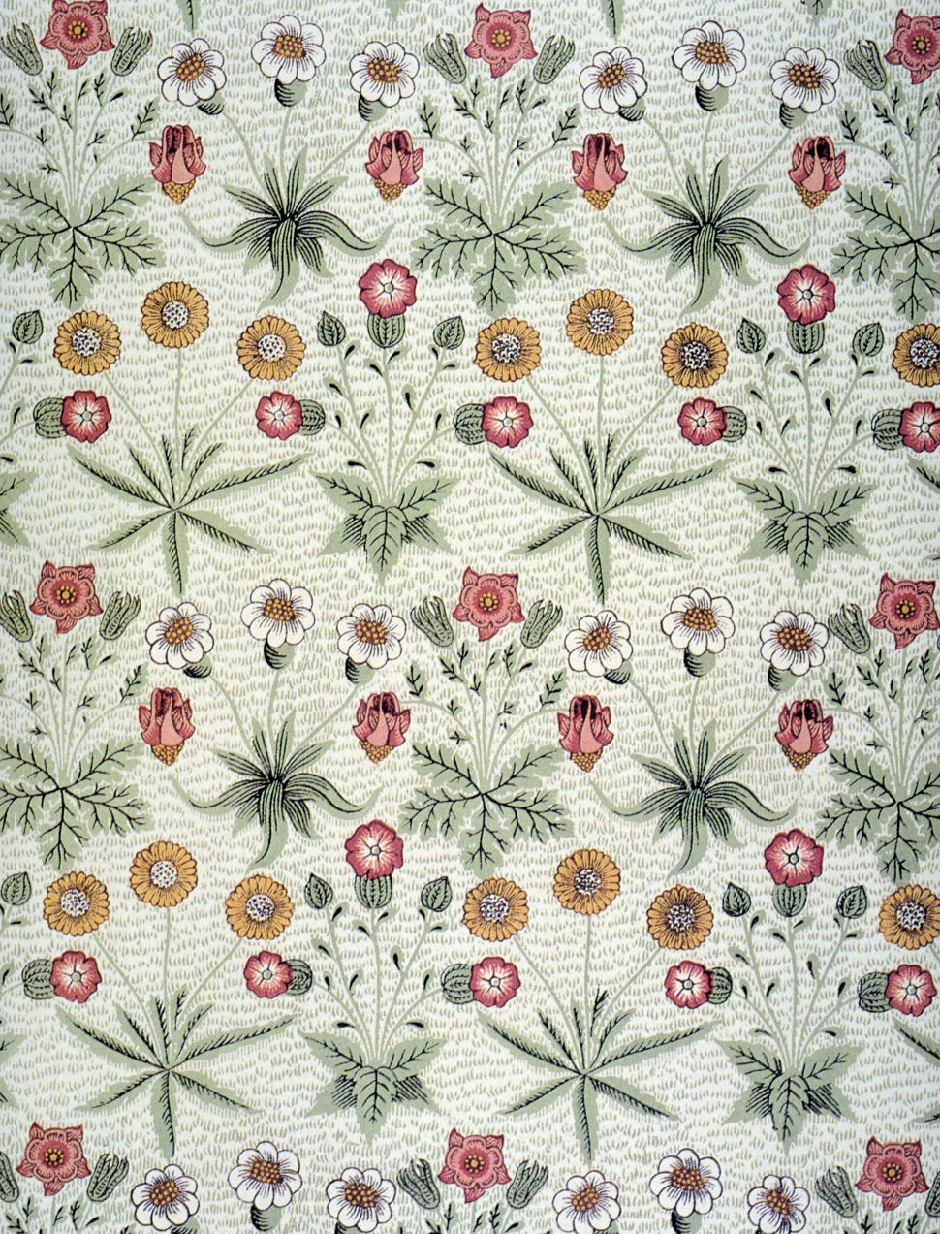
An Influential Artist
“Daisy” 1864

Slide 15
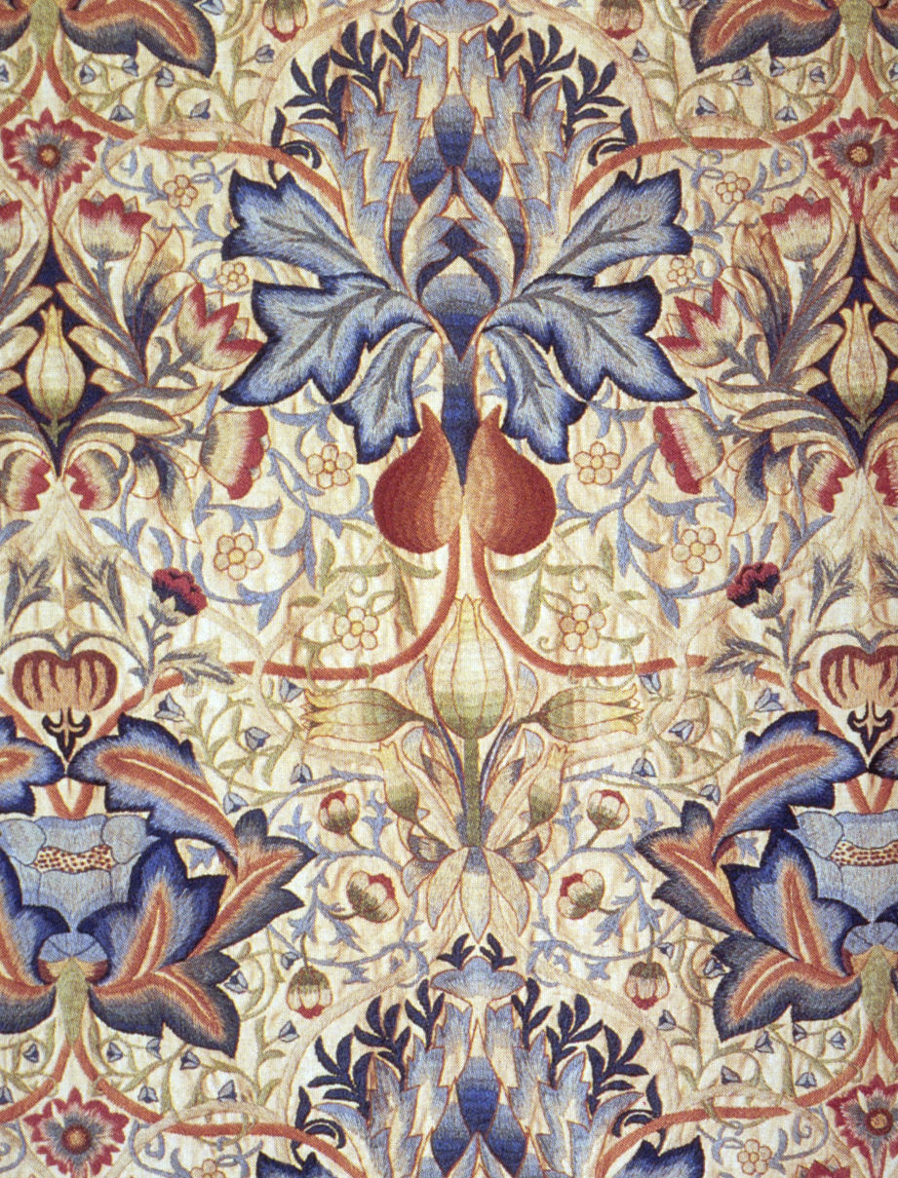
An Influential Artist
“Acanthus” 1875

Slide 16

An Influential Artist
“Strawberry Thief” 1883

Slide 17
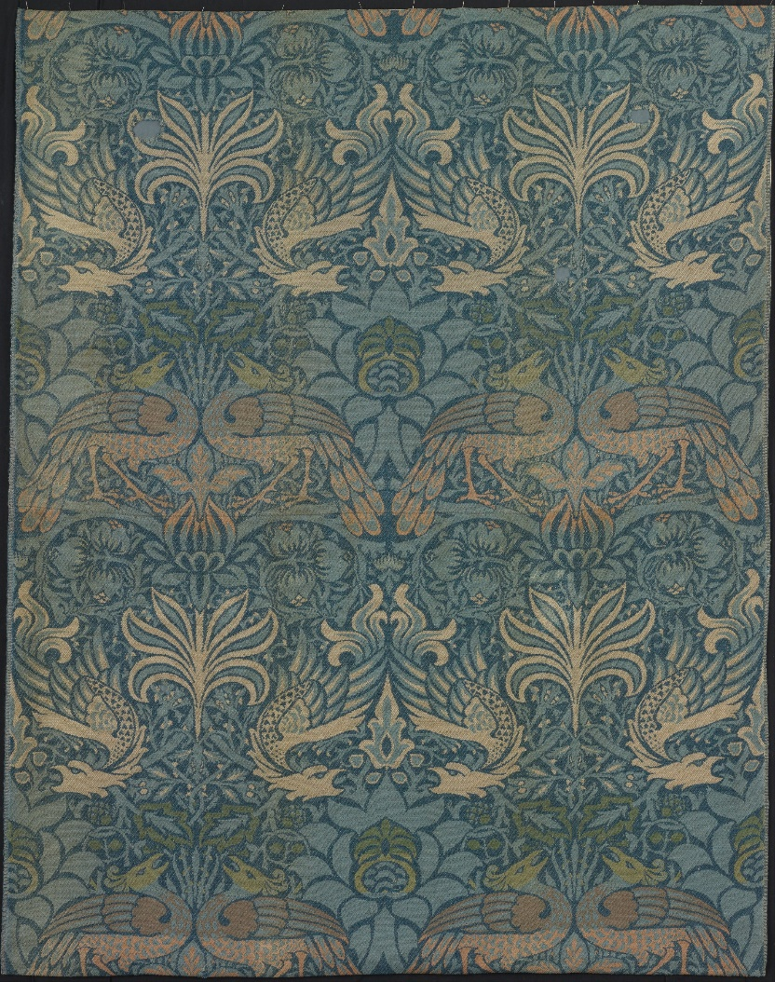
An Influential Artist
“Peacock and Dragon” 1878

