Slide 1
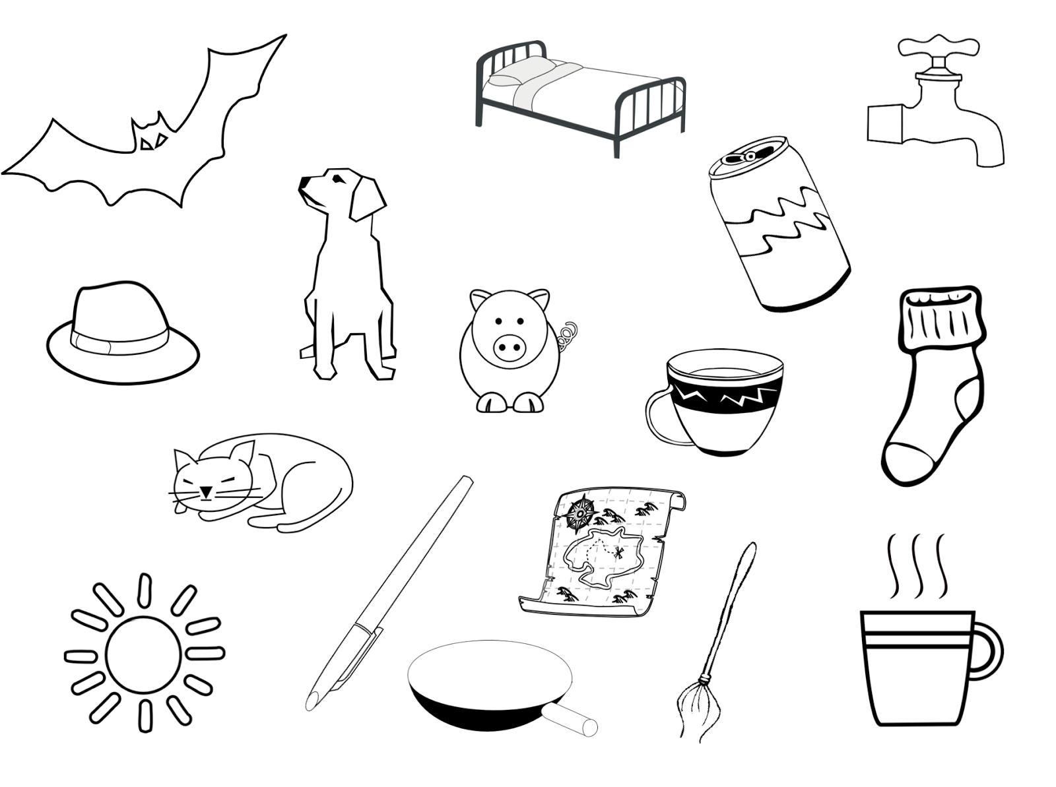
Can I use my phonic sounds to help me write these words? 08.01.21

