Slide 1

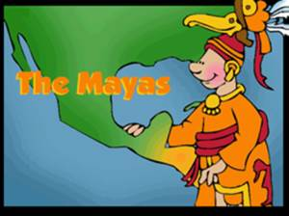
KQ1
Why do we study the Mayan civilization in school?

Slide 2
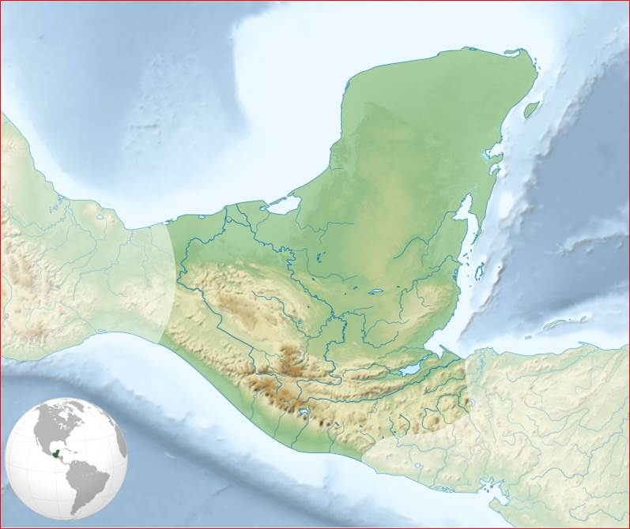
Mayan lowland
Mexico
Mayan mountains
Guatemala
Pacific Ocean
50 miles

Slide 3
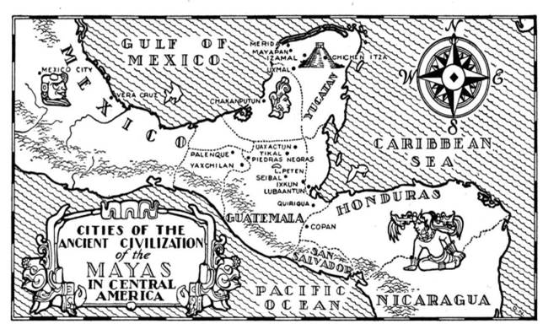
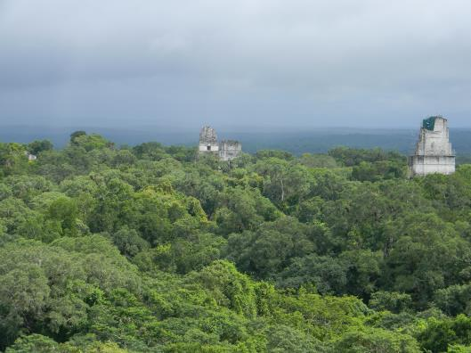
Tikal
http://upload.wikimedia.org/wikipedia/commons/4/48/Tikal%2C_Guatemala_Laslovarga64.JPG

Slide 4
Introduction
The Mayan ruins of Tikal are hidden deep in the rainforests of Guatemala.
From the air, only a handful of temples and palaces peek through the canopy.
The stone carvings are weather-beaten. Huge plazas are covered in moss and giant reservoirs are engulfed by jungle.
The only inhabitants are wild animals and birds.

Slide 5
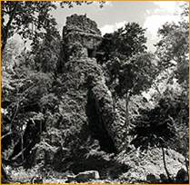
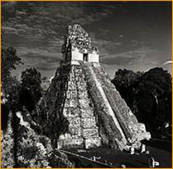
This is what people found over 100 years ago. But what is it?

Slide 6
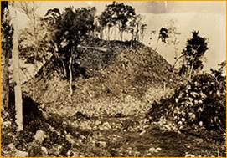
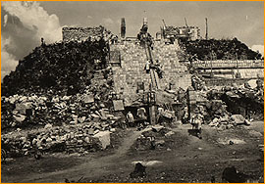
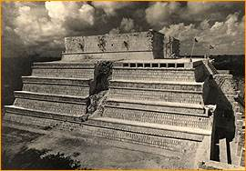
Chichen Itza Temple of the Warrior

Slide 7
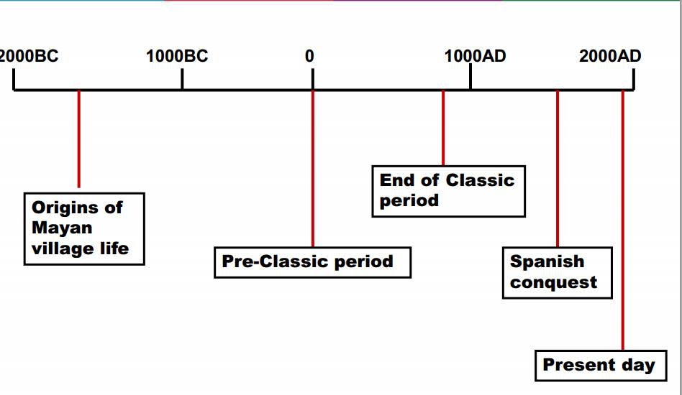
When did they live there?
Mayans we study

Slide 8
Finding the clues to what made the Maya special
Once they were a rich, powerful, civilization.
So what made them special?
Your team has just 10 minutes to find the clues shown in the gallery of pictures placed around the room.

Slide 9
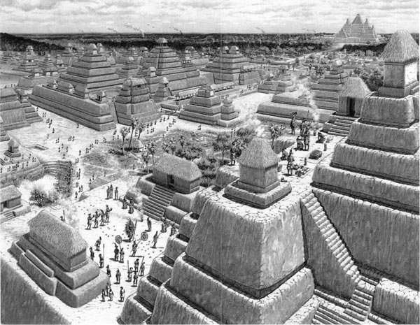
Artist’s impression of Mayan city of El Mirador
http://www.ancient-wisdom.co.uk/guatemalamirador.htm

Slide 10
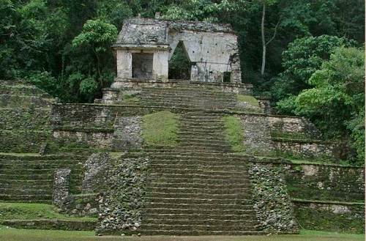

Slide 11
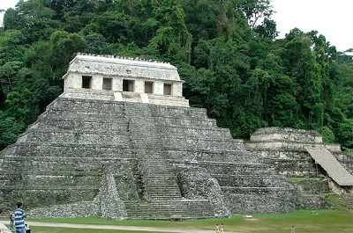

Slide 12
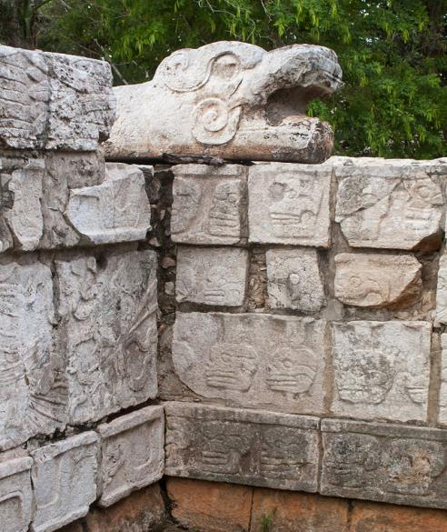
http://commons.wikimedia.org/wiki/Category:Reliefs_in_Chich%C3%A9n_Itz%C3%A1#mediaviewer/File:2010._Chich%C3%A9n_Itz%C3%A1._Quintana_Roo._M%C3%A9xico.-27.jpg

Slide 13
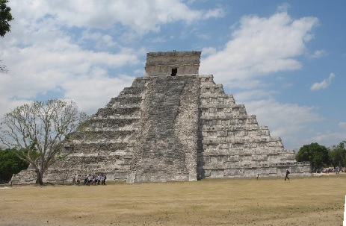
Can you see the shape of the snake slithering down the side of the temple?

Slide 14
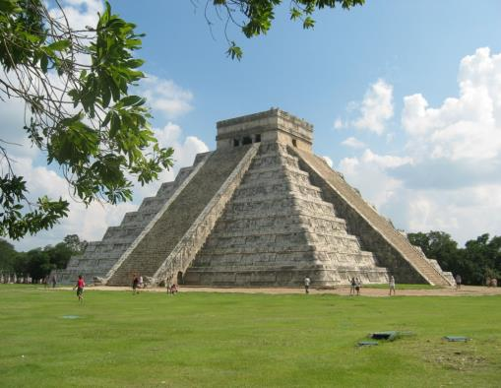
Temple of Kukulkan
The pyramid has 4 sets of steps, one on each side. Each has 91 steps which added together make 364. Leading up to the platform at the top is one final step, making a total of 365 steps. What might that tell you?
http://upload.wikimedia.org/wikipedia/commons/d/da/Chichen-Itza_El_Castillo.jpg

Slide 15
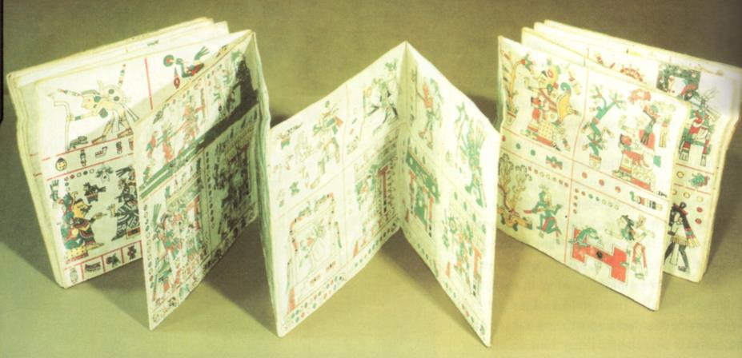
Clue 1

Slide 16
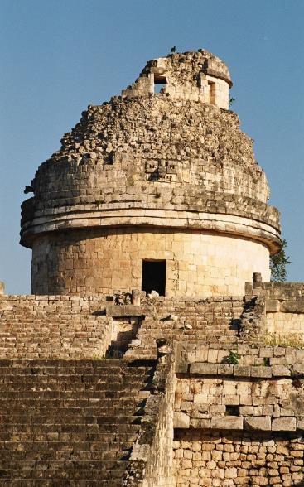
Clue 2
Caracol observatory from which they could see the stars
http://upload.wikimedia.org/wikipedia/commons/9/95/Chich%C3%A9n_Itz%C3%A1_Mayan_observ

Slide 17
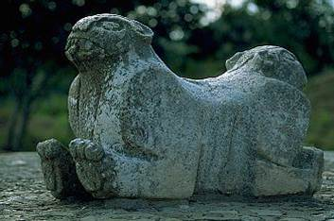
Clue 3
Sculpture of a Jaguar

Slide 18
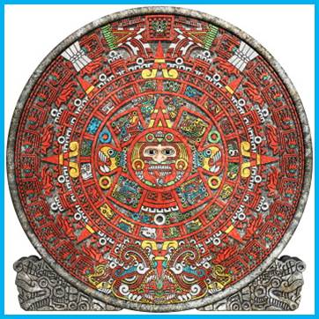
Clue 4
Aztec calendar based on the Mayan calendar
http://www.incamayanaztec.com/Ancient-Mayan-Accomplishment-Calendar.jpg

Slide 19
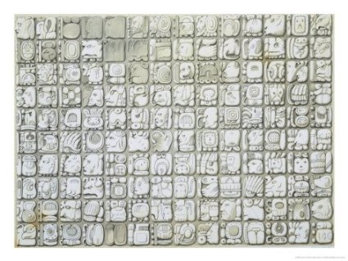
Clue 5
Each shape represents a sound

Slide 20
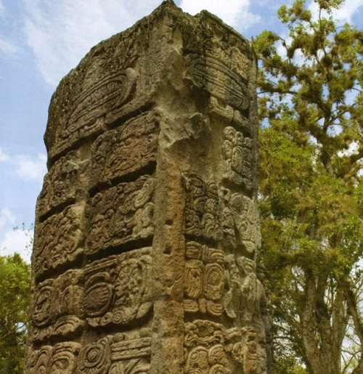
Clue 6

Slide 21
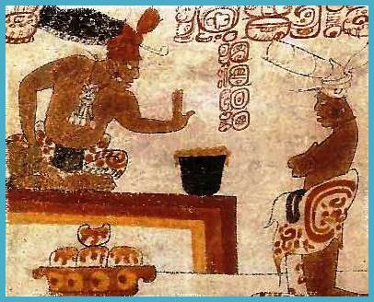
Clue 7
The lord tests the heat of his chocolate in this painting on a Classic Maya vase . Note the Maize cakes, covered with chocolate-chilli sauce below him. The Maya were the first to discover the use of chocolate in this way. Chocolate has been described as the life blood of the Maya.

Slide 22
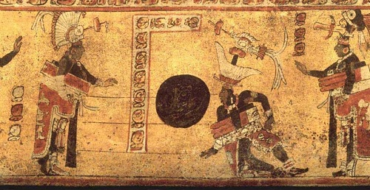
Clue 8 Ball game
Notice the padding the players are wearing mainly around their waists. Much use was made of the hip to move the ball through the vertical hoop.

Slide 23
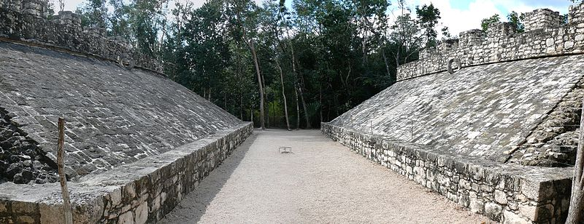
Stone hoop used for ball game
http://commons.wikimedia.org/wiki/File:Coba_Ballcourt-27527.jpg

Slide 24
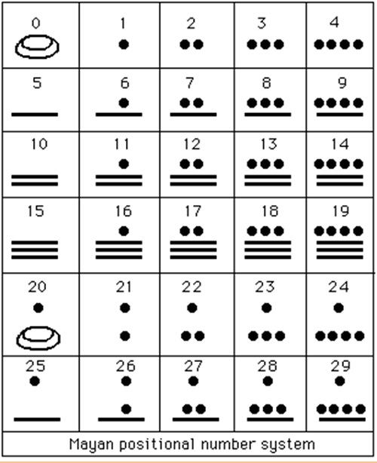
Maya system of counting
http://www.incamayanaztec.com/Ancient-Mayan-Accomplishment-Mathematics.gif

Slide 25
They developed their own mathematics, using a base number of 20, and had a concept of zero. They also had their own system of writing. Their civilisation was so stable and established, they even had a word for a 400-year time period.

Slide 26
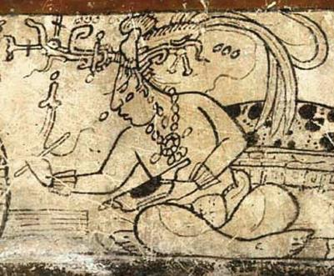
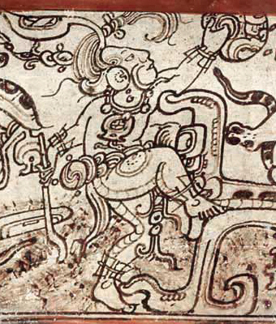
Mayan gods
Maize God
Chaac – Rain God

Slide 27
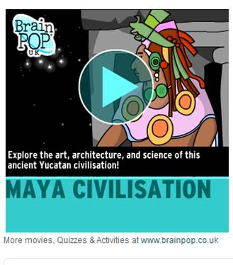
How well does this video explain the significance of the Maya?
What should it include?
What are the most important parts for the film to focus on?

