Slide 1
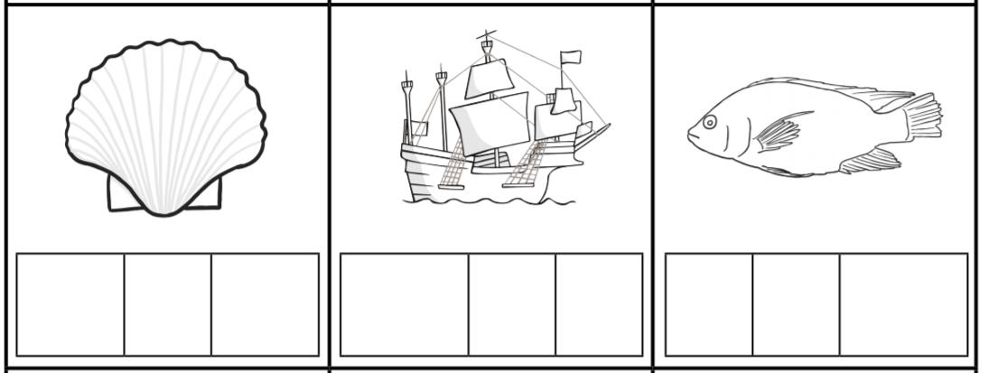
Can I write these ‘sh’ words?
When writing in a phoneme frame you put only one sound in a box, so the sh sound would be together in one box like the first example.
sh
e
ll

Slide 2
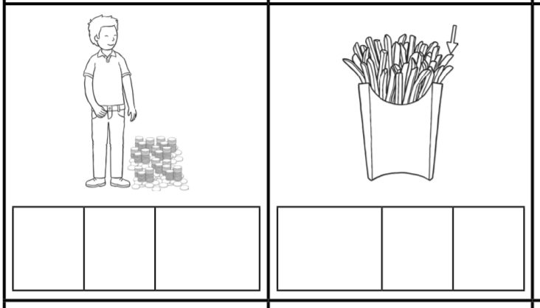
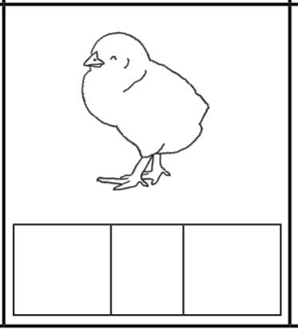
Can I write these ‘ch’ words?
r
i
ch

