Slide 1

Welcome to Year 6
01
Mr Campbell • Class teacher
Mrs Dean • Group support
Miss Whiting • Friday teacher
Mrs Cookson-Chadwick and
Miss Dineen • Learning support

Slide 2

Our Year 6 Class Charter
02
We use our manners.
We are good role models.
We are positive!
We respect everyone.
We give 100% in everything that we do.

Slide 3

How we learn in Year 6
03
Listen attentively
Share our ideas with others
Take part in group work (sometimes carrying out different roles)
Individual or independent tasks
Reading and research
Recording evidence and taking notes
Setting and achieving our own personal targets

Slide 4

A Super Learner
04
I am a good listener in every lesson.
I am a good team worker and listen to others.
I am an independent learner - I think for myself.
I can organise myself.
I am a reflective learner.
I am a resilient learner.
I can make a great contribution to my class. I join in everything.

Slide 5

Timetable
05
English and Maths are taught daily.
RE is taught three times a week.
Computing, PSHE, Topic (History/ Geography), Art, PE, French, Music, DT and Science are taught once a week.

Slide 6

Autumn Term 1 Topics
06
English: ‘The Nowhere Emporium’ and ‘Wonder’
Maths: Place Value and Four Operations
Science: Classification
PSHE: Meet your Brain and places
Computing: Communication and collaboration
Art: 2D to 3D drawing
History: WW2
RE: Creation and Covenant
PE: Invasion Games

Slide 7

English (Reading)
07
Class novel
Guided reading
In Year 6 we are developing reading stamina by accessing a wide range of authors and texts
Regular reading helps to develop vocabulary, improve spellings and the ability to read at pace and with understanding.
Home reading
Good readers = Good writers

Slide 8

English (Writing)
08
In Year 6, we write every day:
  Range of genres (fiction / non-fiction)
  Grammar and punctuation
  Spelling
  Handwriting
  Presentation
  Writing across the curriculum

Slide 9

Maths
09
We follow the Red Rose Mastery Maths scheme
We use a range of strategies in Year 6:
  Mental methods – the ability to recall and calculate at pace
  Written methods – we practice formal method followed in our ‘Written Calculations Policy’
Problem Solving / Reasoning – every lesson has some deeper learning so everyone can use their Maths skills to apply them to a range of contexts
Table Facts
  It is important that everyone knows their table facts (forwards and back from, multiplications and divisions, fluently)
  x2 – x12
Number Facts (to 1, 10, 100, 1000)
  This is being able to recall that 6 + 4 = 10, so therefore 0.6 + 0.4 = 1, 60 + 40 = 100, 600 + 400 = 1000, 0.06 + 0.04 = 0.10)

Slide 10


RE
10
Branch 1:
Creation and Covenant
Branch 2:
Prophecy and Promise
Branch 3:
Galilee to Jerusalem
Branch 4:
Desert to Garden
Branch 5:
To the ends of the earth
Branch 6:
Dialogue and Encounter

Slide 11

Faith in Action
11

Slide 12

Class Routines
12
Reading books can be changed on a Monday, Tuesday or Wednesday.
Homework will be due in on Thursdays.
PE is taught on a Thursday afternoon.
Please could children have a separate lunchbox drink.
Break time snack is a piece of fruit.

Slide 13

Weekly Blog and Home Practise
13
The weekly blog will be published every Friday.
It is vital that your child practices the basics daily:
Reading at least 30 minutes a day.
Table facts (x2 – x12)

Slide 14

Spelling
14
We focus on a different spelling pattern or spelling rule each week.
Spellings are handed out on Friday, to test the following Friday
Main Spelling Strategies are:
  1. Does it look right?
  2. Rhyming words
  3. Syllables
  4. Look, Say, Write, Cover, Write, Check

Slide 15

Sumdog challenges
15
Times tables challenge
Maths related to that week challenge
Spelling challenge

Slide 16

How can you support?
16
Listen to your child read (even though they are great readers, it is still important for them to develop expression, understanding and discussion of new vocabulary).
Help them to learn their spellings of the week (little and often works best).
Keep practising number bonds and times tables.

Slide 17

Safeguarding routines
17
Drop and Go:
8.40am – 8.50am
Collect and Go:
3.15pm – 3.25pm
All the children line up outside on the playground to be dismissed.
Only those with permission to walk/cycle home, can bring a phone.
Club – dismissed from gate.

Slide 18

Safeguarding - Online Safety
18
Our Online safety curriculum is taught throughout the year alongside our PSHE Curriculum.
We teach the children safe online behaviours in these areas.
We also teach the children how to behave when online. This includes when gaming or when engaging in social media (most platforms are not suitable for primary aged children).
School and home have a joint responsibility to safeguard your children against all online harm. See our parental controls guidance on our Safeguarding page.
Our online safety updates and guides will keep you updated on how you can keep your home a safe space when it comes to letting your children access the internet.

Slide 19
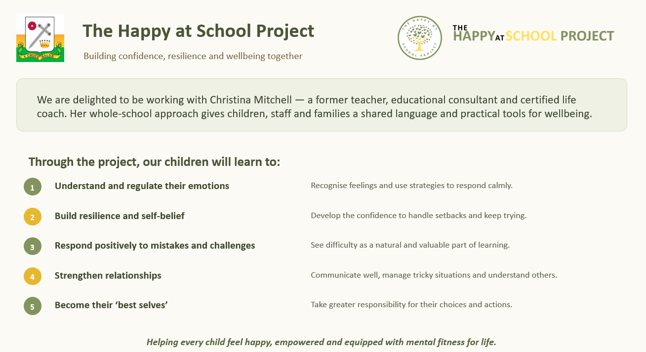
19

Slide 20

Pupil Expectations
20
Outstanding behaviour – to follow the class rules at all times and the Golden Rules of the school.
Rewards
    House points
    Star of the Week
    Writer of the Week
    Marvellous Mathematician
    Bookworm of the Week
    Super Learner
    Gold, double gold, triple gold, quadruple gold!

Slide 21
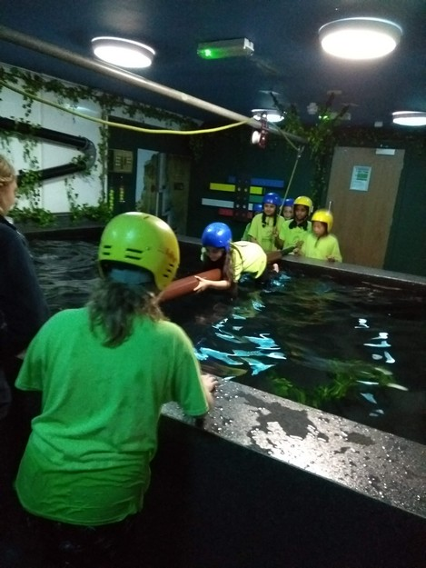

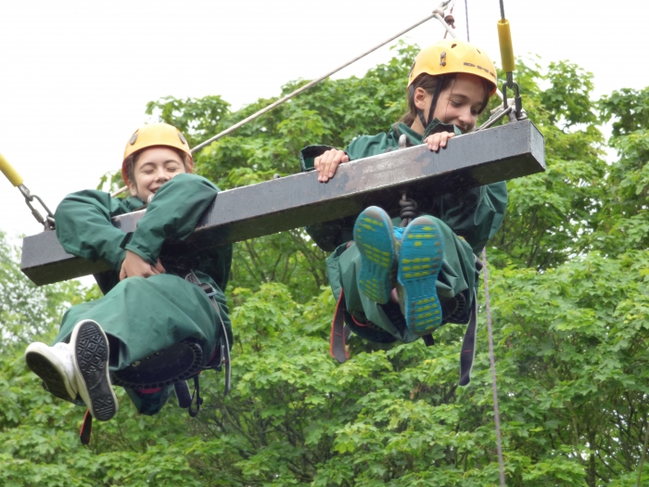

Robinwood
21

Slide 22

Why do we go?
22
Outdoor Education focuses on personal development through responsible use of the natural environment and interaction with others. Most of the activities fall into one or more of the following categories:
Adventure in the outdoors
Personal organisation and challenge
Social skills and teamwork
We aim to have fun!

Slide 23

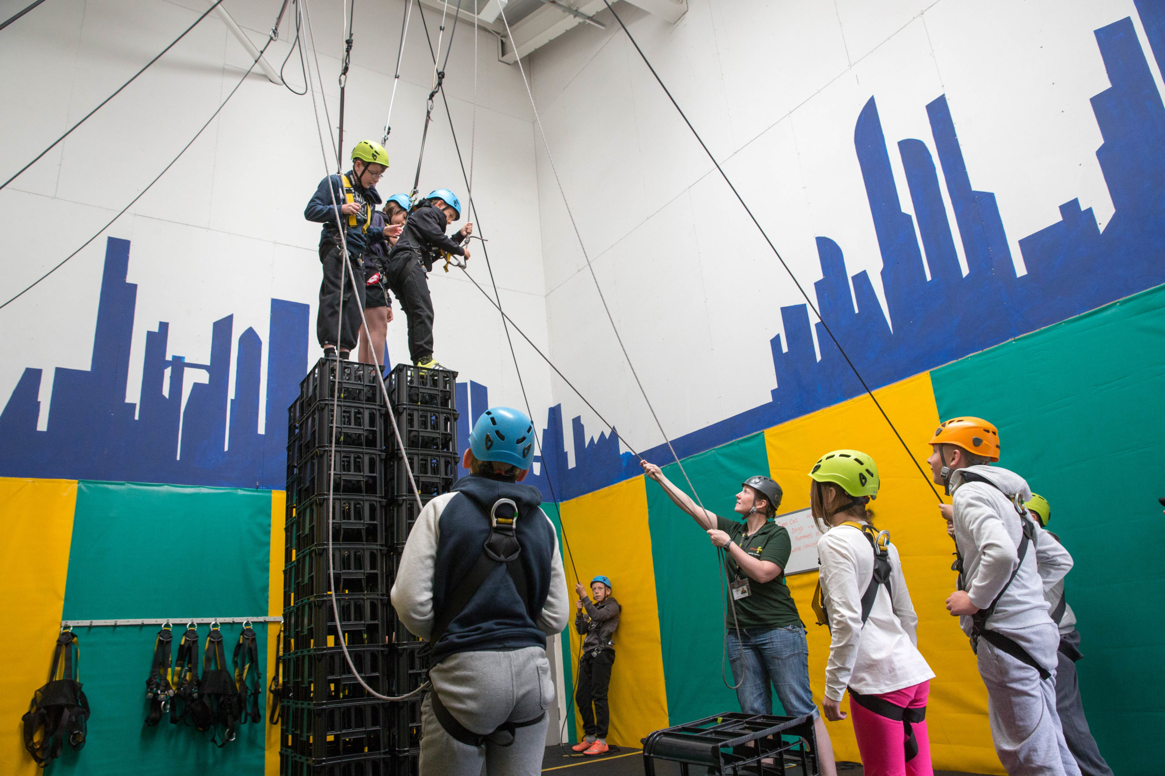
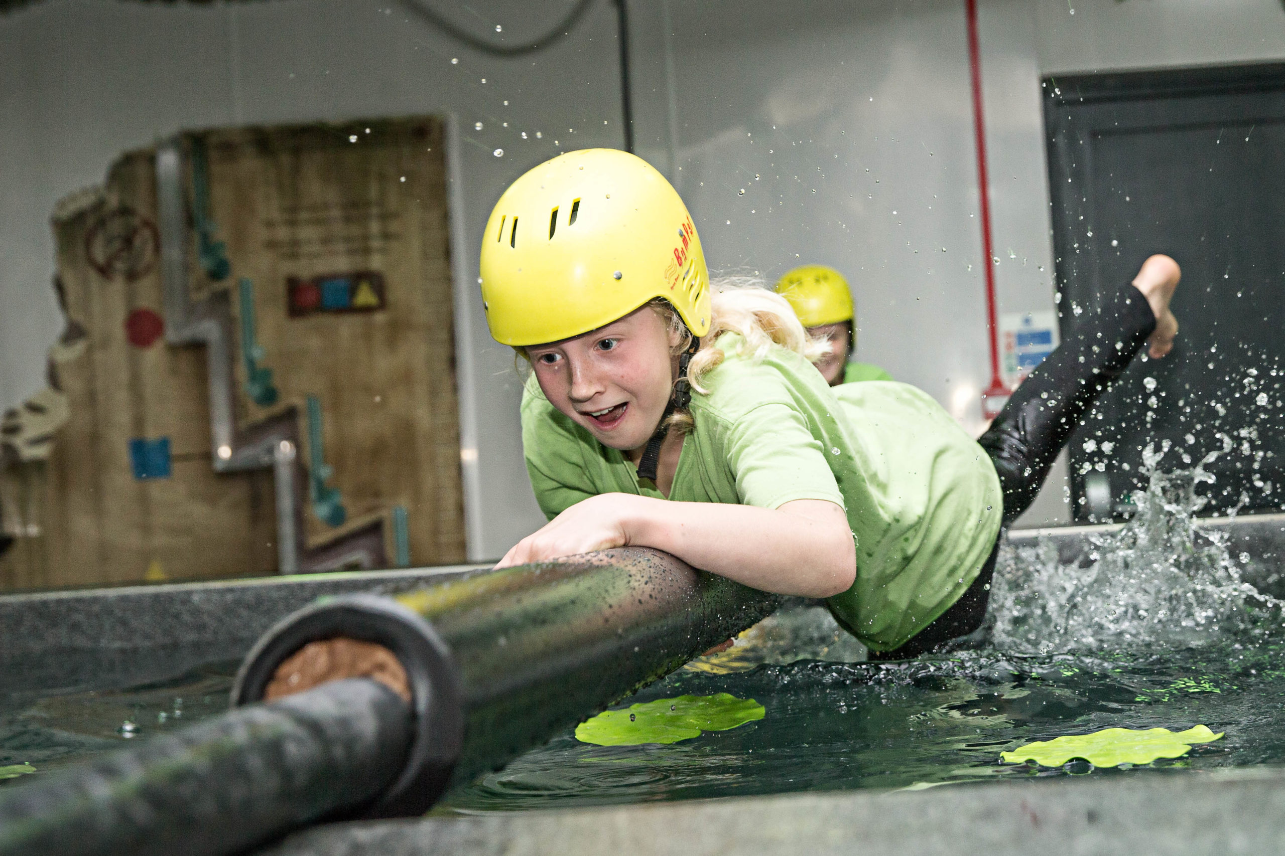
Activities
23
Zip wire
Trapeze
Team Challenges
Quest
Challenge Course
Giant Swing
Archery
Dungeon
Crate Challenge
Canoeing
Climbing
Caving
Piranha Pool

Slide 24

What else…?
24
Equipment – all provided.
Clothes – lots of old, warm, scruffy fleeces and jogging trousers. No jeans.
Meals – cooked breakfast, lunches , home-made evening meals, supper.

Slide 25

Dates
25
Wednesday 4th February – Friday 6th February 2025

Slide 26

SATs
26
SATs week is Monday 10th May 2027 – Thursday 13th May 2027.
We will have a SATs meeting in January.

Slide 27

SATs
27
WE will be giving a SATs test experience this week from a previous year. Please do not look at previous tests online.
We do this early in the year to:
Give the children experience
Show them areas they need to improve
Use the data to plan focused support
To see what type of test techniques they need!

Slide 28

Any queries, please contact the office and we will reply as soon as possible.
Questions
28

