Slide 1

Welcome to Year 3

Slide 2

Mr Campbell Mrs Woof

Slide 3

Your child as a learner in Year 3
We will nurture the following personal skills and attitudes:
Self-confidence
Self-esteem
Independence
Resilience
Initiative
Problem solving
Enthusiasm
Opinion
Positive mind-set

Slide 4

How will your child learn in Year 3?
Listening attentively
Sharing ideas
Working within groups
Individually
Reading and research
Thinking skills
Recording

Slide 5
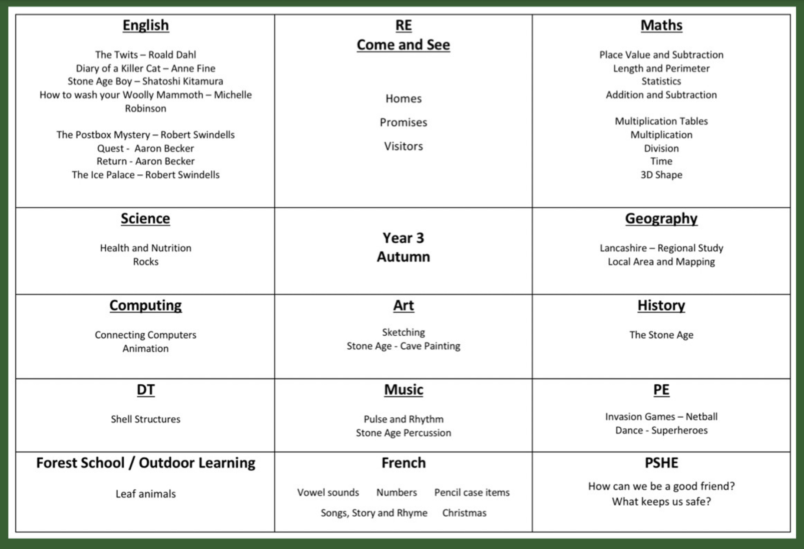
Curriculum

Slide 6

Maths
Red Rose Mastery Scheme
Mental methods
Written methods
Place Value
Problem Solving and reasoning – Deeper Learning
Table Facts
  x2, x5, x10, x3, x4, x8 (test every Friday)
Number Facts
  Number bonds to 20 / 100

Slide 7

English
Reading in many different contexts
Class novels
Writing related to the class novel and cross curricular opportunities
Spelling rules through games and activities daily
Handwriting
Grammar and punctuation

Slide 8

Religious Education
Come and See
Autumn Term
    Homes
    Promises
    Visitors
Spring Term
    Journeys
    Listening and Sharing
    Giving all
Summer Term
    Energy
    Choices
    Special places

Slide 9
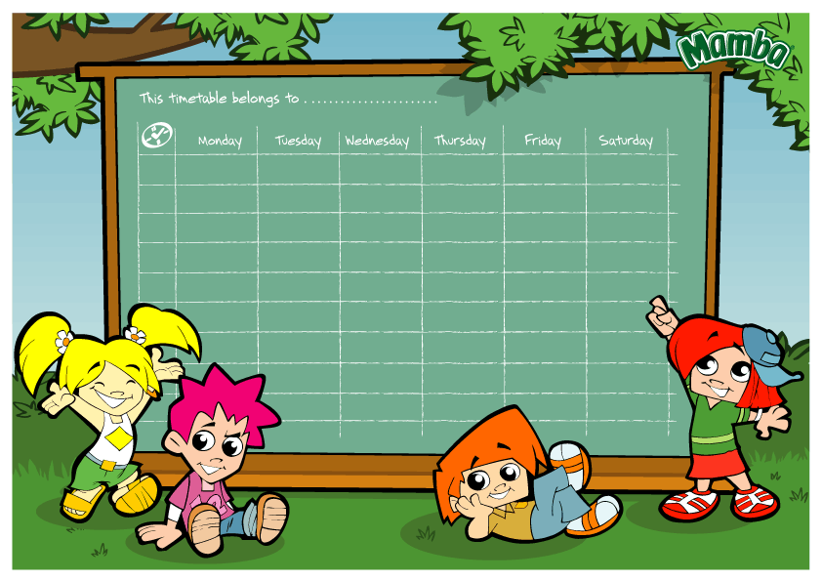
Timetable:
English and Maths every day.
R.E. and class collective worship every week.
P.E. is on a Tuesday afternoon.
French and Music are taught once a week.
PSHE, Science, Art, Geography, History, DT and Computing are taught termly.
Home Practice on the school website on Fridays.
Tables and spelling tests on Fridays.

Slide 10

Reading
- Children are responsible for changing their books when they have finished. Mrs Woof will always be there to help.
- Please ensure the reading diary is signed.
- Please make sure your child’s book is in their bag every day.
- Your child should read at home every night, to a parent or carer, grandparent, sibling or friend.

Slide 11
What to bring:
A warm, waterproof coat
Reading book
Water bottle with a sports top
Fruit
P.E. kit should be in school every day. Children can wear trainers for outdoor sessions but they still need black pumps for inside.
Name in everything.

Slide 12

Friday Blog
Every Friday we will blog to let you know what learning we have done during the week.
We will include links to galleries of our learning.
We also will outline the practice your children need to do over the coming week at home.
Reading, Spelling and Maths.

Slide 13
Safeguarding Routines
End of day
End of day form.
If there is an emergency or a problem please ring school as soon as possible and then we are aware of it and will keep your child until you arrive, we will keep your child in class.
Children always to be collected off the playground.

Slide 14

Online Safety
Taught throughout the year alongside our PSHE Curriculum
We follow the SMART online safety rules
We will have regular guides for parents and guardians on the weekly blog.
In Year 3 our focus is on
The use of age appropriate websites including social media
Not sharing personal information online
Knowing what to do if something worries or upsets them online
Being responsible online

Slide 15

Behaviour expectations:
    Traffic lights – gold, double gold and triple gold!
    House points
    Stickers
    Golden Assembly
    Class Rules
    Golden time
    Praise

Slide 16
And finally:
Please ensure your child's medication is in school.
Make an appointment at the school office and we will see you as soon as possible.

