Slide 1

Welcome to Year 3
2026-2027

Slide 2

Mrs Armstrong Mrs Woof
Mrs O’Neill

Slide 3

Your child as a learner in Year 3
We will nurture the following personal skills and attitudes:
Independence
Self-confidence
Self-esteem
Resilience
Initiative
Problem solving
Enthusiasm
Opinion
Positive mindset

Slide 4

How will your child learn in Year 3?
Listening attentively
Sharing ideas
Working within groups
Working individually
Reading and research
Thinking skills
Recording

Slide 5
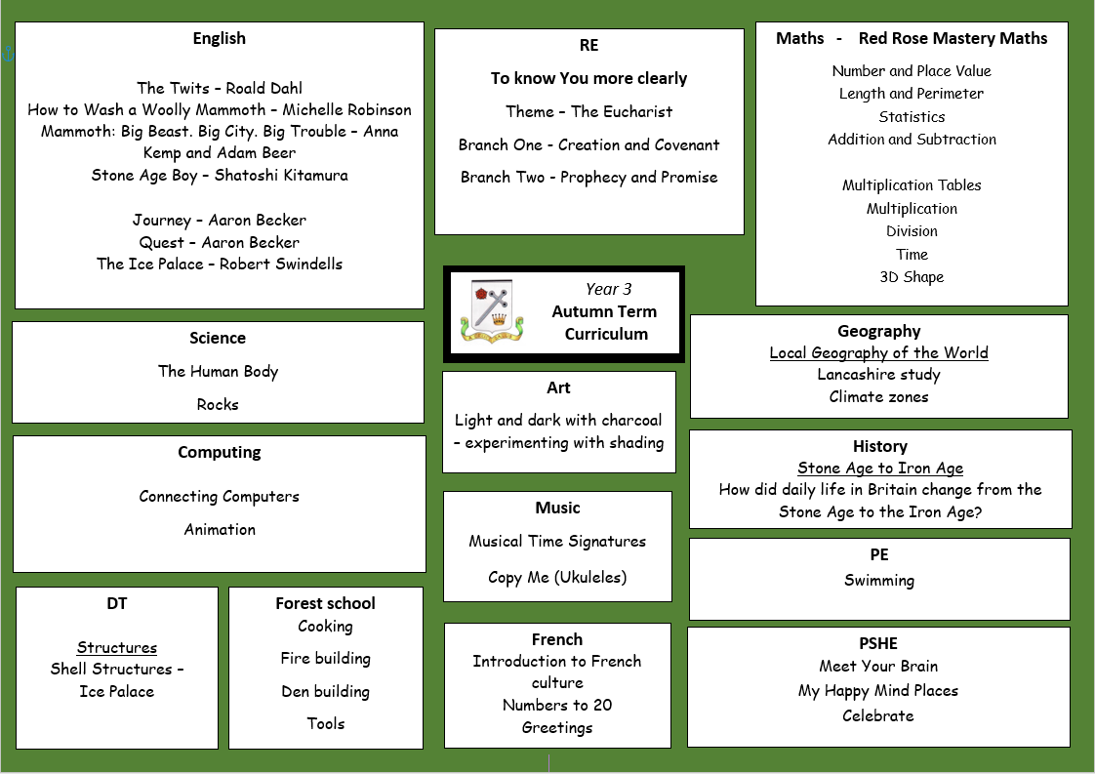
Curriculum

Slide 6

English
Reading in many different contexts
Class novels
Writing related to the class novel and cross curricular opportunities
Spelling rules through games and activities daily
Handwriting (cursive)
Grammar and punctuation

Slide 7

Maths
Red Rose Mastery Scheme
Mental methods
Written methods
Place Value
Problem Solving and reasoning – Deeper Learning
Table Facts
  x2, x5, x10, x3, x4, x8
  Number Facts
  Number bonds to 20 / 100

Slide 8

Religious Education
To know You more clearly
Autumn Term
    Creation and Covenant
    Prophecy and Promise
Spring Term
    Galilee to Jerusalem
    Desert to Garden
Summer Term
    To the ends of the Earth
    Dialogue and Encounter

Slide 9

Reading
Children are responsible for changing their books when they have finished them. Mrs Woof and Mrs O’Neill will always be there to help.
Please ensure the reading diary is signed.
Please make sure your child’s book is in their bag every day.
Your child should read at home every night, to a parent or carer, grandparent, sibling or friend.

Slide 10

Timetable
English and Maths every day.
R.E. and collective worship every week.
P.E. (swimming) is on a Wednesday morning during the Autumn term.
French and Music are taught once a week.
PSHE, Science, Art, Geography, History, DT and Computing are taught termly.
Forest School on Monday afternoons (Autumn 1 only)
Home Practice on the school website on Fridays.

Slide 11
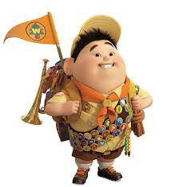
What to bring:
A warm, waterproof coat
Reading book
Water bottle
Wellies for Forest School
Fruit snack
P.E. kit should be in school every day. Children can wear trainers for outdoor sessions but they still need black pumps for inside.
Swimming kit on Wednesdays
Ensure any medication is in school.
Name in everything.

Slide 12

Friday Blog
Every Friday we will let you know what we have been up to during the week.
We will include galleries of our learning.
We will also outline the practice your children need to do over the coming week at home.
Reading, Spelling and Maths.
Sumdog – one Maths challenge and one spelling challenge each week. Please have a go!

Slide 13
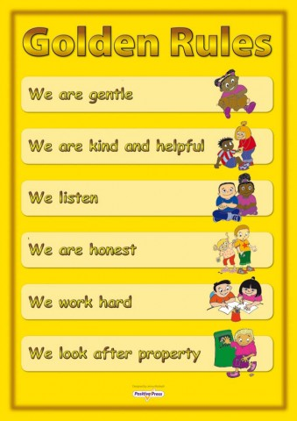
Behaviour expectations
    Gold, double gold and triple gold!
    House points/Dojos
    Golden box
    Stickers
    Golden Assembly
    Class Rules
    Praise

Slide 14
Safeguarding Routines
End of day
End of day form.
If there is an emergency or a problem please ring school as soon as possible and then we are aware of it and will keep your child until you arrive
Children always to be collected from the playground.

Slide 15
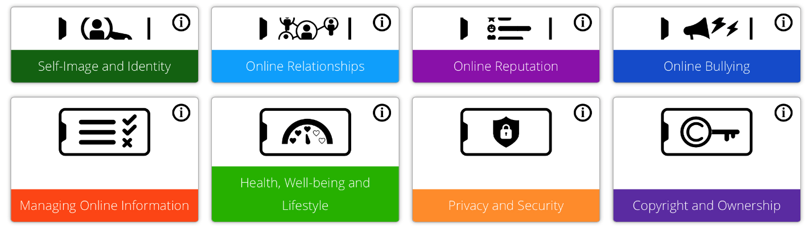
Safeguarding - Online Safety
Our Online safety curriculum is taught throughout the year alongside our PSHE Curriculum.
We teach the children safe online behaviours in these areas.
We also teach the children how to behave when online.This includes when gaming or when engaging in social media (all platforms are now banned for under 16s).
School and home have a joint responsibility to safeguard your children against all online harm.
See our parental controls guidance on our Safeguarding page.
Our online safety updates and guides will keep you updated on how you can keep your home a safe space when it comes to letting your children access the internet.

Slide 16


The Happy at School Project
Building confidence, resilience and wellbeing together
We are delighted to be working with Christina Mitchell — a former teacher, educational consultant and certified life coach. Her whole-school approach gives children, staff and families a shared language and practical tools for wellbeing.
Through the project, our children will learn to:
1
Understand and regulate their emotions
Recognise feelings and use strategies to respond calmly.
1
2
Build resilience and self-belief
Develop the confidence to handle setbacks and keep trying.
2
3
Respond positively to mistakes and challenges
See difficulty as a natural and valuable part of learning.
3
4
Strengthen relationships
Communicate well, manage tricky situations and understand others.
4
5
Become their ‘best selves’
Take greater responsibility for their choices and actions.
5
Helping every child feel happy, empowered and equipped with mental fitness for life.
Notes:
[Sources]
- https://www.happyatschoolproject.co.uk/primary (programme description, founder background and pupil outcomes; accessed 2 September 2026)
- https://www.happyatschoolproject.co.uk/ (official THASP logo; accessed 2 September 2026)
- https://www.longton-st-oswalds.lancs.sch.uk/ (official school badge; accessed 2 September 2026)

Slide 17
And finally:
We are so excited to see you child/children continue to grow!
If you have any queries, make an appointment at the school office and we will see you as soon as possible.

