Slide 1


St. Oswald’s Foundation Stage
Live Love Learn
Our Team
Miss Collinson – Class Teacher
Mrs Maguire-Dorr - Class Teacher
Mrs Cliffe – Teaching Assistant
Mrs Deighton – Teaching Assistant

Slide 2
Foundation Stage Curriculum
The Early Years Foundation Stage sets the standards for learning, development and care for children from birth to five. This may take place in a variety of settings including nursery classes, pre-school playgroups and with registered child minders, as well as in the school Reception class.
Teaching is based on securing progress towards Early Learning Goals, which indicate what is expected of most children by the end of the Foundation Stage, before moving onto the National Curriculum in Year 1.
Every child enters Reception at a different stage. We will complete a baseline assessment for each child when arriving with us in September, through observations and then targets will be set from them for each individual child. All progress will be reported to you at parents evenings and via their school report at the end of the Reception year.
These goals are contained within the following areas of learning:-

Slide 3


The Areas of Learning
There are seven different areas of learning:
Prime Areas
Personal, Social and Emotional Development
Physical Development
Communication and Language
Specific Areas
Literacy
Mathematics
Understanding the World
Expressive Arts and Design

Slide 4
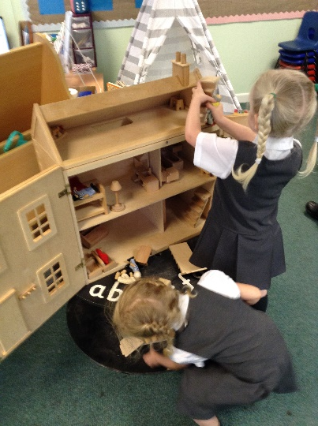
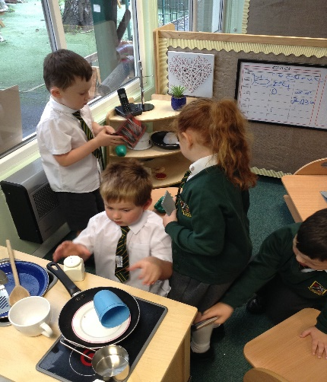
Personal, Social, Emotional Development
PSED permeates all areas of learning. During the first few weeks of school, we concentrate heavily on PSED and we hope to help the children settle into school life. Making sure the children feel safe and valued, helping them to learn the routines and expectations and make sure they know it’s ok to make mistakes.
“For young children, being special to someone and cared for is vital for their physical, social, emotional health and well being.”
We focus on building self esteem-giving them the ‘can do’ attitude.
Allowing them to feel valued and approach things with a positive mindset.
We promote independence through lining up, using their own coat pegs & looking after their property.
We encourage the school’s Golden rules and recognise achievements in assembly at the end of the week.
The children build relationships with their peers through continuous play, break and lunch times.
St Oswald’s has an excellent partnership with the church and Fr Michael is a regular visitor to school.
The children are taught RE through the Come and See programme, which involves a lot of stories, discussion and circle time.

Slide 5
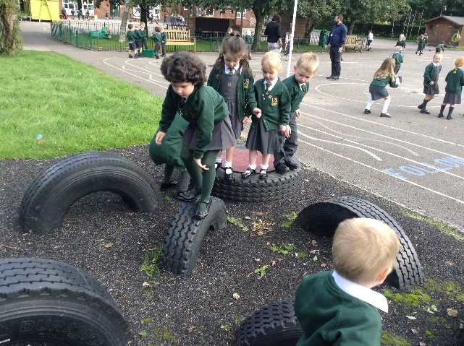
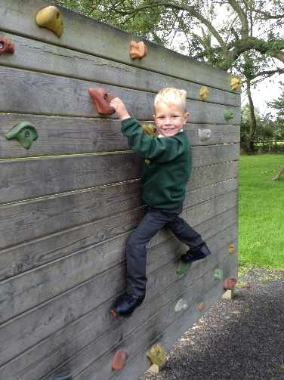
Physical Development
“A healthy active child will have physical skills of balance, control, manipulation and co-ordination.
Movement is the main way in which we explore and learn – it builds children’s self esteem and confidence.”
Physical development involves providing opportunities for young children to be active and interactive. Children must also be helped to understand the importance of physical activity, and to make healthy choices in relation to food.
We focus on developing the children’s gross motor skills through Physical Education & outdoor play, as well as developing the fine motor skills in order for the child to be able to hold a pencil with the correct grip.
All PE kits should be brought into school on a Monday and then go home on a Friday for a wash ☺

Slide 6
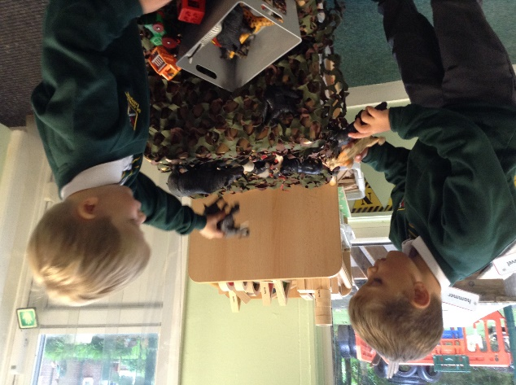
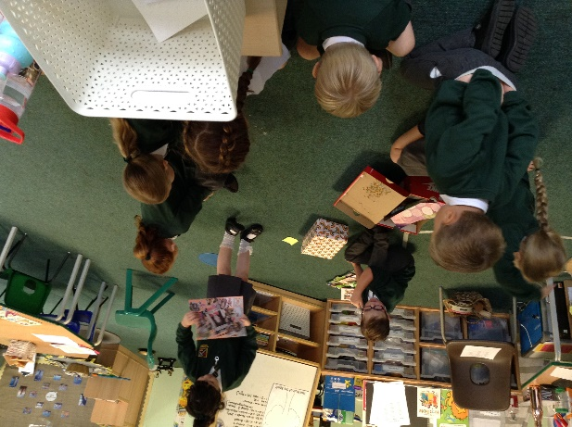
Communication and Language
“Children learn in a holistic way and that the use of communication and language is at the heart of all their learning.”
We value Children’s talk and encourage conversation by providing a rich menu of songs, stories, rhymes and poems on a daily basis. We aim to develop their confidence and skills in expressing themselves; and to speak and listen in a range of situations.
We set up role play areas which are familiar to the children to encourage and promote talking, we use a lot of circle time to provide the children with the chance to listen actively and share their views with the rest of the class. We ask open ended questions in response to their stories and their experiences in order to extended thinking and vocabulary.

Slide 7
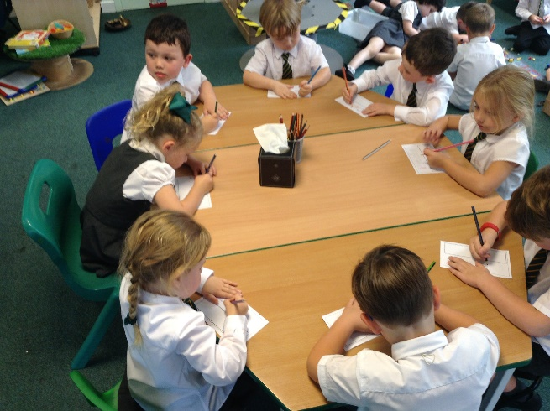
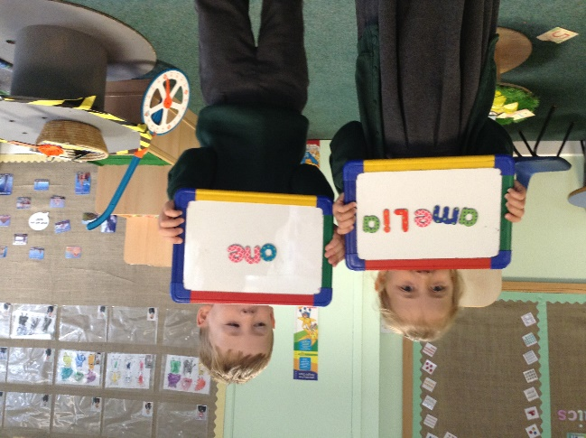
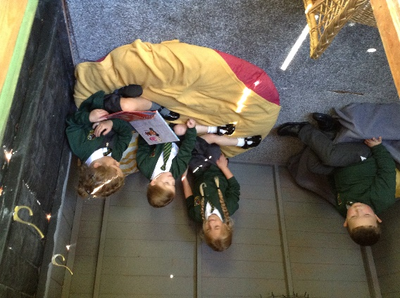
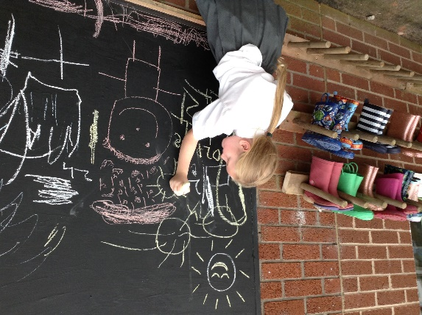
Literacy
Literacy development involves encouraging children to link sounds and letters and to begin to read and write. Children are given access to a wide range of reading materials (books, poems, and other written materials) to ignite their interest.
We teach all of our literacy through a different stories every week to stimulate the children's learning. We encourage activities such as sequencing, character descriptions, writing for purpose e.g. letters or diaries.
We teach sounds and letters through 30minutes of Phonics every morning following the Revisit, Teach, Practice, Apply model. Your children will learn 2/3 new sounds each week (starting w/c 21st September).
The children will also learn humpty words which are sight words, that can not be sounded out so sometimes are quite tricky to learn. These will be brought home to practise, along with their reading book.
Every child starts with a wordless picture book to encourage and promote talking and discussion about what they think is happening in the stories, again to build their vocabulary.
Once they are confident with blending their sounds in school, your child will move to a book with words ☺

Slide 8
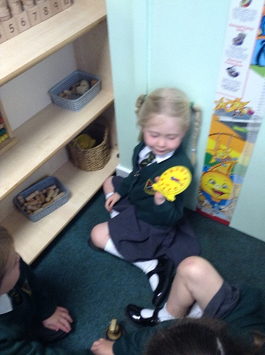
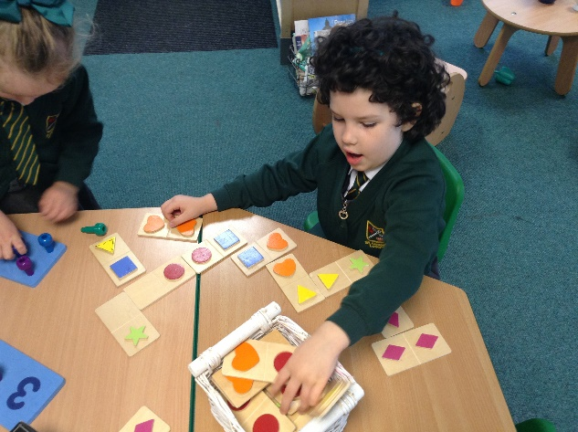
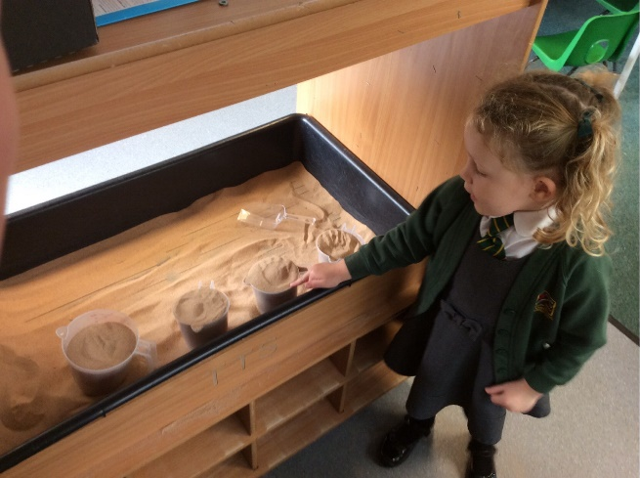
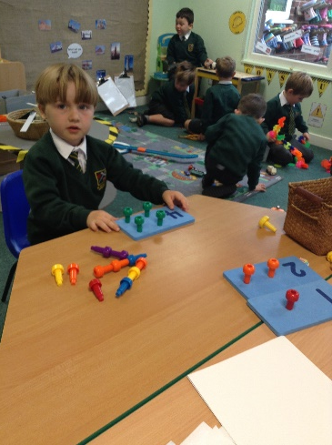
Mathematics
Mathematics involves providing children with opportunities to develop and improve their skills in counting, understanding and using numbers, calculating simple addition and subtraction problems and to describe shapes, spaces, and measure.
At St Oswald’s, Mathematical understanding is developed through stories, songs, games and imaginative play, so that children enjoy using and experimenting with numbers and shapes. The majority of our maths in Reception is taught using practical equipment, so they can physically see the amounts to the number value.
We use Numicon at school to help the children understand the value of a number.This is a resource that your children might talk to you about.
We have weekly maths challenges in the classroom to promote independence for the children to apply their learning.

Slide 9
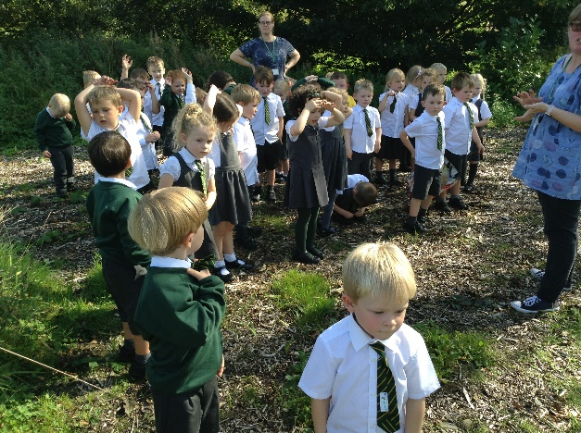
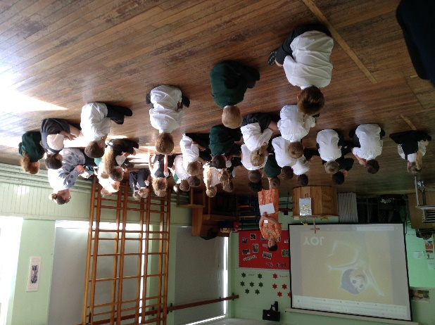
Understanding the World
Understanding the world involves guiding children to make sense of their physical world and their community through opportunities to explore, observe and find out about people, places, technology and the environment.
We can see children noticing, contemplating, practising, experimenting and making adaptations.
We encourage the wonder and excitement by providing a role model and support them to ask questions and solve problems by joining in
Understanding the world includes all the other subjects such as; Science, History, Geography and ICT. Children will also have a weekly French lesson to develop their language.
We do a lot of practical activities such as sense walks, taste experiments, cooking, timelines and mapping skills.
We encourage children to extend their findings by asking open ended questions such as;
What would happen if…? How can we…? Can you find a way to…?

Slide 10
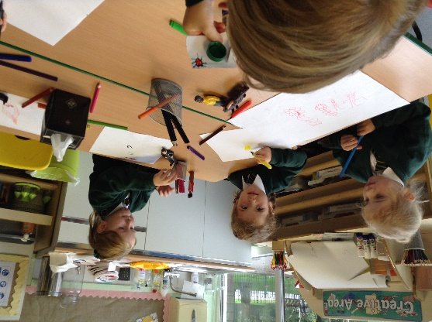
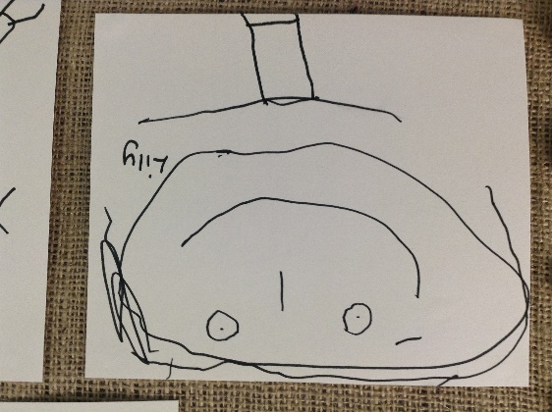
Expressive Arts and Design
Expressive arts and design involves enabling children to explore and play with a wide range of media and materials, as well as providing opportunities and encouragement for sharing their thoughts, ideas and feelings through a variety of activities in art, music, movement, dance, role-play, and design and technology.
We provide opportunities for children to experiment with musical equipment, learn lots of songs and rhymes, through daily learning and a weekly music lesson with Mrs Winter.
We encourage children to investigate colours & textures using simple tools & techniques in a variety of ways, such as using paints, pastels, crayons. This is done independently in the creative area, as well as having focused Art Week projects.
To develop children’s imagination, a lot of our story telling involves acting out narratives and retelling the story using their own ideas. We also have small world characters to encourage their own imaginative play.

Slide 11
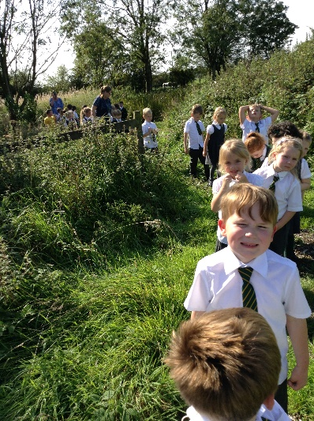
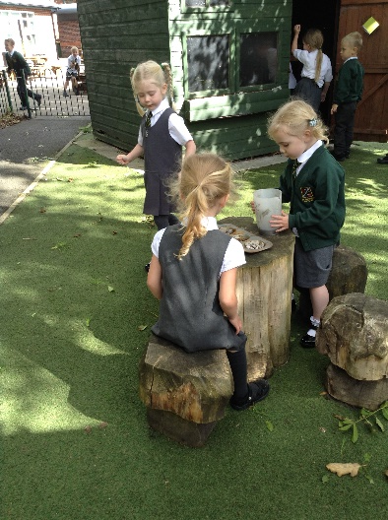
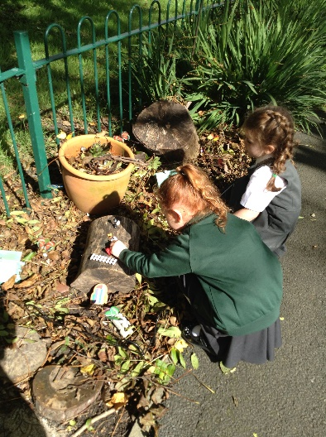
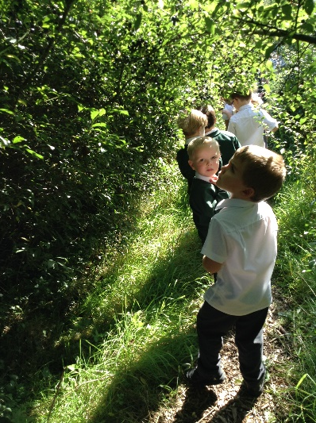
Outdoor Learning
“The outdoor learning environment offers opportunities to learn and develop knowledge and understanding of the world as it is a much richer context than the indoors. The outdoor space allows children to relive their experiences through movement, express their emotions through role play and make connections with the world around them. To children, outside is a blank slate on which to create endless possibilities.”
Children enjoy their learning in the outdoors at St. Oswald’s. We have a wonderful outdoor area, accessible in all weathers. This facility makes a significant contribution to cross-curricular experiences. Every child in Reception has structured access daily.
We are very lucky to have our own pond at St Oswald’s which we will take regular trips to, so please send some wellies in for your child, named please ☺
We love to go outside as much as we can and explore the world around us.

Slide 12
Seesaw
This year we have set up the Seesaw app so you are able to see your child's journey in Reception as we are not as accessible as we usually are at the moment!
Pictures will be uploaded weekly and announcements will allow us to send out any information we think you might need ☺
You can comment on the pictures you see and can reply to announcements, however please do not be offended as your messages may not always get a reply. Any urgent queries need to be done via the school email or phone.
You can upload your Home Learning activities onto Seesaw if this is easier than printing!
Thank you for all your support during this unique time ☺

Slide 13
How can I help as a Parent?
Learning starts at home, please encourage your child by reading your reading books and revisiting the Humpty Words each night.
Children will be given new Humpty Words to learn when they are confident with the ones they have.
(reinforced at school and will be checked regularly, please make this fun for the children e.g. find me the word, snap, which one is missing?) the first sets will be given out the W/C 21st September.
Encourage independence as much as possible, let them get dressed in a morning to help with getting changed for PE.
Just some reminders
Send a full water bottle in each day.
Please put names in all of their school clothes.
Send a pair of wellies to be kept in school all the time.
We are here to help – please don’t hesitate to contact us with any query, via the school email or phone.
Check the website regularly.
Newsletter is sent every Friday from Mrs Wood
ENJOY it because it will go very quickly!

