Slide 1


Year 2
2020/21

Slide 2
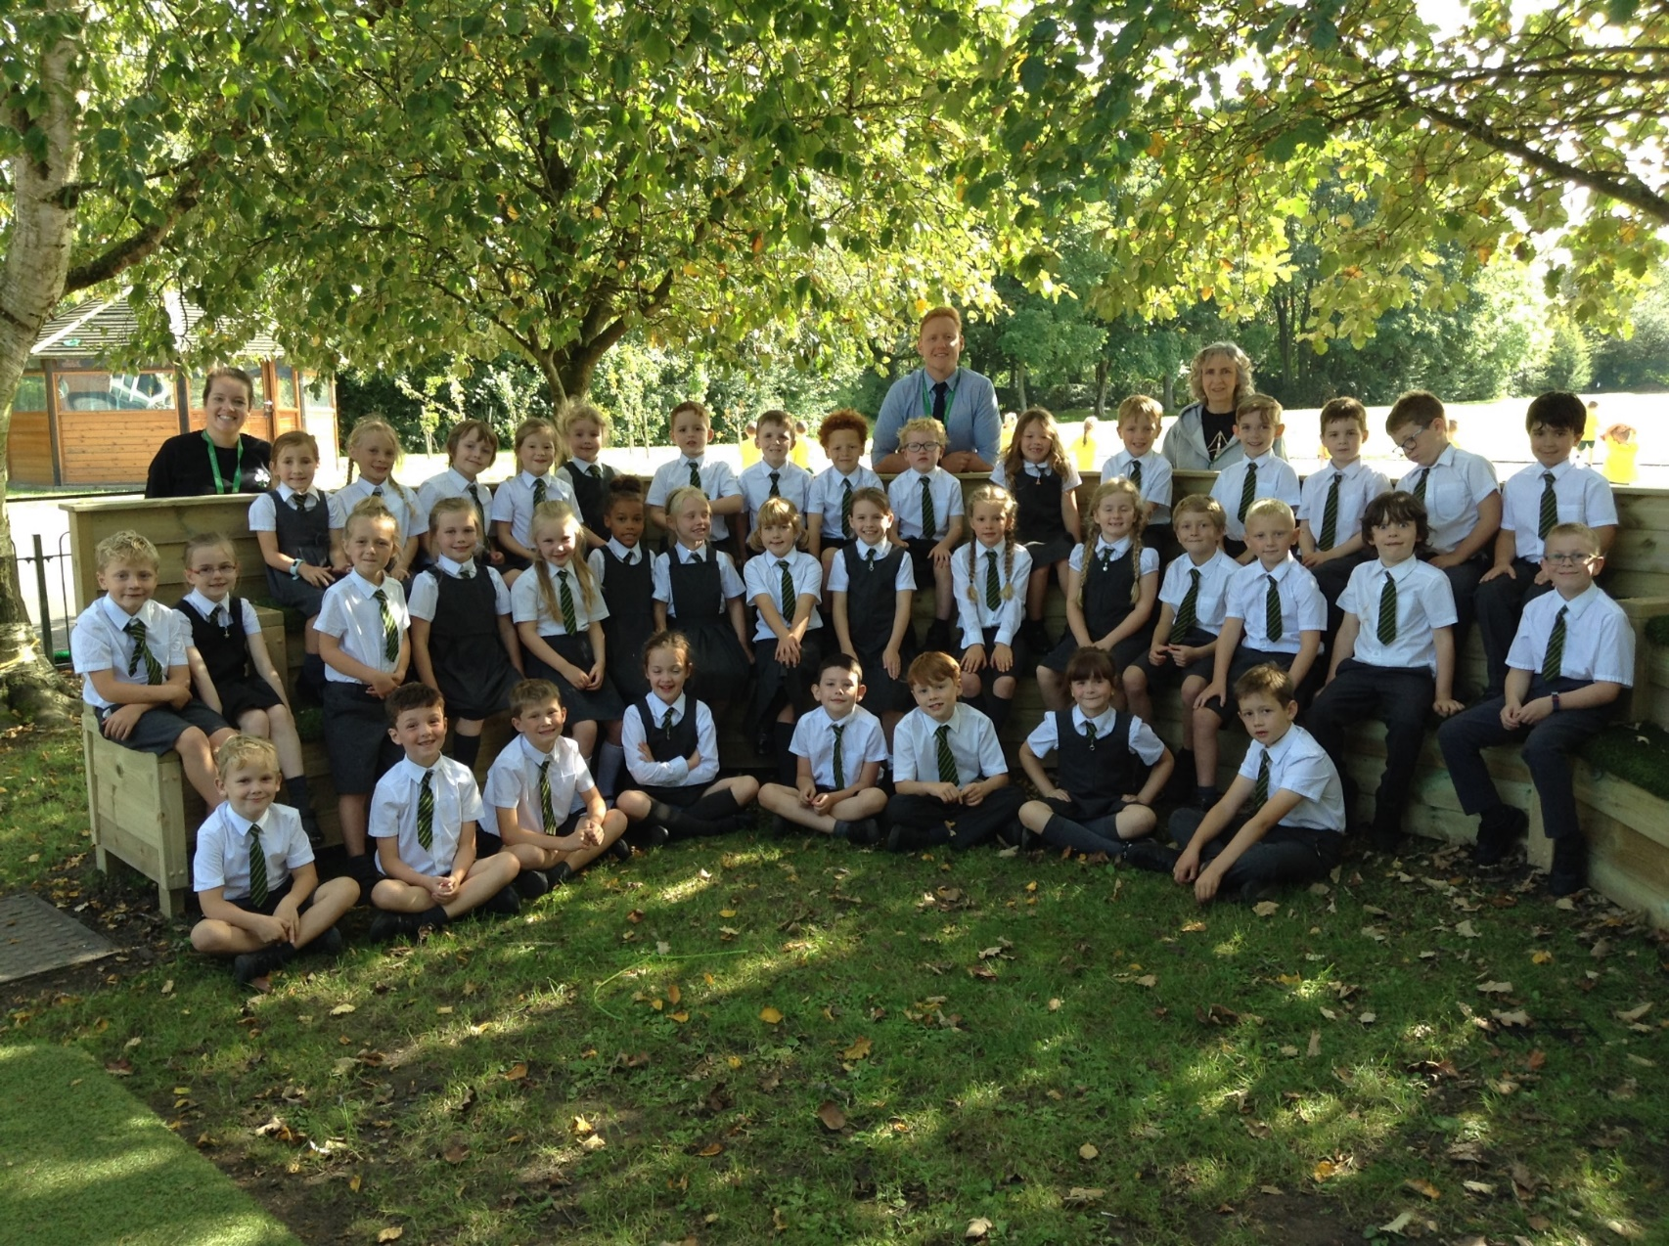
Year 2

Slide 3
Year 2 Teaching Team
Teacher:
Miss. Bennison
Mr. Ingram
Teaching Assistant:
- Mrs. Woof

Slide 4
Vision for the Year
For everyone to:
- Become more effective and resilient learners
- To achieve and exceed end of year expectations
- Enjoy their learning and have fun!
- Be ready by the end of the year for Y3

Slide 5
Reading and Literacy
- Reading and Literacy is taught daily through our class novel.
- Mrs Woof will listen to readers one-to-one.
- Miss Bennison and Mr Ingram will carry out guided reading sessions.
- Handwriting and presentation will be taught daily.

Slide 6
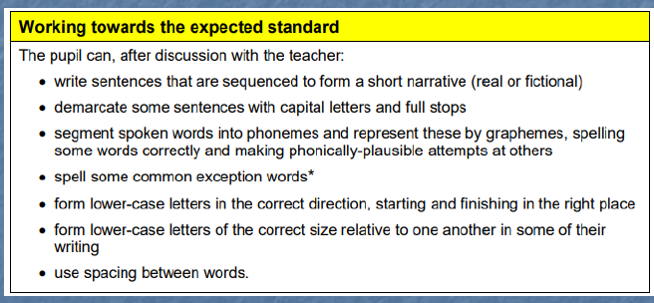

Slide 7
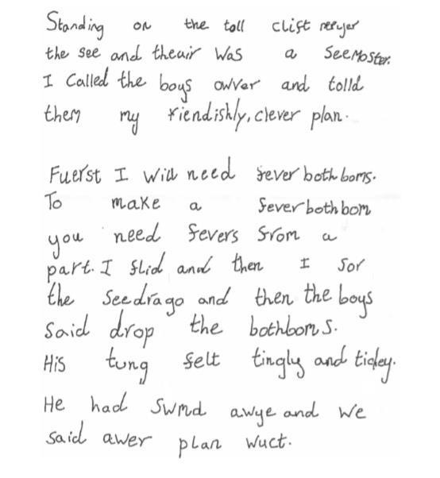
Working towards standard

Slide 8
Reading skills – Deduction
To make a judgement about something based on the information you have.
Example - A man was standing in the doorway. He looked out and put up an umbrella.
Deductive Question: What was the weather like? Answer: It was raining because he put up his umbrella to keep him dry.

Slide 9
Reading skills – Inference
To form an opinion that something is probably true because of other information that you already know.
Near the beginning of a story we find out the main characters’ have been watching a film about spies. Shortly after they see a neighbour looking in the bushes.
Inferential Question: Give two reasons why the girls may have thought Mr Shenks was a spy?
Answer: The reader could infer that he was searching for something and the fact the girls had been watching a spy film has made them suspicious.

Slide 10
Spelling, grammar and punctuation
Phonics and spellings will be taught daily.
In Year 2 we will begin to focus on using the correct spellings by using sounds in the right places.
Introduction of technical terms, spelling rules and tenses including verbs, nouns, adjectives, plurals, paste tense, suffixes etc.

Slide 11
Maths
Maths will be taught daily through whole class and group learning
Weekly arithmetic tests
x2, x10, x5 and x3 tables will be taught along with corresponding division facts.
Focus on understanding through fluency and reasoning
Practice and consolidation through Sumdog and Home Practice challenges

Slide 12

P.E.
- Children will take their PE kit home on a Friday for washing. Please return on the Monday.
- PE uniform: pupils can wear trainers and tracksuit bottoms during the winter months.
No jewellery.
- Please check your child’s name is on every item, including shoes.

Slide 13
Foundation subjects
In History we will focus on London Long Ago. We will study The great fire of London & the Great Plague, Samuel Peyps, knights and castles, King Arthur and Henry VIII.
In Geography we will study hot and cold places and equator along with weather and climate. We will use map reading and skills/field work around school and study a small area in the UK as well as a contrasting non-European country.
We will have RE lessons for 2 hours per week. In the Autumn term we will be looking at new beginnings, Preparations, signs and symbols.
All of the Year 2 Art work will link into our foundations subjects along with Design and Technology.
Year 2 will be taught Music and French on a Tuesday afternoon by Mrs Winter and Mrs Quilliam.

Slide 14
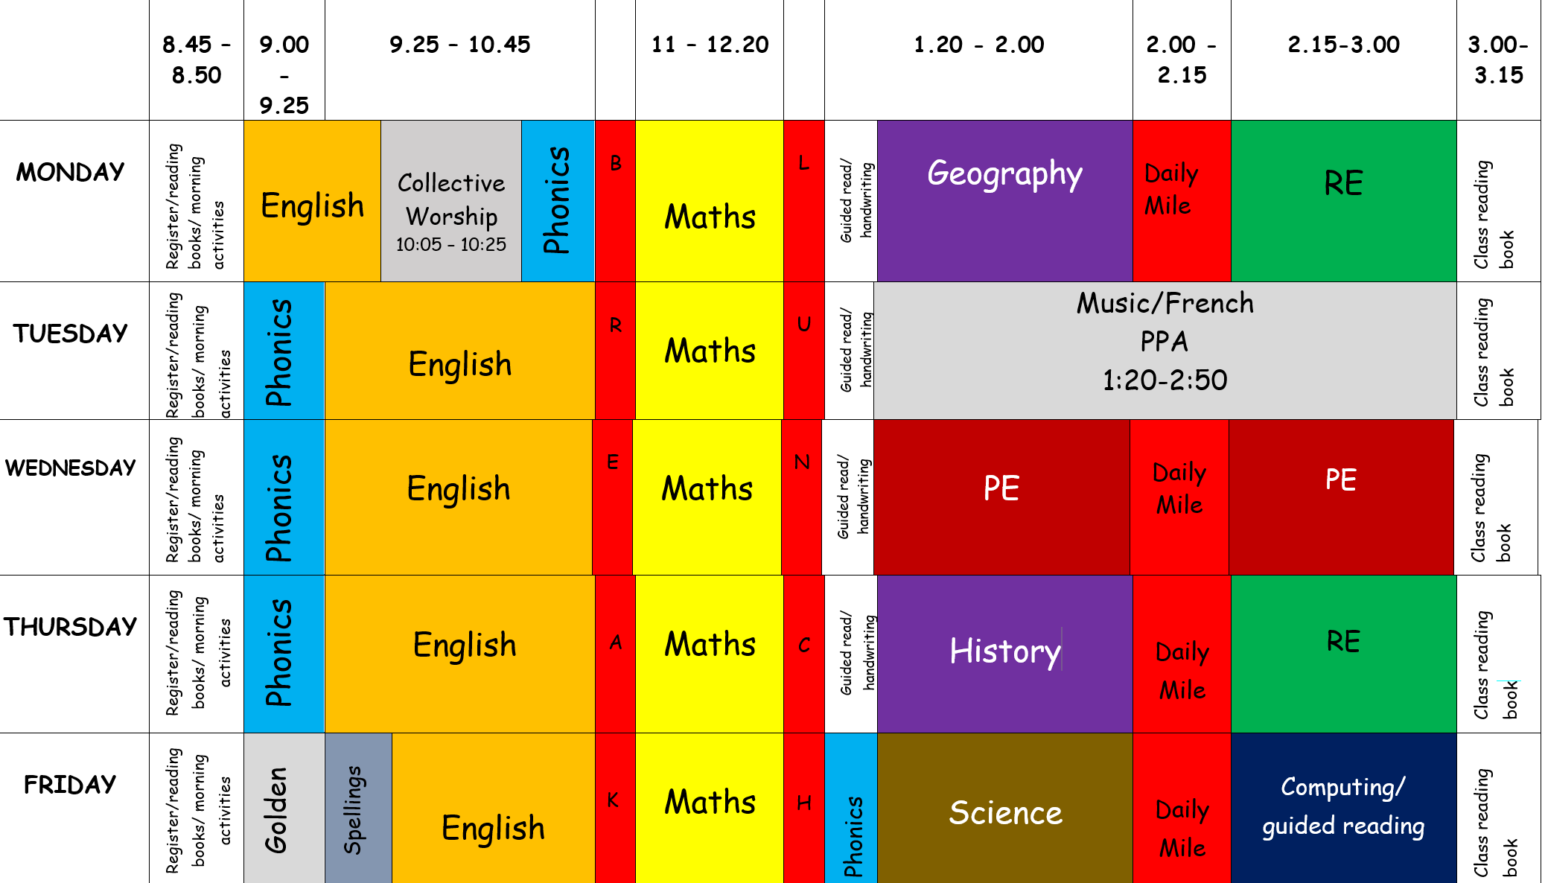
Timetable

Slide 15
Learning and behaviour Expectations
Rewards
Golds
Green slips
House points
Table points stickers golden assembly
Positive praise
Consequences
Sad face
Amber letter
Red letter
Missed play times
All children are expected to follow the Class and Golden Rules at all times.
End of year expectations for all our subjects including reading, writing and maths are available on the Year 2 page.
Everyone will have personal targets known as ‘Think Pinks’.

Slide 16
Growth Mindset, My Personal Best and Super Learners
Our aim is to help our children to develop positive attitudes to their learning.
We hope to develop resilient and confident learners.
Mistakes are welcome!
All this starts at home!

Slide 17

Online Safety
Taught throughout the Year alongside our PSHE curriculum
We follow the SMART e-safety rules

Slide 18
Home Practice
- Please keep an eye on our class blog which can be found on the school’s website.
- Spellings will be given out on a Friday and will be tested the following Friday. These will include phonics, spelling rules and common exception words.
- Children are to read at home daily for at least 15 minutes.
- Children should be practising 2, 5 & 10 times tables at home. Towards the end of Year 2 children should also be encouraged to learn their 3’s and 4’s.
Sumdog logins have been given out.

Slide 19
Finally…
If you have any issues or concerns, please do not hesitate to get in touch with the school office.
Thank you for your continued support.

