Slide 1

Welcome to Year 4
2020/21

Slide 2

The Team
Mrs Tipping and Mrs Whitworth

Slide 3

Vision for the year
For everyone to:
enjoy their learning.
achieve the very best that
they can.
become independent and confident learners.

Slide 4

Your child as a learner in Year 4
We will nurture the following personal skills and attitudes:
Self-confidence
Self-esteem
Independence
Resilience
Perseverance
Initiative
Problem solving
Enthusiasm
Opinion
Positive mind-set

Slide 5

How do we learn in Year 4?
By:
Listening attentively
Sharing ideas with others
Taking part in group work
Working individually
Reading and carrying out research
Working towards targets
Recording ideas and work

Slide 6

Year 4
Curriculum
English
Maths
Science
History – Celts, Romans, Anglo-Saxons
and Vikings
Geography – Coasts
Computing
Art / Design and Technology
PE
RE
PSHE (Personal, Social, Health Education)
Music – Mrs Winter
French – Mrs Quilliam

Slide 7

Timetable
English and Maths will be taught each morning and where necessary some afternoons.
RE will be taught during the week. We will also take part in Collective Worship.
A “Time to Talk” (PSHE) session will be taught once a week.
PE is usually on a Wednesday afternoon – please ensure your child’s PE kit is sent in on a Monday and kept in school. They will bring it home on a Friday to be washed.
French and Music are taught once a week.
Science, Geography, History, Art, DT and Computing are taught throughout the year.

Slide 8

Maths
This term we will be focussing on:
Place Value
Mental strategies
Written methods
Problem solving
Number facts
Table facts
Your child will be given an individual table target
They will be tested on this during the week.
Children in Year 4 need to be able to recall all their times tables upto 12 x 12 quickly, at random and accurately, as they will be tested on these in May 2021 in the new National Multiplication Check.

Slide 9

Reading and English
Reading books will be sent home w/c 21st September, however, your child will be heard reading in school at some point during the week.
Please read with your child at home for 20 minutes each evening and ask questions about what your child has read, the characters, the meanings of words and what they think might happen next.
English is taught daily through our class novel.
Writing is related to the class novel and is also cross curricular, linked to our topics.
Grammar and punctuation is taught explicitly during the week.
Handwriting will be taught explicitly and practised during the week.
Spellings will be taught explicitly during the week.
Children will need to practise their spellings at home
in preparation for a weekly test.
Please use the look, say, cover, write and check strategy – your
child should be familiar with this from class.

Slide 10
RE
Autumn Term
People
Called
Gift
Spring Term
Community
Giving and receiving
Self-Discipline
Summer Term
New life
Building bridges
God’s People

Slide 11
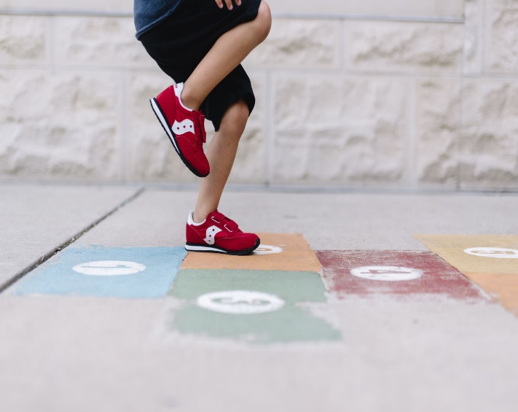
Daily Routines
A warm, waterproof coat should
be brought into school every day.
Water bottle with a sports top.
Fruit.
Packed lunch (if not having a school dinner).
Children may bring in their own hand sanitiser if they wish.
PE kit should be brought into school on a Monday and brought home on a Friday for washing.
Please do not bring in any other items or bags from home.

Slide 12

School website and Home Practice
Learning links can be found on the school website under ‘Parents’, ‘Home Learning Resources’. They are a safe way for your children to independently use the internet for learning purposes.
Home Practice will be on the school website every Friday on the Year 4 Class Page.

Slide 13

Home Practice
Will be on the school website on a Friday and will usually comprise:
Reading (20 minutes every night)
Spelling practice
Times tables practice (your child should know their individual target)
A maths and / or a multiplication challenge set on Sumdog
A spelling challenge set on Sumdog
A grammar / punctuation challenge set on Sumdog

Slide 14
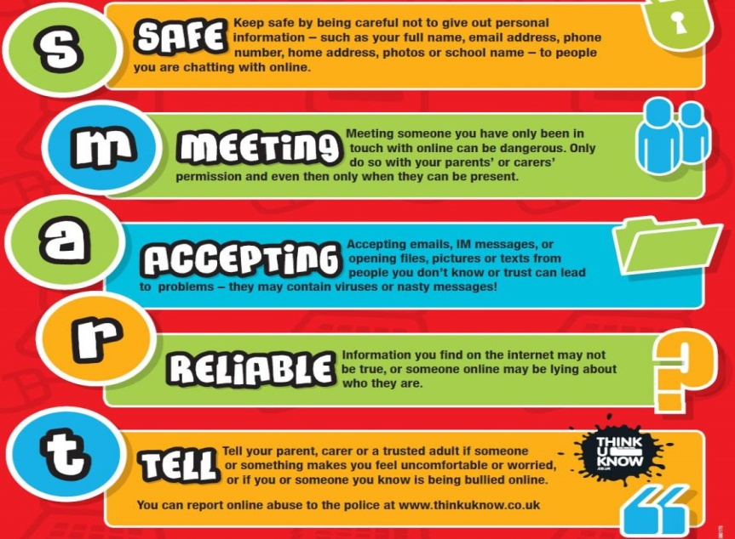
Online Safety
E-safety is taught in school. This will help to keep your child safe online.
We follow the SMART e-safety rules.
In Year 4 our lessons will cover:
What it means to be responsible and respectful offline and online
How to protect themselves from online identity theft
What to do if something worries or upsets them online
When it is OK to use the work of others

Slide 15

Behaviour Expectations
Pupils are expected to follow the class rules at all times and the Golden Rules of the school.
Rewards
    Green slips
    House points
    Class Dojos
    Stickers
    Golden assembly
    Star of the week
    Writer of the week
    Mathematician of the week
    Bookworm of the week
    Super Learner
    Special mention
    Gold

Slide 16
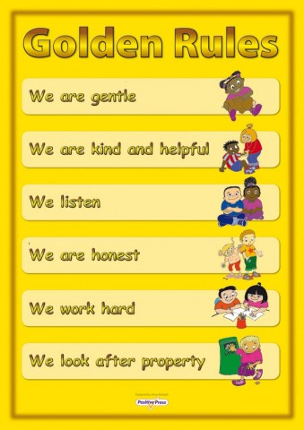
Our Golden Rules
We also have 2 new Golden Rules this year
We wash our hands
We don’t touch anybody

Slide 17
Expectations
Consequences:
Verbal warning
Sad face
Amber – referral to Headteacher
Red – Very serious – ‘Red Think Sheet’, ‘Incident Report’ letter home, telephone conversation with the Headteacher

Slide 18
Super Learners
We have a whole school focus to develop a positive attitude to learning and a ‘can do’ attitude ie resilience and perseverance.
Mistakes are good
We try and keep a positive mind-set
Instead of saying I can’t do this, we say I can’t do this yet
We do our best in everything that we do
We are proud of what we achieve

Slide 19
Safeguarding
Please ensure you have completed the End of Day form.
Collect and Go is in operation at the end of the day. Children should be collected from the playground at the stated time.
If there is an emergency or a problem at collection time, please ring the school as soon as possible and then we are aware of it - we will keep your child safe until you arrive.

Slide 20

And Finally...
We would like to take this opportunity to thank you for your support in this unique and difficult time.
We hope that together we can encourage the children in Year 4 to carry out everything they do to the best of their ability and do their very best in all aspects of school life.
Should you have concerns, please contact school by email or telephone and we will telephone you back as soon as we are able.

