Slide 1
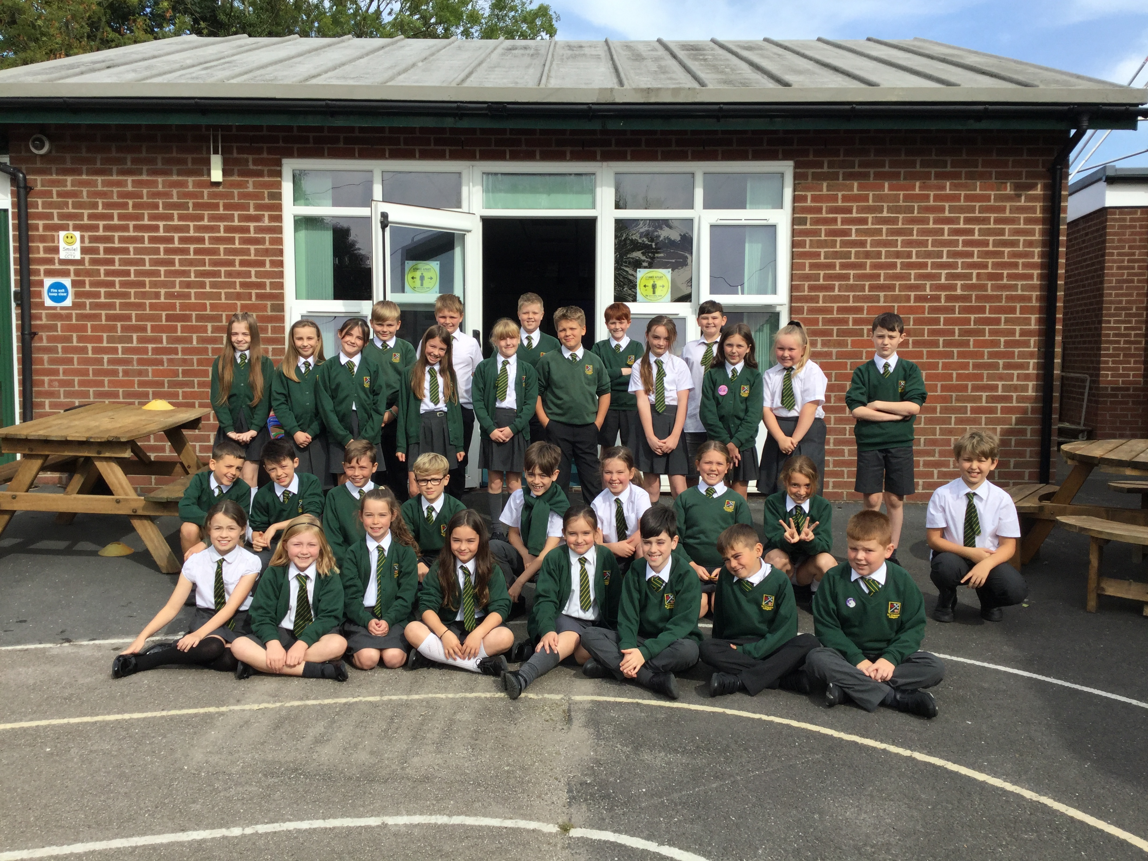
Welcome to Year 5
Miss Gravili
Mrs Mulgrew/Mrs Little

Slide 2
Visions for EVERYONE this Year:
To be interested and enjoy their learning.
To become even more independent and take on some responsibilities.
To become confident and resilient learners.
To achieve their personal best.

Slide 3
Year 5 Curriculum
English
Maths
RE
Science
Computing
History
Geography
Art
Design and Technology
Physical Education – Miss Gravili / Mrs Cookson
Music – Mrs Winter
French – Mrs Quilliam
End of Year 5 KLIPS (Website)

Slide 4

English
Reading:
  In Year 5 we are developing enjoyment of reading, stamina as a reader, comprehension and accessing a wider range of authors and texts through the following:
  Class novel
  Individual reading
  Silent reading
  Home reading

Slide 5

English
Writing:
In Year 5 we are working on purpose for writing through our novels/curriculum, content and technical aspects. We will be working on the following:
Fiction.
Non-Fiction.
Writing across the curriculum.
SPAG( spelling, punctuation and grammar)
Handwriting.

Slide 6
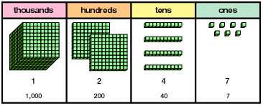
Maths
Mental methods.
Written methods
Place Value.
Fractions, Decimals and Percentages.
Shape, Measure, Data and Statistics.
Problem Solving.
Table Facts Facts(x2 – x12 fluently) and Number Facts.

Slide 7

RE
Autumn Term
    Ourselves
    Life Choices
    Hope
Spring Term
    Mission
    Memorial Sacrifice
    Sacrifice
Summer Term
    Transformation
    Freedom and Responsibility
    Stewardship

Slide 8

Timetable
Monday
  Collective Worship, Maths, English , PSHE (Talk Time)/Science.
Tuesday
  RE, English, Maths, PE, Computing.
Wednesday
  French/Music, English, Maths.
Thursday
  RE, English, Maths, History or Geography
Friday
  Golden Assembly, English, Maths, RE, Art.

Slide 9

Home Reading Books
Year 5 can change their books (1-3 books) on:
  Fridays
Please ensure the reading diary is signed to say the books have been read. The children may write down any new vocabulary and meanings, also comments about the story.
Please make sure your child’s book is in their bag every day.

Slide 10

Home Practice
Given out on Fridays:
  Reading everyday.
  Times table/number fact challenges on Sumdog.
  Spellings to learn for the following Friday and Sumdog challenge for that week’s rule.
  Spelling, Grammar and Punctuation (SPAG) challenges also on Sumdog.

Slide 11
Safeguarding Routines
The class are taken by the teacher to the playground to be collected.
After school club will also collect the children from the playground.
Thank you for the blue End of Day slips.
Medical Box – If necessary, please check the medication for your child is all up to date.

Slide 12

Online Safety
Taught in the Autumn term and revisited
regularly throughout the year.
We follow the SMART e-safety rules.
In Year 5, our focus is on:
Media Balance and well Being.
Privacy and Security.
Digital Footprint and Security.
Relationships and Communication.
Cyberbullying, Digital Drama and Cruel Speech.
News and Media Literacy.

Slide 13

As a school, we teach our children how to use the internet responsibly. However, due to the age restrictions for social media platforms, we advise you to be aware of the risks around social media.

Slide 14
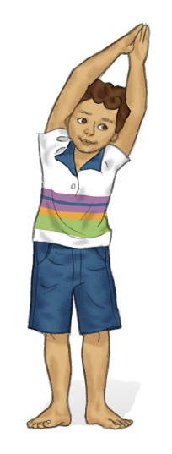

P.E / Sport
PE is on Tuesday afternoons.
Please have P.E bags in school on Monday. We will send kit home on Friday every week to wash.

Slide 15

Super Learners
I am a good listener
I am a good team worker
I am an independent learner. I think for myself.
I am a reflective learner.
I can make a great contribution to my class. I join in everything.
I can organise myself.

Slide 16

Expectations of the Pupils
Outstanding behaviour – to follow the Golden Rules at all times.
Rewards
    Green/Gold
    Green slips
    House points
    Stickers
    Certificates
    Raffle Tickets
    Golden Assembly

Slide 17

Expectations of the Pupils
Consequences
    Verbal warning
    Sad face
    Amber/Red – referral to Mrs Wood.

Slide 18


RSE – Relationships and Sex Education
This will take place in the spring Term.

Slide 19
Finally...........
Any questions?
If you need to speak to me at any time please make an appointment with Mrs Rothwell.

