Slide 1
Welcome to Year 6
Mr Mears Mrs Jones
Mrs Wilson Mrs Wood

Slide 2
Vision for the year
For EVERYONE to:
become more effective and resilient learners
be independent – adaptable and able to use their own initiative
enjoy their learning – happy and enthusiastic
develop their self confidence and self esteem
achieve their very best in everything that they do
be prepared for their transition to high school
be responsible and reliable

Slide 3
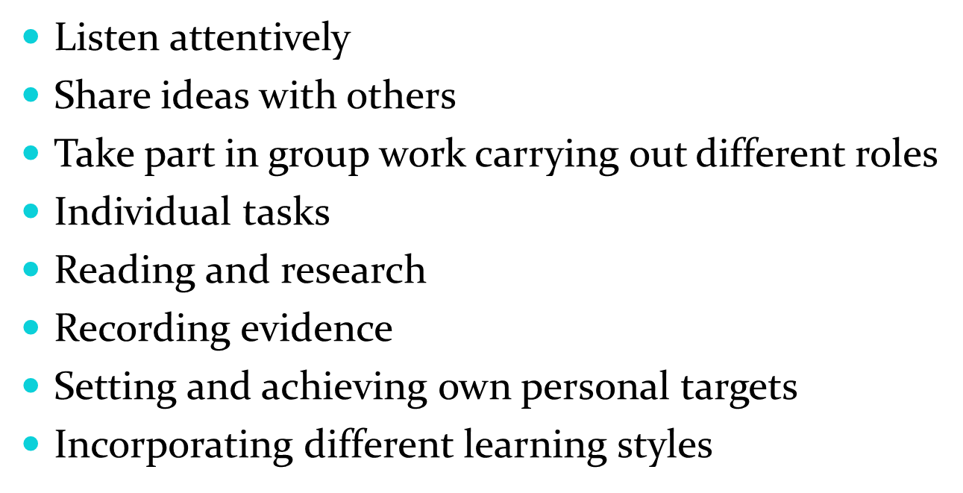
How we learn in Year 6?

Slide 4
Year 6 curriculum in brief
English / Maths – every morning, Monday to Friday
Science / Computing / History / Geography / Art / Design and Technology timetabled for the afternoons
Religious Education – timetabled for two and half hours every week
Physical Education – Mr Mears / Mrs Cookson to teach PE on Monday afternoons (please bring PE kit every Monday and leave it in school all week – your child will bring it back every Friday for it to be washed)
Music – Mrs Winter leads Music every Wednesday
French – Mrs Quilliam leads French every Wednesday

Slide 5

English (Reading)
There are many reading opportunities every day in Year 6 which include:
  Home reading
  Silent reading
  Guided reading (in small groups)
  Class novel
  Class Library
  In Year 6 we are developing stamina as a reader and accessing a wide range of authors and texts
  Regular reading helps to develop vocabulary, improve spellings and the ability to read at pace and with understanding.

Slide 6

English (Writing)
In Year 6, we write every day :
  English lessons, where we teach
    Range of genres (fiction / non-fiction)
    Grammar (SPaG)
    Handwriting
  Writing across the curriculum
    Science, Geography, RE, History
  Handwriting – all handwriting should be joined and legible
  Good readers = Good writers

Slide 7
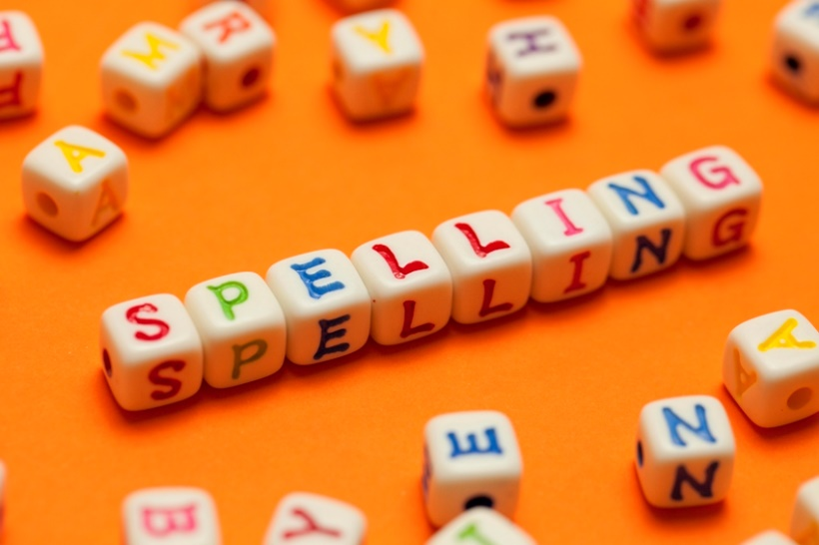
Spelling
We focus on a different spelling pattern or spelling rule each week
Spellings handed out on Friday, test on the following Friday
Main Spelling Strategies:
  1. Does it look right?
  2. Rhyming words
  3. Syllables
  4. Mnemonics
  5. Look, Say, Write, Cover, Write, Check

Slide 8

Maths
We use a range of strategies in Year 6:
  Mental methods – the ability to recall and calculate at pace
  Written methods – we practice formal method followed in our ‘Written Calculations Policy’
Problem Solving / Reasoning – every lesson has some challenge so everyone can use their Maths skills to apply them to a range of contexts
Table Facts
  It is important that everyone knows their table facts forwards and backward, multiplications and divisions, fluently)
  x2 – x12
Number Facts (to 1, 10, 100, 1000)
  This is being able to recall that 6 + 4 = 10, so therefore 0.6 + 0.4 = 1, 60 + 40 = 100, 600 + 400 = 1000, etc)

Slide 9

RE
Autumn Term
    Loving
    Vocation and Commitment
    Expectations
Spring Term
    Sources
    Unity
    Death and Life
Summer Term
    Witnesses
    Healing
    Common Good

Slide 10
Home Reading books
Year 6 can change their book on:
  Monday / Tuesday / Wednesday (depending on their group)
  Roller Coaster / Big Dipper / Waltzer
Your child will fill in their Reading Journal as much as possible and bring it in any day
Please make sure your child reads 20 minutes a day

Slide 11
Home Practice
Begins on Fridays
It is vital that your child practises the basics daily:
  Reading at least 20 minutes a day.
  Table facts (x2 – x12)
  Sumdog challenges (explained on next slide):
    Maths Practice
    Spelling Practice
    SPaG Practice

Slide 12
Home Practice
As part of the Home Practice, we would like every child to complete the Sumdog challenges every week. They will consist of a:
    Maths challenge
    Spelling challenge
    SPaG challenge
Each challenge will have 100 questions to complete, using any game they choose.
Little and often will help to learn these basic skills so do not think they have to complete them in one day.

Slide 13
How can you help?
Listen to your child read often (even though they are great readers, it is still important for them to develop expression, understanding and discussion of new vocabulary)
Help them to learn their spellings of the week (little and often works best)
Keep practising number bonds and times tables (each child has a their own target weekly)

Slide 14
Safeguarding routines
Drop and Go:
8.35am Families with siblings arrive
8.45am Families with Infants arrive
8.55am Families with Juniors arrive
Collect and Go:
3.05 Families with Infants depart
3.15pm Families with Juniors depart
3.20pm Families with Siblings depart

Slide 15

Online Safety
Taught in the Autumn term and revisited regularly
throughout the year.
We follow the SMART e-safety rules.
In Year 6, our focus is on:
the use of age appropriate websites including social media;
not sharing personal information online;
knowing what to do if something worries or upsets them online.
As a school, we teach our children how to use the internet responsibly. However, due to the age restrictions for social media platforms, we do not expect to address issues arising from the use of social media.

Slide 16


Slide 17
Physical Education
PE is on Monday afternoons
Please bring in the PE kit on Monday where it will be kept in school for the week
Every child will take their PE kit home on Friday to have it washed

Slide 18
Statements of a super Learner
I am a good listener
I am a good team worker
I am an independent learner. I think for myself.
I am a reflective learner.
I can make a great contribution to my class. I join in everything.
I can organise myself.

Slide 19
Expectations of the Pupils
Outstanding behaviour – to follow the class rules at all times and the Golden Rules of the school.
Rewards
    Green slip
    House points
    Stickers
    Star of the Week
    Writer of the Week
    Marvellous Mathematician
    Bookworm of the Week
    Super Learner
    Gold

Slide 20
Expectations of the Pupils
Consequences
    Verbal warning
    Sad face
    Amber – referral to Headteacher
    Red – Very serious – ‘Red Think sheet’, ‘Incident Report’ and meeting with Headteacher

Slide 21
Finally...........
Any questions?
If you have any concerns, please make a telephone appointment via the office.

