Slide 1
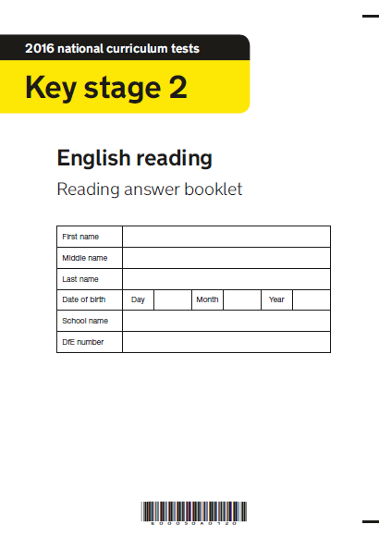
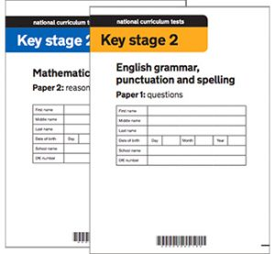
SATs 2026

Slide 2
What are the SATs?
SATs are the Standardised Assessment Tests that are given to children at the end of Key Stage 2.
The SATs take place over four days, starting on Monday 11th May ending on Thursday 14th May.
The SATs papers consist of:
  Grammar, punctuation and spelling (Paper 1: GPS) – Monday 11th May
  Grammar, punctuation and spelling (Paper 2: Spelling) – Monday 11th May
  Reading – Tuesday 12th May
  Maths (Paper 1: Arithmetic) – Wednesday 13th May
  Maths (Paper 2: Reasoning) – Wednesday 13th May
  Maths (Paper 3: Reasoning) – Thursday 14th May

Slide 3
How the SATs are administered
The tests take place during normal school hours, under exam conditions.
Children are not allowed to talk to each other from the moment the assessments are handed out until they are collected at the end of the test.
After the tests are completed, the papers are sent away to be marked externally.
The results are then sent to the school in July.
Each test lasts no longer than 60 minutes:
Spelling, punctuation and grammar (Paper 1: Grammar/ Punctuation) – 45 minutes
Spelling, punctuation and grammar (Paper 2: Spelling) – 15 minutes
Reading – 60 minutes
Maths (Paper 1: Arithmetic) – 30 minutes
Maths (Paper 2: Reasoning) – 40 minutes
Maths (Paper 3: Reasoning) – 40 minutes

Slide 4
SATs Results
Tests are marked externally. Once marked, the tests will be given the following scores:
A raw score (total number of marks achieved for each paper);
A scaled score;
A judgement on if the National Standard has been met.
After marking each test, the external marker will convert the raw score to a scaled score. Even though the tests are made to the same standard each year, the questions must be different. This means the difficulty of the tests may vary. Scaled scores ensures an accurate comparison of performance over time.
Scaled scores range from 80 to 120.
A scaled score of 100 or more shows the pupil is meeting the National Standard.
A scaled score of 110 shows that the pupil has achieved greater depth at the standard.

Slide 5
Grammar, Punctuation and Spelling: Monday 11th May
Grammar, punctuation and spelling consists of two papers.
Paper 1 focuses on all three elements (grammar, punctuation and spelling or GPS). The paper lasts for 45 minutes.
Paper 2 consists of a spelling test only. It should take approximately 15 minutes, although this is not a set amount of time (pupils should be given as much time as they need to complete the test).

Slide 6
SPAG
This test focuses on:
Grammatical terms/ word classes;
Functions of sentences;
Combining words, phrases and clauses;
Verb forms, tenses and consistency;
Punctuation;
Vocabulary;
Standard English and formality.
This test requires a range of answer types but does not require longer formal answers.

Slide 7
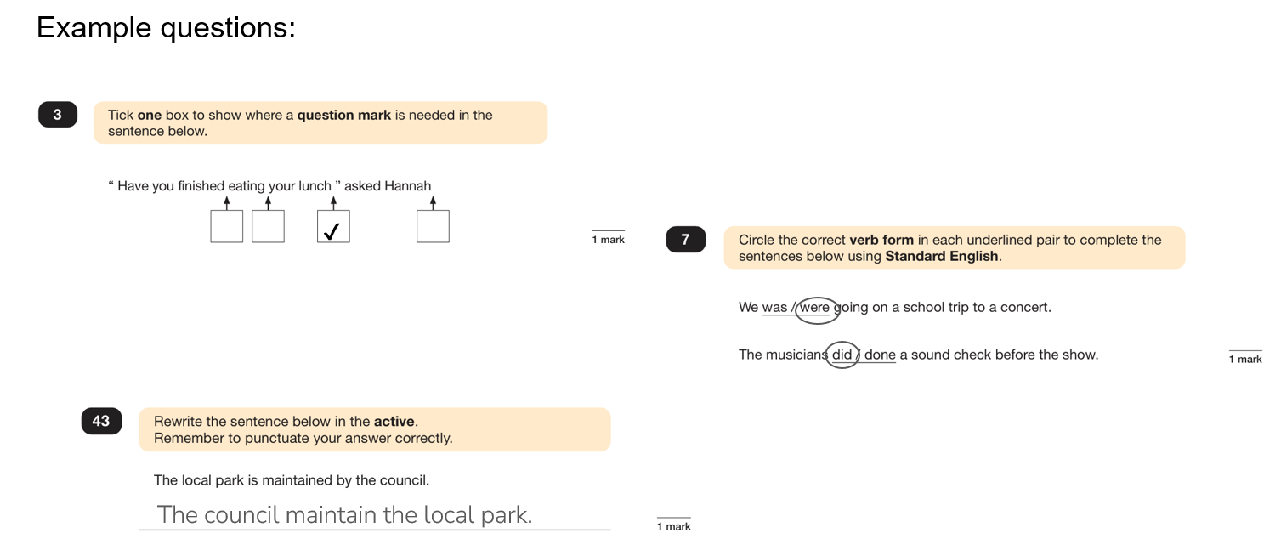

Slide 8
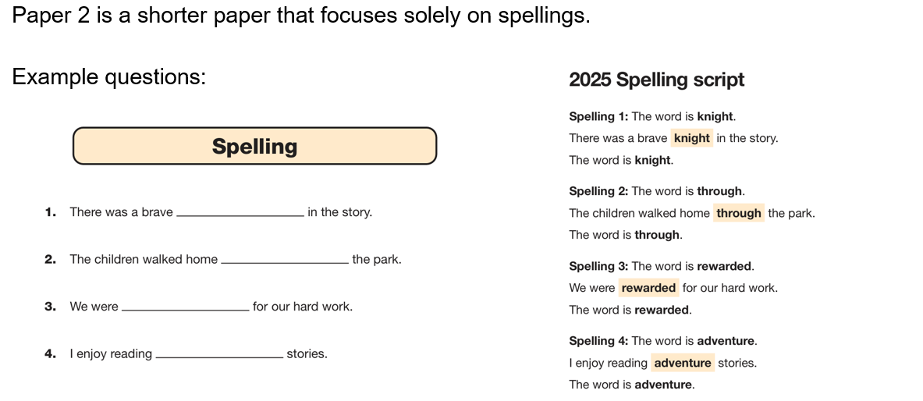

Slide 9
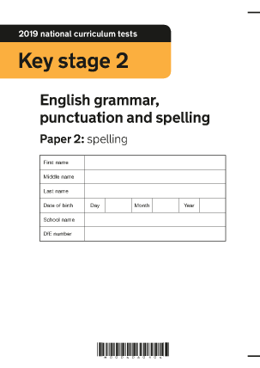
SPAG: In Class
We are revising our SPAG knowledge with SATs boot camp.
We have two SPAG sessions and one spelling session weekly to revise key grammar and spelling rules.
Children are learning test technique as part of these sessions.

Slide 10

SPAG: At Home
Completing the boot camp home practise.
Completing the overnight home learning. There will be two evenings a week where the focus will be grammar or spelling.
Learning the weekly spellings for our tests – these are the statutory words or rules that your child needs to know for their SATs.

Slide 11
Reading: Tuesday 12th May
There is one reading test that lasts for 60 minutes.
The test is designed to measure if the children’s comprehension of age-appropriate reading material meets the national standard. There are three different set texts for children to read. These could be any combination of non-fiction, fiction and/ or poetry.
The test covers the following areas (known as Content Domains):
Give/ explain the meaning of words in context;
Retrieve and record information/ identify key details from fiction and non-fiction;
Summarise main ideas from more than one paragraph;
Make inferences from the text/ explain and justify inferences with evidence from the text;
Predict what might happen from details stated and implied;
Identify/ explain how information/ narrative content is related and contributes to meaning as a whole;
Identify/ explain how meaning is enhanced through choice of words and phrases;
Make comparisons within the text.

Slide 12
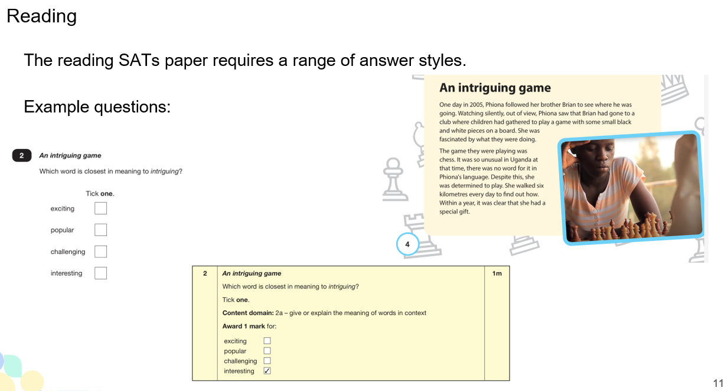

Slide 13
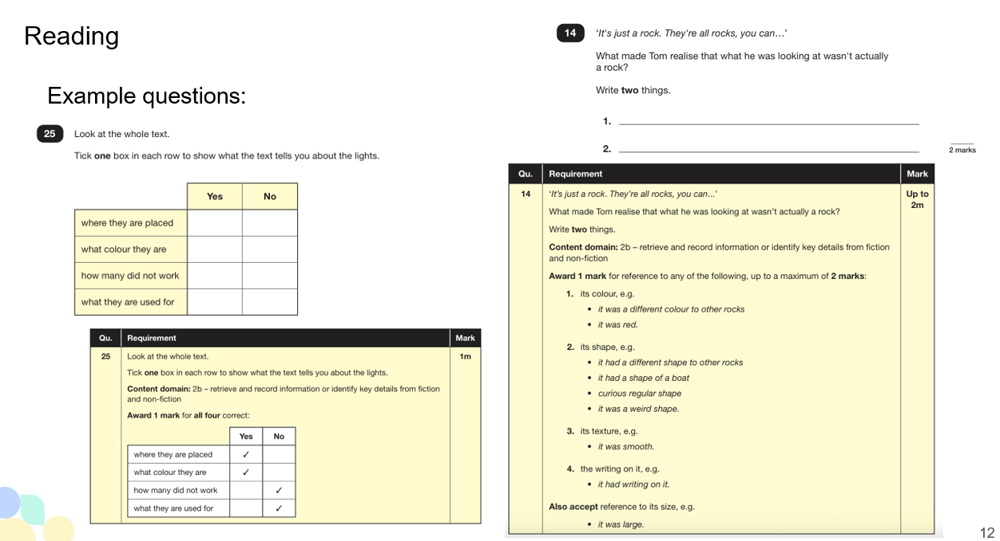

Slide 14
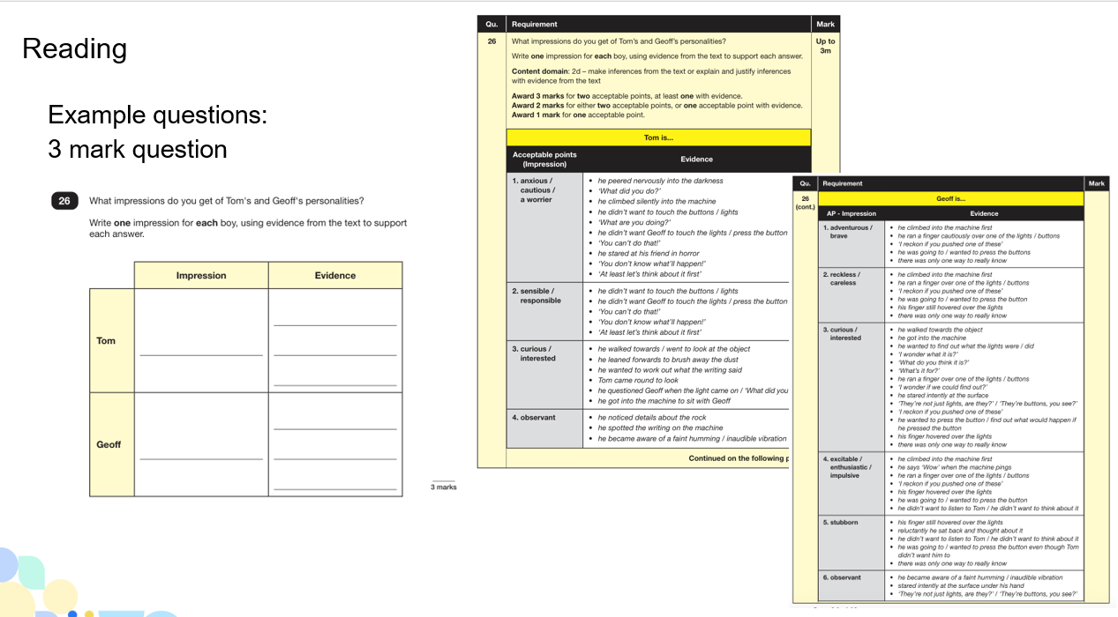

Slide 15

Reading: In Class
In class our guided reading sessions are based on past papers.
Every session, we mark and discuss the answers together, including ‘test technique’.
I have been sharing the mark scheme with children so they can understand what the questions are asking them to do.

Slide 16
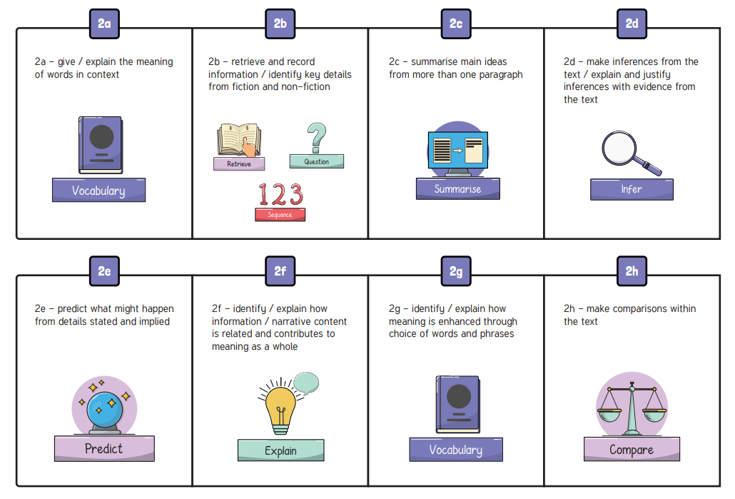
Reading: At Home
Read for 30 minutes each night with your child.
When you read together, check understanding by questioning with the reading domains.
Complete the reading comprehension home practise.

Slide 17
Reading: At Home
Since the current testing formation for the SATs began in 2016, there has been a tendency for three types of questions to be the most popular.
In the 2025 Reading SATs paper,
12% of marks could be gained from answering questions involving giving and explaining the meaning of words in context;
30% of marks could be gained from answering questions involving retrieving and recording information or identifying key details from a text;
48% of marks could be gained from answering questions involving making inferences from a text and justifying inferences with text evidence.
When reading with your child at home try focusing on these types of questions.

Slide 18
Maths: Wednesday 13th May and Thursday 14th May
The maths assessments consist of three tests.
Paper 1: Arithmetic (30 minutes) – Wednesday 13th May
Paper 2: Reasoning (40 minutes) – Wednesday 13th May
Paper 3: Reasoning (40 minutes) – Thursday 14th May

Slide 19
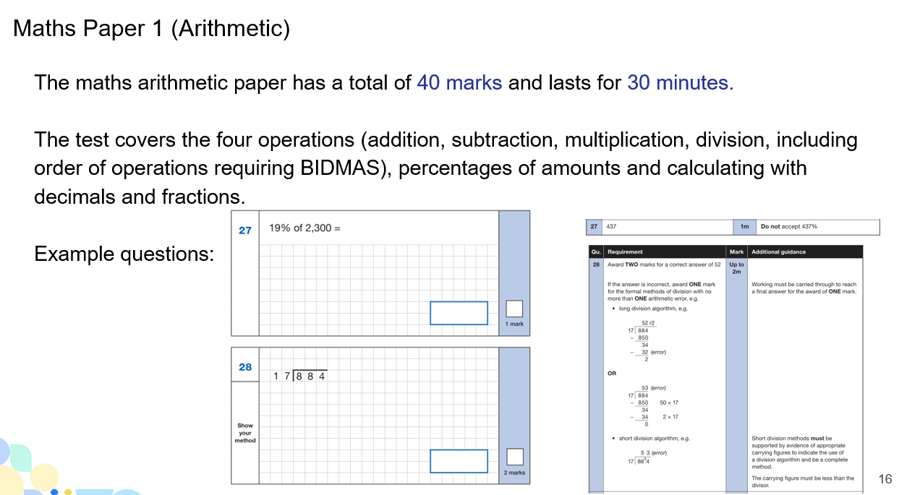

Slide 20
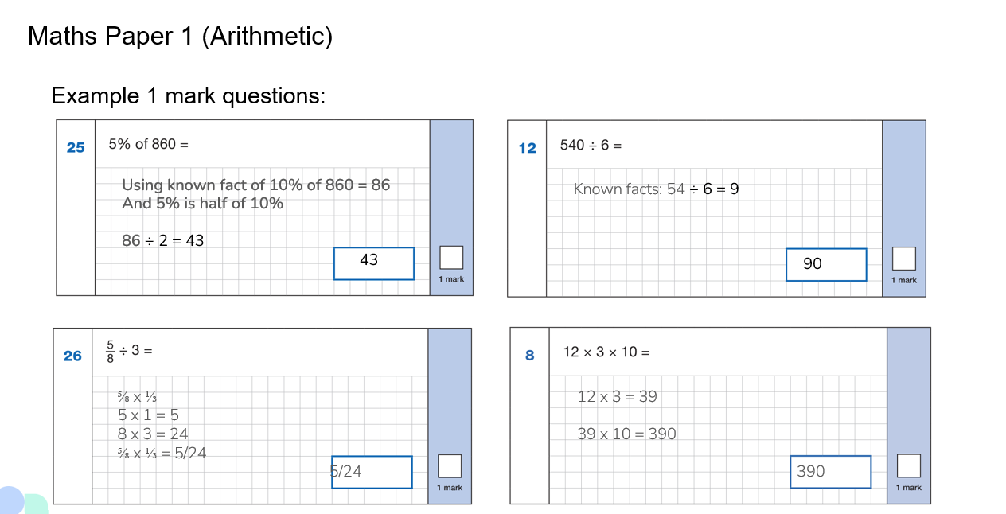

Slide 21
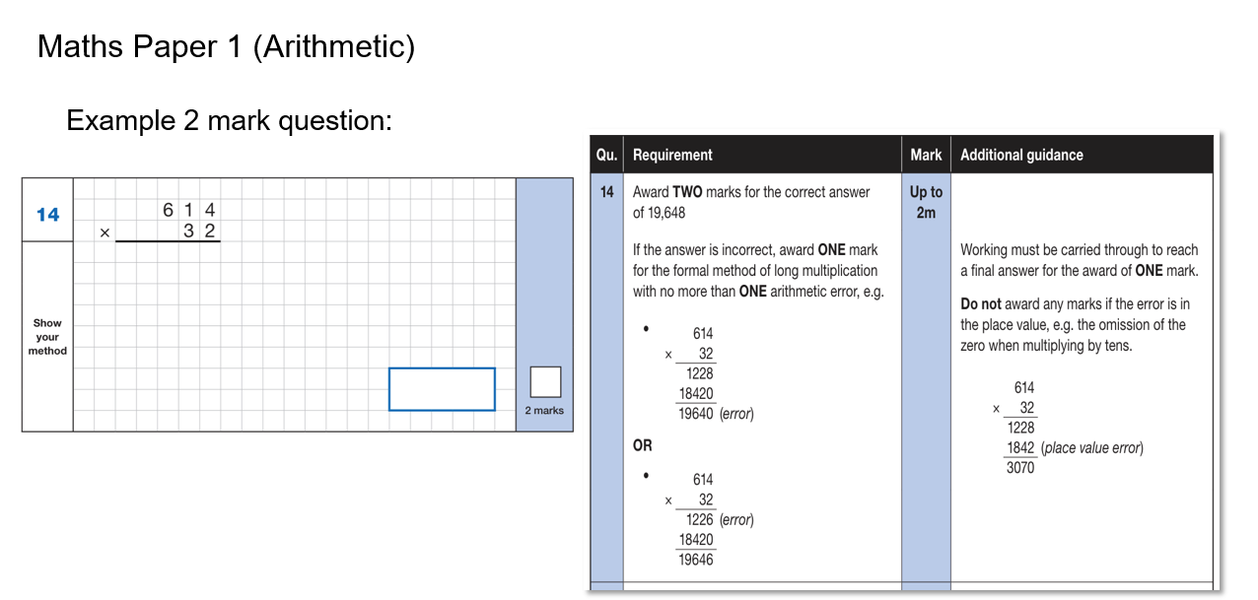

Slide 22
Maths Papers 2 and 3 (Reasoning)
Paper 2 will take place on Wednesday 13th May and paper 3 will take place on Thursday 14th May. These tests have a total of 35 marks each and lasts for 40 minutes each.
These papers require children to demonstrate their mathematical knowledge and skills, as well as their ability to solve problems and their mathematical reasoning. They cover a wide range of mathematical topics from key stage 2 including:
Number and place value (including Roman numerals);
The four operations;
Geometry (properties of shape, position and direction);
Statistics;
Measurement (length, perimeter, mass, volume, time, money);
Algebra;
Ratio and proportion;
Fractions, decimals and percentages.

Slide 23
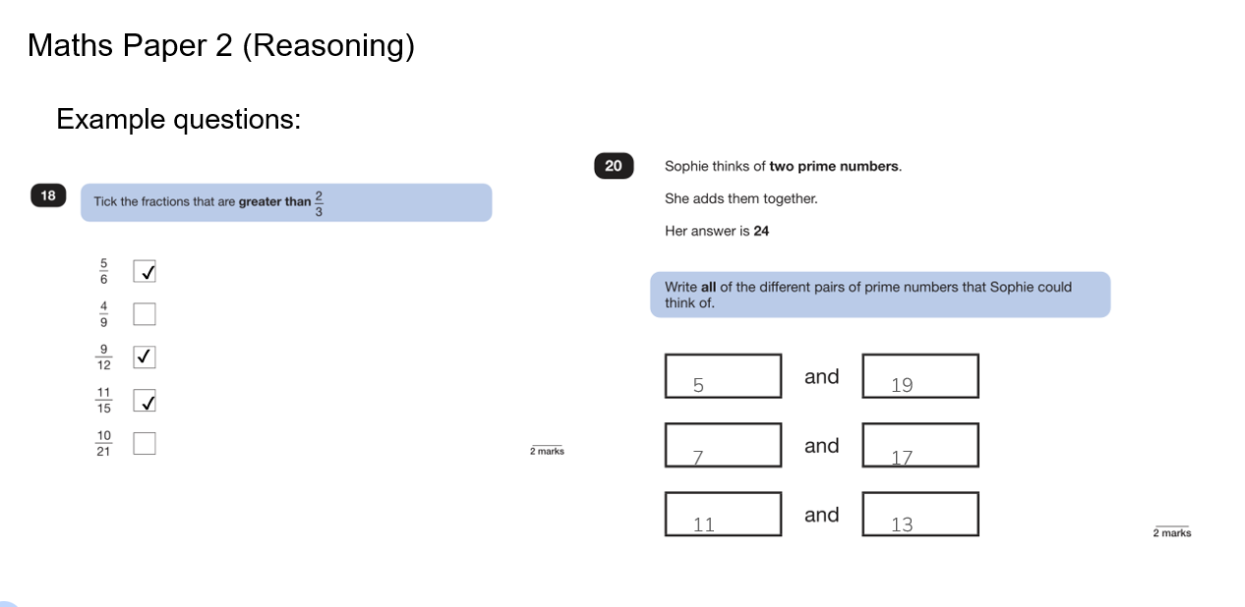

Slide 24
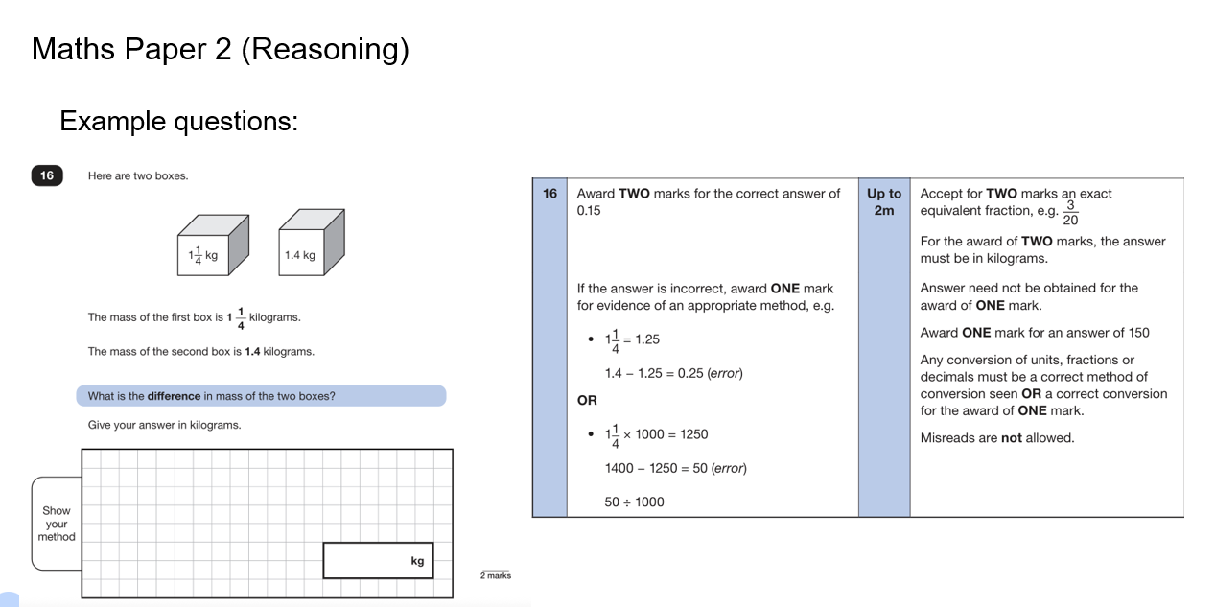

Slide 25
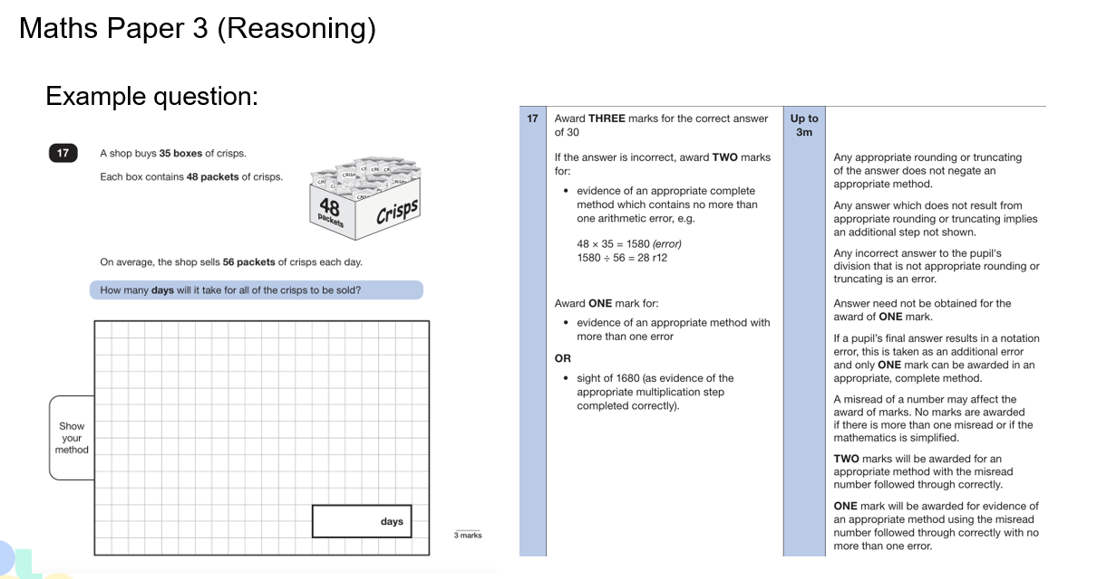

Slide 26
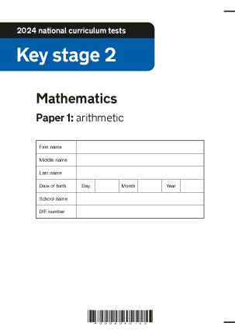
Maths: In Class
In class we now have increased practise of arithmetic questions.
We also begin each Maths lesson with reasoning questions from past papers.
We have been learning about test technique and how to apply our learning to reasoning questions.
Our times table tests continue each Friday.

Slide 27


Maths: At Home
Completing the boot camp home practise.
Completing the overnight home learning. There will be two evenings a week where the focus will be arithmetic or reasoning.
Practising times tables – Times Table Rock Stars.
Helping your child to learn key Maths facts and formula!

Slide 28
Supporting your child
Firstly, a positive attitude goes a long way. Give them as much encouragement and support as you can (but we don’t need to tell you that)!
Tips:
Don’t use past papers as they are used in school to prepare the children.
Attend any SATs meetings at school (or read any literature sent home).
Talk to your child’s class teacher if you have any concerns rather than worry your child.
Encourage your child to talk to their teacher or a trusted adult (including yourself) about their anxieties. Don’t forget that a small amount of anxiety is normal and not harmful.
Give your child a quiet, distraction free space to complete homework or study.
Give your child time to go outside and reduce screen time.
Ensure your child is eating and drinking well and getting a good amount of sleep.
Plan something nice and fun for the weekends before and after SATs. This will help them to relax before the SATs and give them something to look forward to after.

Slide 29
Things to remember about SATs
SATs focus on what children know about Maths and English.
They will not reflect how talented they are at science, geography, art, PE…, and they certainly won’t highlight all their amazing personal characteristics.
SATs don’t tell the whole story.
Their results will say if they did or did not meet a certain standard but not necessarily by what margin. These thresholds change each year according to the overall national performance, so what was classed as ‘meeting the expected standard’ this year might not be the same as last year. Your school may be able to provide you with more detailed feedback.
SATs are only four days out of a whole Primary School career.
In reality, there's one or two papers each day that last 30 to 60 minutes.

Slide 30
Robin Wood
Wednesday 4th to Friday 6th February 2026

Slide 31


Slide 32
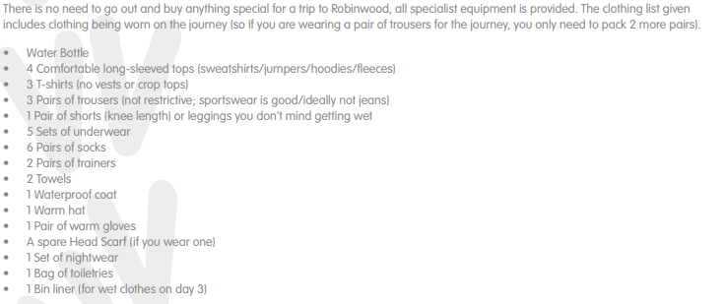
Kit List

Slide 33
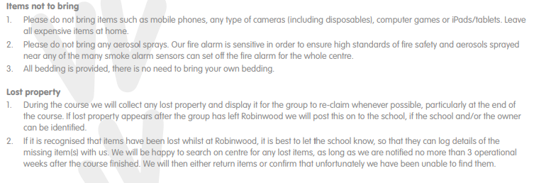

Slide 34
Wednesday 4th February
Come to school in your own clothes (outdoor clothes as we have a 1 mile walk to the castle!)
Put your luggage next to the green room
Make sure any medication is handed to Mrs Rothwell in the office on Tuesday 3rd February
We will leave school at approximately 9:30am

Slide 35
Friday 6th February
We will return to school at approximately 3.00/3.15pm

