Slide 1

Welcome to Year 3
2025-2026

Slide 2

Mr Campbell Mrs Woof
Mrs O’Neill Mrs Tiley

Slide 3

Your child as a learner in Year 3
We will nurture the following personal skills and attitudes:
Self-confidence
Self-esteem
Independence
Resilience
Initiative
Problem solving
Enthusiasm
Opinion
Positive mind-set

Slide 4

How will your child learn in Year 3?
Listening attentively
Sharing ideas
Working within groups
Working individually
Reading and research
Thinking skills
Recording

Slide 5
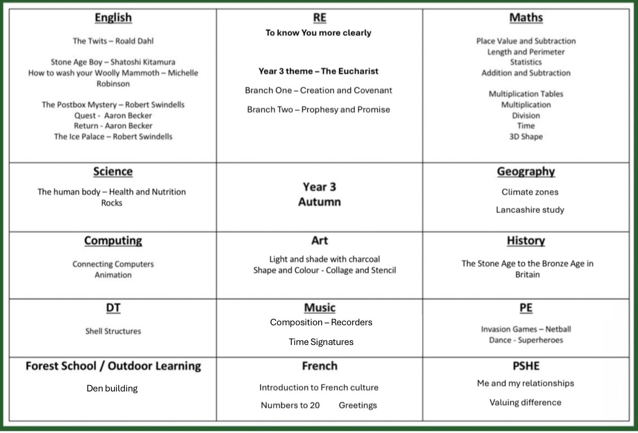
Curriculum

Slide 6

English
Reading in many different contexts
Class novels
Writing related to the class novel and cross curricular opportunities
Spelling rules through games and activities daily
Handwriting
Grammar and punctuation

Slide 7

Maths
Red Rose Mastery Scheme
Mental methods
Written methods
Place Value
Problem Solving and reasoning – Deeper Learning
Table Facts
  x2, x5, x10, x3, x4, x8 (test every Friday)
Number Facts
  Number bonds to 20 / 100

Slide 8

Religious Education
To know You more clearly
Autumn Term
    Creation and Covenant
    Prophesy and Promise
Spring Term
    Galilee to Jerusalem
    Desert to Garden
Summer Term
    To the ends of the Earth
    Dialogue and Encounter

Slide 9

Timetable:
English and Maths every day.
R.E. and collective worship every week.
P.E. is on a Tuesday afternoon.
Swimming is on a Monday afternoon during the Autumn term
French and Music are taught once a week.
PSHE, Science, Art, Geography, History, DT and Computing are taught termly.
Forest School on Mondays
Home Practice on the school website on Fridays.

Slide 10

Reading
- Children are responsible for changing their books when they have finished them. Mrs Woof and Mrs Lancaster will always be there to help.
- Please ensure the reading diary is signed.
- Please make sure your child’s book is in their bag every day.
- Your child should read at home every night, to a parent or carer, grandparent, sibling or friend.

Slide 11

What to bring:
A warm, waterproof coat
Reading book
Water bottle with a sports top
Wellies for Forest School –Sprint Term
Fruit snack
P.E. kit should be in school every day. Children can wear trainers for outdoor sessions but they still need black pumps for inside.
Swimming kit on Mondays
Name in everything.

Slide 12

Friday Blog
Every Friday we will blog to let you know what learning we have done during the week.
We will include links to galleries of our learning.
We also will outline the practice your children need to do over the coming week at home.
Reading, Spelling and Maths.

Slide 13
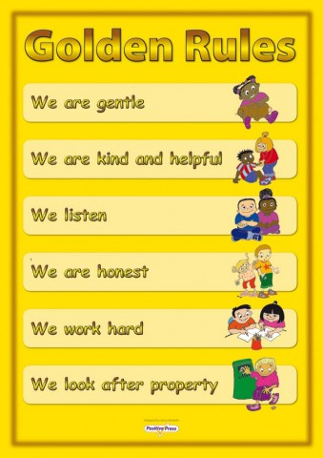
Behaviour expectations:
    Gold, double gold and triple gold!
    House points/Dojos
    Stickers
    Golden Assembly
    Class Rules
    Golden time
    Praise

Slide 14
Safeguarding Routines
End of day
End of day form.
If there is an emergency or a problem please ring school as soon as possible and then we are aware of it and will keep your child until you arrive
Children always to be collected from the playground.

Slide 15


Slide 16
And finally:
Please ensure your child's medication is in school.
If you have any queries, make an appointment at the school office and we will see you as soon as possible.

