Slide 1
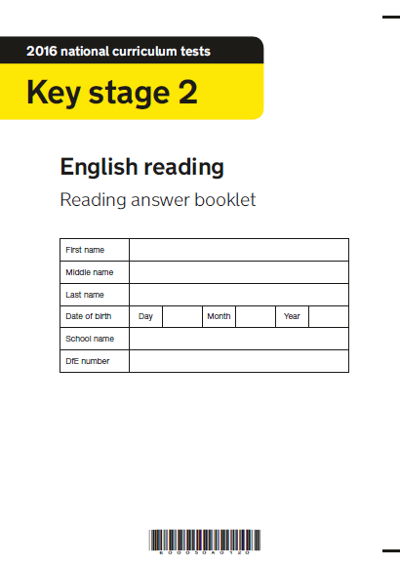
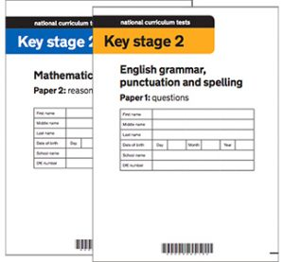
SATs 2025

Slide 2
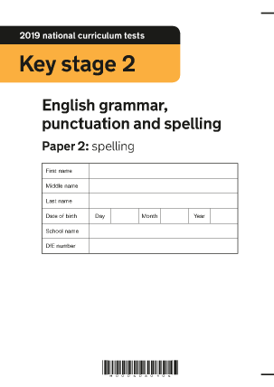
SPAG: In Class
We are revising our SPAG knowledge with SATs boot camp.
We have two SPAG sessions and one spelling session weekly to revise key grammar and spelling rules.
Children are learning test technique as part of these sessions.

Slide 3
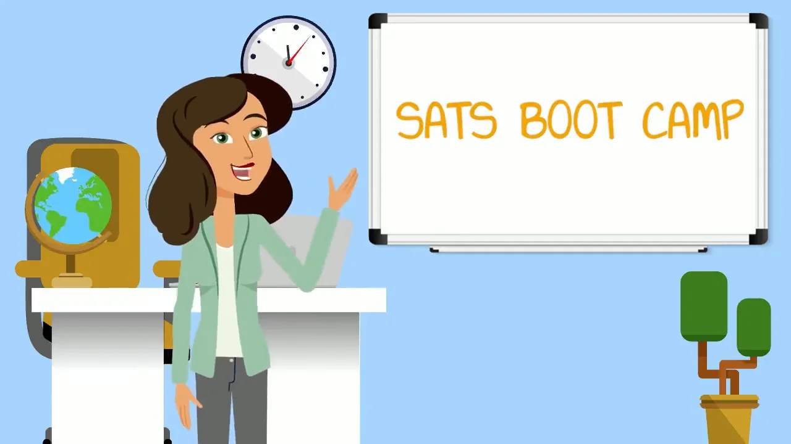
SPAG: At Home
Completing the boot camp home practise.
Completing the overnight home learning. There will be two evenings a week where the focus will be grammar or spelling.
Learning the weekly spellings for our tests – these are the statutory words that your child needs to know for their SATs.

Slide 4
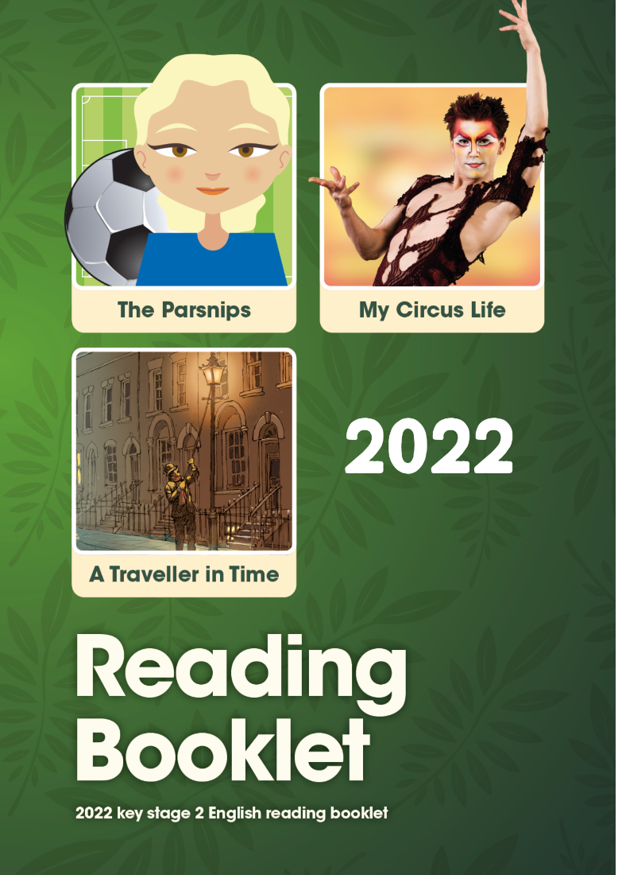
Reading: In Class
In class our guided reading sessions are based on past papers.
Every session, we mark and discuss the answers together, including ‘test technique’.
I have been sharing the mark scheme with children so they can understand what the questions are asking them to do.

Slide 5
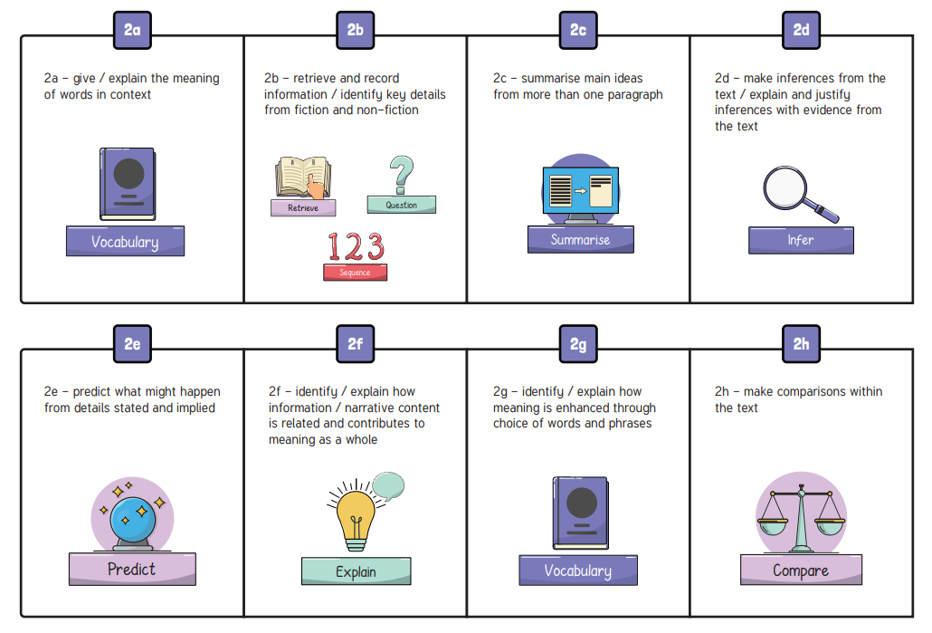
Reading: At Home
Read for 30 minutes each night with your child.
When you read together, check understanding by questioning with the reading domains.
Complete the reading comprehension home practise.

Slide 6
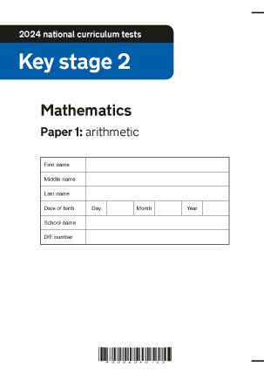
Maths: In Class
In class we now have increased practise of arithmetic questions.
We also begin each Maths lesson with reasoning questions from past papers.
We have been learning about test technique and how to apply our learning to reasoning questions.
Our times table tests continue each Friday.

Slide 7


Maths: At Home
Completing the boot camp home practise.
Completing the overnight home learning. There will be two evenings a week where the focus will be arithmetic or reasoning.
Practising times tables – Times Table Rock Stars.
Helping your child to learn key Maths facts and formula!

