Slide 1

Welcome to Year 1
2024/25

Slide 2

The Team
Mrs Sheen Miss Fisher
Mrs Anderson

Slide 3

Vision for the year
For everyone to:
enjoy their learning.
achieve the very best that they
can.
become even more independent and confident learners.

Slide 4

The Curriculum and Timetable
Knowledge and skills are taught through the subjects;
RE taught twice a week.
Daily Phonics, English and Maths.
P.S.H.E, Computing, Science, Art, Geography/History, French, Music and Challenge areas (Independent Learning) taught weekly.
Forest School
PE (fundamental skills, gymnastics, dance and games) on a Friday.
SEESAW - https://app.seesaw.me

Slide 5






English

Slide 6
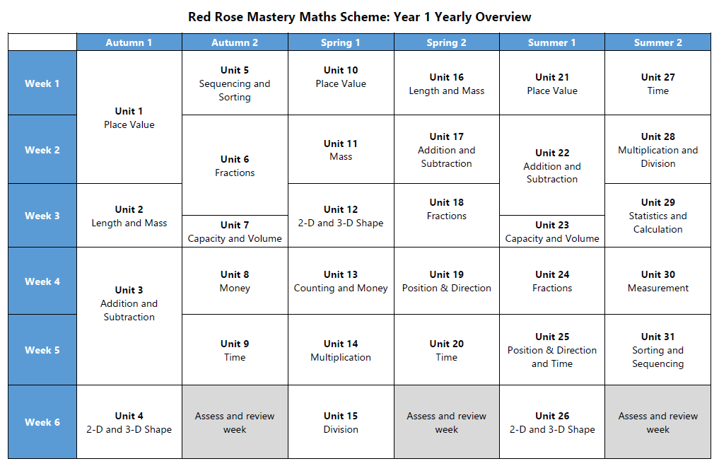
Maths

Slide 7
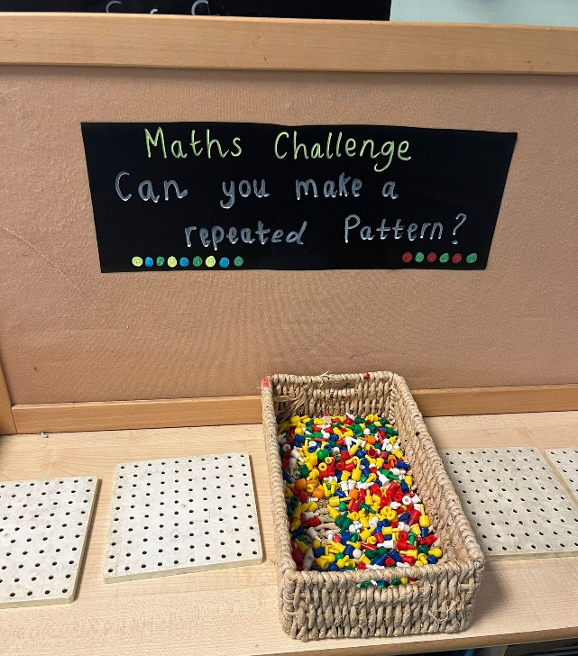
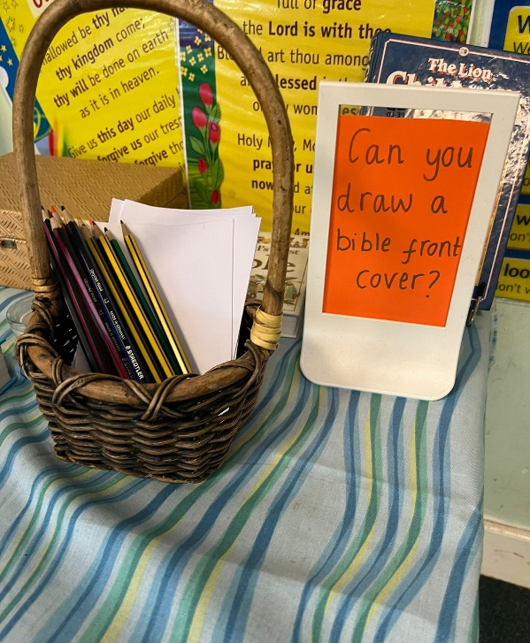
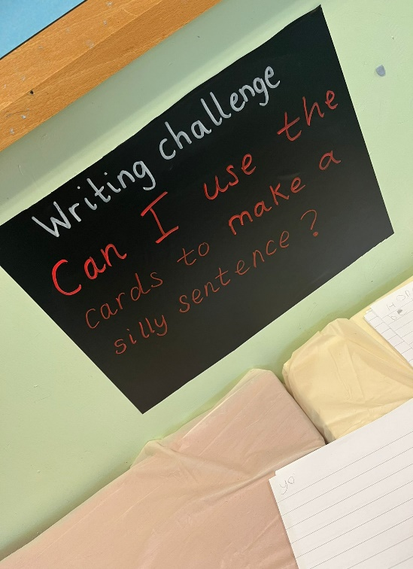
Challenges
Year 1 will be developing the taught skills in the challenge areas of our classroom.
We have Maths challenges, RE, Writing, Creative, Fine Motor and more!
Areas are accessible in the afternoons during challenge time and will be evidenced on Seesaw.

Slide 8

Year 1 Phonic Screening
This is a 40-word check and it assesses phonics skills and knowledge taught through Reception and Year 1.
Your child will read up to four words per page for their teacher and they usually do the check in one sitting of about 5–10 minutes.
The check takes place in June and you will receive the result with the end of year report.

Slide 9

Forest School
The children will be in a group of 17 children for 1 hour every Wednesday afternoon.
Forest School sessions go ahead whatever the weather so please have wellies in school!
Sessions include developing skills such as teamwork, risk-taking, communication, problem-solving, creativity, independence and resilience.
The children will learn about fires, knots, play, shelters, flora, fauna, art, tools, climbing trees and foraging.
The approach is holistic and provides many opportunities for child-initiated learning.

Slide 10
Routines
Home practice will be posted as a blog on the website every Friday and will include;
Reading (10 minutes every night!)
Counting
Maths challenges - Sumdog
Phonics challenges - Sumdog
Tricky words will be sent home when they are taught.
Our Learning links on the Year 1 page are a safe way for your children to independently use the internet for learning purposes.
https://www.longton-st-oswalds.lancs.sch.uk/
https://www.sumdog.com/user/sign_in

Slide 11
Routines
Reading books with be changed
on a Friday. Please sign the diary.
Please bring the green book bag to school
every day.
Your children will read to every teacher at least once a week.
P.E. kits stay in school for the half term.
If possible, please have trainers and pumps in PE bags.
Please provide a named pair of wellies which will stay in school.
Children to bring a named water bottle every day.
A snack is available every day.

Slide 12
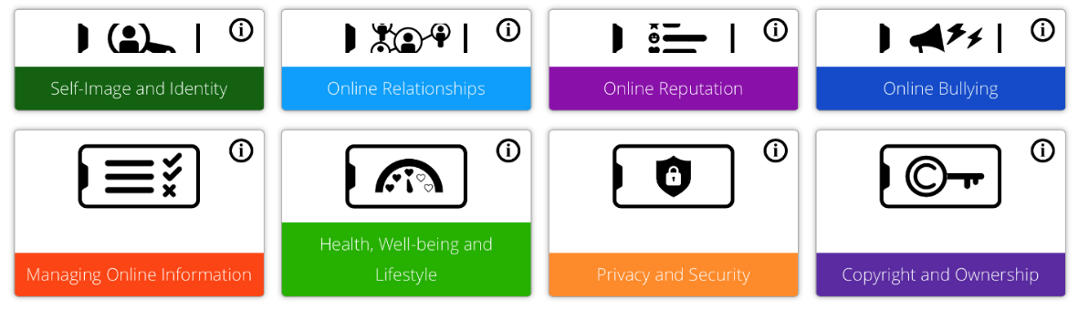
Safeguarding - Online Safety
Our Online safety curriculum is taught throughout the year alongside our PSHE Curriculum.
We teach the children safe online behaviours in these areas.
We also teach the children how to behave when online.This includes when gaming or when engaging in social media (most platforms are not suitable for primary aged children).
School and home have a joint responsibility to safeguard your children against all online harm. See our parental controls guidance on our Safeguarding page.
Our online safety updates and guides will keep you updated on how you can keep your home a safe space when it comes to letting your children access the internet.

Slide 13
Safeguarding
Children who attend the Breakfast Club are brought to class by a staff member.
Children are picked up from the playground by a person named on the end of day form. Please bring this back ASAP.
Children who go to The Play Stop are picked up from the playground by a member of The Play Stop team.

Slide 14

Behaviour Expectations
Pupils are expected to follow the class rules at all times and the Golden Rules of the school.
Rewards
    House points
    Stickers
    Star of the Week
    Dojo
    Quadruple gold!

Slide 15
Seen on green!
Pupils begin each day on green.
If they are spotted, they can move up to gold. Then again to double gold, to triple gold and finally quadruple gold.
They put their name onto Mrs Wood’s door for quadruple gold.

Slide 16

And finally...
Please check the website regularly.
Ensure all medication is sent into school.
If you have an issue or concern don’t hesitate to make an appointment via Mrs Rothwell in the school office.
Thank you!

