Slide 1


Year 2
2021/22

Slide 2
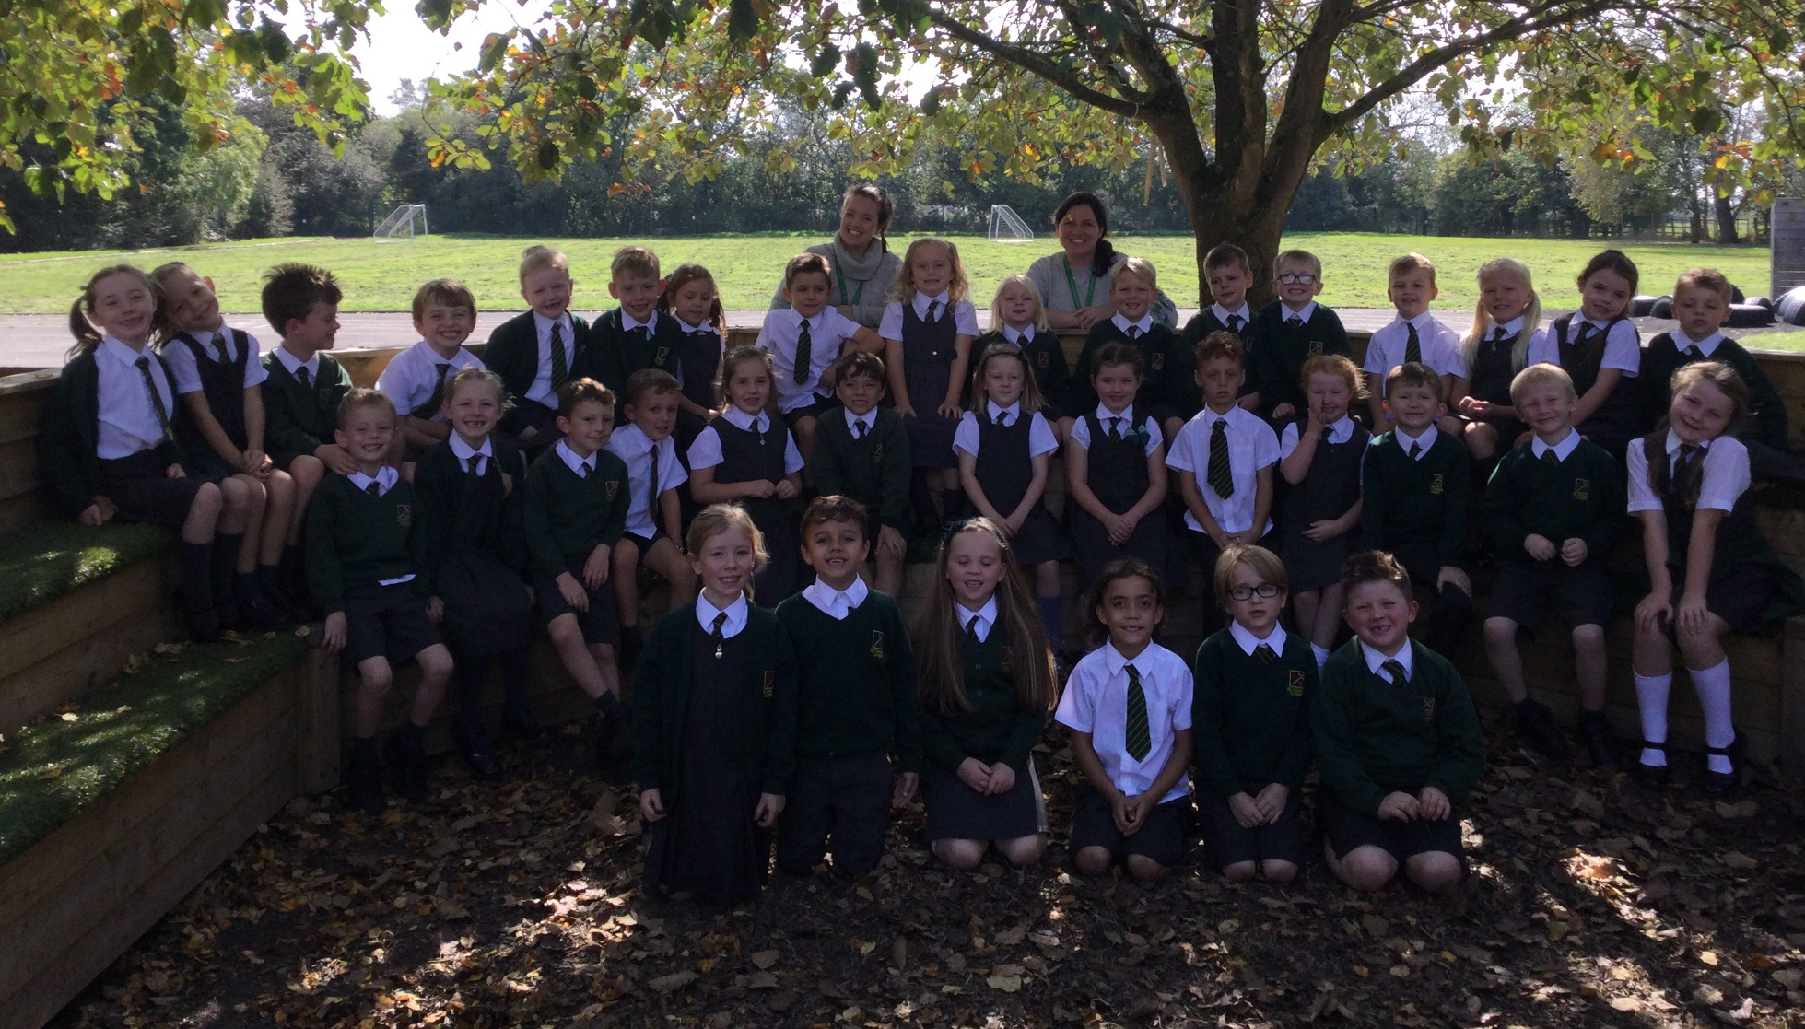
Year 2

Slide 3
Year 2 Teaching Team
Teachers:
Miss Bennison
Miss Gravili
Teaching Assistant:
Mrs Whitworth

Slide 4
Vision for the Year
For everyone to:
- Enjoy their learning and have fun!
- Become inquisitive and resilient learners.
- To progress in their learning and achieve end of year expectations.
- Be ready for Year 3.

Slide 5
English
- Reading is taught daily through our class novel.
- Mrs Whitworth will listen to readers one-to-one.
- Miss Bennison and Miss Gravili will carry out guided reading sessions.
- Writing, Handwriting and presentation will be taught daily.

Slide 6
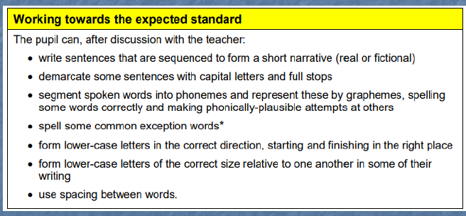

Slide 7
Spelling, grammar and punctuation
Phonics and spellings will be taught daily.
In Year 2 we will begin to focus on using the correct spellings by using sounds in the right places.
Introduction of technical terms, spelling rules and tenses including verbs, nouns, adjectives, plurals, paste tense, suffixes etc.

Slide 8
Maths
Maths will be taught daily through whole class and group learning. We will be following the Lancashire Red Rose Maths Mastery Scheme.
Weekly arithmetic tests.
x2, x10, x5 and x3 tables will be taught along with corresponding division facts.
Focus on understanding through fluency of number facts and reasoning.
Practice and consolidation through Sumdog and Home Practice challenges.

Slide 9

P.E.
PE is on a Friday, please make sure kits are in school. Kit will now be sent home at the end of each half term.
PE uniform: yellow top, green shorts and pumps/dark trainers.
Pupils can wear dark tracksuit bottoms during the winter months.
No jewellery.
- Please check your child’s name is on every item, including shoes.

Slide 10
Routines
Your child should come to school every day with their green book bag and reading pack.
This is so we can read at every opportunity with your child.
Please do not send large rucksacks into school – we have limited space and book bags go into their small trays.
The children also need fresh water daily in a suitable water bottle.
Fruit will be provided at break times.

Slide 11
Foundation subjects
RE - During the Autumn term we will be looking at new beginnings, preparations, signs and symbols. Alongside RE, the children will follow the RSE scheme – Journey in Love.
PSHE - Some of our topics this year will cover: How to be a good friend, how to manage our feelings and how to stay safe.
Science – Topics include: living things and their habitats, plants and materials and their properties.

Slide 12
Foundation subjects
History - Some of our topics include London long ago, Important people from the past and Castles.
Geography - We will use map reading and field work around school. Look at weather, hot and cold countries and study Australia.
Art - will link into our foundations subjects along with Design and Technology.
Music and French will be taught by Mrs Winter and Mrs Quilliam.

Slide 13
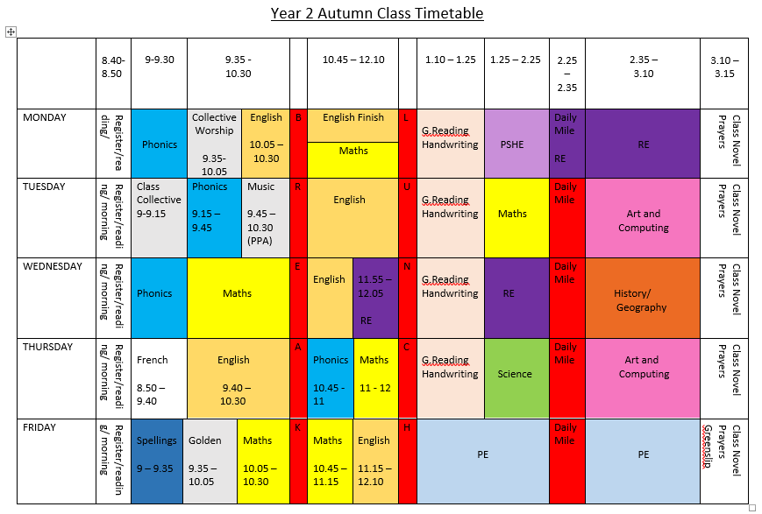
Timetable

Slide 14
Learning and Behaviour Expectations
Rewards
Golds
Dojos
Green slips
House points
Table points
Stickers
Golden Assembly
Positive praise
Consequences
Sad face
Amber letter
Red letter
Missed play times
All children are expected to follow the Class and Golden Rules at all times.
End of year expectations for all our subjects including reading, writing and maths are available on the Year 2 page.
Everyone will have personal targets known as ‘Think Pinks’.

Slide 15

Online Safety
Taught throughout the Year alongside our PSHE curriculum.
We follow the SMART e-safety rules.

Slide 16
Home Practice
- Please keep an eye on our class blog which can be found on the school’s website.
- Spellings will be given out on a Friday and will be tested the following Friday. These will include phonics, spelling rules and common exception words.
Children are to read at home daily for at least 15 minutes.
Book changing takes place every Monday. New books will be issued on Tuesdays, however if your child wants to change their book anytime, we will try to accommodate this.
Children should be practising 2, 5 & 10 times tables at home. Towards the end of Year 2 children should also be encouraged to learn their 3’s and 4’s.
Sumdog logins will be given out but your child probably knows it already.

Slide 17
Safeguarding
At the end of the day, Year 2 will line up on the playground with the other classes.
The class teachers will wave and send your child to you.
We have a list for afterschool and any other clubs.
If your child is going home with someone different and they are not mentioned on the blue form, please let the office know.
Please don’t be offended if we double check this. It is our duty of care.

Slide 18
Finally…
If you have any issues or concerns, please do not hesitate to get in touch with the school office.
Thank you for your continued support.

