Slide 1

Welcome to Year 3

Slide 2

YEAR 3 TEAM:
Miss Smith
Mr Campbell
Mrs Woof

Slide 3

Your child as a learner in Year 3
We will nurture the following personal skills and attitudes:
Self-confidence
Self-esteem
Independence
Resilience
Perseverance
Initiative
Problem solving
Enthusiasm
Opinion
Positive mind-set

Slide 4

How will your child learn in Year 3?
Listening attentively
Sharing ideas
Working within groups
Individually
Reading and research
Thinking skills
Recording
Different learning styles

Slide 5

Curriculum
English
Maths
Science - Rocks
Computing – Computer Science
History – The Stone Age
Geography – Our Local Area
Art - collage, paint – linked to Stone Age topics
Design and Technology – Food
Physical – Striking and Fielding skills
Religious Education - Homes
PSHE – What makes a good friend?
Growth mindset/circle time
Music – Mrs Winter
French– Mrs Quilliam
The end of year expectations for reading, writing and maths are on the school website.

Slide 6

Maths
Red Rose Mastery Scheme
Mental methods
Written methods
Place Value
Problem Solving and reasoning
Table Facts
  x2, x5, x10, x3, x4, x8 (test every Tuesday)
Number Facts
  Number bonds to 20 / 100

Slide 7

English
Reading in many different contexts
Class novels
Writing related to the class novel and cross curricular opportunities
Spelling rules through games and activities most days
Handwriting
Grammar and punctuation

Slide 8

Religious Education
Come and See
Autumn Term
    Homes
    Promises
    Visitors
Spring Term
    Journeys
    Listening and Sharing
    Giving all
Summer Term
    Energy
    Choices
    Special places

Slide 9

Super Learners
Whole school focus
Mistakes are good
Growth mind-set
Instead of saying/try thinking
Resilience

Slide 10

Tuesday Tests
Times tables
Spellings

Slide 11
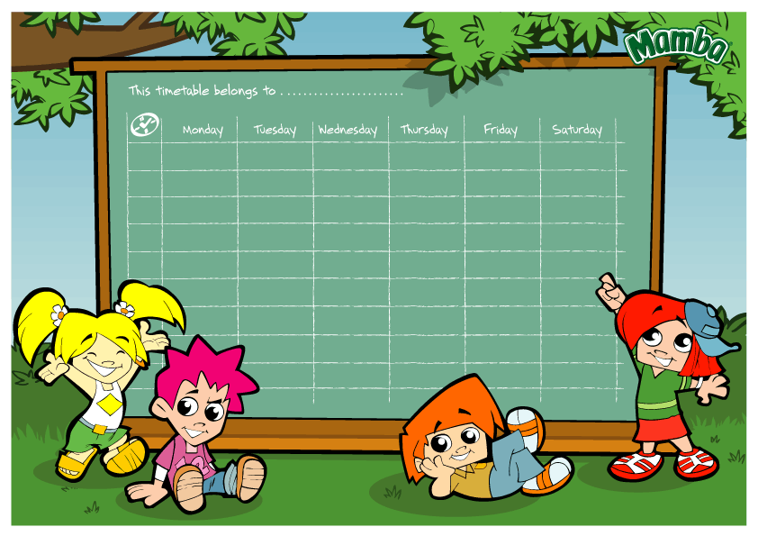
Timetable:
English and Maths every day.
R.E. and class collective worship three times per week.
P.E. is usually on a Tuesday afternoon.
French and Music are taught once a week.
PSHE, Science, Art, Geography, History, DT and Computing are taught throughout the year.
Home practice on the school website on Fridays.
Tables and spelling tests on Tuesdays.

Slide 12

Reading
- Children are responsible for changing their books when they have finished. Mrs Woof will always be there to help.
- Please ensure the reading diary is signed.
- Please make sure your child’s book is in their bag every day.
- Your child should read at home every night, to a parent or carer, grandparent, sibling or friend.

Slide 13

Spelling:
Children will have a list of spellings to practise related to the spelling rules that they have been learning in class.
These will be given out every Friday on the school blog.

Slide 14

What to bring:
A warm, waterproof coat
Reading book
Water bottle with a sports top
Fruit
P.E. kit should be in school every day. Children can wear trainers for outdoor sessions but they still need black pumps for inside.
Name in everything.

Slide 15

Friday Blog
Every Friday we will blog to let you know what learning we have done during the week.
We will include photos of our learning.
We will outline the practice your children need to do over the coming week at home.
Reading, Spelling and Maths.

Slide 16

Safeguarding Routines
End of day
End of day form.
If there is an emergency or a problem please ring school as soon as possible and then we are aware of it and will keep your child until you arrive, we will keep your child in class.
All children are told to come back to class if you are not there at the end of the day.
No children should be told to wait in the car park.
Children should always be collected off the playground.

Slide 17
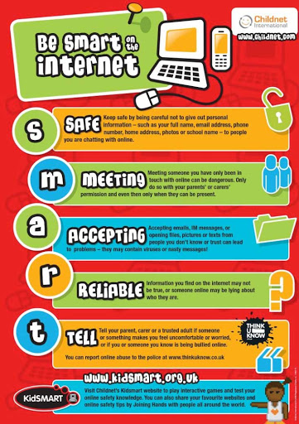
Online Safety
Taught throughout the year alongside our PSHE Curriculum
We follow the SMART online safety rules
In Year 3 our focus is on
The use of age appropriate websites including social media
Not sharing personal information online
Knowing what to do if something worries or upsets them online
Being responsible online

Slide 18

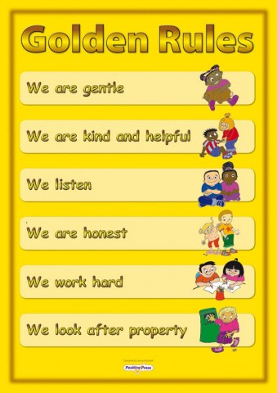
Behaviour expectations:
    Traffic lights - gold.
    House points
    Stickers
    Golden Assembly
    Class Rules
    Class Dojo
    Communication
    Golden time
    Traffic lights – amber = referral to Mrs Wood

Slide 19


And finally:
Please ensure your child's medication is in school.
What to do if you have any concerns about your child?
Make an appointment at the school office and we will see you as soon as possible.

