Slide 1

Welcome to Year 4
2021/22

Slide 2

The Team
Mrs Tipping and Mrs Dexter

Slide 3

Vision for the year
For each child to:
enjoy their learning.
achieve the very best that
they can.
become independent and confident learners.

Slide 4

Year 4
Curriculum
English
Maths
Science (Living things and their habitats, Electricity, Animals – teeth and the digestive system, states of Matter – solids, liquids and gases, Sound)
History – Celts, Romans, Anglo-Saxons
and Vikings
Geography – Coasts
Computing
Art / Design and Technology
PE (Swimming in Spring Term)
RE
PSHE (Personal, Social, Health, Economic Education)
Music – Mrs Winter
French – Mrs Quilliam

Slide 5

Timetable
English and Maths will be taught each morning and where necessary some afternoons.
RE will be taught during the week. We will also take part in Collective Worship.
A PSHE session will be taught once a week.
PE is usually on a Wednesday afternoon – please ensure your child’s PE kit is kept in school. PE kits will be sent home at half term to be washed unless they need washing before hand!
French and Music are taught once a week.
Science, Geography, History, Art, DT and Computing are taught throughout the year.

Slide 6

English
Your child will be heard reading in school at some point during the week.
Please read with your child at home for 20 minutes each evening and talk about what they have read, the characters, the meanings of words and what they think might happen next.
English is taught daily through our class novel.
Writing is related to the class novel and is also cross curricular, linked to our topics.
Grammar and punctuation is taught explicitly during the week.
Handwriting will be taught explicitly and practised during the week.
Spellings will be taught explicitly during the week.
Children will need to practise their spellings at home
in preparation for a weekly test.
Please use the look, say, cover, write and check strategy – your child
should be familiar with this from class.

Slide 7

Maths
This term the topics we will be focusing on are:
Place Value
Length and perimeter
Statistics
Addition and subtraction
Mental strategies
Written methods
Problem solving
Number facts
Table facts
Your child will be given an individual table target.
They will be tested on this during the week.
Children in Year 4 need to be able to recall all their times tables up to 12 x 12 quickly, at random and accurately, as they will be tested on these in May 2022 in the new National Multiplication Check.

Slide 8
RE
Autumn Term
People
Called
Gifts
Spring Term
Community
Giving and receiving
Self-Discipline
Summer Term
New life
Building bridges
God’s People

Slide 9
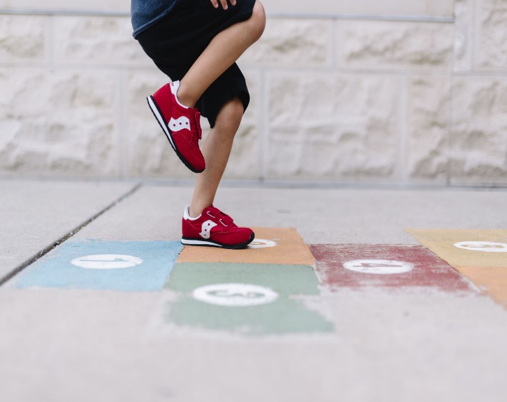
Daily Routines
A warm, waterproof coat should
be brought into school every day.
Water bottle with a sports top.
Fruit.
Your child should bring their reading book into school every day.
Packed lunch (if not having a school dinner).
Your child may bring in their own hand sanitiser if they wish.
PE kit should be kept in school. They will be sent home at half term for washing.
Please do not bring in any other items or bags from home.

Slide 10

Weekly blog and Home Practice
A weekly blog will be uploaded to the school website on a Friday afternoon. This can be found under ‘Classes’, ‘Year 4’, ‘Blog items’.
The blog will give an idea of some of the learning during the week and may include some photos.
Home Practice will also be on the school website every Friday. This will also be on the Year 4 Class Page.
St Oswalds webpage

Slide 11

Home Practice
Home practice will usually comprise:
Reading (20 minutes every night)
A list of the weekly spellings
Times tables practice (your child should know their individual target)
Counting practice
A maths and / or a multiplication challenge set on Sumdog
A spelling challenge set on Sumdog (related to the weekly spellings)
A grammar / punctuation challenge set on Sumdog

Slide 12

Online Safety
E-safety is taught in school. This will help to keep your child safe online.
We follow the SMART e-safety rules.
In Year 4 our lessons will cover:
What it means to be responsible and respectful offline and online
How to protect themselves from online identity theft
What to do if something worries or upsets them online
When it is OK to use the work of others

Slide 13

Online Safety
Each month there will be an ‘Online Safety Blog’ posted on the school website. You can find this under Classes, Year 4, Blog items.
The blog will keep you updated with online developments and share platform guides and links to expert training. This will help you keep your children safe when exploring the internet.
In addition, you can access a huge range of information on the National Online Safety website. A link to this can also be found on the school website.
St Oswalds webpage

Slide 14

Behaviour Expectations
Pupils are expected to follow the class rules at all times and the Golden Rules of the school.
Rewards
    House points
    Class Dojos / Table points
    Stickers
    Golden Assembly
    Star of the week
    Writer of the week
    Mathematician of the week
    Bookworm of the week
    Super Learner
    Special mentions
    Daily miler of the week
    Sumdog champion of the week
    Gold

Slide 15
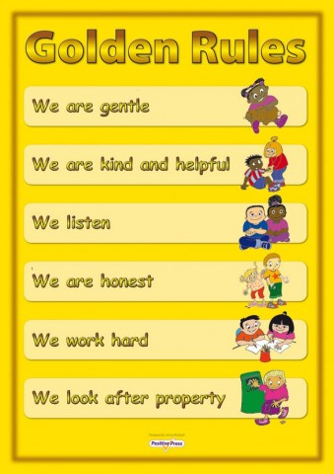

Our Golden Rules

Slide 16

Our Class Rules
Year 4 Class Rules
¨ We treat others as we like to be treated
¨ We are resilient even when we find things tricky
¨ We try our best and put 100% effort into everything that we do
¨ We always use a classroom voice
¨ We always say please and thank you and use our manners
¨ We listen to others’ ideas
¨ We are always helpful to others

Slide 17
Expectations
Consequences:
Verbal warnings
Sad face
Amber – referral to Headteacher
Red – Very serious – ‘Red Think Sheet’, ‘Incident Report’ letter home, telephone conversation with the Headteacher

Slide 18
Super Learners
We have a whole school focus to develop a positive attitude to learning and a ‘can do’ attitude ie. resilience and perseverance.
Mistakes are good
We try and keep a positive mind-set
Instead of saying I can’t do this, we say I can’t do this yet
We do our best in everything that we do
We are proud of what we achieve

Slide 19
Safeguarding
Please ensure you have completed the End of Day form.
Collect and Go is in operation at the end of the day. Children should be collected from the playground at 3.15pm.
If there is an emergency or a problem at collection time, please ring the school as soon as possible and then we are aware of it - we will keep your child safe until you arrive.

Slide 20

And Finally...
We would like to take this opportunity to thank you for your support in this unique and difficult time.
We hope that together we can encourage the children in Year 4 to carry out everything they do to the best of their ability and do their very best in all aspects of school life.
Should you have concerns, please contact school by email or telephone and we will get back to you as soon as we are able.

