Slide 1

Phonics information evening
Tuesday 6th February 2024
Year 1

Slide 2
How we teach phonics
In Foundation stage and Key Stage 1 Children will
Learn 44 phonemes (sounds) eg. ay, ee, igh, ow, oo.
Learn to segment and blend words using their sounds.
Reading - Be able to find sounds in words, helping decode them.
Writing - Use their phonics to help them spell words in their writing.

Slide 3
Key skills in phonics
Identifying the number of sounds in a word – we use phonic fingers.
Segmenting (chop it up) the word into it’s sounds (helps with writing).
Blending these sounds back together (helps with reading).
Knowing all 44 graphemes and their sounds.
Finding sounds in unknown words and using these sounds to decode the word.
Key skills in early spelling also!

Slide 4
7 ai spellings – 1 sound
ai - brain
ay - tray
a_e - cake
a - acorn
ea - steak
ey - grey
eigh - sleigh

Slide 5
How many sounds?
trailer
layer
pancake
chain
crane
strain
player
sway
rainbow
plane
may
tray

Slide 6
How many sounds?
2
3
4
5
6
may
tray
crane
trailer
pancake
chain
player
rainbow
plane
strain
sway
layer

Slide 7
Popcorn Pop

Slide 8
Phoneme Spotter

Slide 9
The Screening
The screening is made up of 40 words.
20 pseudo/nonsense words and 20 real words.
Last year the pass mark was 32.
We administer the test in June and results will be given out at the end of the year with the school report.
Children who don't achieve the required score at the end of Year 1 will take the screening again at the end of Year 2.
In Year 1, the assessment is ongoing daily and we use home practice to recap the sounds we are learning in class.

Slide 10
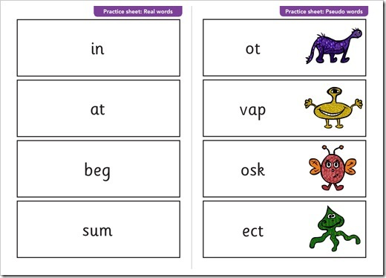

Slide 11
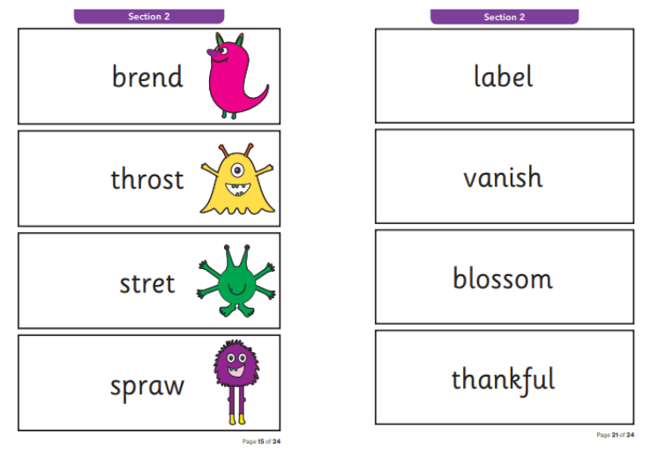

Slide 12
What can I do?
Read every night!
When you are out and about, encourage your child to read menus, signs etc…
When your child is writing and asks for your help, encourage them to use the sounds they know. Sound it out. You know those sounds.
Learn your tricky words. They are non-decodable!
Read a range of texts, this will help develop a range of vocabulary and spelling.
Investigate words. Find rules and patterns.
Visit our school website.

Slide 13
Phonics information evening
Tuesday 6th February 2024
Year 1

