Slide 1
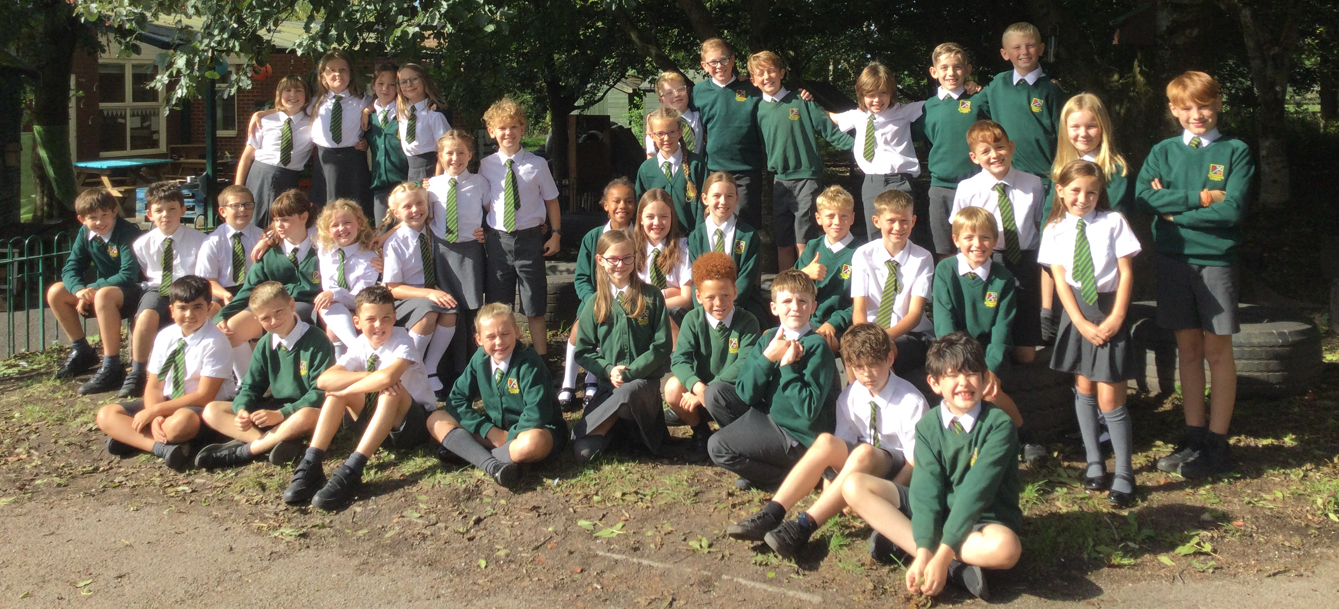
The Team:
Miss Smith
Mrs Dexter
Amazing children
Year 5

Slide 2

Curriculum
English – Goth Girl, spelling, punctuation, grammar, handwriting.
Maths – Red Rose Mastery, counting, times tables.
Science – Forces.
Computing –Sharing information and online safety.
History – Anglo Saxons and Vikings.
Geography – The UK.
Art - Typography and Maps.
Design and Technology – Food Technology (Greek food).
Physical Education – Invasion games.
Religious Education – Ourselves.
PSHE – What makes up our identity?
Music – Heroes of Troy.
French– Myself.
Check the school website for termly overviews.

Slide 3
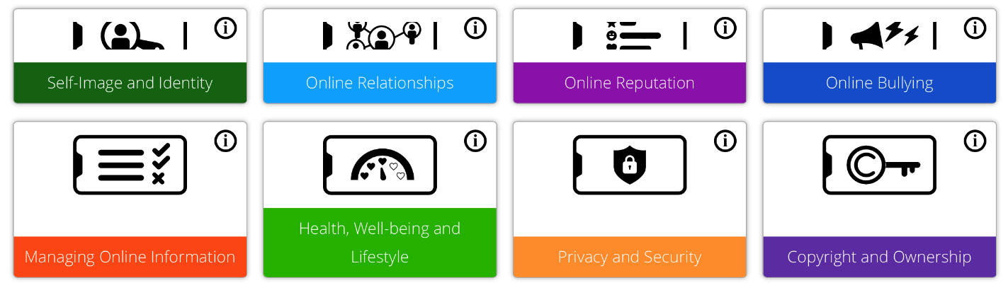
Safeguarding - Online Safety
Our Online safety curriculum is taught throughout the year alongside our PSHE Curriculum.
We teach the children safe online behaviours in these areas.
We also teach the children how to behave when online.This includes when gaming or when engaging in social media (most platforms are not suitable for primary aged children).
School and home have a joint responsibility to safeguard your children against all online harm. See our parental controls guidance on our Safeguarding page.
Our online safety updates and guides will keep you updated on how you can keep your home a safe space when it comes to letting your children access the internet.

Slide 4

Maths
Red Rose Mastery Scheme
Mental methods
Written methods
Place Value
Problem Solving and reasoning
Table Facts up to 12 x, related facts – division, decimals, hundreds of thousands (test every Tuesday).
Number Facts

Slide 5

English
Reading in different contexts
Class novels
Writing related to the class novel and cross curricular opportunities
Spelling rules through games and activities most days. Tested on Tuesdays.
Handwriting
Grammar and punctuation

Slide 6

Autumn Term
    Ourselves
    Life choices
    Hope
Religious Education
Come and See
Spring Term
    Mission
    Memorial sacrifice
    Sacrifice
Summer Term
    Transformation
    Freedom and responsibility
    Stewardship

Slide 7
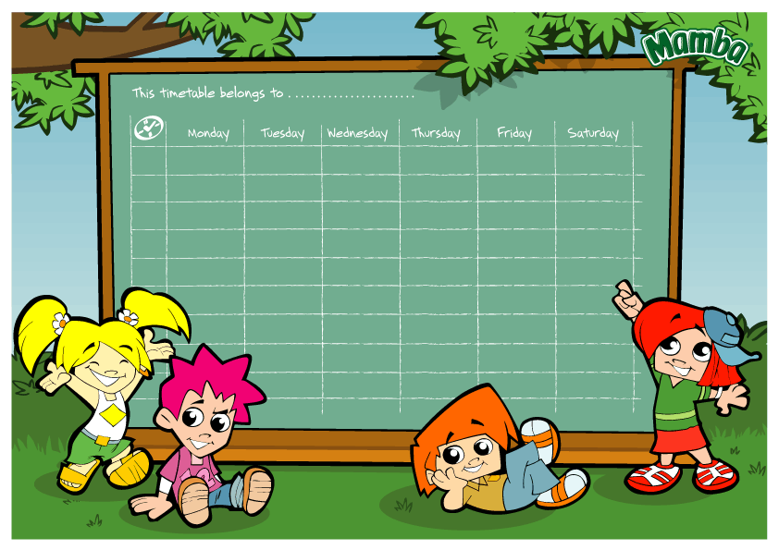
Timetable
English and maths every day.
R.E. and class collective worship three times per week.
P.E. is usually on a Thursday afternoon.
French, Music, PSHE, Science, Art, Geography, History, DT and Computing are taught throughout the year.
Home practice on the school website on Fridays, new spellings and tables targets will also be sent home in the week.
Tables tests and spelling tests will be on Tuesdays.

Slide 8

Routines
Children can change their reading book any day – read every night for 20 minutes and talk about it, book in school every day.
Children can have fruit at break time.
Water bottle every day.
PE kit kept in school and taken home every half term (unless they need washing sooner).
Name on everything.

Slide 9

Weekly Blog and Home Practice
Uploaded every Friday.
Summary of learning from the week.
Spellings, counting, times tables, reading.
Tests
Tuesdays
New spellings and tables targets will be practised in school as well as at home.
Sumdog
2 maths
1 spelling

Slide 10

Safeguarding Routines
End of day
End of day form.
If there is an emergency or a problem please ring school as soon as possible and then we are aware of it and will keep your child until you arrive, we will keep your child in class.
All children are told to come back to class if you are not there at the end of the day.
No children should be told to wait in the car park.
Children should always be collected off the playground.

Slide 11

Online Safety
Taught throughout the year alongside our PSHE Curriculum.
We follow the SMART online safety rules.
Guides will be added to the Weekly Blog regularly.

Slide 12

Behaviour expectations
    Traffic lights – gold, double gold, triple gold.
    House points.
    Table points.
    Stickers.
    Golden Assembly.
    Class Rules – work hard, play hard and be kind.
    Golden Time – tokens earned.

Slide 13



And finally:
Please ensure your child's medication is in school.
What to do if you have any concerns about your child?
Make an appointment at the school office and we will see you as soon as possible.

Slide 14

End of day form
Medical box
Questions?

