Slide 1

What do you know about the climate Crisis?

Slide 2
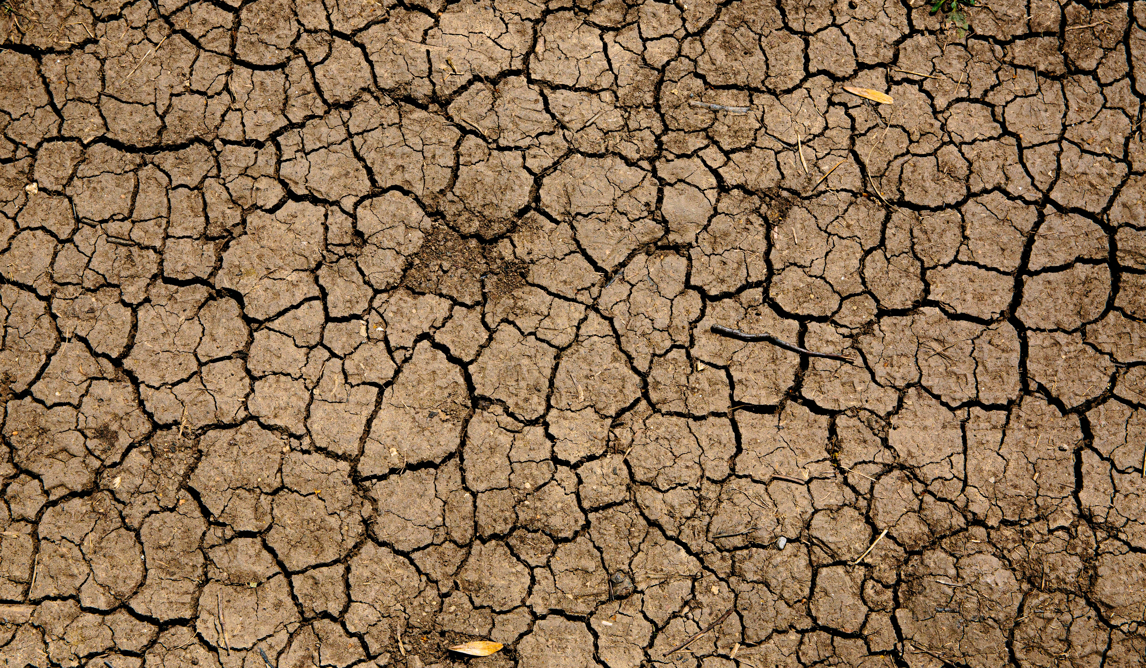
Drought

Slide 3
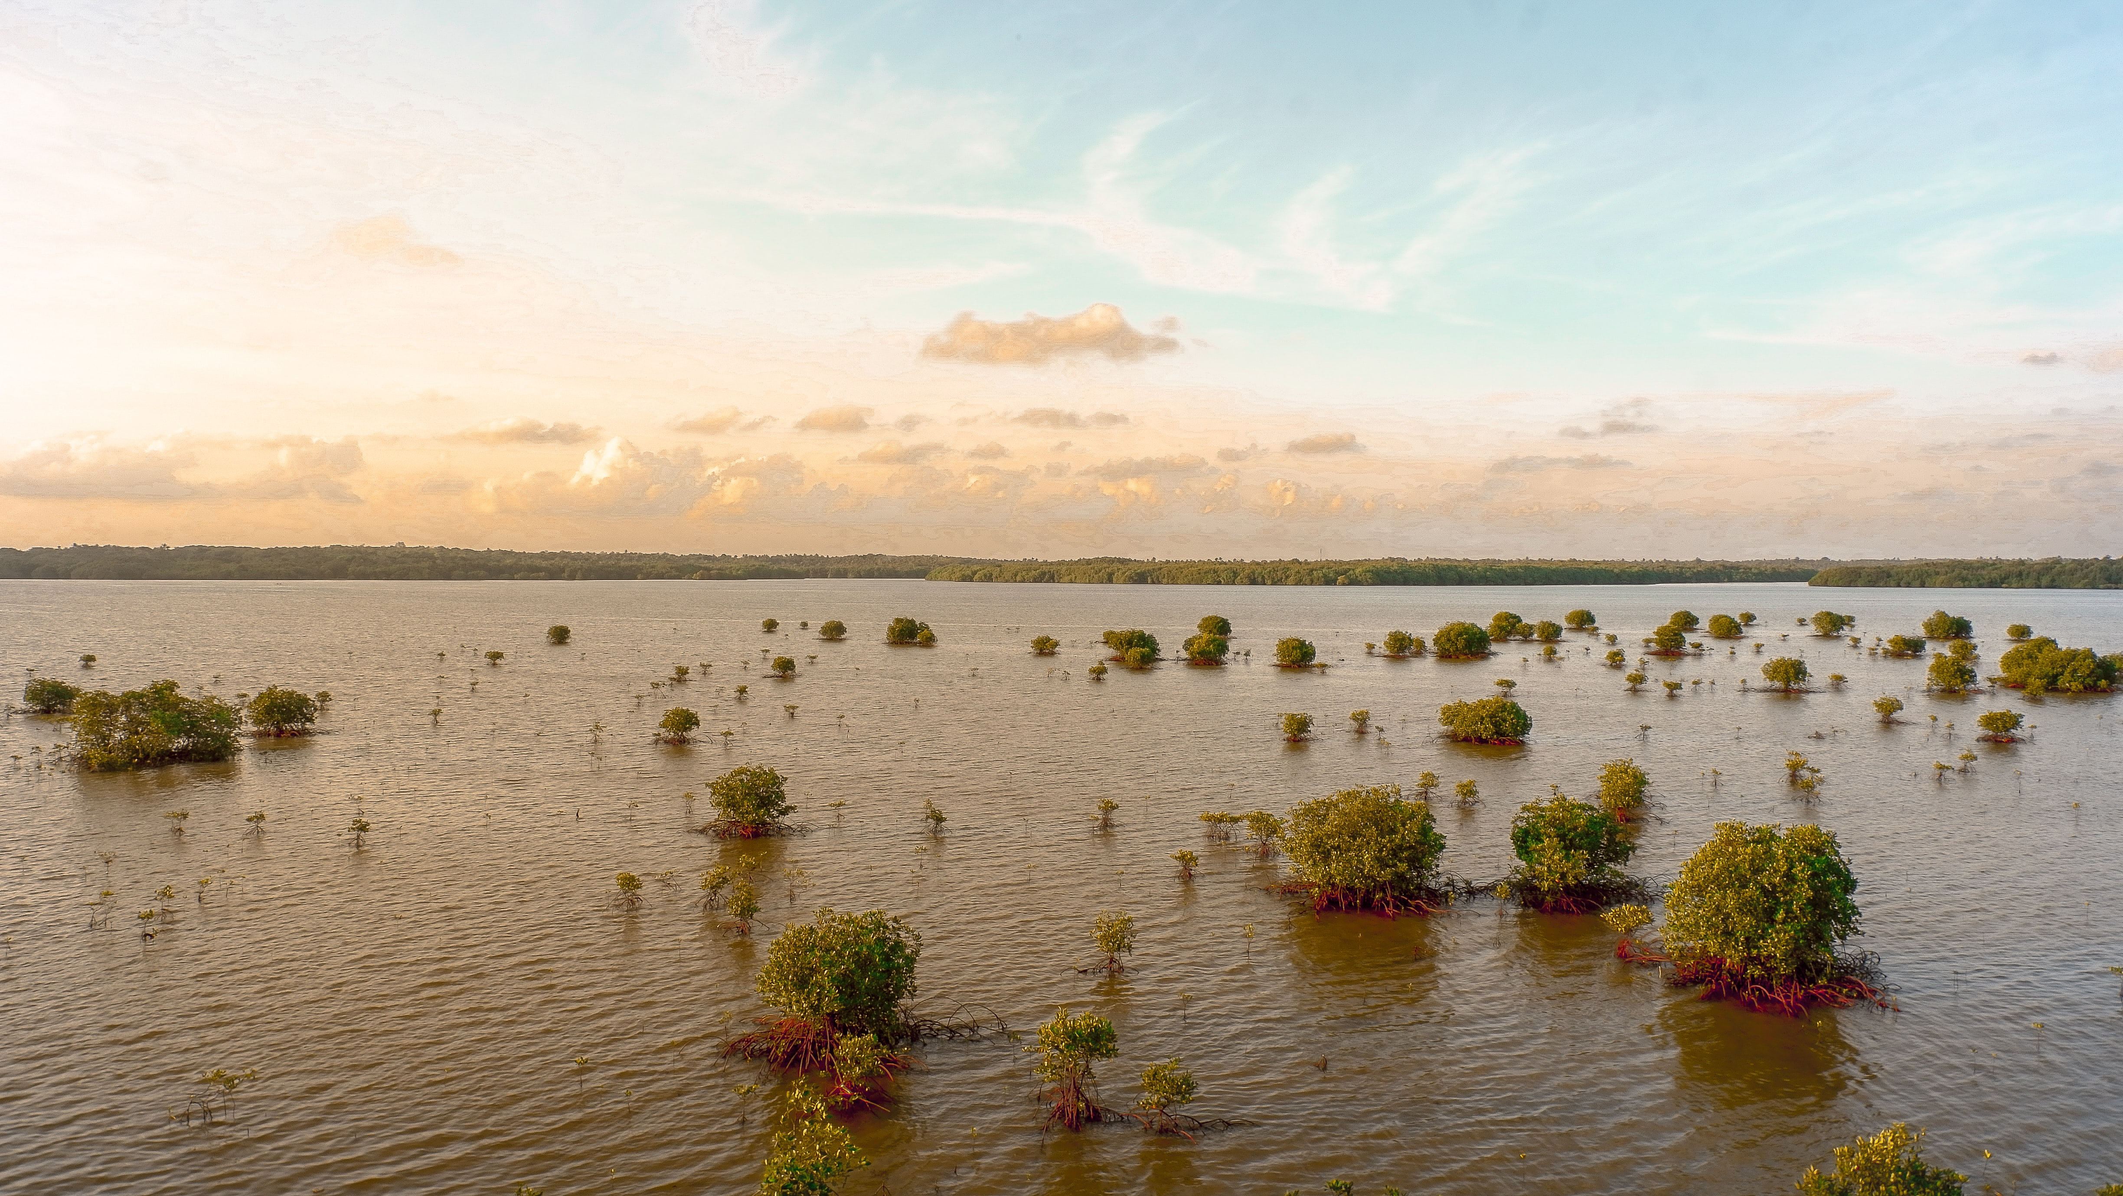
Flooding

Slide 4
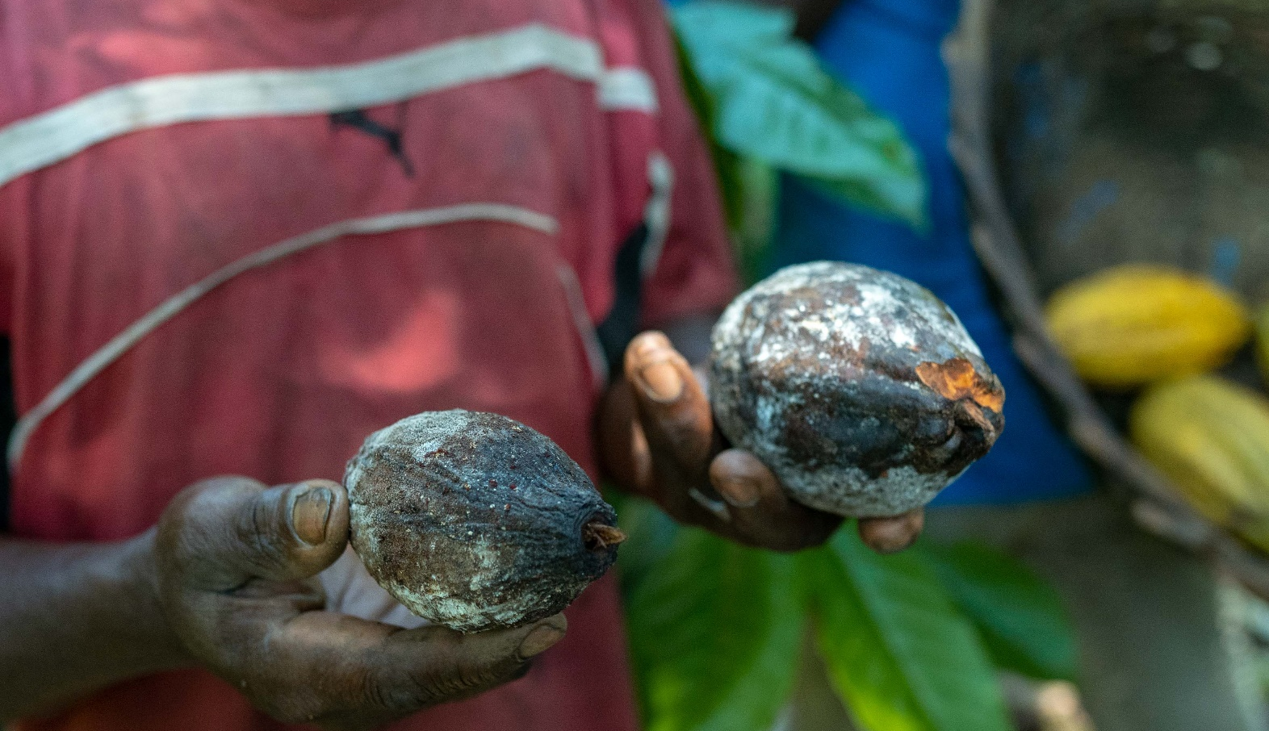
Plant disease

Slide 5
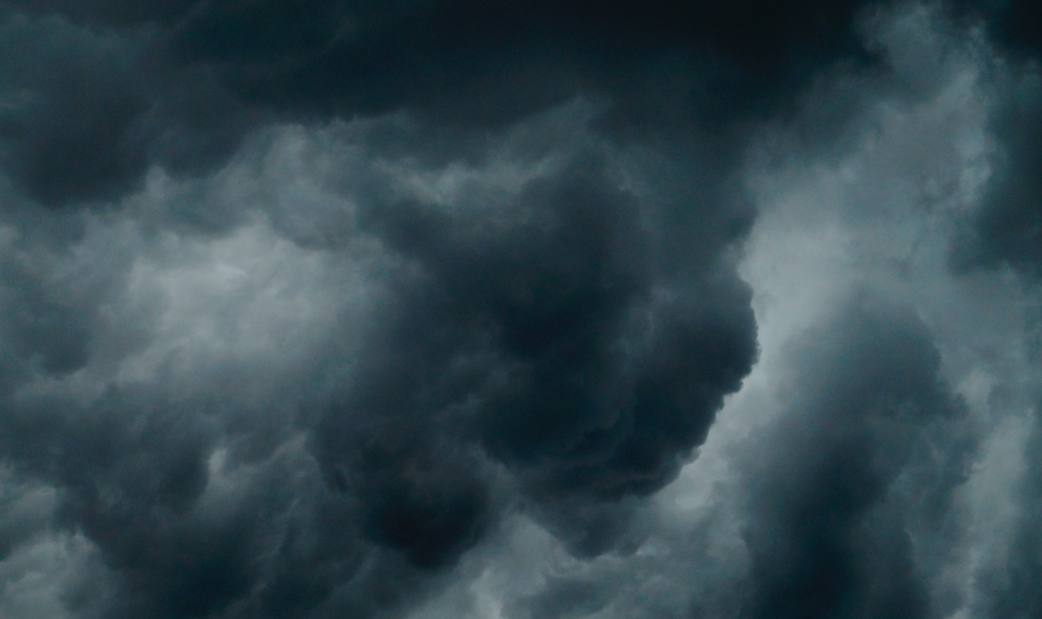
Extreme weather

Slide 6
Rising temperatures
Notes:
The climate crisis means that the world’s temperature will continue to rise. Rising temperatures will cause hot, dry weather and water shortages. Rising temperatures can lead to droughts and/or flooding. Can you remember what impact droughts and floods have on cocoa farms? How might this affect farmer’s basic needs?

Slide 7
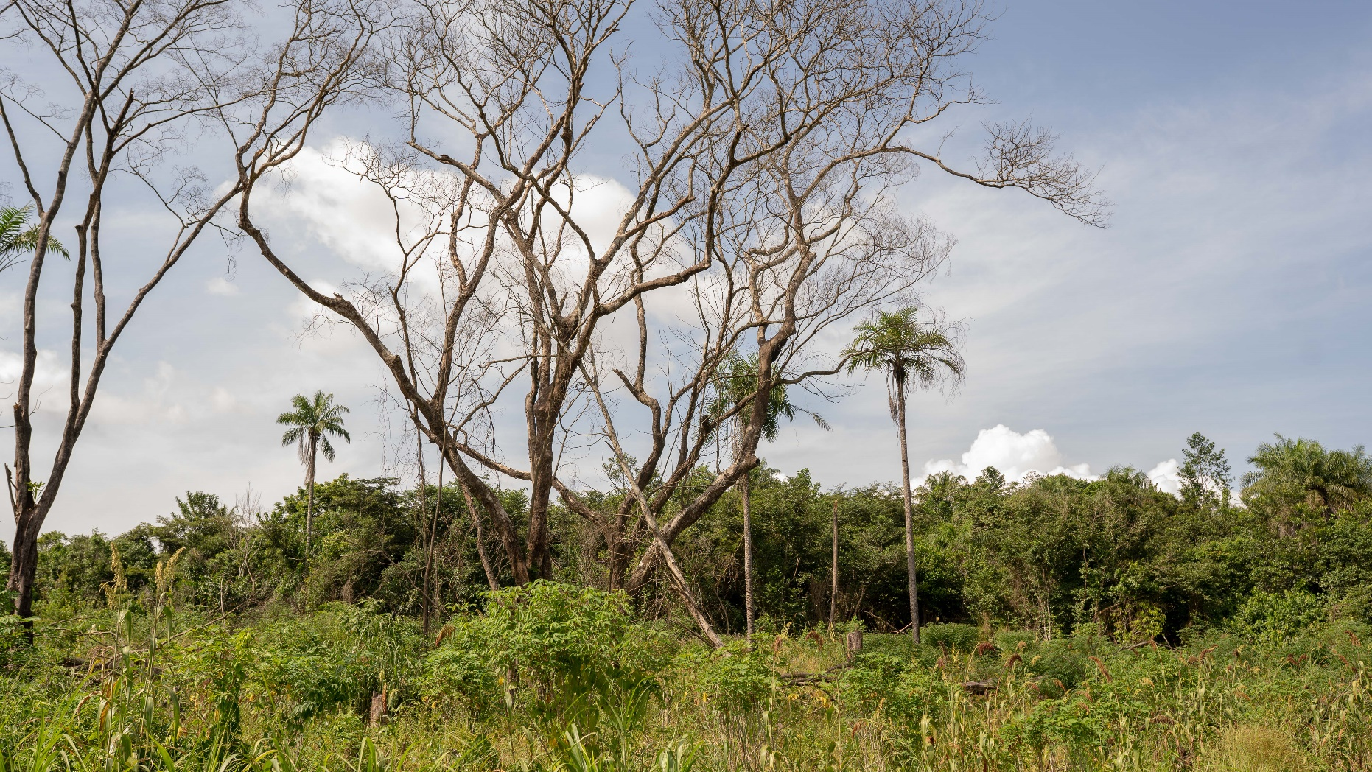
Loss of biodiversity

Slide 8
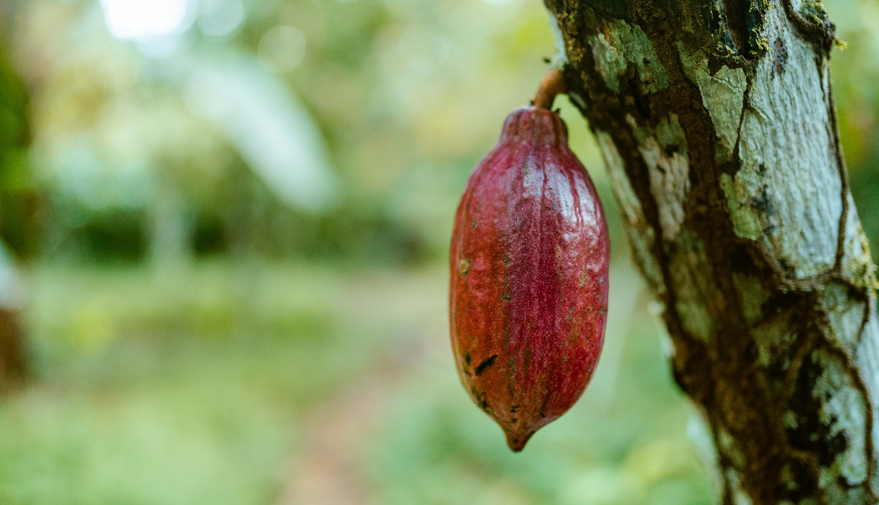
What is your challenge?
How will this challenge affect your farm?
Will this challenge affect your basic needs?

