Slide 1
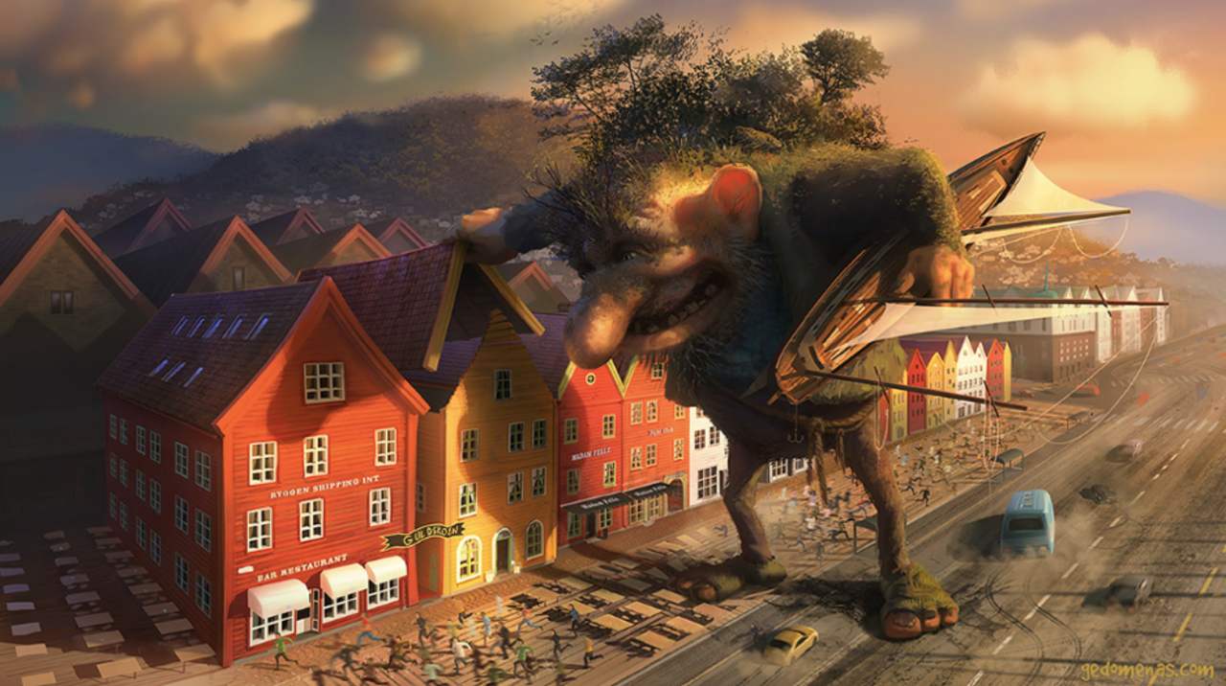
The Troll
Thump! He slammed his enormous, grass-covered foot into the middle of the road, sending shockwaves of dust in all directions.
With a loud grunt, the troll wrenched the entire, fully tiled roof off a nearby holiday home, with the owners peering helplessly and frightened out of the downstairs windows. He didn’t mean any harm, but he just couldn’t help himself…

